Slide 1
Higher Biology
Unit 1
KA 2 Replication of DNA

Slide 2
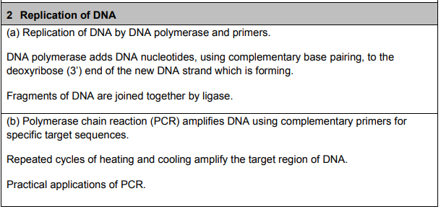
Course Specification

Slide 3
WYSK
Give an account of the structure of a single DNA nucleotide (3)
Give an account of the structure of a DNA molecule (5)
Describe the differences between prokaryotic and eukaryotic cells (5)

Slide 4
WYSK (Answers)
Contains a deoxyribose sugar, a phosphate joined at carbon 5 of sugar and base, names of bases
Double helix, Strands made of nucleotides, sugar phosphate backbone, base pairs joined by weak hydrogen bonds, strands run anti-parallel or 3’ – 5’ and 5’ – 3’
Prokaryotes – circular chromosomal DNA, plasmids / Eukaryotes - circular plasmids in yeast, circular chromosomes in mitochondria, circular chromosomes in chloroplasts, DNA linear chromosomes in nucleus, DNA tightly coiled and packaged with histones

Slide 5
Starter
In your jotter:
Draw and label a nucleotide
Write the complementary strand of DNA to the strand below
A G C C G T A T T C G G A T C

Slide 6
Learning Intention
Understand the process of DNA replication

Slide 7
Success Criteria
I can:
Describe the replication of DNA by DNA polymerase and primers.
Explain the process of DNA polymerase adding DNA nucleotides, using complementary base pairing, to the deoxyribose (3’) end of the new DNA strand
Explain that fragments of DNA are joined together by ligase

Slide 8
Why do cells need to copy their DNA?
DNA is copied during cell division (mitosis) to ensure that new cells have the same number of chromosomes and to ensure that all cells have the same genes.

Slide 9
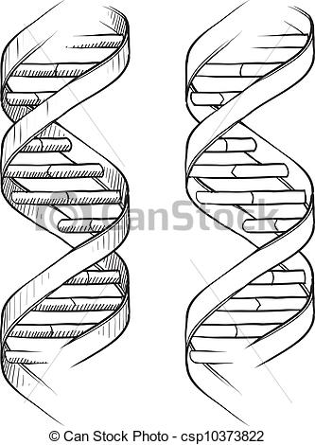
Hypothesise…
Take 5 minutes to discuss in groups ways in which DNA might copy itself.

Slide 10
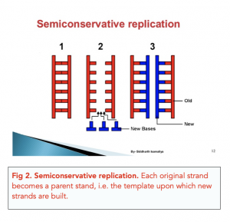
DNA is a unique molecule because it can direct its own replication and reproduce itself.
We describe how it replicates as:
DNA replicates by semi-conservative replication.

Slide 11
Requirements for DNA replication
For DNA replication to occur, the nucleus must contain:
DNA (to act as the template)
Primers
A supply of the 4 types of nucleotide
DNA polymerase and ligase enzymes
A supply of ATP (energy)

Slide 12
A
C
T
G
C
A
T
G
A
C
G
T
DNA parental strand composed of two complementary strands
5’
3’
STEP 1: Hydrogen bonds between the bases break – separating the strands
A
C
T
G
C
A
T
G
A
C
G
T
3’
5’

Slide 13
5’
3’
A
C
T
G
C
A
T
G
A
C
G
T
3’
Primer
5’
STEP 2: Primers (short strands of nucleotides) attach to 3’ end of template DNA and free DNA nucleotides flood the area
T
C
A
C
G
T
A
G

Slide 14
5’
3’
3’
T
T
G
A
C
G
T
A
C
T
G
C
A
A
G
C
A
T
DNA polymerase
C
G
Primer
3’
5’
STEP 3: DNA polymerase uses primers to start adding complementary bases to new strand
5’
T
C
A
C
G
T
A
G

Slide 15
5’
3’
3’
A
C
T
G
C
A
T
G
A
C
G
T
A
C
T
G
C
A
T
G
A
C
G
T
3’
5’
5’
STEP 4: Sugar-phosphate bonds form.
Two DNA molecules identical to the parental molecule have been formed.

Slide 16
Enzyme control of DNA replication
DNA replication is a complex process involving many enzymes.
There are enzymes that break the hydrogen bonds that hold the two strands of DNA together.
The enzyme DNA polymerase controls the formation of the sugar-phosphate bonds when making the new strand.

Slide 17
The leading strand
DNA polymerase can only join nucleotides onto the 3’ end of a growing DNA strand.
Therefore…

Slide 18
Leading vs Lagging
The leading strand is replicated continuously
The lagging strand is replicated in short fragments (called Okazaki Fragments) and is described as being discontinuous

Slide 19
5’ end of DNA strand
5’
5’
3’
Leading strand of replicated DNA
3’
DNA polymerase enzyme
Direction of replication
3’
3’ end of DNA strand
Primer
Start of complementary strand of replicated DNA
5’
5’
5’

Slide 20
Leading Strand Steps
After the hydrogen bonds break, the DNA unzips
A DNA primer (a short stretch of complementary DNA) attaches to the start of the piece of DNA being copied.
DNA polymerase then attaches free nucleotides to the 3’ end of the primer.
This is a continuous process until leading strand is copied.

Slide 21
3’ end of DNA strand
Primer
DNA polymerase
Ligase
5’ end of DNA strand

Slide 22
Lagging Strand Steps
Many primers attach along the lagging strand
These are extended by the DNA polymerase
The fragments are then joined together by the enzyme ligase
This is a discontinuous process creating the lagging strand

Slide 23
Replication Video
https://www.youtube.com/watch?v=TNKWgcFPHqw

Slide 24
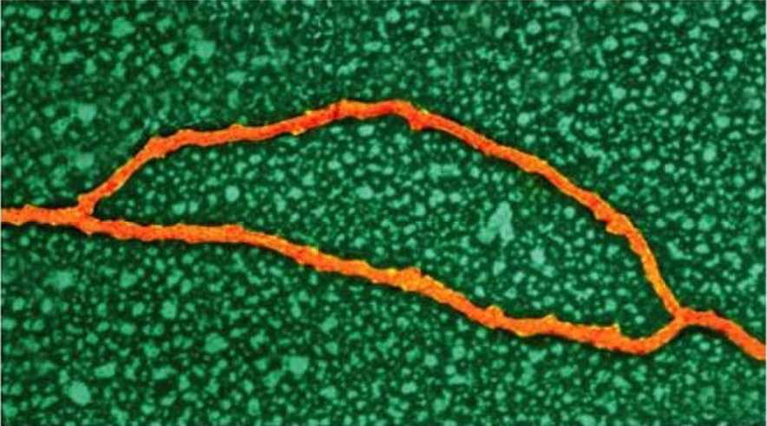
Replication bubbles and forks

Slide 25
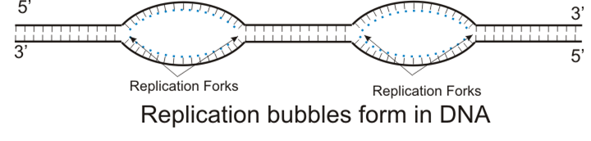
When copying a long chromosome many replication forks operate simultaneously to speed up the replication process.

Slide 26
Success Criteria
I can:
Describe the replication of DNA by DNA polymerase and primers.
Explain the process of DNA polymerase adding DNA nucleotides, using complementary base pairing, to the deoxyribose (3’) end of the new DNA strand
Explain that fragments of DNA are joined together by ligase

Slide 27

Extension Activity-Comic Strip
Create a comic strip showing DNA replication
Be creative!

Slide 28
Plenary
With the person next to you number yourselves 1 and 2
Number 1 become an expert on the Leading Strand
Number 2 become an expert on the Lagging Strand
Teach your partner about your strand
Make sure to ask questions to challenge them on how much they know/learnt!

Slide 29
The polymerase chain reaction (PCR)

Slide 30
Starter
Draw a diagram of DNA replication
Include the leading and lagging strand

Slide 31
Learning Intention
Understand the process polymerase chain reaction (PCR) in the amplification of DNA.
Give practical applications of PCR

Slide 32
Success Criteria
I can:
Describe the process of polymerase chain reaction (PCR) in amplifying DNA
Explain the use of complementary primers for specific target sequences.
State that PCR is repeated cycles of heating and cooling amplify the target region of DNA.
Describe a practical application of PCR

Slide 33
Prior knowledge
The structure of DNA.
DNA replication process.

Slide 34
What is PCR?
PCR (Polymerase chain reaction) was developed by Kary Mullis in the mid-1980s.
For which he received the Nobel Prize.
It has revolutionized molecular biology.

Slide 35
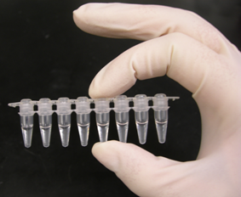
What is PCR?
PCR (Polymerase Chain Reaction) allows specific sections of DNA to be amplified in vitro (replicated out with a cell in a test tube)
in vitro = in glass

Slide 36
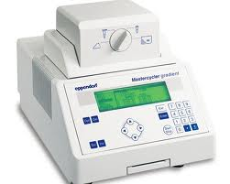
Thermocycler
Millions of copies of a specific piece of DNA can be created in a few hours in a thermocycler.
Thermo = temperature
Cycler = many cycles

Slide 37
The 1st cycle
5’
3’
Single copy of DNA
3’
5’
Step 1: The DNA is heated at approx. 95 ºC for a few seconds. This causes the DNA to denature and the strands to separate.

Slide 38
5’
3’
5’
3’
PCR primer
3’
5’
3’
5’
Step 2: The DNA is cooled to approx. 50-65 ºC for a few seconds. This makes short primers to bond to the separated DNA strands.

Slide 39
5’
3’
3’
5’
5’
3’
3’
5’
Step 3: The DNA is heated again to approx. 72ºC for a few minutes. This allows a heat-tolerant DNA polymerase (Taq polymerase) to replicate the DNA. The process is copied over and over again for roughly 20-30 cycles.

Slide 40
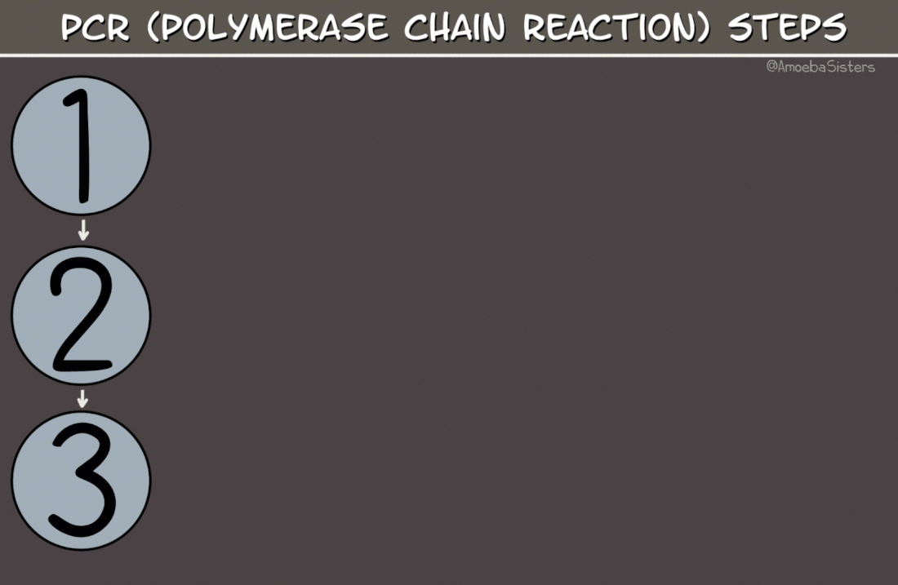

Slide 41
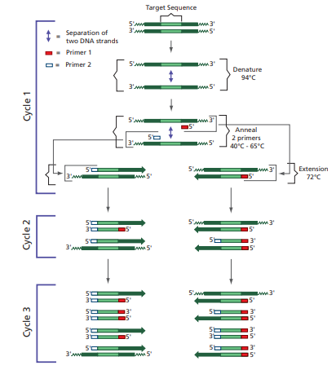

Slide 42
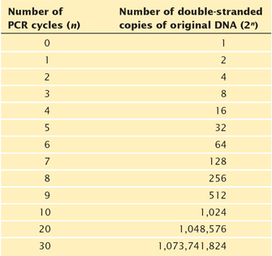

Slide 43
Requirements for PCR
1. Sequence specific primers – these are designed by the scientist and can be manufactured by a machine.
The sequence for primers can be designed by looking at the published genome sequences.

Slide 44
Requirements for PCR
2. Heat tolerant DNA Polymerase.
The enzyme used in PCR is particular because it is heat tolerant
It needs to be heat tolerant because the thermocycler will reach temperatures of 95 ºC

Slide 45
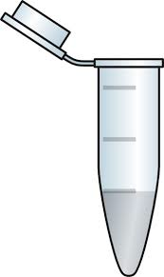
Primers
Supply of nucleotides
pH buffer
Mg²⁺ - DNA polymerase co-factor (makes the polymerase work better)

Slide 46
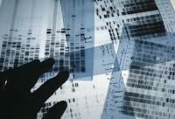
Uses of PCR
DNA Profiling
PCR helps to rapidly identify people. Specific areas of DNA known to vary between individuals is amplified. Giving different sized fragments in different people.

Slide 47

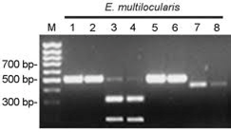
Uses of PCR
2. Disease detection
DNA sequences that are known to indicate certain genetic disorders or diseases are amplified using PCR for the purposes of diagnosis.

Slide 48
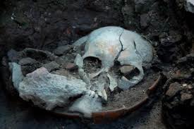
Uses of PCR
3. Archeological analysis
Ancient DNA, degraded over the years, can be amplified and used in archaeological, paleontological and evolutionary research.

Slide 49
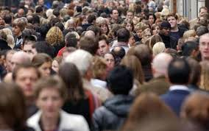
Uses of PCR
4. Population studies
Analysis of human or other species’ population genetics can be rapidly performed using PCR analysis.

Slide 50
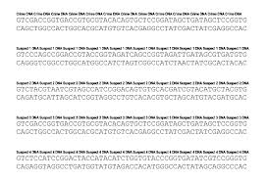
Uses of PCR
5. Sequencing DNA sequences can be worked out.

Slide 51
Key concepts
Small sections of DNA can be replicated in vitro using the PCR
PCR manipulates the natural process of DNA replication
PCR is now an automated technique widely used in many areas of research, medicine and industry
PCR involves continuous and repeated cycles of heating and cooling.

Slide 52
PCR Video
https://www.youtube.com/watch?v=hO3mTqrEeq8

Slide 53
Success Criteria
I can:
Describe the process of polymerase chain reaction (PCR) in amplifying DNA
Explain the use of complementary primers for specific target sequences.
State that PCR is repeated cycles of heating and cooling amplify the target region of DNA.
Describe a practical application of PCR

Slide 54

Extension Activity- Modelling PCR
Work in groups of 2-4
You will need 32 beads of each colour (red, yellow, blue, white)
Red- A
Blue- T
Yellow- C
White- G

Slide 55
Modelling PCR
Assemble the beads to form the DNA template
5’ ATAGGCACTGCCTAGT 3’
3’ TATCCGTGACGGATCA 5’

Slide 56
Modelling PCR
Assemble 2 sets of DNA primers
3’ TATCCG 5’
5’ CCTAGT 3’

Slide 57
Modelling PCR
Line up the 2 DNA strands
Get your iPad ready to take photos

Slide 58
Modelling PCR
Perform PCR:
Denature
Primers anneal
Replication
Repeat
Remember to take photographs at each stage!!

Slide 59
Plenary
Go round the room and check each groups photos- try and spot any mistakes!

Slide 60
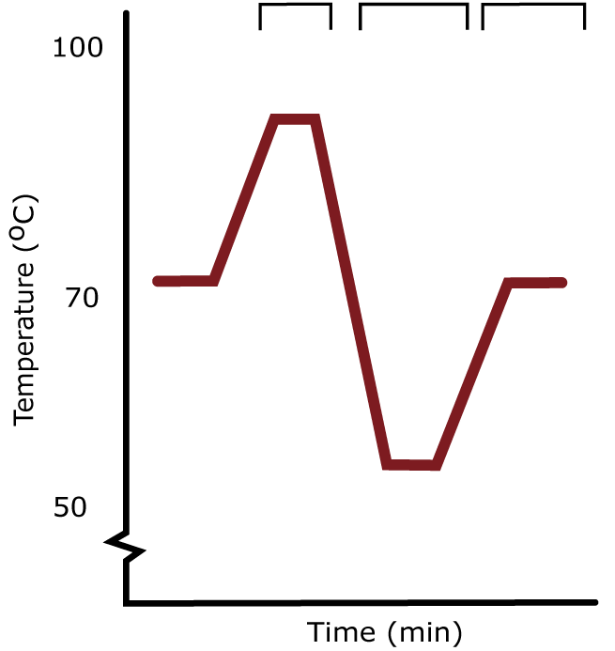
Plenary
1
Describe what is happening at each stage of PCR?
3
2

Slide 61
Now Complete…
Revision Mind Map
Revision Quiziz https://quizizz.com/admin/quiz/5b8e38d4b3aa530019b32e13/3-dna-replication-higher-human-biology?type=quiz,presentation&source=MainHeader&page=FeaturedPage&searchLocale=
Past Paper questions on Teams

Slide 62
Starter
Describe stage 1,2 and 3 of PCR

