Slide 1
Higher Biology
Unit 3
KA 1 – Food Supply, Plant Growth and Productivity

Slide 2
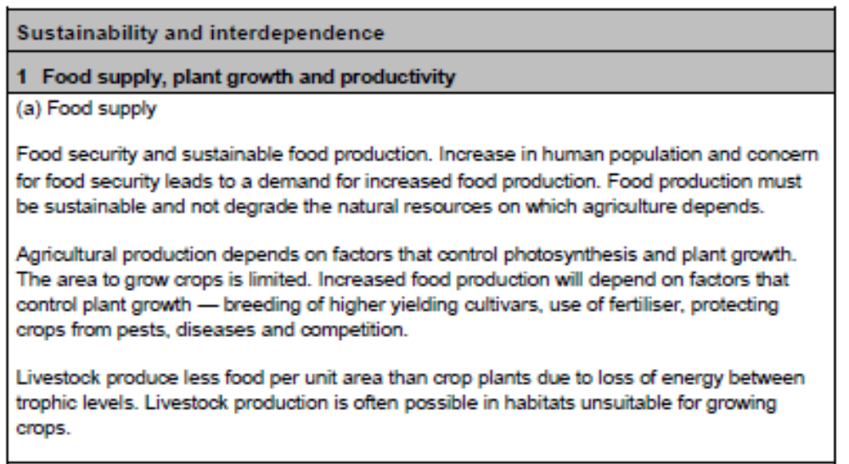
Course Specification

Slide 3
Starter
Draw a food chain with four organisms in it.
Describe what the arrows in a food chain show?
State how much energy is passed on from one organism to the next in a food chain?
Explain where the energy comes from in a food chain?

Slide 4
Learning Intention
By the end of this topic, you should be able to:
  Describe how the food supply of the world can be controlled
  Explain and reason why food supply needs to be tightly controlled and regulated

Slide 5
Success Criteria
I can:
State why there is an increased demand for food and explain the importance of food security.
Explain what is meant by sustainable food production and the factors which influence it.
List and describe the methods used to improve crop efficiency.
Explain why livestock yield less food per area than plants

Slide 6
Food supply
The human population in currently growing.
The present human population is:
http://www.census.gov/popclock/

Slide 7
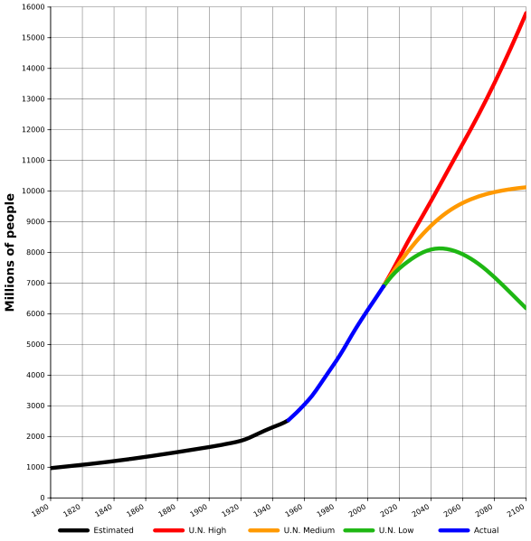
United Nations estimate of how the human population could increase.

Slide 8
Food Security
Feeding over 8 billion people requires a sufficient and sustainable supply of food.
This makes food security a massively important subject for the future of the human race.

Slide 9
Food security
Food security is defined as:
Sufficient food must be available at all times
Food is sufficiently nutritious and varied to provide a balanced diet
Quantity
Quality
Food security
Access
People have economic means to obtain the available food

Slide 10
Food security: The challenge
Watch these videos Feeding the future and Food security
Get a copy of this article from Nature (a highly respected science publication) on Food Security.
Divide into small groups. Divide the article up and each read a separate section. Discuss each section.
Come up with a list of the main challenges in assuring food security in the future. How can biological science contribute to solving these challenges?
Produce a A4 summary of the challenges and solutions to be photocopied for each group member.

Slide 11
Agricultural production
The earth possesses 75,000 edible plant species, yet we depend on a few to produce 95% of what we eat.
We must increase food production in a sustainable way.

Slide 12
Sustainable food production
Sustainable food production is a method of production
  using processes and systems that are non-polluting
  conserve non-renewable energy and natural resources
  are economically efficient
  are safe for workers, communities and consumers
  do not compromise the needs of future generations

Slide 13
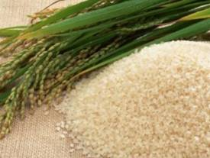
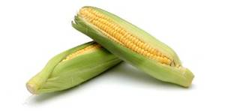
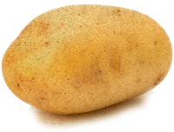
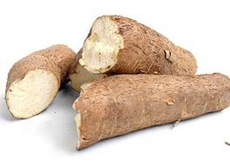
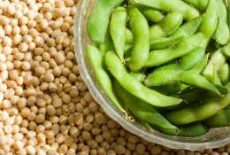
Main crop species
Cereals
Root crops
Maize
Potato
Rice
Cassava
Soya bean
Legumes

Slide 14
Improving yields
As the area of land suitable for growing crops is limited, agriculture can be controlled by:
Add minerals (fertiliser) or water (irrigation systems) to remove factors which may be limiting plant growth.
Replace existing strains of crops with a higher-yielding cultivar (cultured variety).
3. Protect crops from pests (e.g. insects), diseases (e.g. fungi), and competition (from weeds) by using pesticides, fungicides and herbicides
4. Develop pest-resistant crop plants.

Slide 15
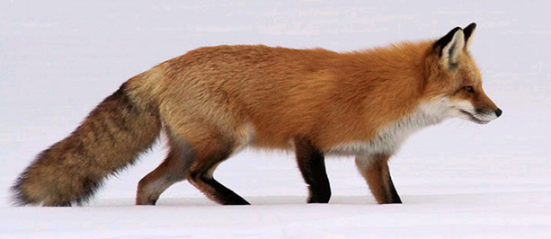
Productivity of arable land
Energy is lost from food chains in the following ways:
Only 10% is incorporated into body tissues
Undigested food and waste
Maintaining body temperature
Movement

Slide 16
As you move a long a food chain, energy is lost between each trophic level and the next.
Cereal plant Farm animal Human
As a result of this loss of energy, livestock production generates far less food per area of land than plant production.
90% energy lost
90% energy lost
10% energy passed on
10% energy passed on

Slide 17
Shorter food chains have much less loss of energy:
Cereal plant Farm animal Human
Cereal plant Human
90% energy lost
90% energy lost
10% energy passed on
10% energy passed on
100 kJ
10,000 kJ
1,000 kJ
90% energy lost
10% energy passed on
10,000 kJ
1,000 kJ

Slide 18
Plenary
Research a job within the Food Security Sector. Find out the following:
Name of job
Role and remit
Potential Salary
Locations for the job
Career progression

Slide 19
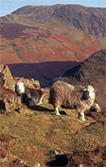
Therefore arable land planted with crops produces far more food than the same land planted with grass to feed livestock.
However, not all land can be
planted with crops. In this
case, it is more efficient to
use them for livestock.

Slide 20
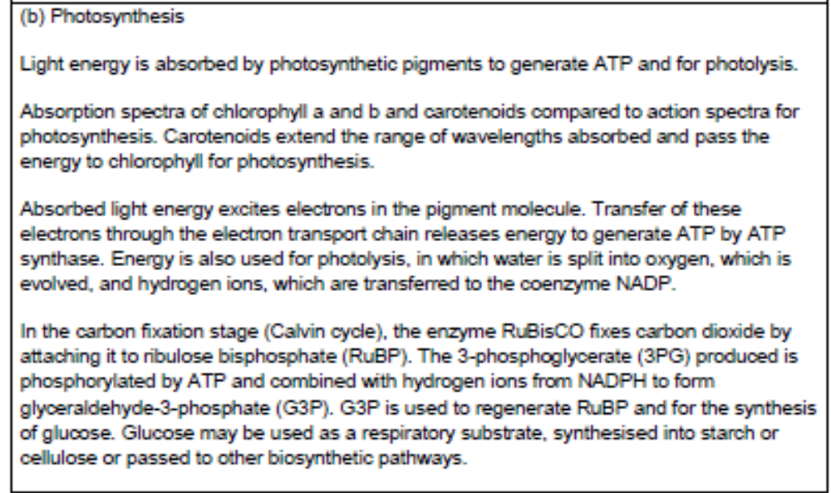
Course Specification

Slide 21
Starter
Reminder of photosynthesis from National 5:
Write the summary word equation for photosynthesis
Name the two stages
Describe what happens in each stage

Slide 22
Learning Intention
By the end of this topic, you should be able to:
  Describe the stages of photosynthesis

Slide 23
Success Criteria
I can:
  Explain what is meant by the absorption and action spectra
  Explain the role of carotenoids in relation to chlorophyll absorption
  Explain how chlorophyll is used to produce ATP and carry out photolysis
  State the fate of all the products of the first stage of photosynthesis
  Describe the Calvin cycle, including the roles of; RuBP, CO2. RuBisCo, intermediates, G3P, ATP and NADPH
  Give possible fates of the sugar produced during photosynthesis

Slide 24
Photosynthesis
Photosynthesis is a set of enzyme controlled reactions that builds up glucose from carbon dioxide and water. It is the fixing of light energy into chemical energy. (N5 but still a good start)
Pigments (chlorophyll)
Carbon dioxide
+
+
Oxygen
water
Glucose
Light energy
The first stage in photosynthesis is to capture the energy from the light

Slide 25
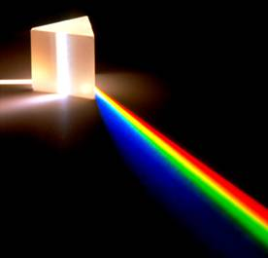
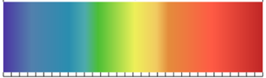
Visible Light
Visible light is made up of a spectrum of different colours.
Each colour of light has
a different wavelength.
400 nm 500 nm 600 nm 700 nm
Colour in a copy of the visible light spectrum in your jotters.

Slide 26


Fates of Light
2 Reflected
White light
White light hitting a leaf (or any surface) will be either:
1 Absorbed
3 Transmitted

Slide 27
Light Absorption
Leaves contain several coloured pigments of which chlorophyll is the most important.
These pigments absorb light energy. These pigments absorb different wavelengths of light.

Slide 28
Which wavelengths of light are used by plants
Your teacher will explain how to extract leaf pigments from nettles.
Place the leaf pigments solution in front of a spectroscope. This will show which colours are absorbed by the leaf pigments.

Slide 29
Collect a leaf and cut into small pieces.
Add some propanone and sand into a mortar and pestle.
Grind this up, until the propanone turns green.
Filter the mixture into a test tube.
Hold the spectroscope up towards the test tube and look towards the light.

Slide 30
violet | blue | green | yellow | orange | red
Colour in the normal spectrum. Then colour in a second copy of the spectrum viewed through the leaf pigments:

Slide 31
Spectrum viewed through Chlorophyll
violet | blue | green | yellow | orange | red
The blue and violet are no longer visible and only some of the red is still seen. These have been absorbed by the leaf pigments.
These are most important wavelengths for a plant in photosynthesis.

Slide 32
Separation of leaf pigments by thin-layer chromatography
Follow the instructions for the separation of leaf pigments by chromatography practical.

Slide 33
Accessory Pigments
The xanthophyll and carotene allow the plant to carry out photosynthesis in a wider range of light wavelengths – they extend the absorption spectrum.
They are known as carotenoids or accessory pigments as they pass the energy they capture onto chlorophyll a and b.

Slide 34
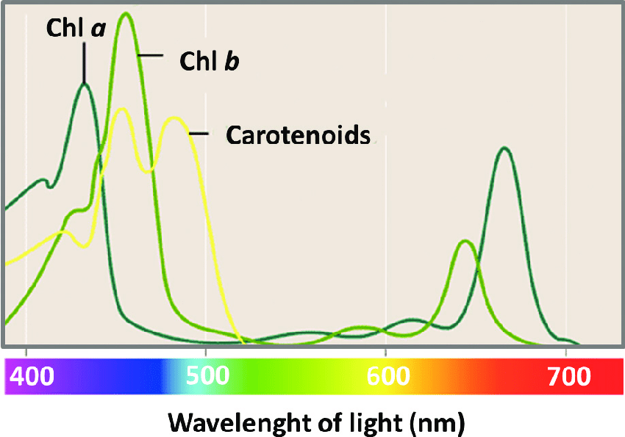

Slide 35
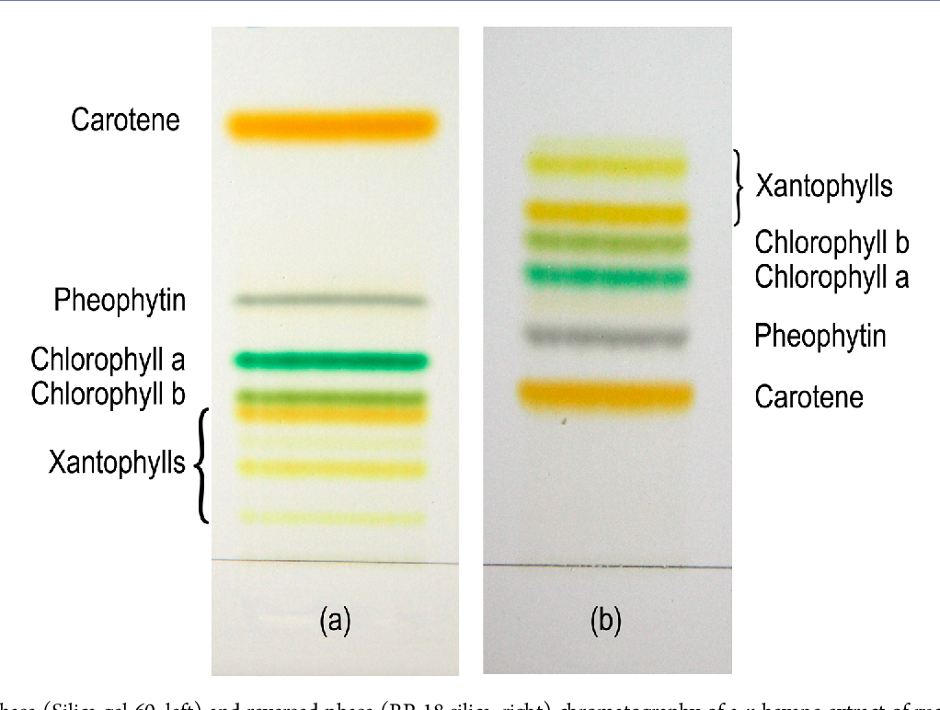
Chromatography

Slide 36
Absorption and Action Spectra
A leaf contains several pigments which can be separated by chromatography.
The main pigments are:
Chlorophyll a (blue-green*)
Chlorophyll b (yellow-green*)
Carotene (yellow*)
Xanthophyll (yellow*)
* This is the colour of the spot on the chromatography paper

Slide 37
An absorption spectrum shows the absorption of light of each wavelength by each pigment.
An action spectrum shows the rate of photosynthesis at each light wavelength.
Comparison of absorption and action spectra reveals a close match – this is good evidence for the importance of leaf pigments in photosynthesis.

Slide 38
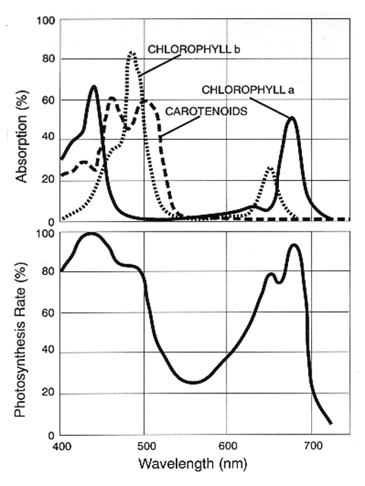
Absorption spectrum
Action spectrum

Slide 39
Photosynthesis
Photosynthesis happens in two stages:
  Photolysis (light dependent)
  Carbon fixation (light independent)

Slide 40
Photosynthesis
https://www.youtube.com/watch?v=CMiPYHNNg28

Slide 41
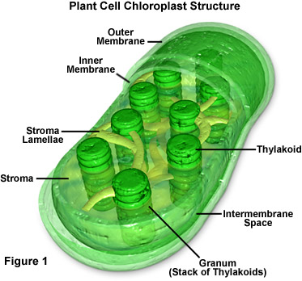
Where is it happening?
Photolysis takes place in the granum, stacks of sacs of membrane containing pigments
Carbon fixation takes place in the stroma

Slide 42
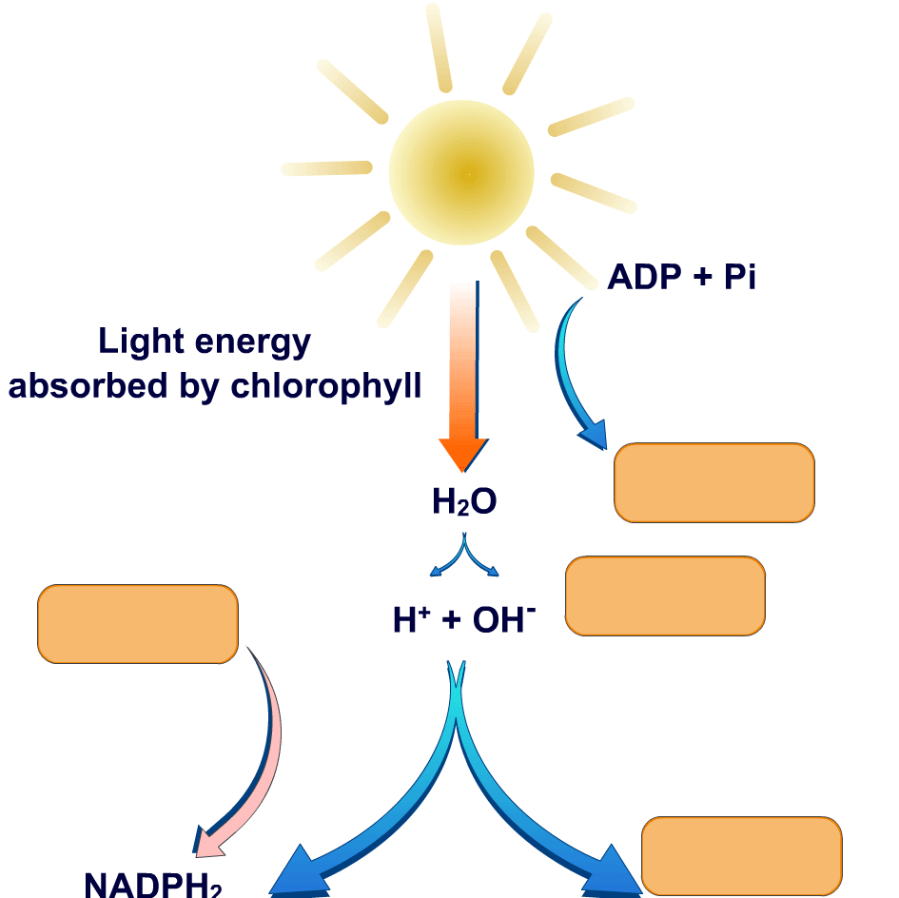
Photolysis- Light Dependent Stage
Light Energy is absorbed by chlorophyll and used to:
  Regenerate ATP
  Split water
Photolysis of water results in:
  Release of oxygen as a by-product
  Release of hydrogen
The hydrogen is transferred to the hydrogen acceptor NADP which becomes NADPH₂
The hydrogen and the ATP are used in the carbon fixation reactions.

Slide 43
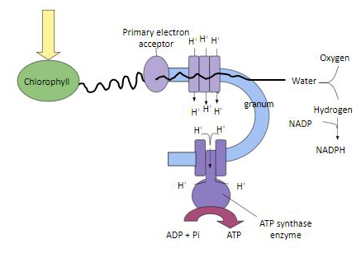
Photolysis- Stage 1
Chlorophyll absorbs light energy that excites electrons

Slide 44
Photolysis- Stage 2
Excited electrons travel to an electron transport chain

Slide 45
Photolysis- Stage 3
Energy is used to split water into Oxygen and Hydrogen ions

Slide 46
Photolysis- Stage 4
Co-enzyme NADP carries hydrogen ions to next stage as NADPH

Slide 47
Photolysis- Stage 5
Energy from the electrons is also used by ATP synthase to make ATP

Slide 48
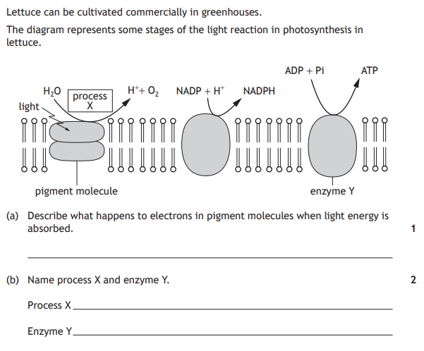
Electrons become excited OR Electrons transferred along the electron transport chain.
Photolysis
ATP synthase

Slide 49
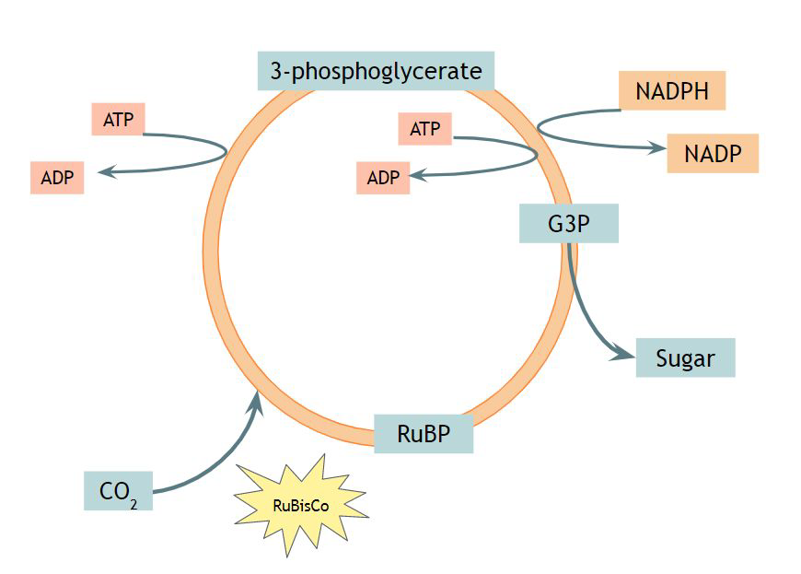
Carbon Fixation - stage 1
CO₂ is accepted by the compound ribulose biphosphate (RuBP) (RuBisCO is an enzyme that fixes carbon dioxide by attaching it to RuBP)

Slide 50
Carbon Fixation - stage 2
The compound formed immediately splits into two molecules of a compound called 3-phosphoglycerate (3PG).

Slide 51
Carbon Fixation – stage 3
The 3PG is phosphorylated by ATP and combined with hydrogen ions from NADPH to make glyceraldehyde-3-phosphate (G3P)

Slide 52
Carbon Fixation – stage 4
The G3P is used to make glucose

Slide 53
Carbon Fixation – stage 5
The G3P is used to regenerate RuBP

Slide 54
Carbon Fixation
3-phosphoglycerate
6 carbon compound
Cellulose
Starch
ATP
Carbon Dioxide
ADP + P_{i}
Glucose
NADPH
NADP
Enzyme is RuBisCO
G3P = glyceraldehyde-3-phosphate
2 turns of the cycle gives you 2 G3Ps
RuBP =
Ribulose BisPhosphate
ATP
1 molecule of 3C goes to side while 5 converted back to RuBP
ADP + P_{i}

Slide 55
Carbon Fixation
Glucose may then be
  Used as a respiratory substrate
  Stored as starch
  Used to synthesis cellulose for cell walls.
  Passed to biosynthetic pathways to make proteins, fats, nucleic acids

Slide 56
Success Criteria
I Can..
State why there is an increased demand for food and explain the importance of food security.
Explain what is meant by sustainable food production and the factors which influence it.
List and describe the methods used to improve crop efficiency.
Explain why livestock yield less food per area than plants
Explain what is meant by the absorption and action spectra
Explain the role of carotenoids in relation to chlorophyll absorption
Explain how chlorophyll is used to produce ATP and carry out photolysis
State the fate of all the products of the first stage of photosynthesis
Describe the Calvin cycle, including the roles of; RuBP, CO2. RuBisCo, intermediates, G3P, ATP and NADPH
Give possible fates of the sugar produced during photosynthesis

Slide 57
Essay
Write notes on photosynthesis under the following headings.
(i) Use of energy absorbed by photosynthetic pigments (3)
(ii) Carbon fixation (4)

Slide 58
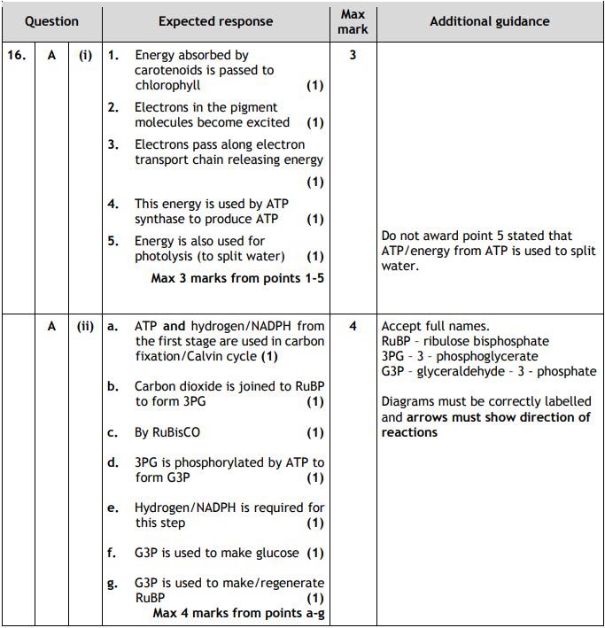

Slide 59
Plenary
Write notes on human food supply under the following headings:
(i) food security and population;
(ii) factors affecting food production.
(8)
You can’t answer ii yet!
Notes:
2014
RH

Slide 60
(i) Food security and population
1. (food security is ability of human population to access) sufficient/enough/correct/right supply/quantity/amount of food
2. sufficient/enough/correct/right quality of food OR example
2a. If neither 1 nor 2 scored mention of quantity and quality of food
3. increasing population increases the demand/need for food OR food security more difficult to achieve
4. production/supply is sustainable OR example
5. does not degrade/destroy natural resources/environment/land on which agriculture depends OR example
(ii) Factors affecting food production
6. (food production) depends on photosynthesis
7. food production limited by area of crop/land
8. factors which limit/affect photosynthesis include light/temperature/carbon dioxide availability (any 1)
9. second factor
10. high-yielding/ polyploid cultivars OR GM/selectively bred organisms increase food production OR example described
11. pests eat/damage crops/livestock OR weeds compete with crops OR disease/parasites kill/damage crops/livestock
12. vetinary care/pesticides/fungicides/herbicides/insecticides OR biological control/cultural methods control pests/weeds/diseases
13. increased irrigation/water availability/multiple cropping/agricultural machinery/fertilizers increases food production 14. livestock produce less food per unit area than crops due to energy loss at each trophic level
15. livestock can be grazed/raised/kept on habitats/land not suitable for crops

Slide 61
Past Paper Questions
2018 mcq 8, 9, section 2 - q7 & 8
2017 mcq 14, section 2 – q11
2016 mcq 14 + 15
2019 essay 16A
2022 mcq 18-20, section 2 q10
2023 mcq 17-19, section 2 q11 + 13
2024 mcq 18-19, section 2 q10, q13e

