Slide 1
Higher Biology
Unit 3
KA 2 – Plant and Animal Breeding

Slide 2
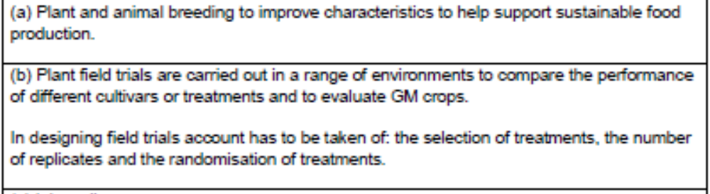
Course Specification

Slide 3
Starter (Recap)
Make an SQA approved glossary in your jotter to remind yourself of the definitions of:
  Homozygous
  Heterozygous
  Recessive
  Dominant
  Allele
  Gene
  Reliable / Valid / Accurate

Slide 4
Learning Intention
I will be learning about breeding and field trials

Slide 5
Success Criteria
I Can..
Give examples of characteristics that have been selected for in plants and animals
State the purpose of carrying out plant field trials
In plant field trials explain the importance of; selection of treatments, replicates, randomisation of treatments

Slide 6
Breeding
Characteristics of plants and animals can be selected and manipulated by breeders.
This is done in order to produce new and improved animal breeds or plant cultivars.
Cultivar: a plant variety produced in cultivation by selective breeding.

Slide 7
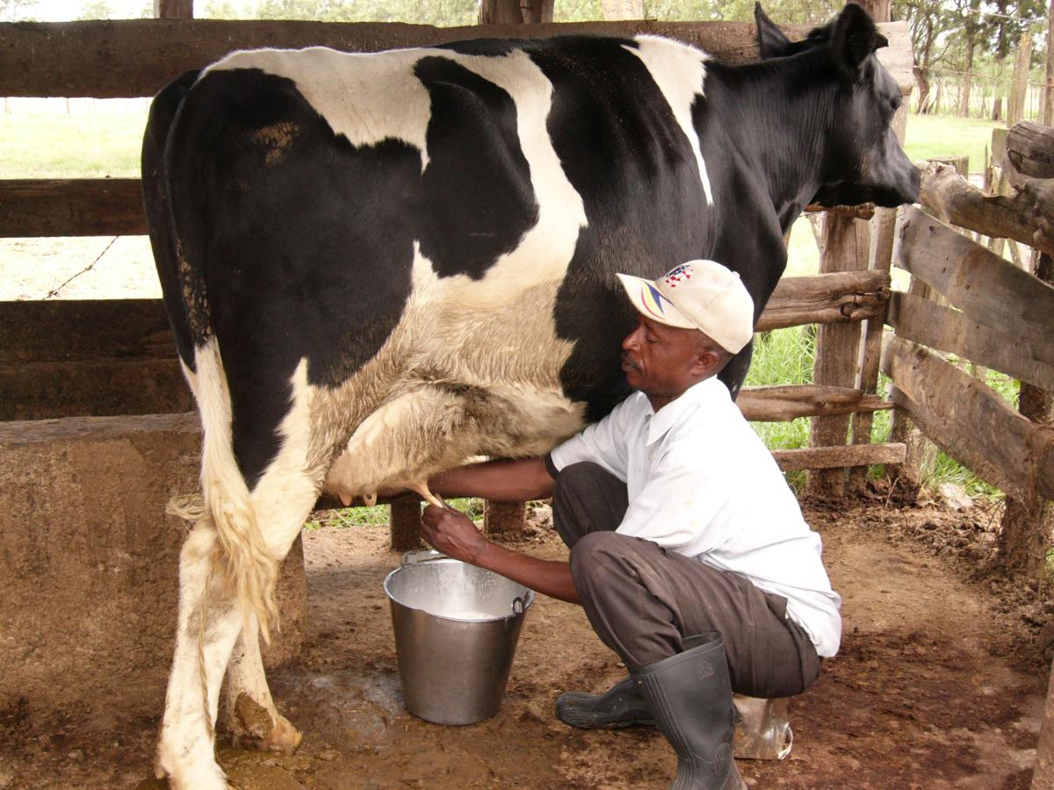
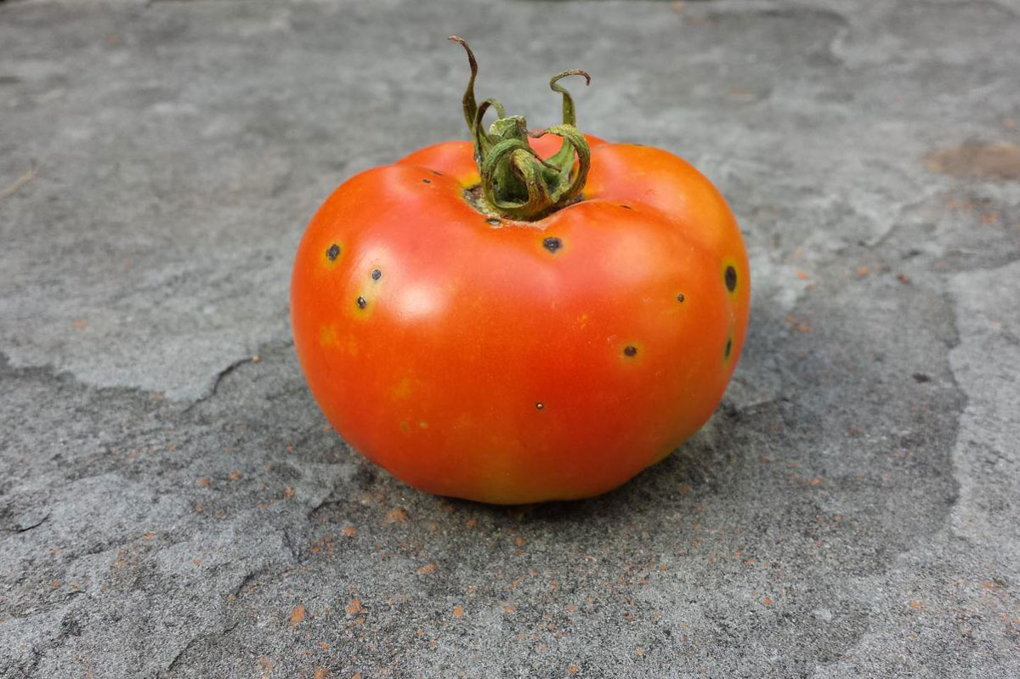
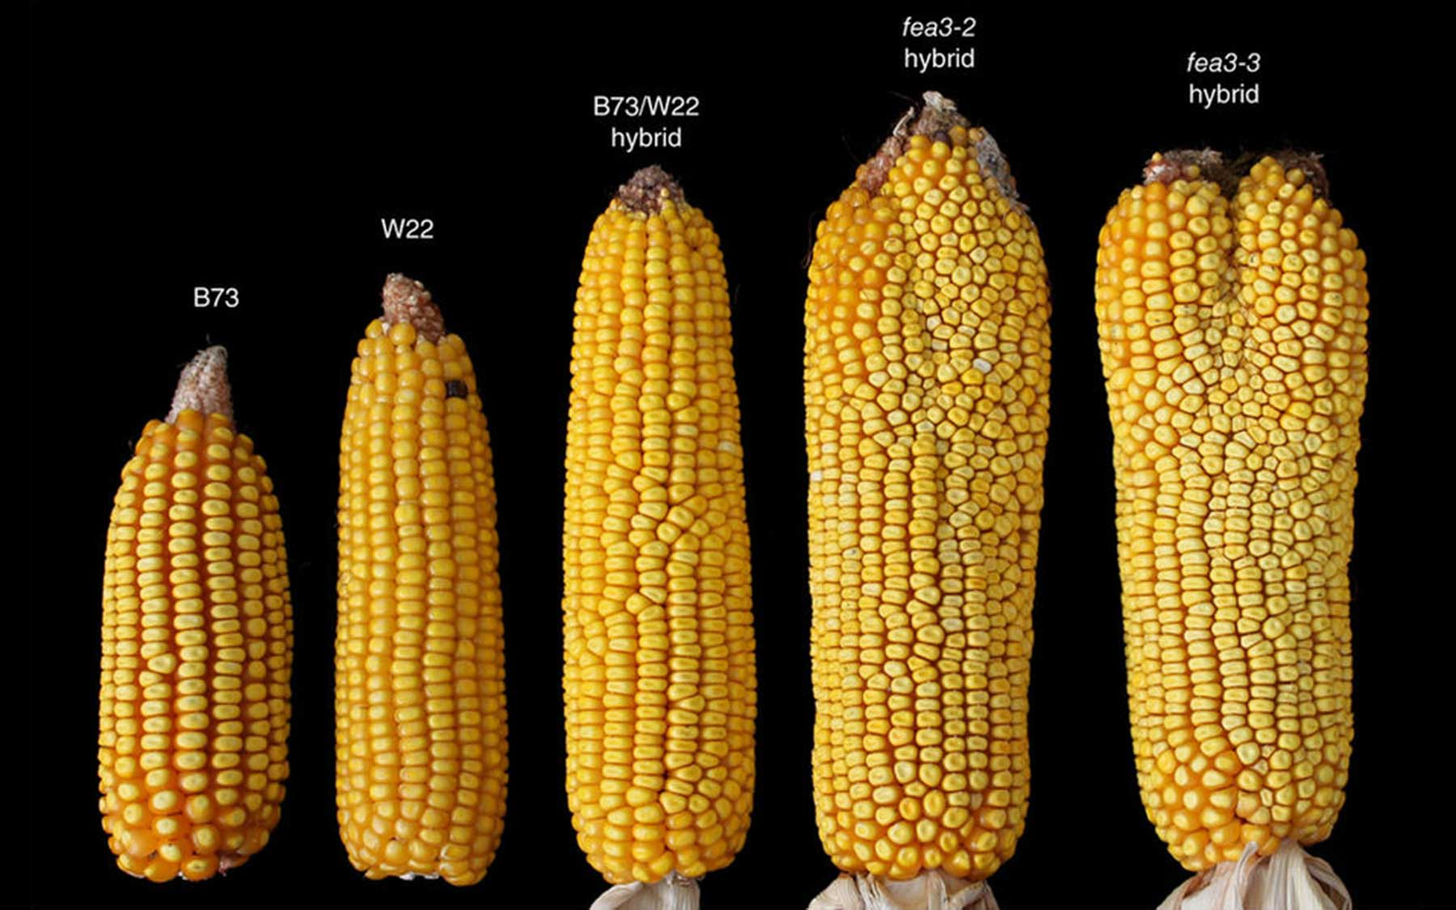
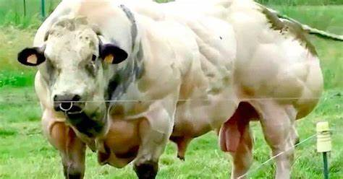

Slide 8
Breeding Characteristics
Plant crop or Animal Breed | Desirable Characteristic that increases food production
Wheat | High grain yield
Potato | Resistance to fungal disease
Soya bean | High protein content of seeds
Strawberry | Resistance to frost
Dairy cattle | High milk yield
Beef cattle | High meat yield

Slide 9
Selecting and Breeding
Over the centuries, farmers and
increasingly scientists have been involved
in manipulating the characteristics of plants and animals in order to obtain
higher yields and thus ensure sustainable food sources.

Slide 10
Plant field trials
Plant field trials are used to
  compare the performance of different cultivars or GM crops
  find out the effect of different environmental conditions on a new cultivar

Slide 11
Plant field trials
Explain how each of the following are involved in the design of a trial:
Selection of treatments
Number of replicates
Randomisation of treatments

Slide 12
Plant field trials
Selection of treatments:
  Ensure they are valid to compare e.g. using wild types versus other cultivars
2. Number of replicates:
  Several replicates are required to ensure reliability of results. Reduces effect of experimental error and variability
3. Randomisation of treatments:
  The ordering of the plots should be random to eliminate observer bias when measuring treatment effects

Slide 13
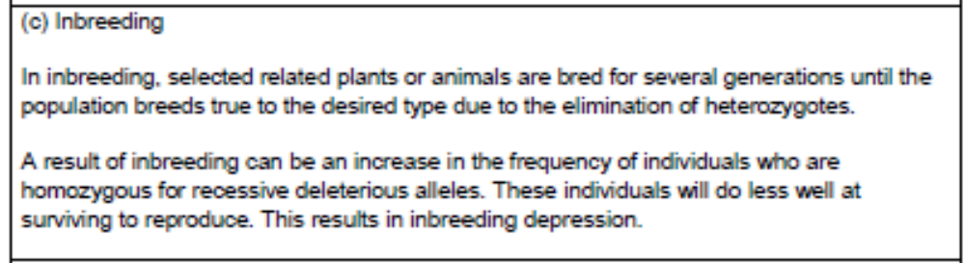
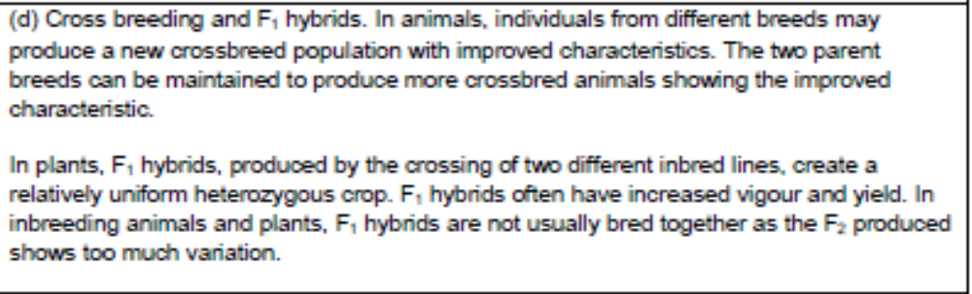
Course Specification

Slide 14
Starter
If brown hair is dominant to blonde hair and one parent is heterozygous and one parent is homozygous recessive, what is the expected ratio of the offspring?

Slide 15
Learning Intention
I will be learning about different types of breeding

Slide 16
Success Criteria
I can:
  Explain the difference between inbreeding and cross breeding
  Explain what is meant by inbreeding depression, how it can be avoided and why some plants are less susceptible
  Explain how a hybrid plant or animal can be created and how this crossbreed can be maintained
  Define hybrid vigour and explain why the F2 generation is not useful

Slide 17
Selecting and Breeding
Plants or animals with the desired characteristics are identified.
These are then used as the parents of the next generation.
The aim is to combine the alleles of a gene for a desired trait present in one parent with the alleles of a gene for another desired trait in the second parent.
Thus creating offspring which have superior characteristics to their parents.

Slide 18
Inbreeding
Inbreeding occurs when individuals breed within a particular gene pool, usually with close relatives.
Self-pollinating plants are the most extreme case of inbreeding.
Inbreeding can be used over several generations in order to eliminate certain heterozygous traits.

Slide 19
Inbreeding Depression
If inbreeding continues over a long period of time, heterozygosity can decrease and homozygosity can develop.
However, if inbreeding is forced inbreeding depression can happen.
This results in an increase in the frequency of individuals who are homozygous for recessive deleterious alleles.

Slide 20
Inbreeding Depression
Inbreeding depression can result in :
  Reduced vigour
  Reduced size
  Reduced fertility
  reduced yield
These individuals do less well at surviving to reproduce

Slide 21
In The News
Kenny the White Tiger:
https://www.iflscience.com/kenny-white-tiger-reveals-price-inbreeding-25367
The Blue People of Kentucky:
https://www.iflscience.com/the-science-behind-the-mysterious-blue-people-of-kentucky-47413

Slide 22
Cross breeding
Cross breeding is carried out to prevent this accumulation of harmful alleles.
This involves the introduction of new alleles into a population.
This is carried out by breeding a plant or animal with a strain containing a different but beneficial genotype OR by crossing a cultivar.

Slide 23
Cross breeding
Once a new breed has been produced with improved characteristics, it must be maintained.
The two parent breeds must be maintained to produce more crossbreed animals showing the improved characteristic.

Slide 24
Use of F1 Hybrids
An F1 hybrid is formed from a cross between two genetically dissimilar parents of the same species
F1 hybrids are often used in plant breeding.
They are produced by crossing two different inbred lines – this makes a relatively uniform heterozygous crop.

Slide 25
Use of F1 hybrids
These F1 plants have increased vigour
  Higher yield
  Increased disease resistance
  Increased growth rate
Why is the F2 generation not as useful as the F1?
The F1 will be a uniform group of heterozygotes, breeding to the F2 will produce a wide genetic variation, so production will be less controlled.

Slide 26
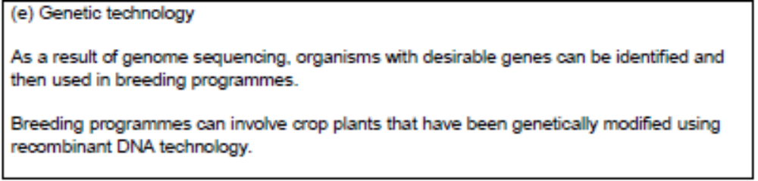
Course Specification

Slide 27
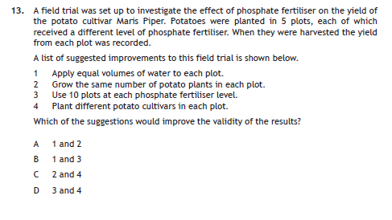
Starter

Slide 28
Starter

Slide 29
Learning Intention
I will be learning about genetic technologies

Slide 30
Success Criteria
I can:
  Explain how DNA sequencing has been used in breeding
  Explain how recombinant DNA techniques have been used in breeding
  Give examples of genes that have been inserted into crop plants

Slide 31
Genetic Technology
Increasingly genetic technologies are being used in breeding programmes.
Explain how the following technologies have been (or could be) used in breeding.
1. Genetic transformation
2. Genome sequencing
3. Gene probes

Slide 32
Genetic Technology
Genome sequencing
allows identification of genes that have desired characteristic and the individuals that are carrying these alleles
2. Gene probes
use of these identifies whether the gene is homozygous/heterozygous or there is a presence/absence of particular markers which will decide on breeding

Slide 33


Genetic Technology
3. Genetic transformation
  Using genes from other species and introducing these to the genome of the plants that are being worked with e.g. introducing the Bt gene for pest resistance or glyphosate resistance gene for herbicide tolerance.

Slide 34
Success Criteria
I Can..
Give examples of characteristics that have been selected for in plants
and animals
State the purpose of carrying out plant field trials
In plant field trials explain the importance of; selection of treatments,
replicates, randomisation of treatments
Explain the difference between inbreeding and cross breeding
Explain what is meant by inbreeding depression, how it can be avoided
and why some plants are less susceptible
Explain how a hybrid plant or animal can be created and how this
crossbreed can be maintained
Define hybrid vigour and explain why the F2 generation is not useful
Explain how DNA sequencing has been used in breeding
Explain how recombinant DNA techniques have been used in breeding
Give examples of genes that have been inserted into crop plants

Slide 35
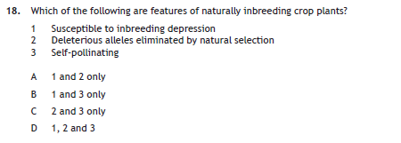
Plenary

Slide 36
Quiziz
https://quizizz.com/admin/quiz/602a3e4d359741001beb3014?source=quiz_share

