Slide 1
Higher Biology
Unit 2
KA 6 – Environmental Control of Metabolism

Slide 2
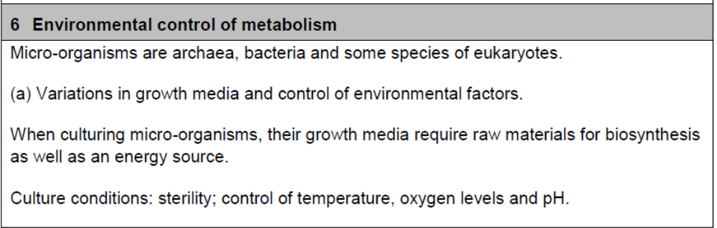
Course Specification

Slide 3
Starter
Describe the ways in which an organism can avoid adverse conditions.

Slide 4
Learning Intention
By the end of this topic you should know the following:
Microorganisms include archaea, bacteria and some species of eukaryote.
Explain the growth of microorganisms, including the control of growth media and environmental conditions.

Slide 5
Success Criteria
I will be able to:
  Describe microorganisms
  Explain they are found in three different types and name the three different types as archaea, bacteria and some kinds of eukaryotes
  Explain what microorganisms need to grow well
  Explain how microorganisms are grown in lab conditions

Slide 6
Microorganisms
You will remember from unit 1 that there are three domains of life.
The three domains of life are archaea, bacteria and eukaryote.
Microorganisms are found in all three of these domains.

Slide 7
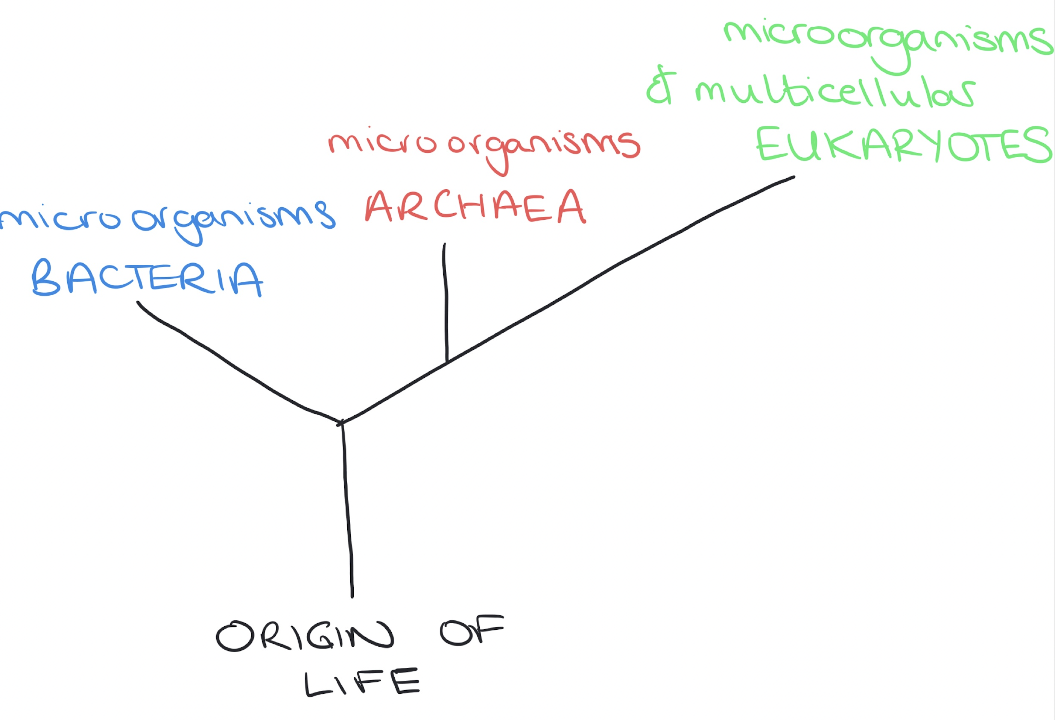

Slide 8
Microorganisms
Microorganisms are really useful
Microorganisms are frequently used in labs for several good reasons.
Microorganisms are used because of:
  their adaptability
  ease of cultivation
  speed of growth

Slide 9
Microorganisms
Microorganisms are great to grow in the lab because:
  they use a wide variety of substrates for metabolism
  They produce a range of products from their metabolic pathways.

Slide 10
Growth of microorganisms (cell culture)
Microorganisms can be cultured relatively easily in a laboratory.
Many microorganisms produce all the complex molecules required for biosynthesis.
These are molecules like amino acids, vitamins and fatty acids.

Slide 11
Growth of microorganisms
Some microorganisms need to be given these.
They must be given an appropriate growth medium with these raw materials added in eg vitamins, fatty acids, amino acids.
Growth media – a solid or liquid substance used to grow, transport or store microrganisms.

Slide 12
Growth of microorganisms
There are however things that all microorganisms need in growth media.
They all need:
  An energy source (chemical substrates or light for photosynthetic microorganisms)

Slide 13
Growth of microorganisms
Growing microorganisms needs their culture conditions to be tightly controlled.
They need:
  Sterility (to reduce competition with unwanted bacteria for nutrients and reduce spoilage of products)
  Control of temperature
  Control of oxygen levels (aerobic or anaerobic)
  Control of pH

Slide 14
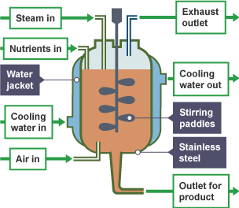
Fermenter

Slide 15
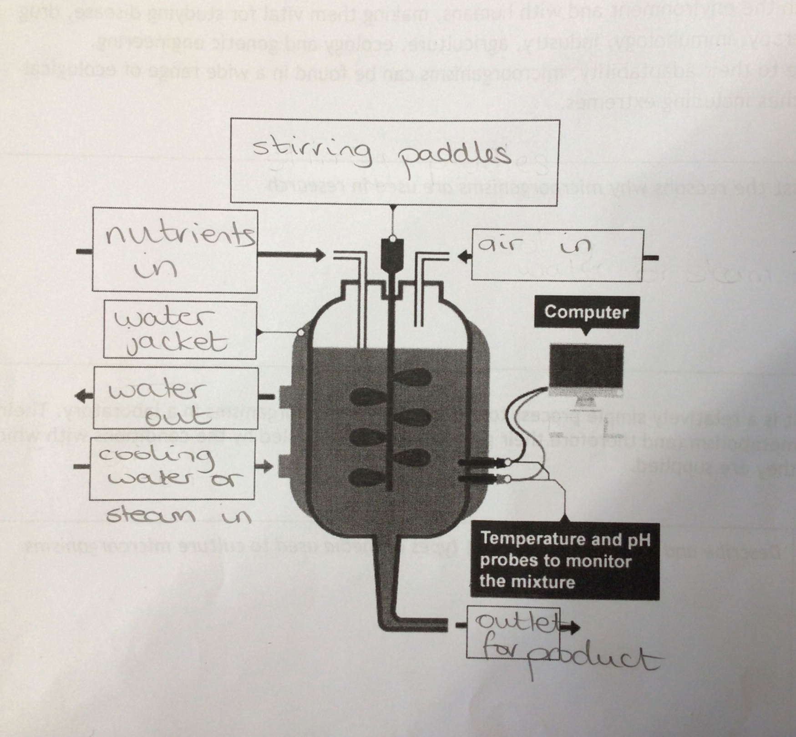

Slide 16
Research Task
Research some of the products made using microorganisms in industry.

Slide 17
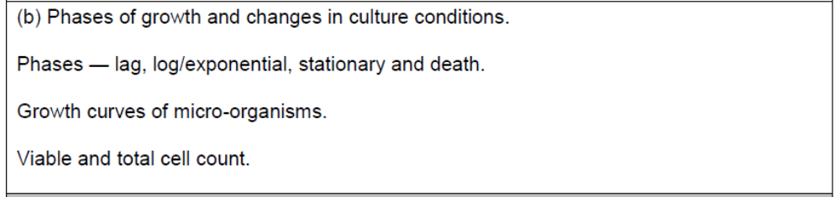
Course Specification

Slide 18
Starter
https://quizizz.com/admin/quiz/6374e5bd440f75001d90be21?source=quiz_share

Slide 19
Learning Intention
Recognise and explain the stages of a microorganism growth curve.

Slide 20
Success Criteria
I will be able to:
  Describe a growth curve of microorganism
  Name the different stages
  Describe the different stages
  Explain a semi log scale
  Explain the difference between viable cell counts and total cell counts

Slide 21
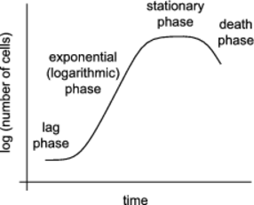
Growing microorganisms
Microorganisms grow in very specific patterns.
Their growth curve looks like this:

Slide 22
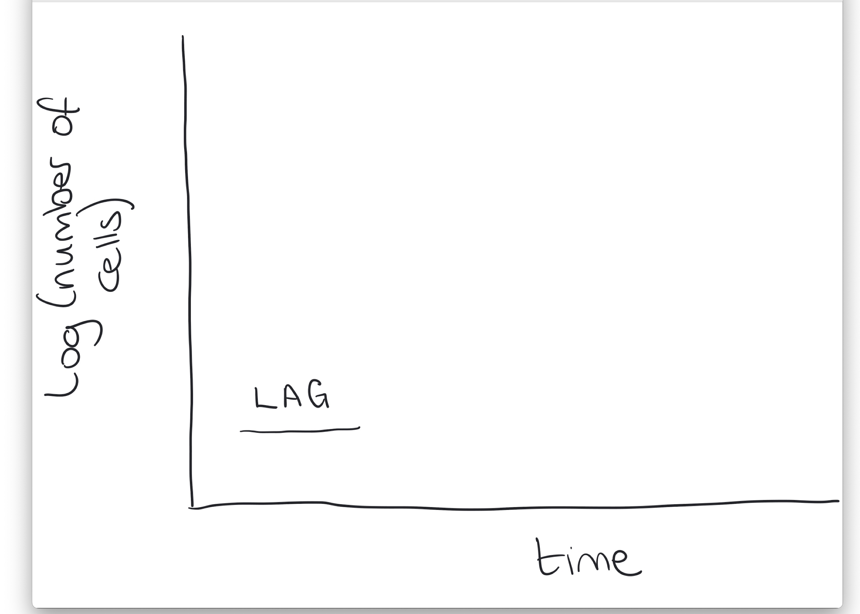
Growing Microorganisms
lag phase
where microorganisms adjust to the conditions of the culture by producing enzymes that metabolise the available substrates

Slide 23
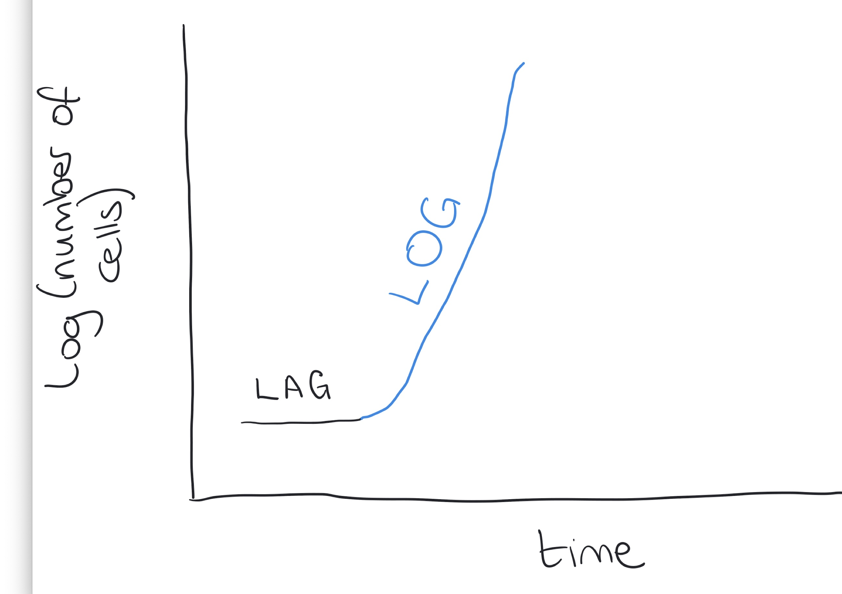
Growing microorganisms
exponential (logarithmic) phase
the rate of growth is at its highest

Slide 24
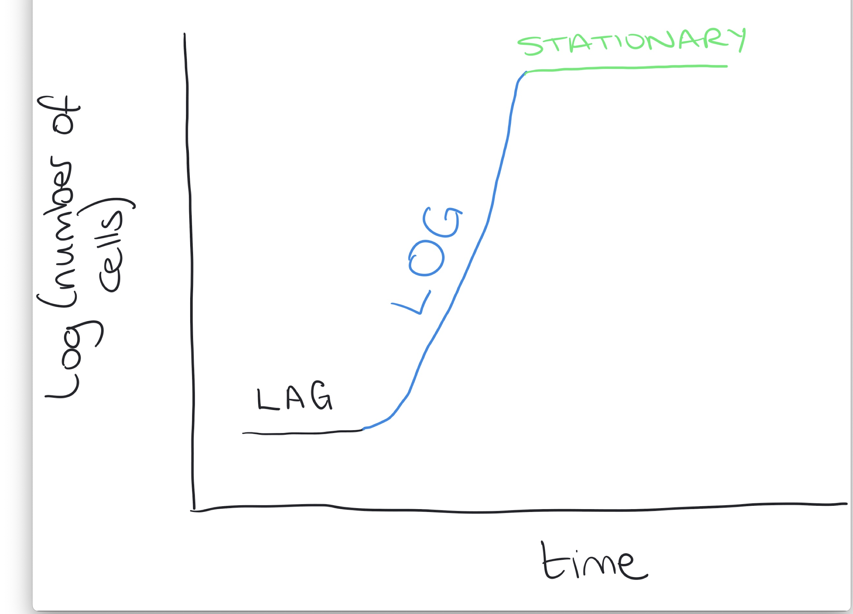
Growing microorganisms
stationary phase
growth rate = death rate
the culture medium becomes depleted
secondary metabolites are produced

Slide 25
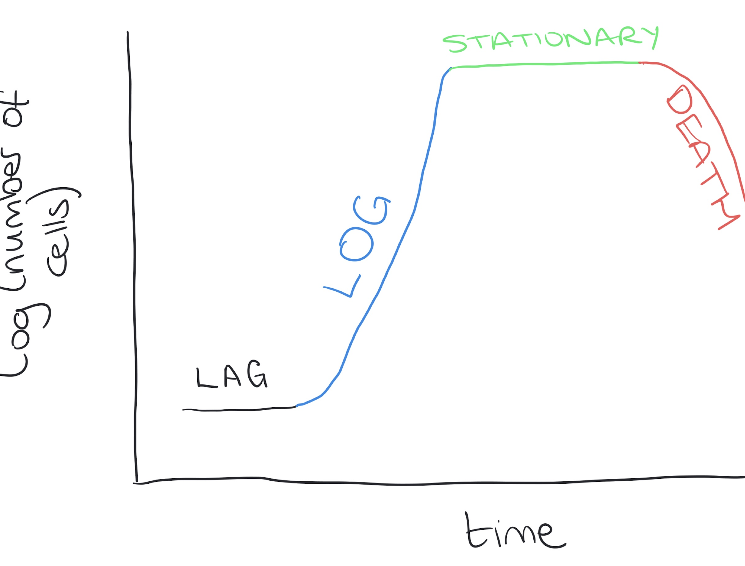
Growing microorganisms
death phase
where lack of substrate and the toxic accumulation of metabolites causes death of cells

Slide 26
Secondary Metabolites
Secondary metabolites are produced in the stationary phase
Secondary metabolites are things like antibiotics
These are produced to confer an ecological advantage
Producing them allows microorganisms to outcompete other microorganisms

Slide 27
Semi-logarithmic scales
Microorganism populations double every time they divide
This means their population numbers climb into very very high numbers very quickly
Using normal graph paper wont let us plot their growth
We use semi-logarithmic paper that looks like this:

Slide 28
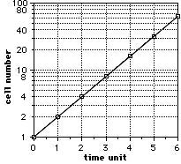
Semi-logarithmic paper

Slide 29
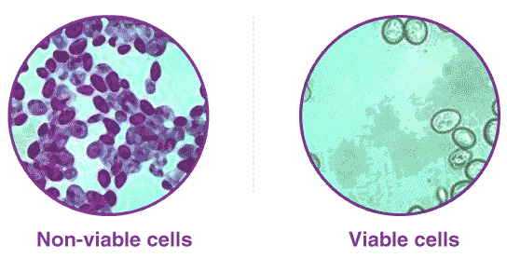
Counting Cells
Viable cell count – only living cells
Total cell count – living and dead cells

Slide 30
Success Criteria
I am able to:
  Describe microorganisms
  Explain they are found in three different types and name the three different types as archaea, bacteria and some kinds of eukaryotes
  Explain what microorganisms need to grow well
  Explain how microorganisms are grown in lab conditionsDescribe a growth curve of bacteria
  Name the different stages
  Describe the different stages
  Explain a semi log scale
  Explain the difference between viable cell counts and total cell counts

Slide 31
Plenary
https://quizizz.com/admin/quiz/5fd33c8754b346001b8e91e6?source=quiz_share

