Slide 1
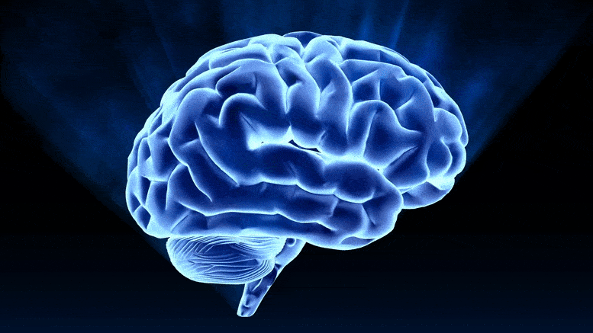
Higher Human Biology
M I S S M C B R I D E
3.2 The Cerebral Cortex

Slide 2

What should you already know from National 5 Biology?
What is the name of the 3 main parts of the brain?
Cerebrum, cerebellum and medulla
Which part of the brain would help you remember the answers to these questions?
Cerebrum
Which part of the brain would be lethal if injured?
Medulla

Slide 3
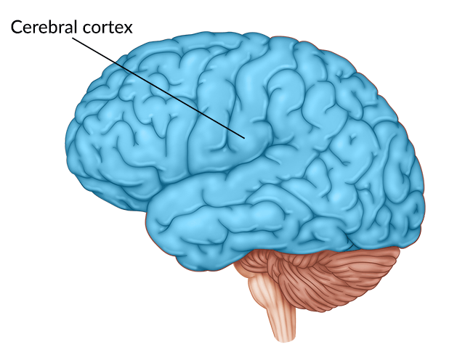
T H E C E R E B R A L C O R T E X
The cerebral cortex is the outer layer of your brain. It is the centre of conscious thought- it is responsible for things that you are consciously aware of such as thinking, reasoning, learning, decision making and understanding.
It recalls memories and alters behaviour in the light of experience. This means you can change your behaviour based on what you’ve learned from past experiences.

Slide 4
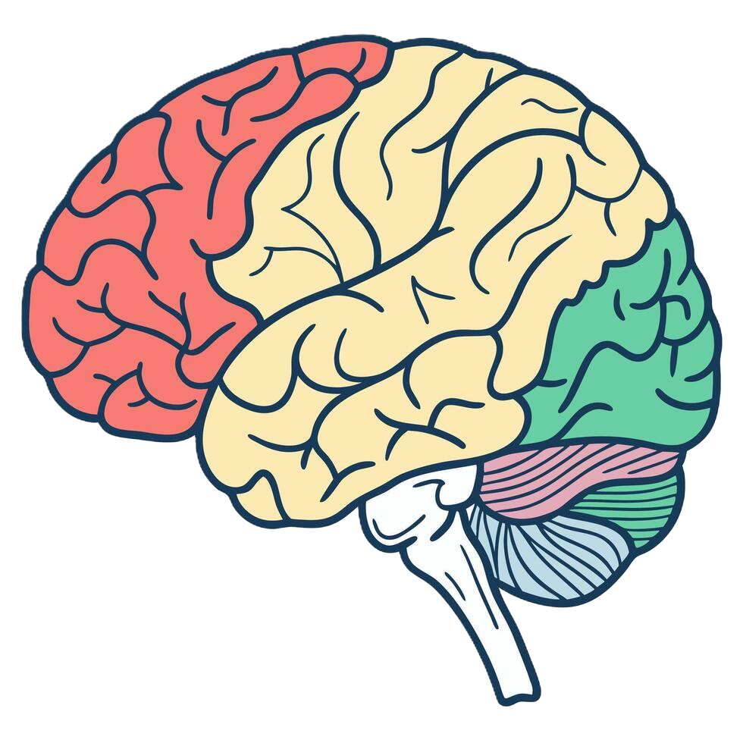
T H E C E R E B R A L C O R T E X
There is localisation of brain functions in the cerebral cortex.
There is sensory areas, motor areas and association areas.
The association areas are involved in language processing, personality, imagination and intelligence.

Slide 5
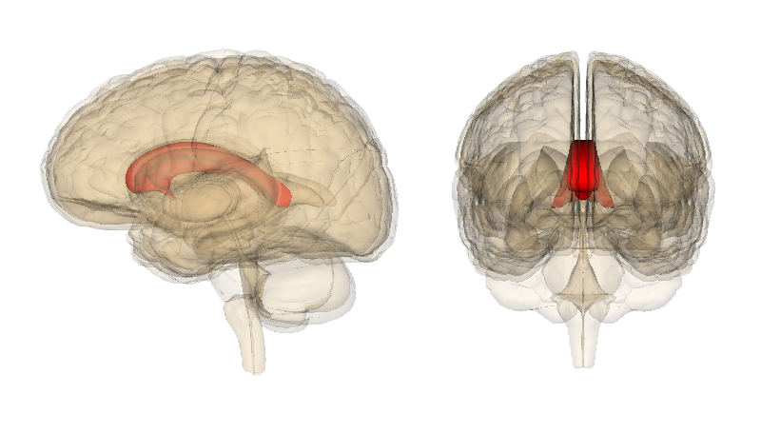
T H E C E R E B R A L C O R T E X
Information from one side of the body is processed in the opposite side of the cerebrum.
The left cerebral hemisphere deals with information from the right visual field and controls the right side of the body and vice versa.
Transfer of information between the cerebral hemispheres occurs through the corpus callosum.

Slide 6
C O U R S E S P E C N O T E S
3.2 The Cerebral Cortex
The cerebral cortex is the centre of conscious thought. It also recalls memories and alters behaviour in the light of experience. There is localisation of brain functions in the cerebral cortex. It contains sensory areas, motor areas and association areas. There are association areas involved in language processing, personality, imagination and intelligence. Information from one side of the body is processed in the opposite side of the cerebrum. The left cerebral hemisphere deals with information from the right visual field and controls the right side of the body and vice versa. Transfer of information between the cerebral hemispheres occurs through the corpus callosum.

