Slide 1
Higher Biology
Unit 1
KA 4 Cellular Differentiation

Slide 2
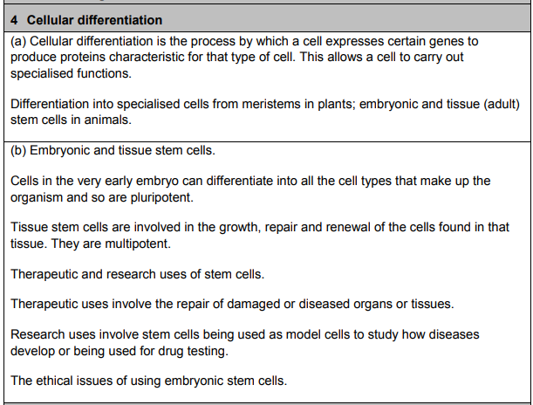
Course Specification

Slide 3
Starter
https://quizizz.com/admin/quiz/5e78b515aa08a6001b68cba1

Slide 4
Learning Intention
By the end of this lesson I will be able to:
  Explain the concept of cellular differentiation
  Describe stem cells and meristems
  Explain the differences between adult and embryonic stem cells
  Describe therapeutic and research uses of stem cells

Slide 5
Success Criteria
  I can:
  Define the term “cellular differentiation”
  Explain what is meant by the term “meristem” and identify where it would be found
  Define the term Stem Cell
  Explain the difference between pluripotent and multipotent stem cells

Slide 6
Cellular differentiation
Multi-cellular organisms are comprised of a large number of cells. These are specialised to carry out specific roles in the body.
Differentiation is the process by which unspecialised cells become altered and adapted to form a special function in the body.

Slide 7
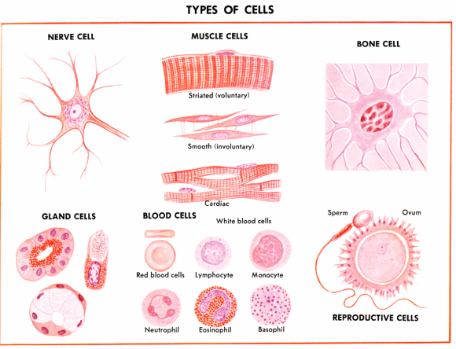
Specialised / differentiated

Slide 8
Cellular differentiation
Cells in a multicellular organism do not all look the same
But they all contain the same code
Therefore they must have a different pattern of expression
Cellular differentiation is the process of expressing specific genes to produce the proteins characteristic for particular cell types

Slide 9
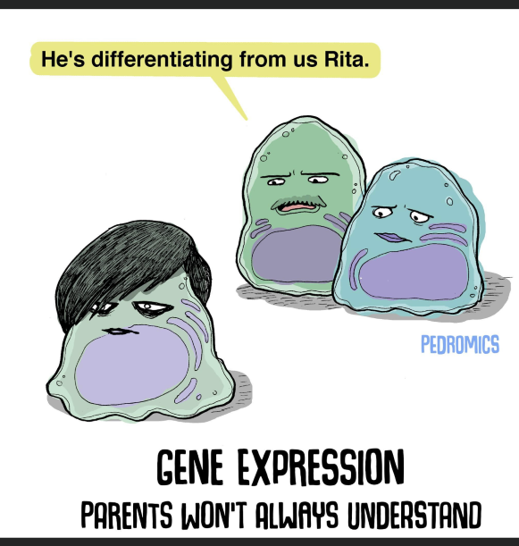
A stem cell is a cell that is capable of self renewal AND differentiation
Differentiation = specialisation

Slide 10
Selective gene expression
Every cell in your body has all the genes necessary for constructing the whole organism
Genes can be switched on or switched off when they are required otherwise the body would waste energy producing proteins in cells where they are not needed
e.g. insulin produced in pancreas cells only, not in brain or heart cells.

Slide 11
What can differentiate
Once a cell has gone through differentiation it cannot go back (actually scientists have managed to make this happen, but it is not what you see in normal systems)
There are particular cells that can self renew or differentiate
  Meristems in plants
  Stem cells in animals

Slide 12
Meristems in plants
Meristems are groups of unspecialised plant cells capable of dividing (self-renewing) throughout the life of the plant, or differentiating into other cell types
Meristems in plants are found at the points where the plant grows

Slide 13
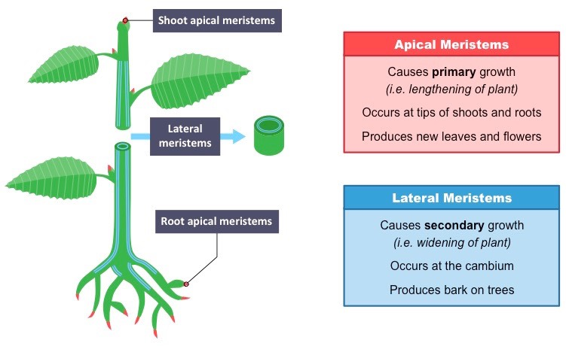
Meristems

Slide 14
Meristems
https://www.youtube.com/watch?v=lLnjo4Pf2JM

Slide 15
Stem cells in Animals
Found in all multicellular organisms, Self-renewing and can differentiate
Stem cells in animals can be further split into groups depending on how many different cell types they can differentiate into
  Embryonic stem cells
  Tissue stem cells

Slide 16
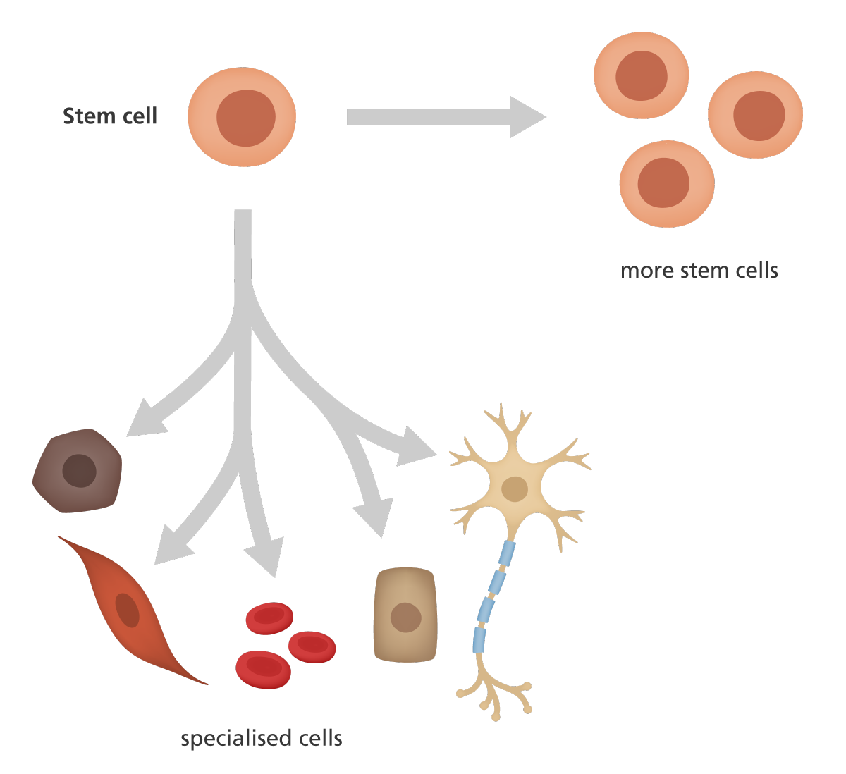
Stem Cells

Slide 17
Stem Cells
https://www.youtube.com/watch?v=evH0I7Coc54

Slide 18
Embryonic stem cells
Totipotent:
toti = total
potent = capacity
The state of the cells after the first few divisions of the fertilised egg have the capacity to become all cell types plus placenta

Slide 19
Embryonic stem cells
Pluripotent:
pluri = many
potent = capacity
At blastocyst stage (early embryo) cells become pluripotent
Have the capacity to become all cell types but not placenta
All of the genes can be switched on, so they can differentiate into any cell

Slide 20
Adult/Tissue stem cells
Multipotent
Can develop into cells that are closely related
Limited number of several cell types
Make all cell types from the tissue they come from (e.g. bone marrow stem cells can form any blood cell)
Found in many parts of the body

Slide 21
Success Criteria
  I can:
  Define the term “cellular differentiation”
  Explain what is meant by the term “meristem” and identify where it would be found
  Define the term Stem Cell
  Explain the difference between pluripotent and multipotent stem cells

Slide 22
Plenary
The local newspaper are running a story on Stem Cells
They need this to be accessible to the public
Help them explain the difference between embryonic Stem Cells and Adult Tissue Stem Cells in simple terms to a non-scientist

Slide 23
Starter
Describe what a Stem Cell is
Describe what a meristem is

Slide 24
Learning Intention
By the end of this lesson I will be able to:
  Explain the concept of cellular differentiation
  Describe stem cells and meristems
  Explain the differences between adult and embryonic stem cells
  Describe therapeutic and research uses of stem cells

Slide 25
Success Criteria
  I can:
  Describe the current therapeutic uses of stem cells
  Give areas of research which stem cells are useful
  Give examples of the ethical issues surrounding stem cells

Slide 26
Therapeutic Uses
Stem cells can be grown and self-renew in the lab as long as the correct conditions are given.
They are already being used in several therapeutic areas
E.g. skin regeneration and corneal repair

Slide 27
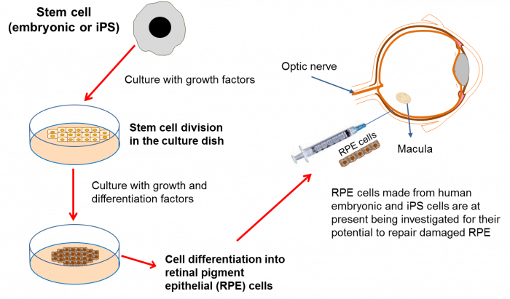
Therapeutic Uses

Slide 28
Research Uses
Stem cells are used as model systems to test different drugs and track disease response.
Stem cells are also used to work out more about cell biochemistry and cellular processes.

Slide 29
Research Task
Research the uses of Stem Cells in Medicine
Create a poster presentation showing the use of Stem Cells in Medicine you have picked

Slide 30
Ethical Issues
The use of embryonic stem cells raises particular ethical issues
There are specific treatments now using these cells and there is potential for more and also scientific advancements
This work involves the destruction of embryos

Slide 31
Ethics Task
There are 5 statements around the room
You are to decide whether you agree or disagree with each statement and explain why
Write your answers on the poster paper at each station

Slide 32
Success Criteria
  I can:
  Describe the current therapeutic uses of stem cells
  Give areas of research which stem cells are useful
  Give examples of the ethical issues surrounding stem cells

Slide 33
Plenary
Explain a use of Stem Cells in research or medicine to someone else in the class
You have 5 minutes then you will listen to them for 5

Slide 34
Quiziz
https://quizizz.com/admin/quiz/5e78d981bbf896001b17cfa7

