Slide 1
Higher Biology
Unit 1
KA5 The Structure of the Genome
KA6 Mutations

Slide 2
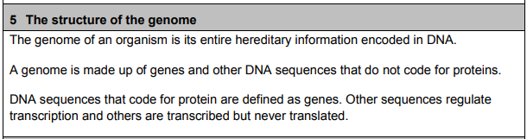
Course Specification

Slide 3
Starter
Discuss in pairs how you would define the term “genome”

Slide 4
Learning Intention
By the end of this topic I will be able to:
Describe the structure of the Human Genome

Slide 5
Success Criteria
I can:
Define the term “genome”
Describe the structure of the genome
Describe the functions of coding and non-coding DNA sequences

Slide 6
Genome
The genome of an organism is its entire hereditary information encoded in the DNA
A genome is made up of genes and other DNA sequences that do not code for protein

Slide 7
Human genome
The human genome:
3 billion base pairs of DNA
Codes for approximately 20% genes
Contains “protein-coding” and “non-protein-coding” regions
Coding regions only make up 2% of DNA

Slide 8
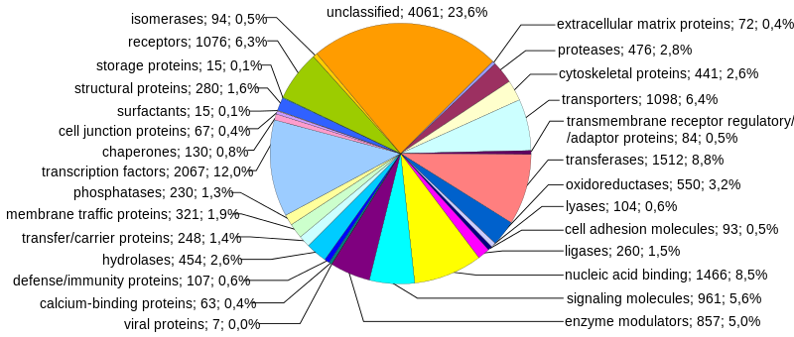
Protein-coding regions

Slide 9
Non-coding Regions
Much of the non-protein-coding regions are made of DNA sequences which are repeated over and over again.
So what does the remaining 98% of the DNA do?

Slide 10
Non-coding Regions
The function of much of it remains unknown, however these are some of the proposed functions:
1. Protection: Some of the repetitive sequence makes up a telomere at the ends of the chromosome. This prevents them from fraying at the ends.

Slide 11
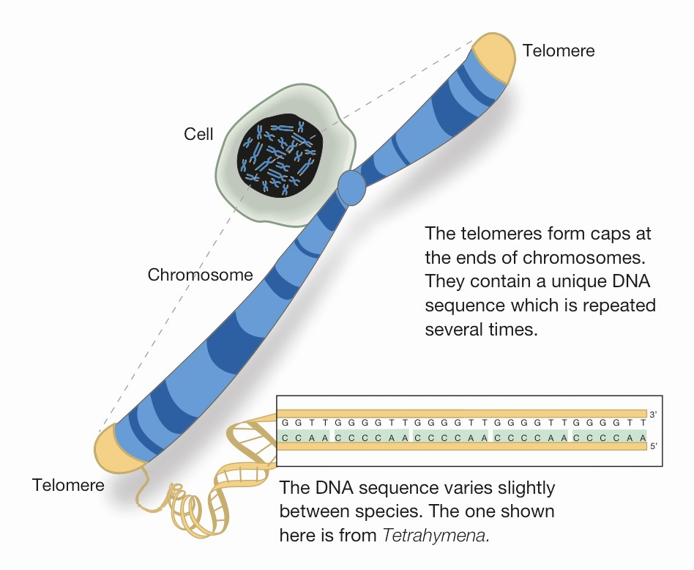

Slide 12
2. Regulation of transcription
RNA polymerase is unable to initiate the transcription process on its own. It needs transcription factors.
Some are activators (help start transcription) and some are repressors (prevent transcription).

Slide 13
Activators are bound to sequences of DNA called regulator sequences. Often these can be at some distance from the coding sequence.
DNA
Activator
RNA polymerase
Regulator sequence
Transcription factors
Promoter
Gene to be transcribed

Slide 14
The DNA must bend to bring the regulator and the activators bound to it in contact with other transcription factors close to the promoter.
Regulator sequence
RNA polymerase ready to start transcription

Slide 15
3. Non-translated forms of RNA
These types of RNA are transcribed, but not translated into proteins:
tRNA
rRNA
RNA fragments
  small nuclear RNA (snRNA) – help with RNA splicing
  micro RNA (miRNA) – help to “silence” genes

Slide 16
The Human Genome Project
https://www.youtube.com/watch?v=AhsIF-cmoQQ

Slide 17
Newspaper Article Task
You are going to write a newspaper article explaining The Human Genome Project to the general public
You should include what it is, why it is important and any other interesting facts that would engage the reader
Remember to use layman terms as many readers will not be Scientists

Slide 18
Success Criteria
I can:
Define the term “genome”
Describe the structure of the genome
Describe the functions of coding and non-coding DNA sequences

Slide 19
Plenary- Editor
Proof read your desk partners newspaper article
Give them editorial tips on how to improve it before it is printed in the newspaper

Slide 20
Starter
Explain what the coding and non-coding regions of DNA sequences do

Slide 21
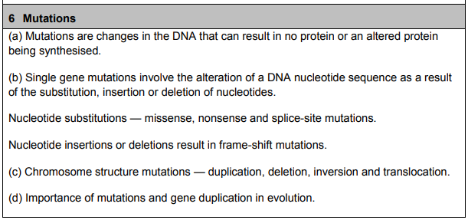
Course Specification

Slide 22
Learning Intention
By the end of this topic I will be able to:
Describe different kinds of single gene mutations and identify them from a diagram
Describe different kinds of chromosome mutations and identify them from a diagram
Understand the importance of mutations for evolution

Slide 23
Success Criteria
I can:
Define the term “mutation”
State the effect of a mutation on the protein produced
Describe three types of single gene mutation
Describe the possible effects of a nucleotide insertion, deletion and substitution

Slide 24
Mutations
Mutations are a change in the structure or amount of an organism’s DNA.
Mutations arise spontaneously and at random

Slide 25
Frequency of mutations
Mutations are rare
In humans it is estimated that there is 1 mutation per 15-30 million base pairs
Mutation rates differ in different genes and different organisms

Slide 26
Types of mutation
Single gene mutations
-substitution
-insertion
-deletion
Chromosome structure mutations
-Duplication
-Deletion
-Inversion
-Translocation

Slide 27
Single gene mutations
These mutations involve a change in one of the base pairs in the DNA sequence of a single gene. Also known as point mutations.
These may occur in the protein-coding sequence or the regulatory sequences which control expression of the gene.

Slide 28
Substitution
One nucleotide in the mRNA is substituted for another different nucleotide
This means the codon will be different and so a different amino acid will be produced
This is called a point mutation.

Slide 29
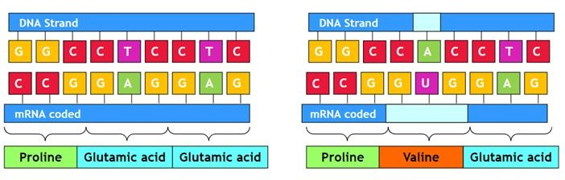
Substitution

Slide 30
Substitution
mRNA
Protein
Met
Gln
Thr
Ser
STOP
mRNA
Protein
Met
Gln
Thr
Ser
STOP

Slide 31
Insertion
A nucleotide is inserted into the mRNA strand
The bases will then all shift along one place
This will result in different codons and therefore different amino acids
It’s called a frameshift mutation

Slide 32
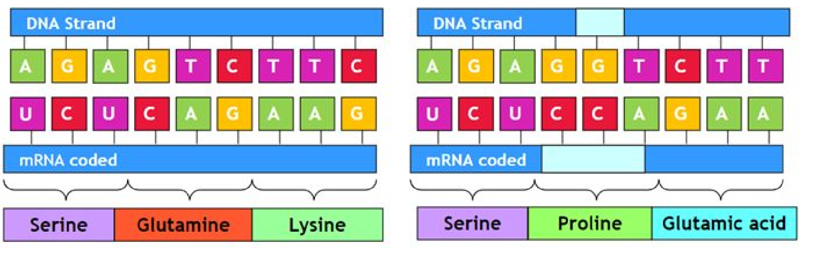
Insertion

Slide 33
Insertion
mRNA
Protein
Met
Gln
Thr
Ser
STOP
mRNA
Protein
Met
Ala
Asp
Ile
Leu

Slide 34
Deletion
One nucleotide in the mRNA is deleted (or removed)
The bases will then all shift along one place
This will result in different codons and therefore different amino acids
This is also a frameshift mutation

Slide 35
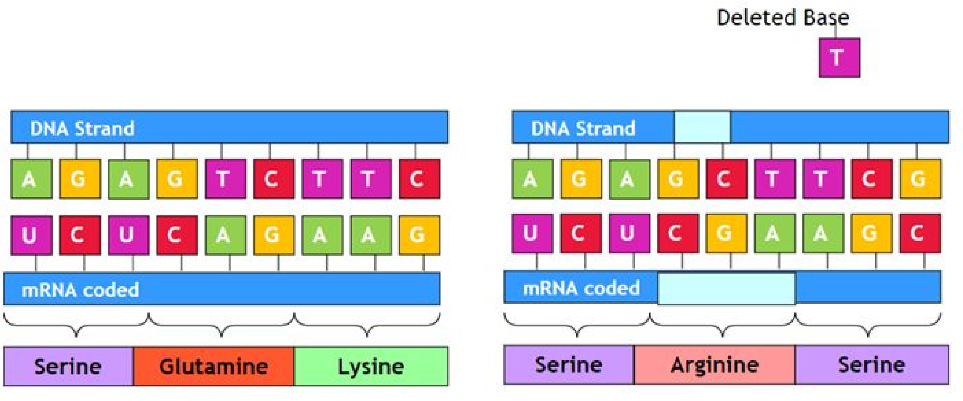
Deletion

Slide 36
Deletion
mRNA
Protein
Met
Gln
Thr
Ser
STOP
mRNA
Protein
Met
Gln
His
Leu

Slide 37
Missence Mutations
Missence mutations result in one amino acid being changed for another
This can result in a non-functional protein or have little effect on the protein

Slide 38
Nonsense Mutations
This results in a premature STOP codon being produced
This results in a shorter amino acid chain and there for a shorter protein

Slide 39
Splice Site Mutations
These result in some introns being retained and / or some exons not being included in the mature transcript
This has an effect later down the line on the amino acids and protein produced

Slide 40
Thalassemia
Intron
Exon
Normal splicing
Abnormal splicing
Normal functional haeomoglobin with 4 oxygen carrying subunits
Haeomoglobin with only 2 oxygen carrying subunits

Slide 41
Frame Shift Mutation
In a frame shift mutation all of the bases are “shifted” along one place
This causes all codons after the deleted or inserted base to be read differently after the mutation
This usually results in a completely different or non-functional protein

Slide 42
Activity Cards
Use your cards to play out different mutations on your mRNA
Try insertion, deletion and substitution mutations
Translate your mRNA into amino acids using your codon chart

Slide 43
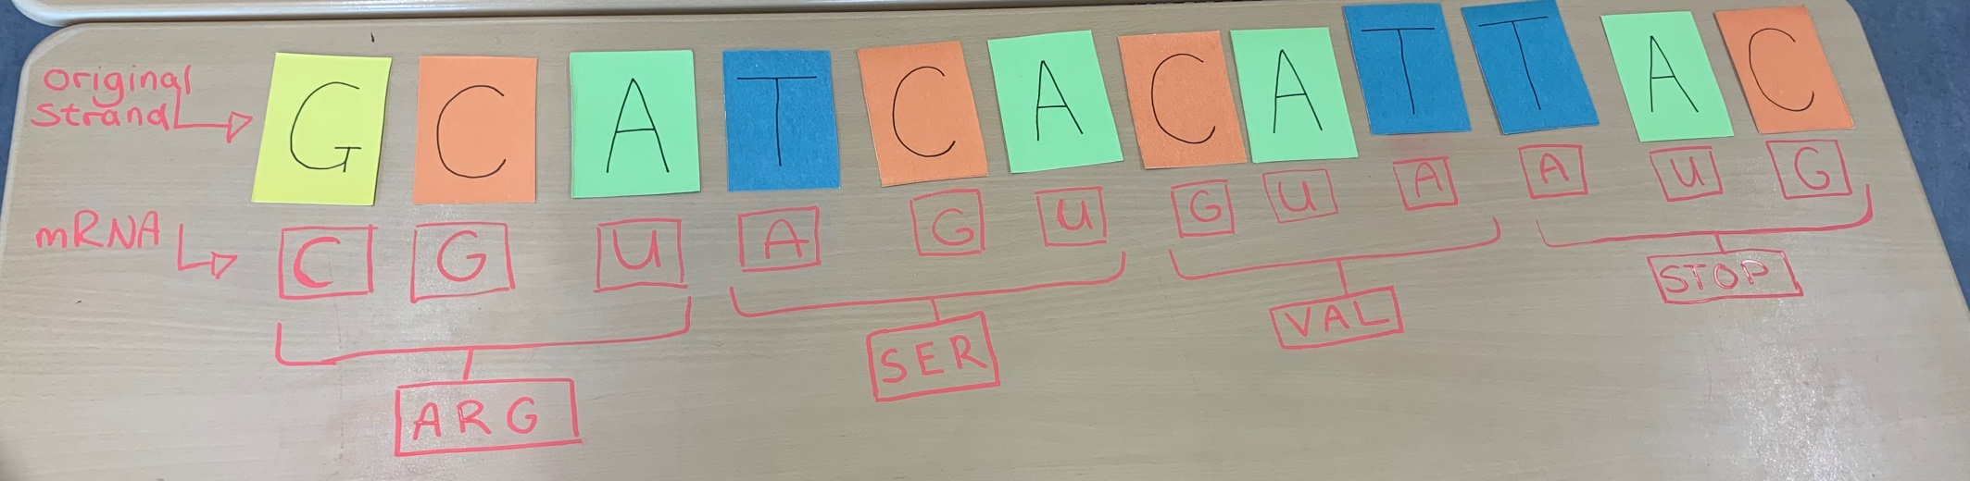
Original

Slide 44
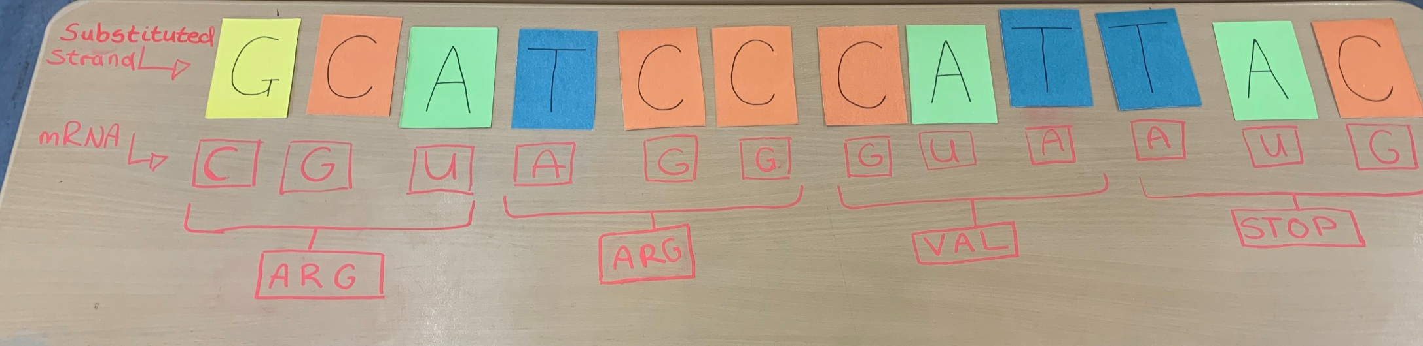
Substitution

Slide 45
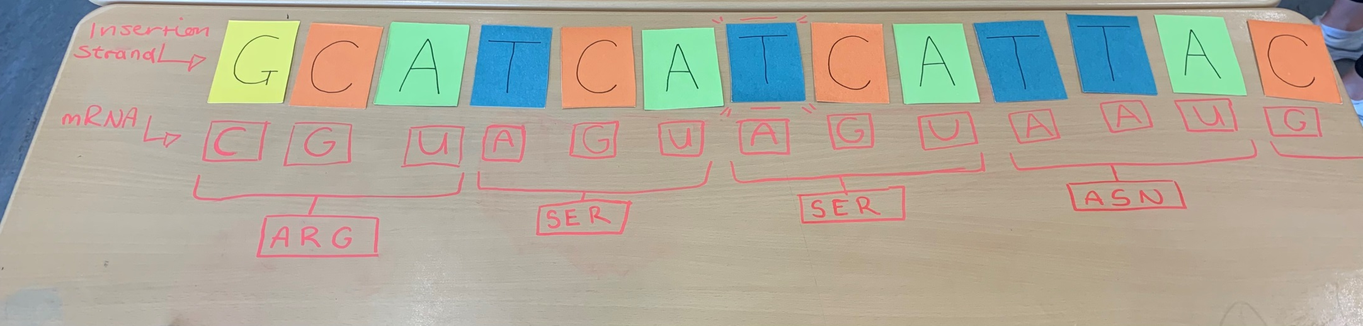
Insertion

Slide 46
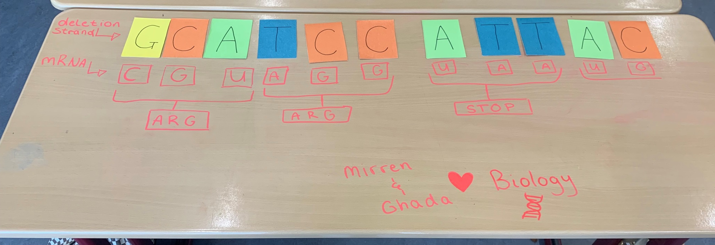
Deletion

Slide 47
Case Study: Sickle cell anaemia
What type of mutation causes this disease?
Are any of the mutations confined to a specific area or ethnic race?
What are the symptoms associated with each mutation?
Are any of the mutations beneficial or are they detrimental?

Slide 48
Plenary
Write a description of each type of mutation:
Insertion, deletion, substitution.
Use the following sequences as your original DNA sequence:
T A G C C G T A T C G T A

Slide 49
Starter
Describe the following:
Missence mutation
Nonsence mutation
Splice Site mutation

Slide 50
Learning Intention
By the end of this topic I will be able to:
Describe different kinds of single gene mutations and identify them from a diagram
Describe different kinds of chromosome mutations and identify them from a diagram
Understand the importance of mutations for evolution

Slide 51
Success Criteria
I can:
Describe and draw the 4 types of chromosome mutation
Explain the importance of duplication in evolution

Slide 52
Chromosome Structure Mutations
Many mutations arise through changes to the chromosome structure or number
As these affect more than one gene these mutations usually have a significant impact on the organism

Slide 53
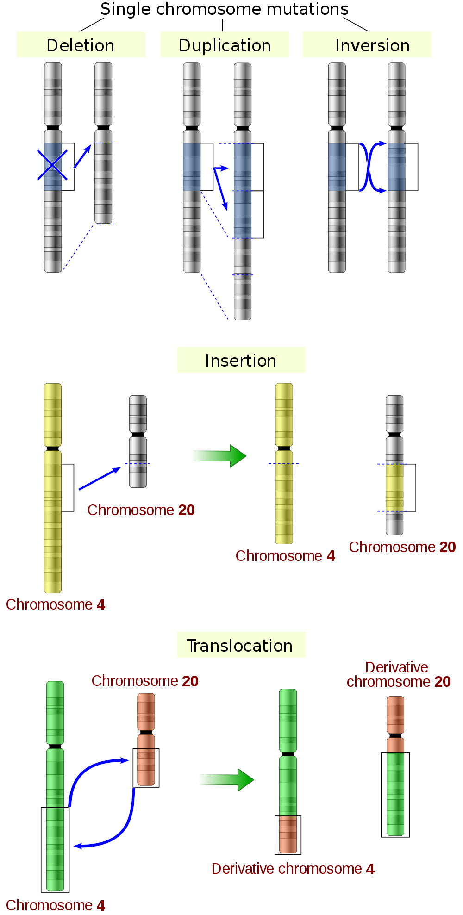
Deletion
A section of the chromosome is removed
Deletion mutations have a drastic effect on the organism – as genes are lost.
e.g. Deletion of part of chromosome 5 leads to Cri du Chat syndrome.

Slide 54
Inversion
Section of the chromosome is reversed
This often results in the formation of non-viable gametes.

Slide 55
Translocation
Where a section of a chromosome is added to a chromosome
This results in problems pairing chromosomes during gamete formation and leads to non-viable gametes.
Non-reciprocal: Reciprocal:

Slide 56
Duplication
This results in a set of genes being repeated from its homologous partner.
Some duplications can be detrimental.
e.g. Duplication of oncogenes is a common cause of cancer.

Slide 57
Evolutionary importance of gene duplication
Allows potential beneficial mutations to occur in the duplicated gene whilst the original gene can still be expressed to produce the protein
The second copy of the gene is free from selection pressure (it can become altered with out affecting the original gene’s function).

Slide 58
Evolutionary importance of gene duplication
This means it can mutate to produce new DNA sequences.
This may confer advantages to the organism and possibly increase it fitness and chances of survival.

Slide 59
Research Activity
Research one of the following human conditions and produce an information leaflet on it:
Cri-du-chat syndrome
Haemophilia A
Chronic Myeloid Leukemia
Turner syndrome
Klinefelter’s
Prader Willi
Angelman
Cystic Fibrosis
BRAC1/2

Slide 60
Sweetie Chromosome
Using gummy bear sweets as your chromosomes you are going to create a stop frame photo animation on the different kinds of chromosomal mutation

Slide 61
Video
https://www.youtube.com/watch?v=mCOMD291oBM

Slide 62
Success Criteria
I can:
Describe and draw the 4 types of chromosome mutation
Explain the importance of duplication in evolution

Slide 63
Plenary
Describe the different types of chromosome mutations

Slide 64
Quiziz
https://quizizz.com/admin/quiz/6153770356bf5c001d56e5c4/higher-biology-16-mutations?source=MainHeader&page=FeaturedPage&searchLocale=&fromSearch=true

