Slide 1
Higher Biology
Unit 3
KA 4 – Animal Welfare

Slide 2
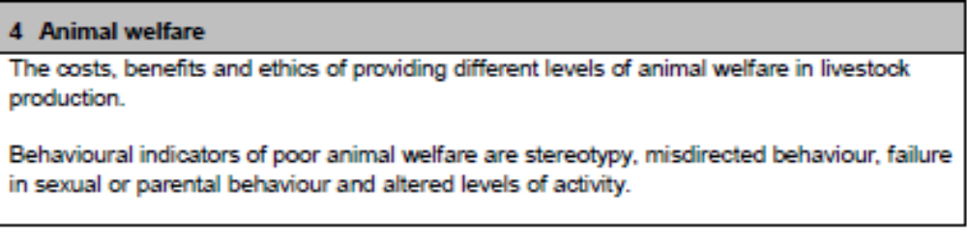
Course Specification

Slide 3
Starter
Can you list four things that animals need to survive?
What else is required to keep animals in containments (e.g. farm or zoo)?

Slide 4
Learning Intention
To learn about the welfare needs of animals in livestock production, zoos and aquariums
To learn about the behaviours that are signs of poor animal welfare

Slide 5
Success Criteria
By the end of this key area, I will be able to:
  Discuss the five freedoms of animal welfare
  Use the five freedoms to evaluate an animal welfare situation
  Discuss the ethics of animal welfare
  Identify indicators of poor animal welfare
  Give examples of enrichment for animals
  Debate the existence of zoos

Slide 6
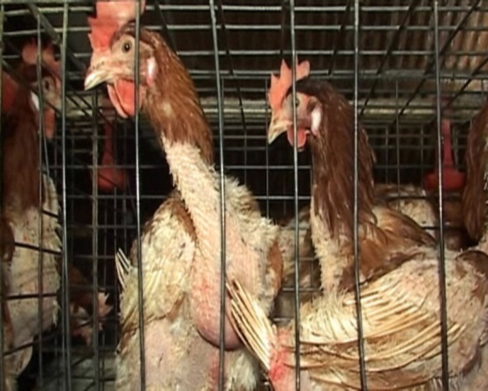
Animal Welfare and food production
The health of an animal impacts on the food production from that animal.
For some time this lead to looking at animal farming in terms of;
  Growth
  Reproduction
  Disease resistance

Slide 7
Animal Welfare
The need for food production has lead to intensive methods that some consider unacceptable
Animal welfare encompasses more than just the basic requirements for life.

Slide 8
Research Task
Research the “5 Freedoms” that animals should have.
HINT: You might find these in the Animal Welfare Act (2006)

Slide 9
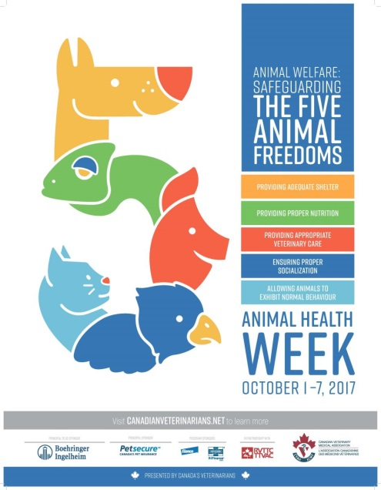
The five freedoms
Proposed in 1979, passed into law 2006
Freedom from hunger and thirst
Freedom from discomfort
Freedom from pain, injury and disease
Freedom from fear and distress
Freedom to express normal behaviour

Slide 10
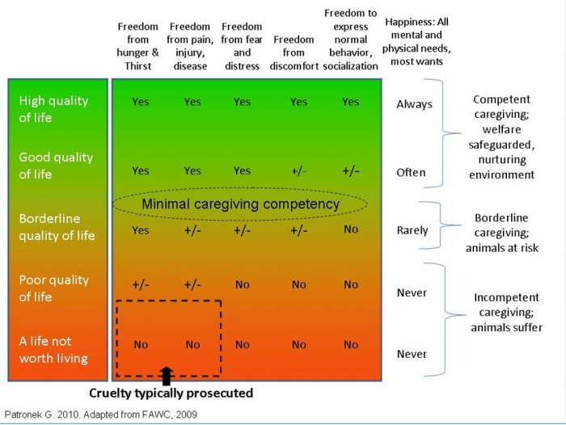
How this can be used – assessing animal care

Slide 11

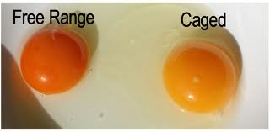

Cost & benefit
There are costs associated with increasing animal welfare e.g. more space
The benefits are in the longer term production and quality of the product from animals with high welfare.

Slide 12
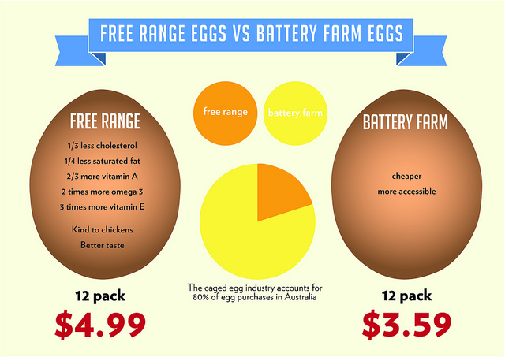

Slide 13
Ethics
An ethical consideration is based on a group consensus of ‘right and ‘wrong’
Since domesticated animals are in our care – there are ethical concerns for their well-being.
In considering animal welfare there is concern for both the physical and mental well-being.
Any welfare concern is also an ethical concern, some ethical concerns (e.g. use of selective breeding) are not welfare concerns.
Notes:
SRUC video of sick pig

Slide 14
Indications of poor welfare
Animals behaviour is a good indicator of their welfare. These include
  Stereotypy
  Misdirected behaviour
  Failure in sexual or parental behaviour
  Altered levels of activity
  This video could be distressing.
Notes:
https://www.youtube.com/watch?v=YuZFzTpcbfY

Slide 15
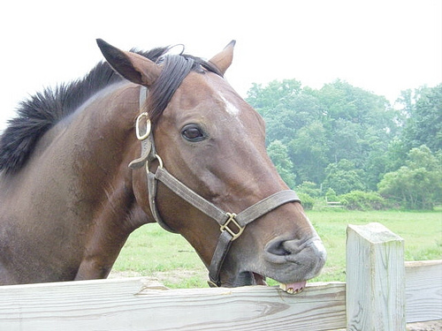
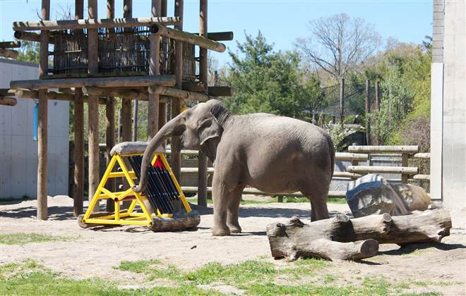
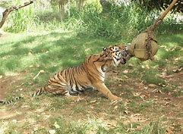
Stereotypy
Repetitive movements such as pacing and chewing are often seen with animals that are in bare and unstimulating environments.
These behaviours are characterised by being
  Persistent
  Repetitive
  Lacking function
In zoos enriching the environment can drastically reduce stereotypy behaviours
Notes:
https://www.youtube.com/watch?v=YuZFzTpcbfY
https://www.youtube.com/watch?v=f6nU40YPums

Slide 16
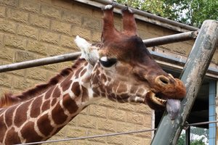

Slide 17
Misdirected Behaviour
Where a normal pattern of behaviour is directed in the wrong way (on itself or on others)
e.g. Feather pecking in chickens with no flooring material (misdirected foraging)
e.g. Sows in farrowing crates will move in a way that would have been nesting behaviour if had access to the materials
Notes:
SRUC videos Sow 1 and 2 for misdirected nesting behaviour
https://www.youtube.com/watch?v=rv_igJGtAlM

Slide 18
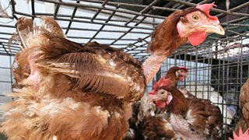

Slide 19
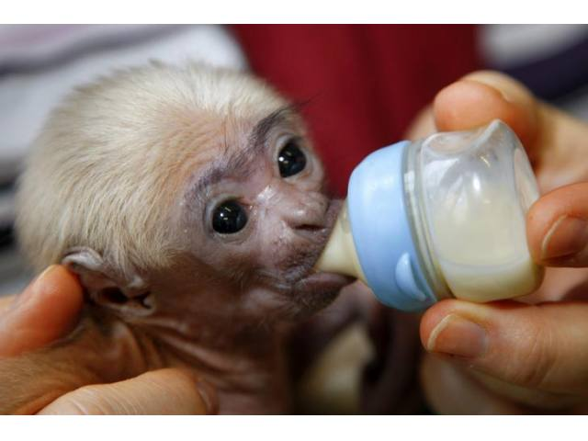
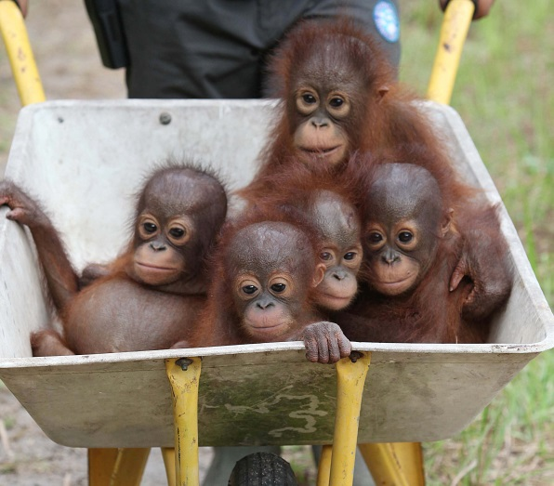
Failure of sexual/parental behaviour
Animals that have poor welfare (especially isolated social animals) can fail to engage in reproductive behaviours, or reject offspring that are born.
Poor parenting can decrease the development (or even survival) of the offspring or may lead to dysfunctional behaviours in the offspring
Notes:
There is a video for the top picture of the monkey being fed – please be aware, it’s a highly significant experiment but it will make you want to weep.
https://www.youtube.com/watch?v=OrNBEhzjg8I

Slide 20
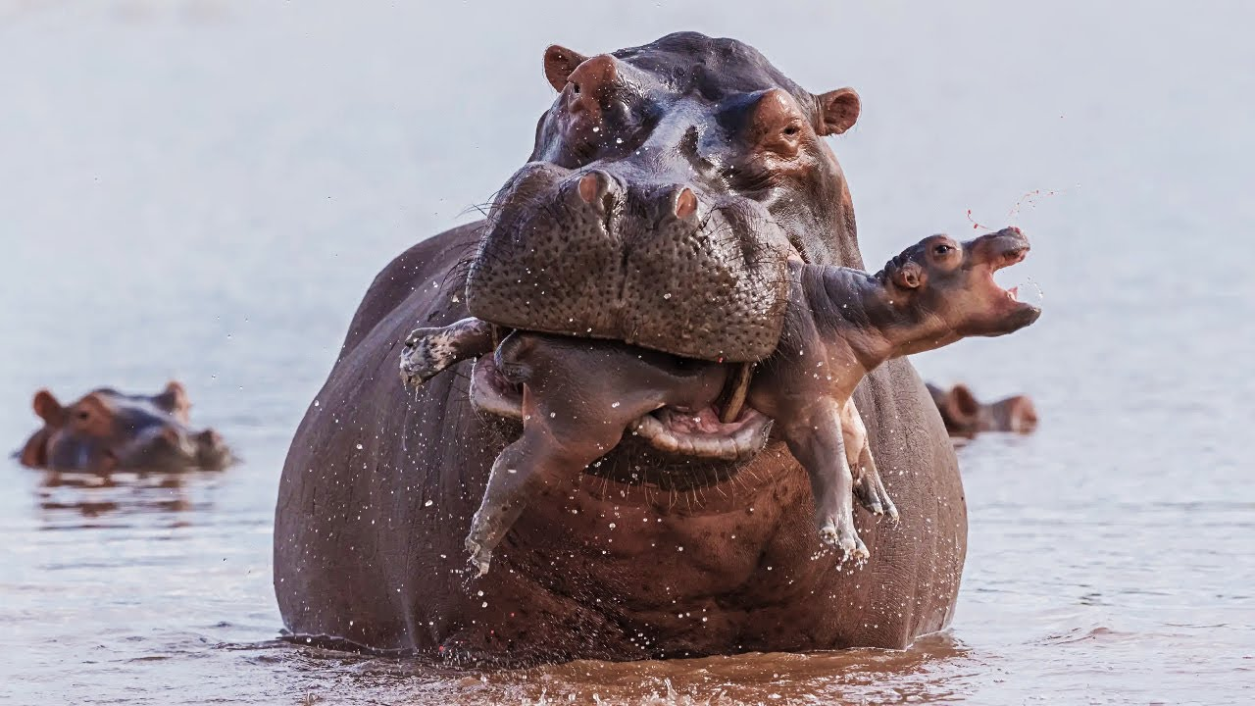

Slide 21
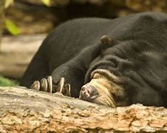
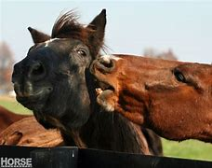
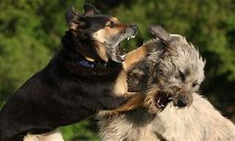
Altered levels of activity
Extremes of activity can be indicators of poor welfare. i.e.
  Hysteria (high levels of activity)
  Apathy (low levels of activity)

Slide 22
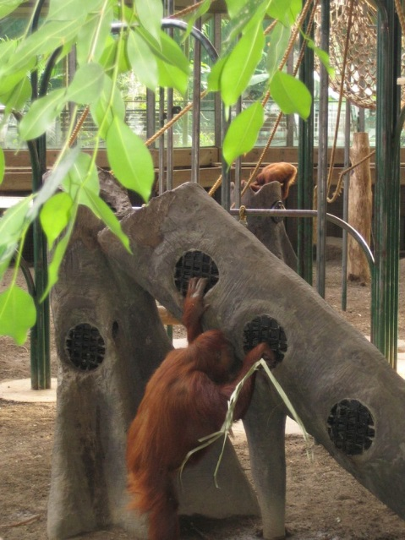
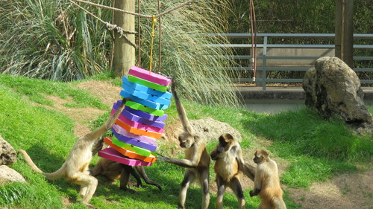
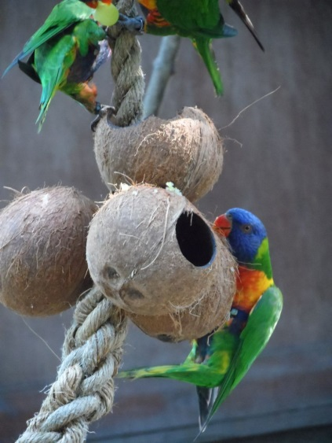
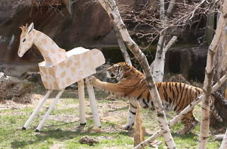
Enrichment
For all of the behaviours enriching the environment so that the animal can access normal behaviours and is suitably stimulated will help their welfare.
This also includes ensuring that the animals have enough other animals with them.
Notes:
https://www.youtube.com/watch?v=c8ZfkoOgGqk
https://www.youtube.com/watch?v=_VPRzyemSAE
https://www.youtube.com/watch?v=ZOVNsY5tiao

Slide 23
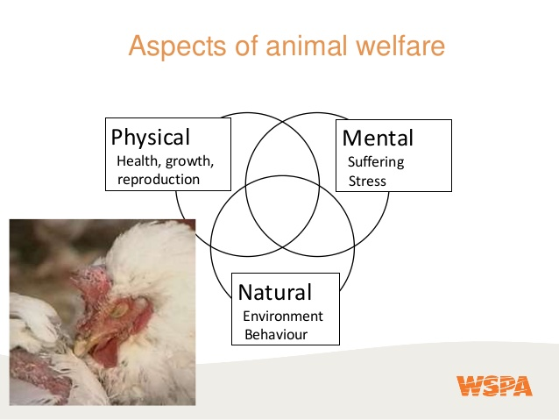
https://www.animalwelfarefoundation.org.uk/education/student-zone/case-studies/#an-inspector-calls

Slide 24
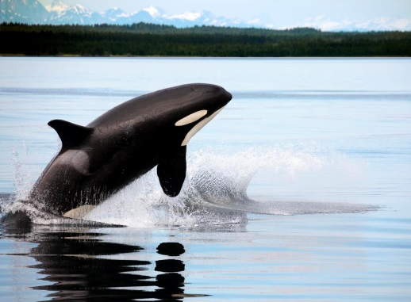
Should zoos exist?
In the term “zoo”, I include aquariums etc.
Notes:
https://www.youtube.com/watch?v=aQDYxTCIVRE
https://www.youtube.com/watch?v=irS_5-eVFUo
https://www.youtube.com/watch?v=XOrPmOXhxo0

Slide 25
Success Criteria
By the end of this key area, I will be able to:
  Discuss the five freedoms of animal welfare
  Use the five freedoms to evaluate an animal welfare situation
  Discuss the ethics of animal welfare
  Identify indicators of poor animal welfare
  Give examples of enrichment for animals
  Debate the existence of zoos

Slide 26

Plenary - quizziz

Slide 27
PPQ
2016 – mcq20, paper 2 q14B
2017 –
2018 –
2019 – mcq22
2022 – MCQ paper 2 q11B 14
2023

Slide 28
Starter
Describe a benefit of intensive farming and free range farming
Describe a cost of intensive farming and free range farming

