Slide 1
Higher Biology
Unit 2
KA 2 – Cellular Respiration

Slide 2
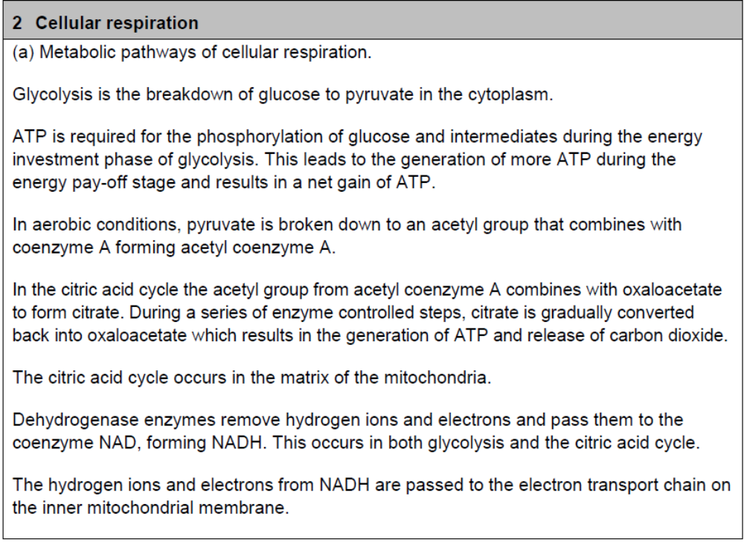
Course Specification

Slide 3
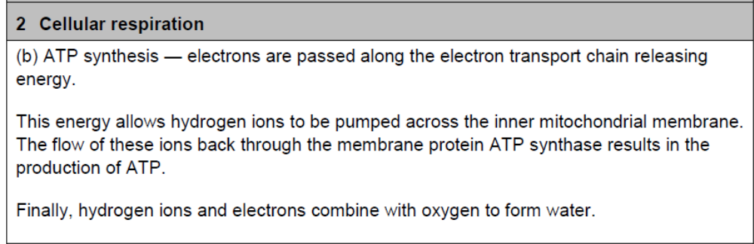
Course Specification

Slide 4
Starter
From your knowledge from National 5 Biology:
  Write out the equation for aerobic respiration
  What is the difference between aerobic respiration and fermentation?
  Why does a cell perform aerobic respiration?

Slide 5
Learning Intention
I will:
  Understand the processes of glycolysis and the citric acid cyle

Slide 6
Success Criteria
I can:
  Explain the importance of respiration to living cells
  Describe the role that ATP play in the transfer of energy
  Describe the process of glycolysis
  State what is meant by the energy investment and pay off in glycolysis
  Describe the citric acid cycle
  Explain the need for hydrogen acceptors and state where they are used.
  Explain the role of dehydrogenase enzymes
  Explain the role of NAD

Slide 7
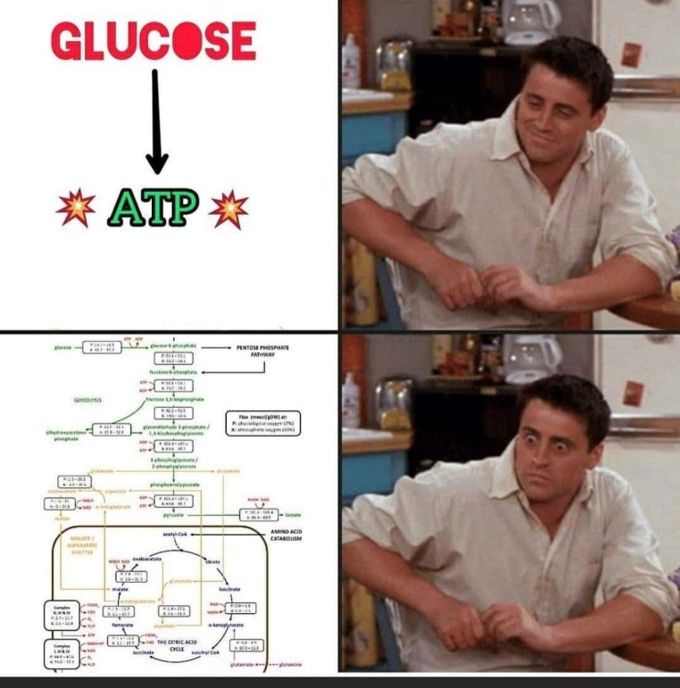

Slide 8
The chemistry of respiration
There are 3 sets of reactions in cellular respiration that release the energy contained in food, by oxidation.
Glycolysis
The citric acid cycle
The electron transport chain

Slide 9
Respiration
During respiration, glucose is gradually broken down and hydrogen released at various stages along the pathway.
By passing hydrogen on, the cell is able to make ATP – the energy the cell uses for all its activities .

Slide 10

ATP (Adenosine triphosphate)
ATP is essential to biological systems as it is the link between reactions that release energy (catabolic) and those that use energy (anabolic).

Slide 11
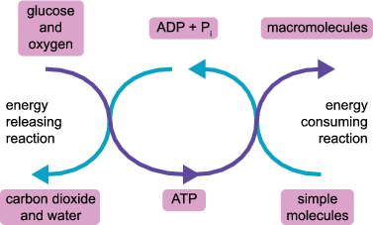
ATP = Energy Currency
ATP is ‘spent’ during cellular work such as muscular contraction or the formation of proteins, and is 'banked' or stored when glucose is broken down during cellular respiration.
Coupling of reactions

Slide 12
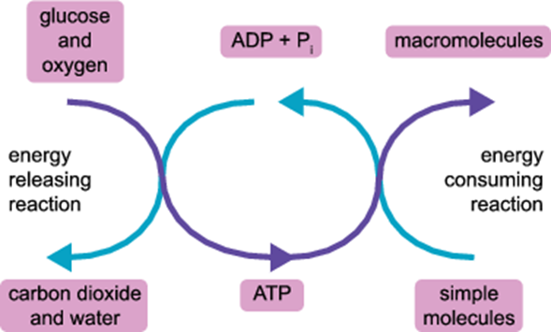

Slide 13
ATP – Amoeba sisters video
https://www.youtube.com/watch?v=23ZzI6WZS28

Slide 14
How is ATP made?
ATP comes from the breakdown of food – usually glucose
Remember the equation
Glucose + Oxygen ---- > ATP + carbon dioxide + water
In the presence of oxygen, glucose is broken down in to energy (ATP), carbon dioxide and water.

Slide 15
ATP
When glucose is broken down in a cell, it releases energy which is used to produce ATP.
ATP is made from joining a phosphate to ADP
The end phosphate bond contains a lot of energy which is released when broken off. This is used by cells to do work and carry out anabolic reactions

Slide 16
ATP cycling
ATP breakdown and production is reversible.

Slide 17
ATP’s other role
ATP also has the role of carrying out phosphorylation reactions in cells.
Phosphorylation means adding phosphates to things.
This is an enzyme controlled process.
  during glycolysis, ATP is broken down to ADP + P.
  The phosphate group is used to phosphorylate glucose.

Slide 18
What is Glycolysis
Glycolysis occurs in the cytoplasm.
It involves a molecule of glucose being broken down to form pyruvate.
This takes place as a series of enzyme controlled steps.
Those in the first half of the chain make up the energy investment phase, while the second half is known as the energy payoff phase

Slide 19
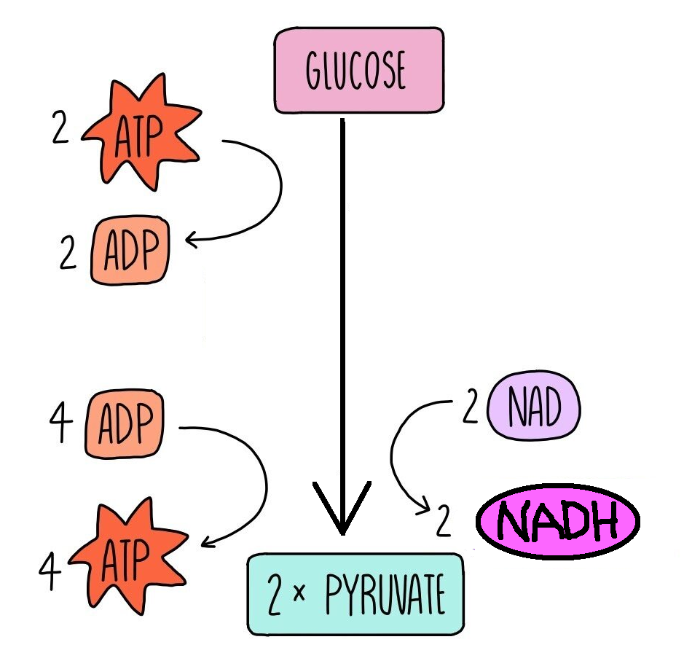
To start the process off, energy from two ATP molecules is needed.
This can be thought of as an energy investment phase where ATP is used to phosphorylate glucose in glycolysis.
The series of reactions eventually produces four ATP molecules, so there is a net gain of two ATP from glycolysis (energy pay-off stage).

Slide 20
Dehydrogenase enzymes remove hydrogen ions and high energy electrons that are passed to a co-enzyme called NAD which is reduced to form NADH.
Later on the NADH will be used to produce ATP

Slide 21
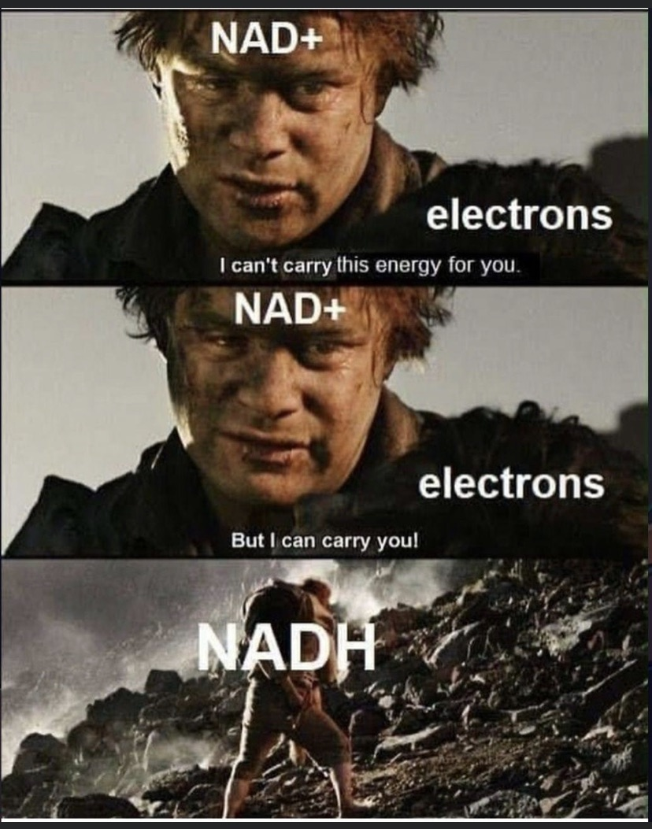

Slide 22
Success Criteria
I can:
  Explain the importance of respiration to living cells
  Describe the role that ATP play in the transfer of energy
  Describe the process of glycolysis
  State what is meant by the energy investment and pay off in glycolysis
  Describe the citric acid cycle
  Explain the need for hydrogen acceptors and state where they are used.
  Explain the role of dehydrogenase enzymes
  Explain the role of NAD

Slide 23
Plenary
Describe the role of ATP in a cell

Slide 24
Starter
Draw a diagram of Glycolysis
Explain what is happening

Slide 25
Learning Intention
I will:
  Understand the process of the citric acid cycle

Slide 26
Success Criteria
Describe the citric acid cycle
Explain the need for hydrogen acceptors and state where they are used

Slide 27
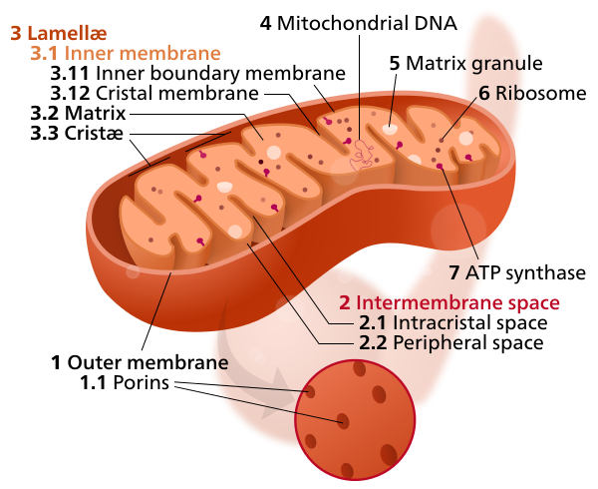
Citric acid cycle
From N5 you should know that in the presence of oxygen, pyruvate can continue to be broken down in the MITOCHONDRIA of the cell

Slide 28
Citric acid cycle
The fluid filled matrix contains the enzymes involved in the Citric Acid Cycle reactions.

Slide 29
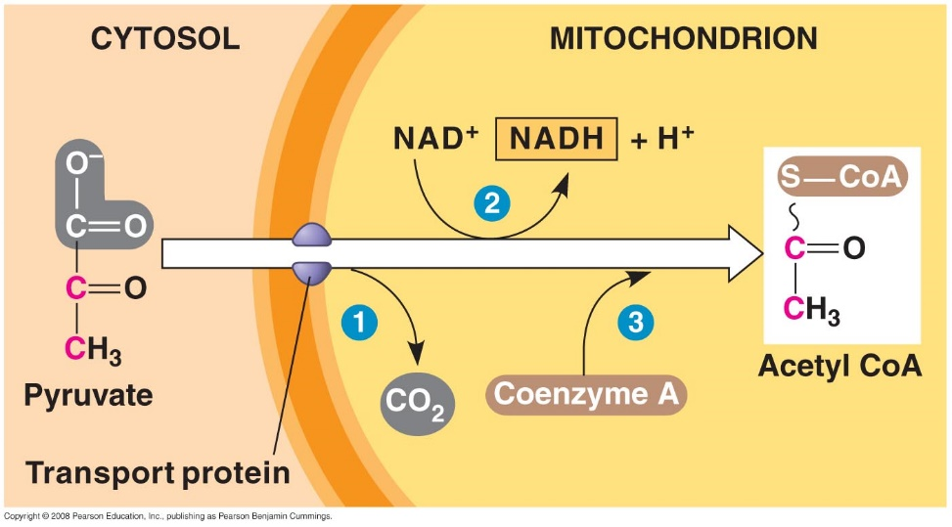
Citric acid cycle
Pyruvate diffuses from the cytoplasm to the mitochondria.
Once inside the mitochondria, a carbon and two oxygen atoms are removed, forming carbon dioxide as a waste.
The molecule that remains is a 2-carbon acetate molecule.

Slide 30
Citric acid cycle
When carbon dioxide is removed from pyruvate to make acetate, extra high energy electrons are produced.
NAD+ captures these electrons and attracts H+ to balance the charge, forming a molecule of NADH.
Notes:
In addition to needing to regenerate NAD+, cells also have problems with controlling the movement of acetate molecules. Acetate molecules are small enough to diffuse away or evaporate (evaporating acetate molecules are what give vinegar its distinctive smell). To prevent this, cells covalently bond acetate molecules to a large carrier, called coenzyme A, making a complex is called acetyl-CoA.

Slide 31
Citric acid cycle
Because the acetate molecule produced from pyruvate is so small and can easily diffuse away, co-enzyme A is attached to it forming Acetyl CoA.
This is now ready for the Citric acid cycle.

Slide 32
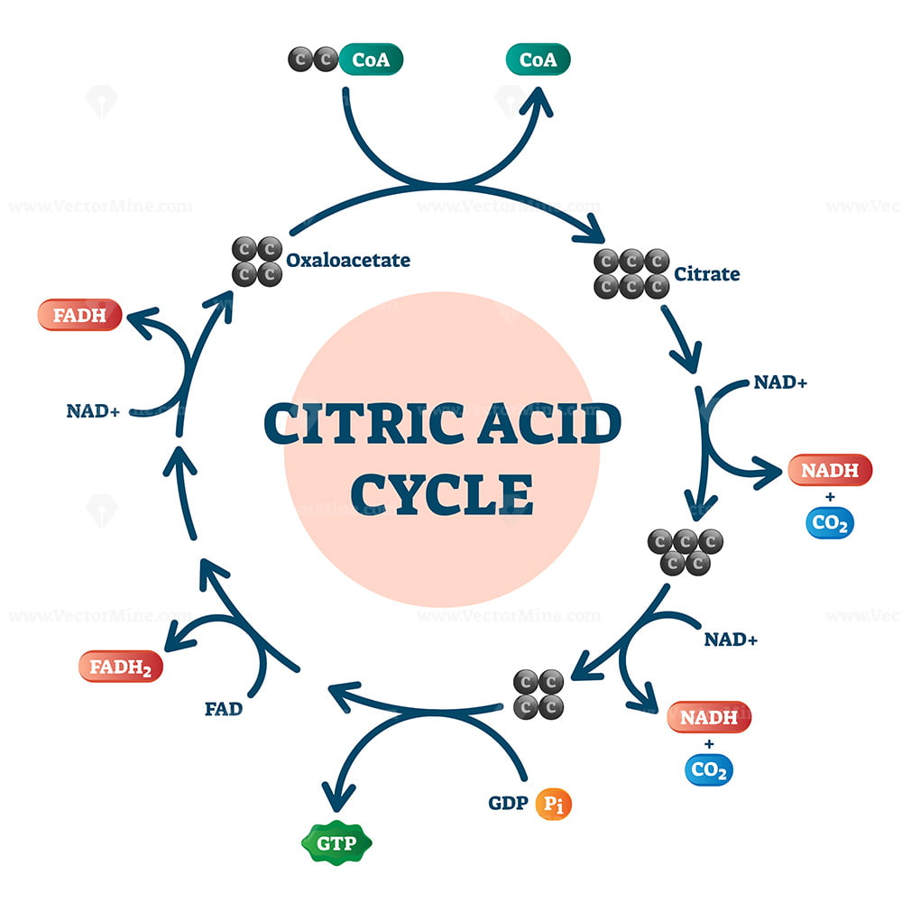
Citric acid cycle
Each acetyl CoA (2C) combines with oxaloacetate (4C) to form a molecule called citrate (6C).
Citrate then goes through a series of enzyme-catalysed reactions back to oxaloacetate.
As each carbon is lost from the citrate molecule a carbon dioxide molecule and hydrogen ions are released

Slide 33
Citric acid cycle
Hydrogen ions and high energy electrons become bound to to NAD to form NADH.
NADH will be used in the next stage for ATP production
FAD not needed for Higher

Slide 34


Citric acid cycle
intermediate
NAD+
Draw this in your jotter then fill in the boxes with the labels on the left
CO2
NADH
intermediate
CO2
intermediate
NAD+
ATP
ADP + Pi
NADH
Oxaloacetate
Acetyl CoA
CO2
Pyruvate
NADH
NAD+
NAD+
NADH
Citrate
FADH2
FAD

Slide 35
Citric acid cycle
Pyruvate
NAD+
CO2
NADH
Acetyl CoA
CO2
Citrate
ATP
NAD+
ADP + Pi
NADH
Oxaloacetate
intermediate
CO2
NADH
NAD+
NAD+
NADH
intermediate
intermediate
FADH2
FAD

Slide 36
Success Criteria
Describe the citric acid cycle
Explain the need for hydrogen acceptors and state where they are used

Slide 37
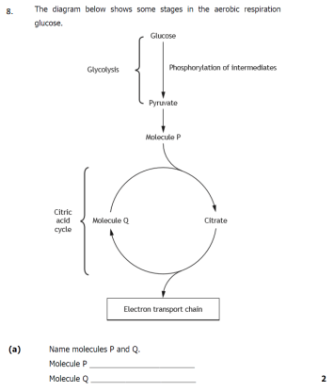
Plenary

Slide 38
Starter
What happens to the carbon dioxide that is produced in the citric acid cycle?
What is the molecule produced when oxaloacetate combines with acetylCoA?
Does the citric acid cycle require oxygen?
Where does the Citric Acid Cycle take place?
What is NAD?

Slide 39
Learning Intention
I will:
  Understand the process of the electron transport chain

Slide 40
Success Criteria
Describe the processes in the electron transport chain
Describe the synthesis of ATP
Explain the role of dehydrogenase enzymes
Explain the role of NAD

Slide 41
Electron Transport Chain
The inner membrane is folded in to many cristae which provide a large surface area.
On the inner membrane the reactions of the electron transport chain occur.

Slide 42
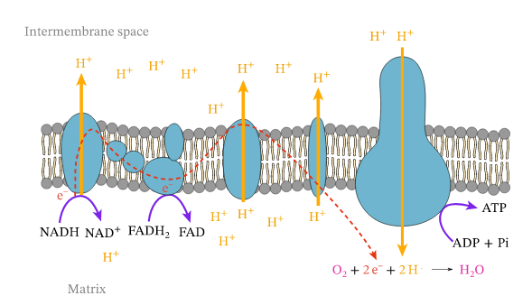
The Electron Transport Chain
The ETC is a series of proteins in the inner mitochondrial membrane
All the Hydrogen ions and electrons that have been transferred to NAD are passed to the ETC.

Slide 43
The Electron Transport Chain
Within the ETC, the H ions and electrons now separate with the high energy electrons cascading down the ETC and releasing their energy

Slide 44
The Electron Transport Chain
The electrons are used to pump Hydrogen ions across the mitochondrial membrane.
The return flow of these H ions rotates part of the membrane protein ATP synthase.
ATP synthase is an enzyme which catalyses the synthesis of ATP

Slide 45
The Electron Transport Chain
Oxygen is the final electron acceptor, which combines with H ions and electrons forming water.

Slide 46
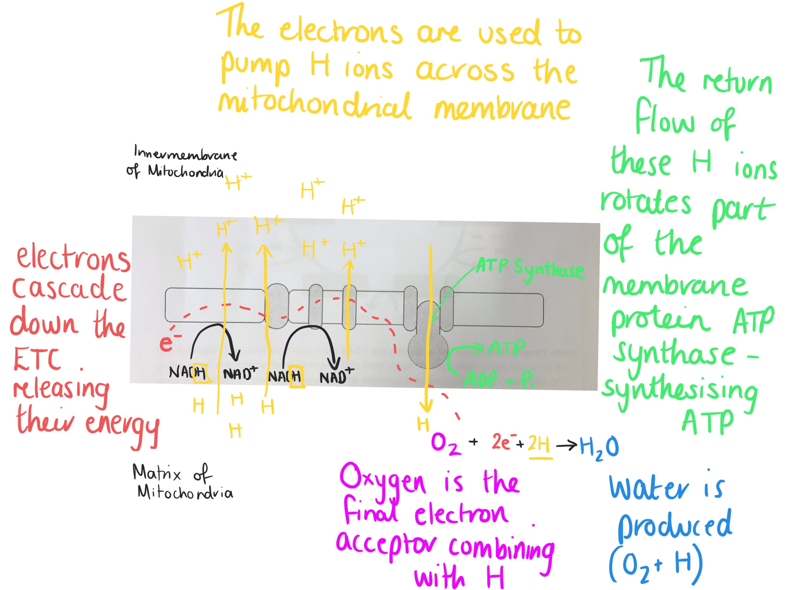

Slide 47
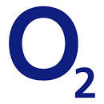
Why is oxygen needed?
Without oxygen, the Citric Acid Cycle and ETC cannot function
Oxygen is needed to break down pyruvate to yield 36ATP
With 2 ATP from glycolysis (which doesn’t require O2, the yield from one glucose molecule oxidised is 38ATP

Slide 48
Success Criteria
Describe the processes in the electron transport chain
Describe the synthesis of ATP
Explain the role of dehydrogenase enzymes
Explain the role of NAD

Slide 49
Plenary
Draw and Annotate a diagram of aerobic respiration including glycolysis, the citric acid cycle and the electron transport chain

Slide 50
Starter
What enzyme is required to produce ATP?
What is the final electron acceptor of hydrogen?
What do the high energy electrons in the ETC do?

Slide 51
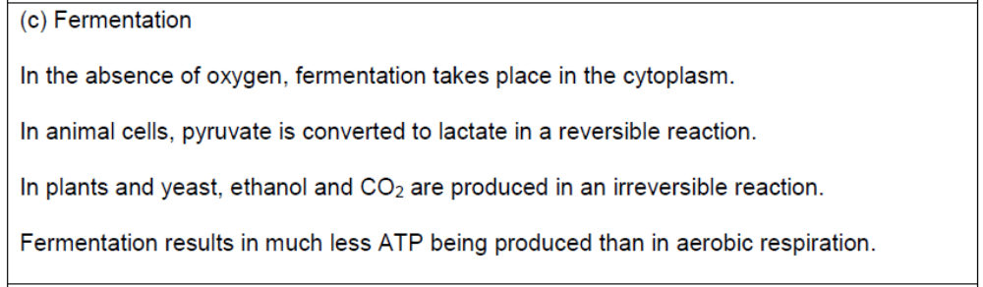
Course Specification

Slide 52
Learning Intention
I will:
  Understand the fermentation pathway in animals, plants and yeast

Slide 53
Success Criteria
I can:
  Give the pathway for fermentation in animal cells
  Give the pathway of fermentation in plant and yeast cells
  Compare the total ATP produced as a result of the respiration and fermentation pathways

Slide 54
Fermentation – Animal cells
Glucose Pyruvate Lactate
Oxygen debt builds up
Oxygen debt repaid
The process of fermentation in animal cells is reversible. Fermentation take place in the cytoplasm.

Slide 55
Fermentation – Plant and Yeast Cells
Glucose Pyruvate Ethanol and Carbon Dioxide
The process of fermentation in plant and yeast cells is irreversible. Fermentation take place in the cytoplasm.

Slide 56
Fermentation
Because the citric acid cycle and the electron transport chain are unable to take place in fermentation, fermentation produces only the net gain of 2 ATP
It is much less efficient than aerobic respiration in producing ATP.

Slide 57
Uses of ATP
ATP is used to transfer energy to cellular process which require energy.
Can you name three processes which require energy?
https://www.youtube.com/watch?v=eJ9Zjc-jdys
https://www.youtube.com/watch?v=YbdkbCU20_M

Slide 58
Success Criteria
I can:
  Give the pathway for fermentation in animal cells
  Give the pathway of fermentation in plant and yeast cells
  Compare the total ATP produced as a result of the respiration and fermentation pathways

Slide 59
Plenary
https://quizizz.com/admin/quiz/5fd33d1f4bf3dd001bf65aea/higher-biology-u2-ka2-cellular-respiration?term=Higher%20Biology%20U2&sortKey=_score&searchLocale=

Slide 60
Essay Questions
2017 Higher Biology Paper
Question 15 A (essay) – 7 marks
2019 Higher Biology Paper
Question 3A (mini essay) – 4 marks
2022 Higher Biology Paper
Question 6 - 4 marks

