Slide 1
Higher Biology
Unit 2
KA 5 – Metabolism in Adverse Conditions

Slide 2
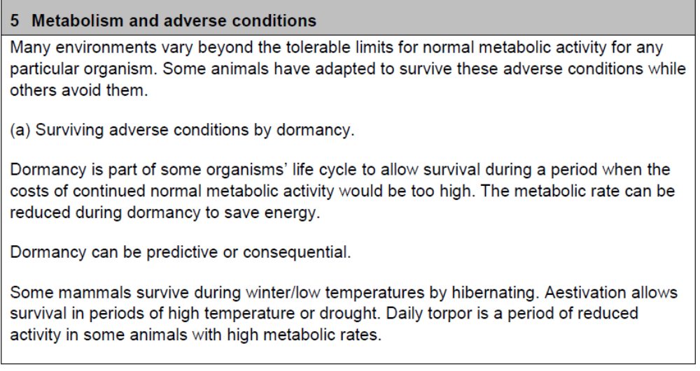
Course Specification

Slide 3
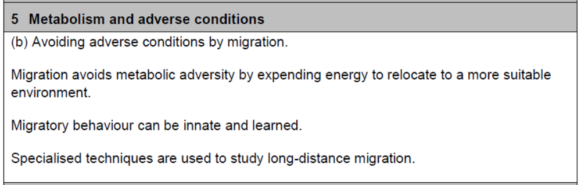
Course Specification

Slide 4
Starter
Can you think of ways in which animals survive or avoid harsh or adverse conditions in the wild?

Slide 5
Learning Intention
By the end of this topic you should be able to:
Explain why organisms avoid adverse conditions and give examples of how they do this
Understand and define the terms dormancy, hibernation, aestivation and daily torpor

Slide 6
Success Criteria
I can:
Explain what is meant by the tolerance of an organism
Give definitions for dormancy, hibernation, aestivation and daily torpor
Give examples of predictive and consequential dormancy
Describe the benefits of migration
Research techniques used to track migration
Describe the innate and learned influences on migration

Slide 7
Surviving Adverse Conditions
Many environments vary beyond tolerable limits for normal metabolic activity for any particular organism
Adverse conditions can include extreme temperatures or lack of water
The normal metabolic rate of an organism can be costly in these conditions
In order to survive, metabolic rate is reduced

Slide 8
Dormancy
The development of an organism is temporarily suspended, minimising metabolic activity and therefore saving energy, until the environmental conditions improve

Slide 9
Dormancy
Dormancy is part of some organisms’ lifecycle
There are two types of dormancy:
Predictive dormancy
Consequential dormancy

Slide 10
Dormancy
Predictive Dormancy
Consequential Dormancy
An organism enters a dormant phase before the onset of adverse conditions e.g. decreasing temperature or day lengths can be used as cues
An organism enters a dormant phase after the adverse conditions have arisen

Slide 11
Examples of Dormancy
Hibernation:
used by many organisms to escape cold weather conditions and scarce food supplies
It is a period of long term inactivity
Normal body functions of an organism change dramatically during hibernation e.g. the heart rate of a jumping mouse falls from 600 beats per minute to 30 beats per minute

Slide 12
Examples of Dormancy
Aestivation:
allows survival in periods of high temperature or drought
e.g. the garden snail becomes dormant until the moisture levels rise again

Slide 13
Examples of Dormancy
Daily Torpor:
a short period (e.g. part of a day) of reduced activity in organisms with high metabolic rates. It involves a reduction in heart rate and breathing rate
e.g. house mice are active during the night and experience torpor through the day when it would be dangerous for them to be out in the open foraging for food

Slide 14
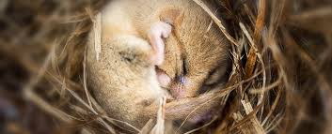
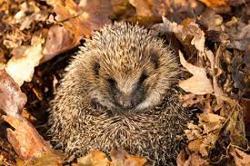
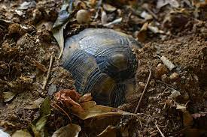
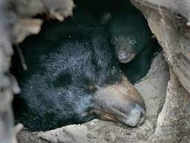
What is the benefit of dormancy?
Dormancy allows an organism to save energy

Slide 15
Hibernation of the Black Bear
https://www.youtube.com/watch?v=8o_qPu-3aEg

Slide 16
Hibernation of a Hedgehog
https://www.youtube.com/watch?v=NABnqClvlG8

Slide 17
Research Task
Use the internet for 20 minutes to find examples of organisms who have dormancy (hibernation, aestivation and daily torpor) as part of their lifecycle.
Create a short fact file style notes in your jotter
You can then swap with your peers and read about different animals

Slide 18
Did you find any of these?
Hedgehogs
Bears
Squirrels
Snails
Worms
Dormice
Organisms don’t always fall into strict categories of dormancy, they can sometimes overlap

Slide 19
Avoiding Adverse Conditions
Many animals use behavioral strategies to avoid adverse conditions
The main technique is migration

Slide 20
Migration
Migration avoids metabolic adversity by expending energy to relocate to a more suitable environment, which is an advantage
The expenditure of energy to relocate is a disadvantage to the organism in the short term but is beneficial in the long term
Organisms that migrate include swallows and whales

Slide 21
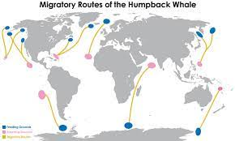
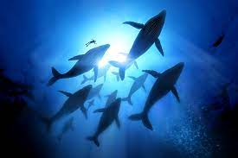
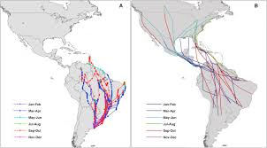
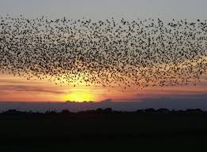
Notes:
Image from Scholar.

Slide 22
Migration
Migratory behaviour is thought to be influenced by both innate and learned behaviour
Innate behaviour is inherited from parents to offspring and is likely to be the biggest
influence on successful migration
Learned behaviour is gained by experience. It may come from parents or other members of a social group

Slide 23
Whale Migration Video
https://www.youtube.com/watch?v=w3l1mA3GHCw

Slide 24
Migration of Geese
https://www.youtube.com/watch?v=5QAjfH05IUE

Slide 25
Migration of Turtles
https://www.youtube.com/watch?v=tWmSYazdZR4

Slide 26
Migration Research Activity
Reasons for migration
Triggers for migration
Types of migration
Surviving migration
Problems with defining migration
Examples of organisms that migrate
Notes on genetic control of migratory behaviour in blackcaps

Slide 27
Techniques
Early methods included tagging with capture and release techniques
Radio tags that can be followed by VHF receivers
Satellite tracking
Leg rings

Slide 28
Facts of interest
The longest insect migration is the monarch butterfly. It travels up to 4,750km in the autumn.
The rarest migrant is the Amsterdam albatross. There are only 70-80 adults in the world.
The largest migrant is the blue whale. It reaches a length of 24-27m.

Slide 29
Facts of interest
The longest recorded journey in water is a leatherback turtle, which travelled 20,558km in 647 days.
The highest migration is the bar-headed goose that can reach up to 9,000m altitude.

Slide 30
Success Criteria
I can:
Explain what is meant by the tolerance of an organism
Give definitions for dormancy, hibernation, aestivation and daily torpor
Give examples of predictive and consequential dormancy
Describe the benefits of migration
Research techniques used to track migration
Describe the innate and learned influences on migration

Slide 31
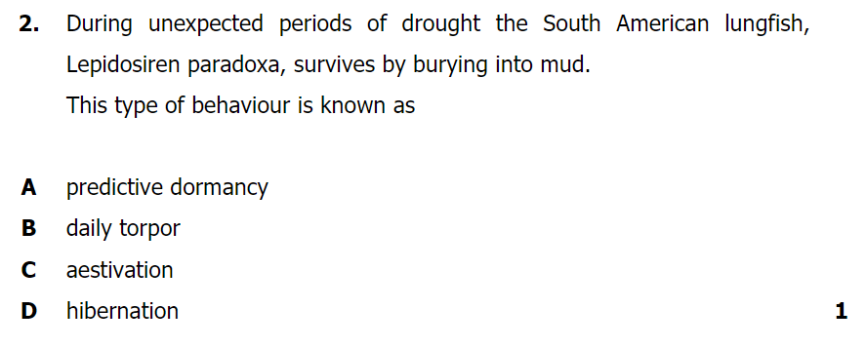
Plenary

