Slide 1
Higher Biology
Unit 3
KA 7 – Components of Biodiversity

Slide 2
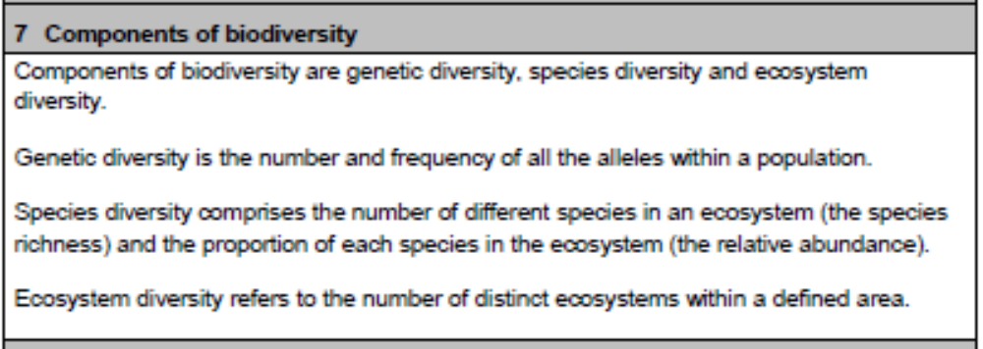
Course Specification

Slide 3
Starter
Describe the term “biodiversity”

Slide 4
Learning Intention
By the end of this topic I will be able to:
List the three measurable components of biodiversity
Explain why each component is important

Slide 5
Success Criteria
I can:
Explain what is meant by genetic diversity, species diversity and ecosystem diversity
Gives reasons as to why each of these are important

Slide 6
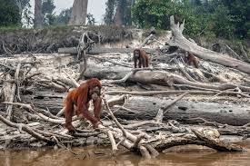
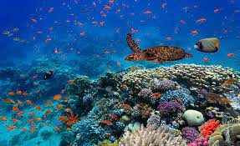
Biodiversity
The total variation that exists among all living things on Earth (total number complexity of structure and genetic variation)

Slide 7
Biodiversity
https://www.youtube.com/watch?v=GlWNuzrqe7U
Notes:
Biodiversity- David Attenbourgh

Slide 8
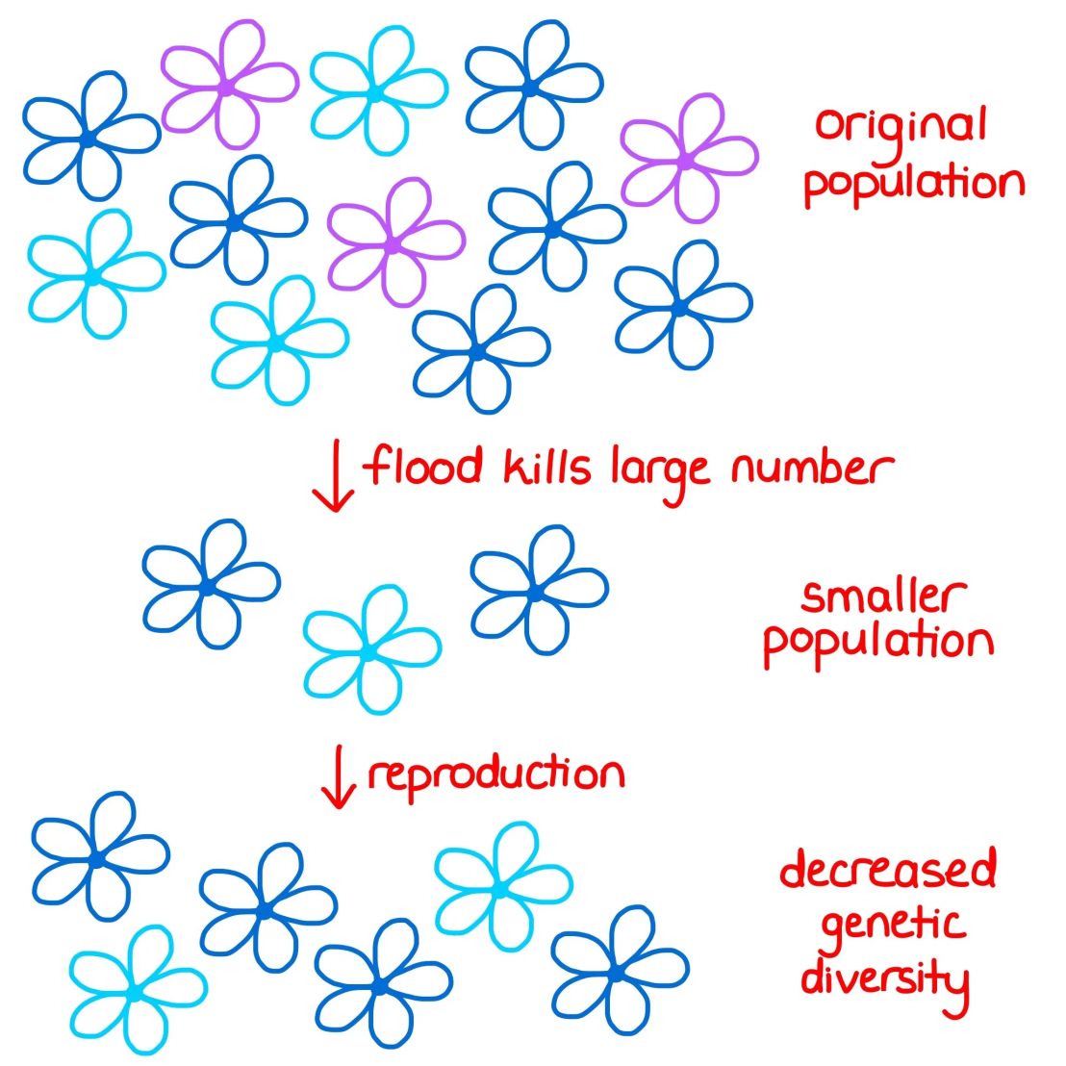
Genetic Diversity
The number and frequency of all the alleles within a population

Slide 9
Genetic Diversity
If one population is wiped out or dies out then the species may have lost some of its genetic diversity, this may limit the ability of the species to adapt to changing environments.

Slide 10
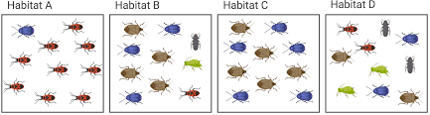
Species Diversity
The number of different species in an ecosystem (the species richness) and the proportion of each species in the ecosystem (the relative abundance)

Slide 11
Species Diversity
A community with a dominant species has a lower species diversity than one with the same species richness but no particularly dominant species

Slide 12

Ecosystem Diversity
The number of distinct ecosystems in a defined area

Slide 13
Ecosystem Diversity
Biogeography is the study of the geographic distribution of plants, animals, and other forms of life.
It is concerned not only with habitation patterns but also with the factors responsible for variations in distribution

Slide 14
Success Criteria
I can:
Explain what is meant by genetic diversity, species diversity and ecosystem diversity
Gives reasons as to why each of these are important

Slide 15
Plenary
Go to the National Biodiveristy Network website and look at the data available for your local area. Compare this to somewhere else in the uk
https://nbn.org.uk/

