Slide 1
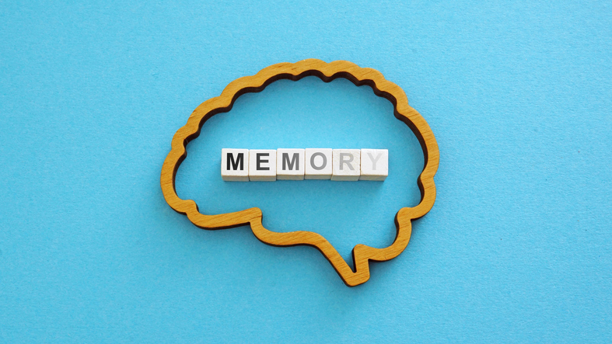
Higher Human Biology
M I S S M C B R I D E
3.3 Memory

Slide 2
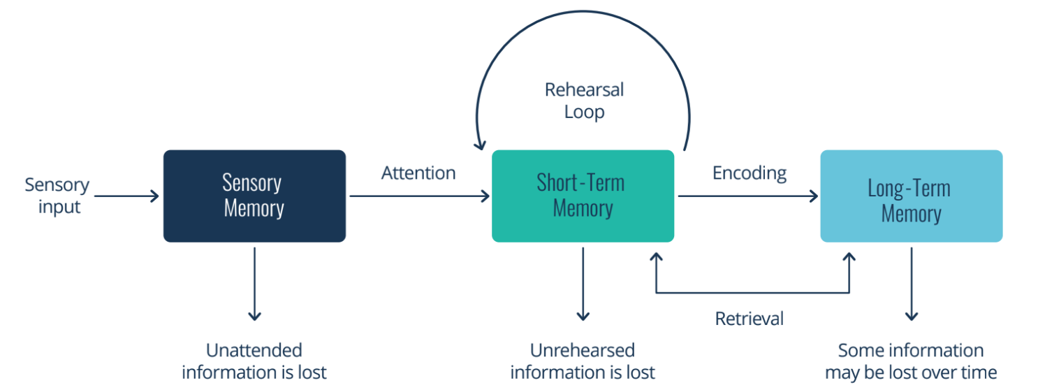
M E M O R Y
Memory involves:
Encoding – taking in information
Storage – keeping information over time
Retrieval – recalling information when needed
Memories include past experiences, knowledge and thoughts.

Slide 3
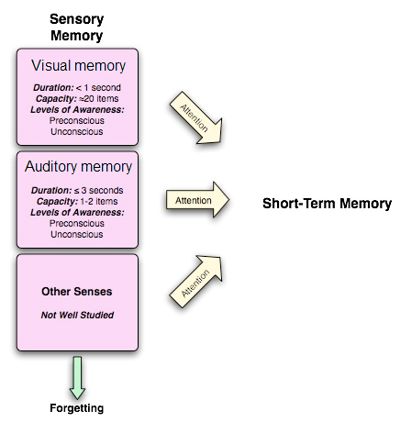
S E N S O R Y M E M O R Y
All information entering the brain passes through sensory memory and enters short-term memory (STM).
Sensory memory retains all the visual and auditory input received for a few seconds.
Only selected images and sounds are encoded into short-term memory.

Slide 4
S H O R T T E R M M E M O R Y
STM has a limited capacity (approx. max 7 items) and can only hold information for a short time (memory span)
The capacity of STM can be improved by ‘chunking’.
The short term memory cannot remember these 12 numbers.
3
5
2
7
7
1
4
6
2
5
8
1
Grouping the numbers into groups of 3. The STM sees this as 4 items.
3 5 2
7 7 1
4 6 2
5 8 1

Slide 5

S H O R T T E R M M E M O R Y
STM can also process data, to a limited extent, as well as store it. This ‘working memory model’ explains why the STM can perform simple cognitive tasks.
Imagine you're trying to work out a tip in a restaurant.
You look at the bill and see £42.50. You then calculate 10% in your head.
While you're doing this, your working memory:
  Holds the number £42.50 in your mind.
  Performs the calculation.
  Keeps track of the answer while you decide how much to leave.
Once you've paid and left the restaurant, that information is usually no longer needed and is forgotten.
This shows that working memory is a temporary workspace in your mind that allows you to hold and manipulate information for a short period of time while carrying out a task.

Slide 6
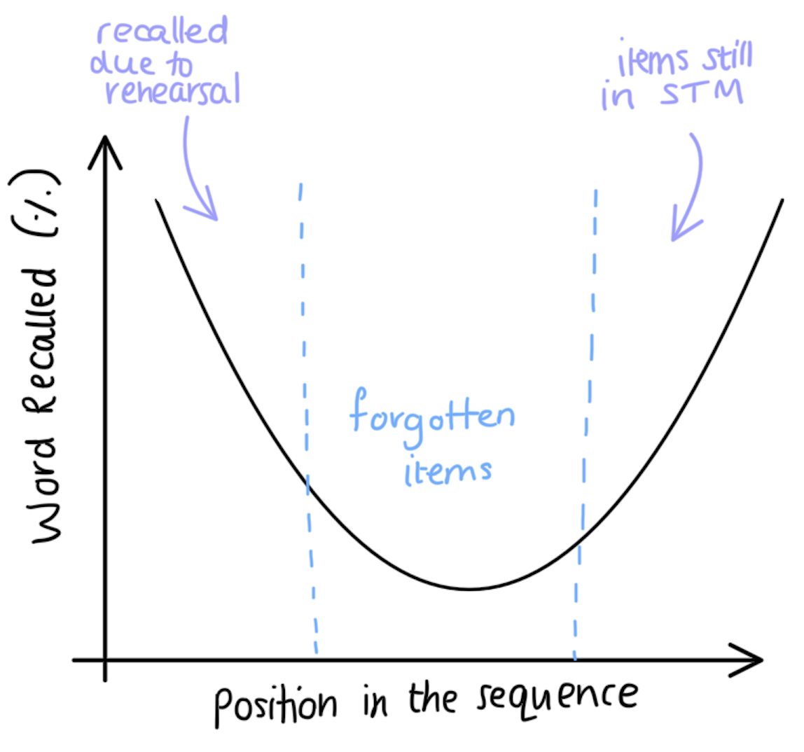
S E R I A L P O S I T I O N E F F E C T
We remember items at the beginning and end of a list best.
Items recalled from the start are remembered due to rehearsal.
New information can push old information out of STM when capacity is full (displacement).
Information is forgotten if it is not rehearsed (decay).
The items recalled from the end are still in the STM.

Slide 7
L O N G T E R M M E M O R Y
LTM has an unlimited capacity and holds information for a long time.
The transfer of information from STM to LTM by rehearsal, organisation and elaboration (ROE).
Rehearsal: Repeating the information (Shallow form of encoding)
Organisation: Putting information into similar logical groups.
Elaboration: Expanding on the information. (Deeper form of encoding)

Slide 8
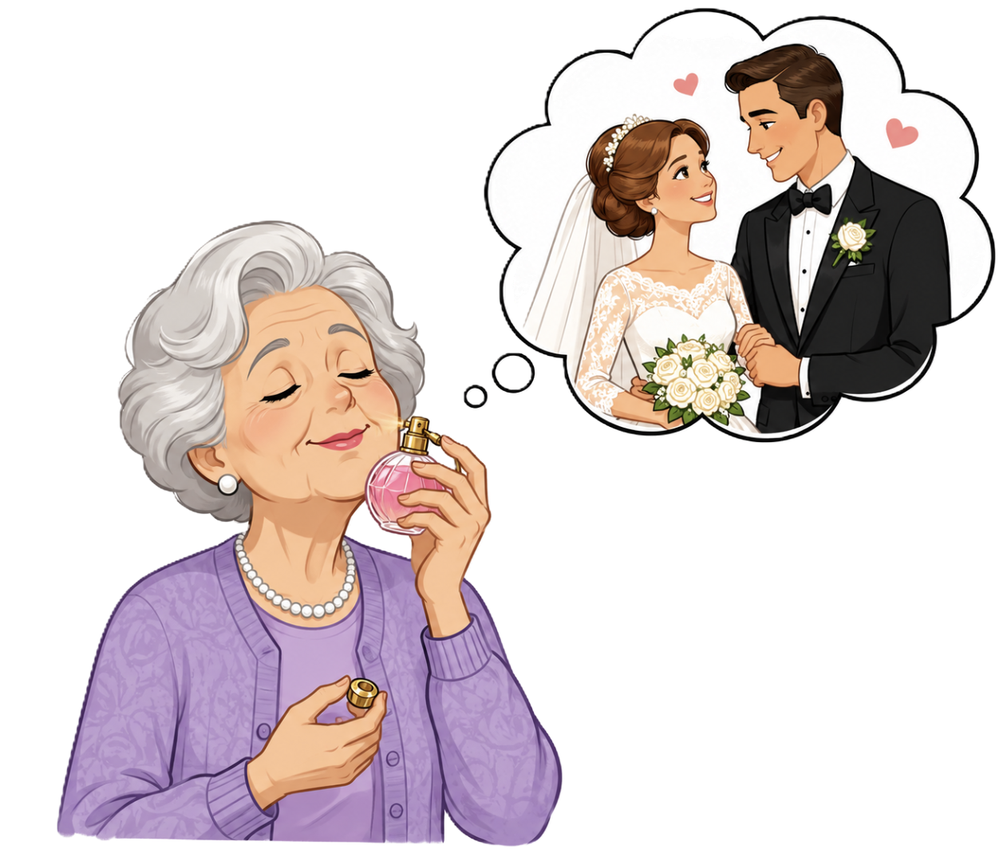
C O N T E X T U A L C U E S
Retrieval is aided by the use of contextual cues.
Contextual cues relate to the time and place when the information was initially encoded into LTM.

Slide 9
C O U R S E S P E C N O T E S
3.3 Memory
(a) Memory involves encoding, storage and retrieval of information. Memories include past experiences, knowledge and thoughts. All information entering the brain passes through sensory memory and enters short-term memory (STM). Information is then either transferred to long-term memory (LTM) or is discarded.
Sensory memory retains all the visual and auditory input received for a few seconds. Only selected images and sounds are encoded into short-term memory. STM has a limited capacity and holds information for a short time. The capacity of STM can be improved by ‘chunking’. Memory span, the serial position effect, maintaining items by rehearsal and loss of items by displacement and decay. STM can also process data, to a limited extent, as well as store it. This ‘working memory model’ explains why the STM can perform simple cognitive tasks. LTM has an unlimited capacity and holds information for a long time. The transfer of information from STM to LTM by rehearsal, organisation and elaboration. Rehearsal is regarded as a shallow form of encoding information into LTM. Elaboration is regarded as a deeper form of encoding which leads to improved information retention. Retrieval is aided by the use of contextual cues. Contextual cues relate to the time and place when the information was initially encoded into LTM.

