Slide 1
Higher Biology
Unit 3
KA 3 – Crop Protection

Slide 2
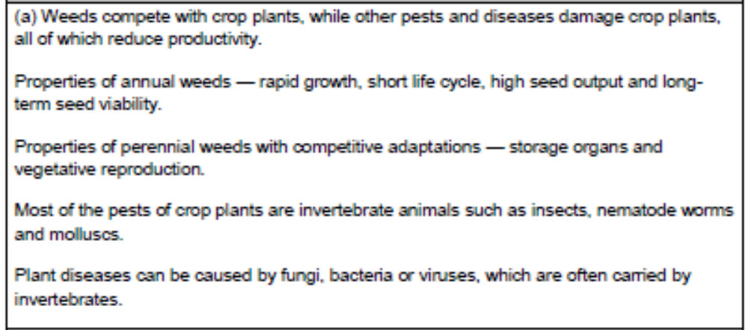
Course Specification

Slide 3
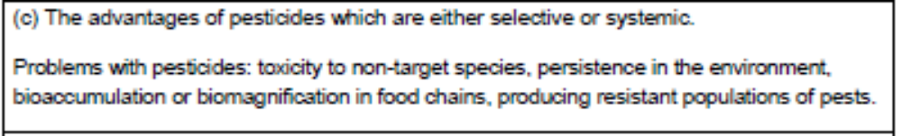
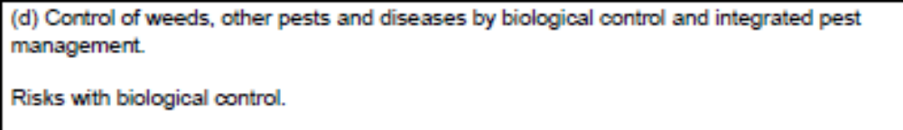
Course Specification

Slide 4
Starter
Pedigree dogs are produced by mating members of the same breed with one another. This often results in the production of offspring suffering conditions which affect their fitness. For example, bulldogs have problems with their breathing and Labradors are prone to arthritis.
This phenomenon is know as:
a) hybrid depression.
b) natural selection.
c) inbreeding depression.
d) selective

Slide 5
Learning Intention
By the end of this key area I will be able to:
Describe the main features of weeds and what problems they cause
Describe the main pest species that attack crops
State the causes of the main diseases which affect crops

Slide 6
Success Criteria
I can:
State the definition of a weed in relation to crop plants
Describe the properties of annual and perennial weeds

Slide 7
Natural Ecosystem
In a natural ecosystem a balance exists
between the producers and consumers.
There is also a diverse variety of plant
species that co-exist with their fellow
plants, insects and micro-organisms.
The diversity and genetic variety amongst
species make them more resilient to weeds,
pests and fungal infections.

Slide 8
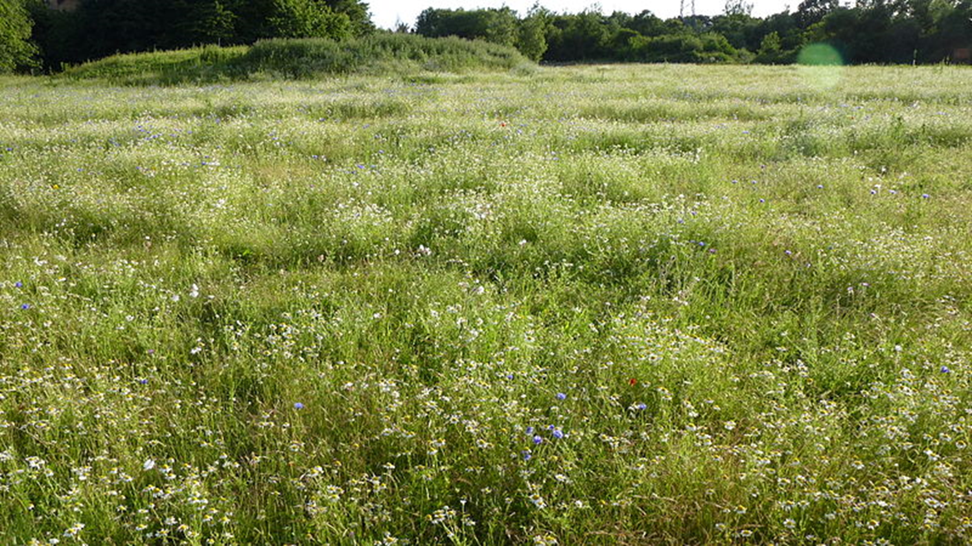
Natural Ecosystem

Slide 9
Monoculture
In monoculture only one species of crop
plant in the area.
The members of the crop are often
genetically identical.
Weeds, pests and fungal infections have to
be tightly controlled to ensure the greatest
yield of the crop.

Slide 10
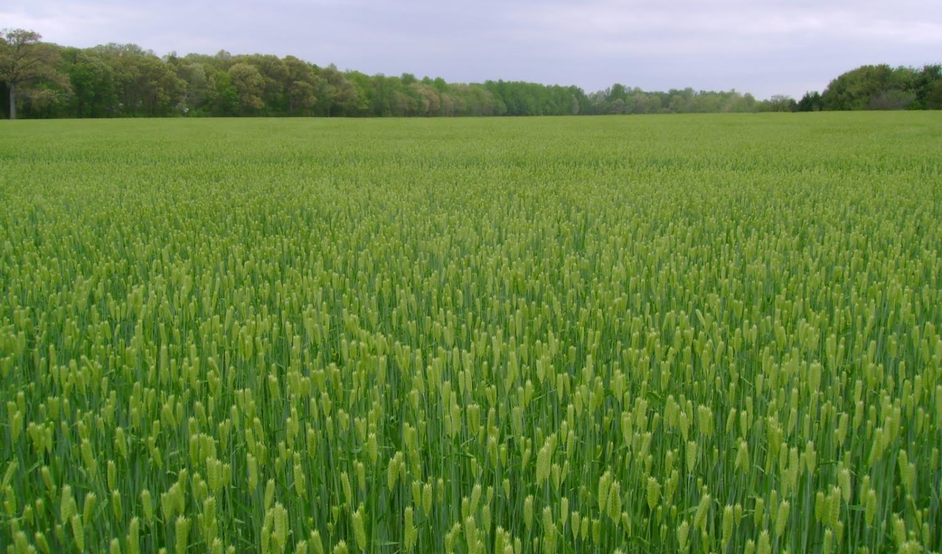
Monoculture

Slide 11
Weeds
Think about what plants in the same
habitat compete for:
Competition in Plants

Slide 12
Competition in monoculture
Competition can be reduced in
monocultures be growing the plants in
rows.
However, the gaps fill in with weeds. A
weed is any kind of plant that grows
where it not wanted.

Slide 13
Economic impact of weeds
In agriculture weeds cause a significant
economic impact as they may:
Cause a significant reduction in the productivity of the crop due to competition
Release chemical inhibitors into the soil which further reduces the crop
Contaminate grain crops with their seeds and reduce the crop’s value
Act as hosts for crop pests and diseases

Slide 14
Properties of annual weeds
Annual plants are plants which complete their entire life cycle (from seed to death) in one year.
Produce vast numbers of seeds
Grow very quickly
Annual Weeds
Seeds are viable for long periods of time
Short life cycle

Slide 15
Properties of Perennial weeds
Perennial plants are plants which live for several years, becoming dormant in winter time and growing again in the spring
Already established in the habitat
Reproduce vegetatively (asexually)
Perennial Weeds
Have storage organs to provide food when conditions are poor

Slide 16
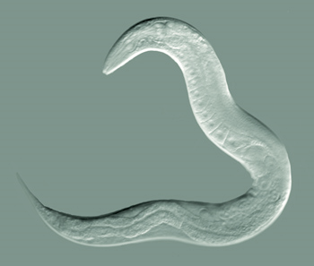
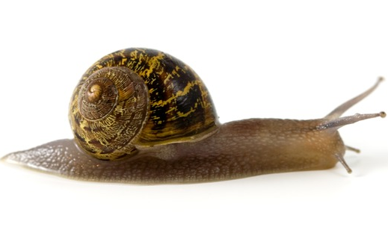
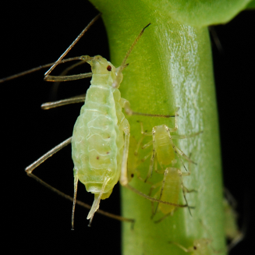
Invertebrate pests
Pests which attack crops broadly fall into three main groups:
Nemotode worms
Molluscs
Insects
e.g. snails or slugs
e.g. aphids, butterflies

Slide 17
Invertebrate Pests
Research the characteristics of each pest:
Insects
Nematode worms
Molluscs

Slide 18
Effect of invertebrate pests
Invertebrate pests destroy the leaves. This reduces the plants ability to carry out photosynthesis, and therefore their ability to produce sugar. This causes a reduction in vigour and yield.
Some pests can also be a vector (carrier) for other diseases which can damage the crop.

Slide 19
Plant Diseases
Plant diseases are caused by pathogens. These can be either:
Bacteria
Fungi
Viruses
These can be spread through the air, the soil, or by invertebrate vectors.

Slide 20
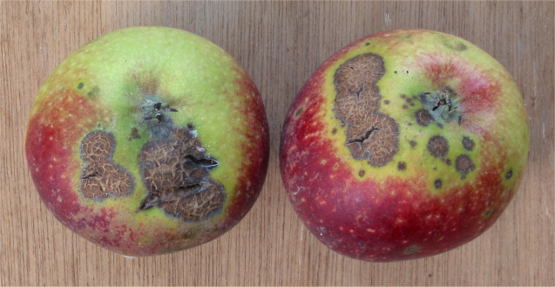
Economic effect of plant diseases
Plant diseases can affect the yield of the crop
They can also make crops less marketable of they are blemished or because they degrade too quickly in storage

Slide 21
Plenary
Read the following article and weigh up the pros and cons of sustainable farming in Scotland.
https://www.en.krishakjagat.org/global-agriculture/scottish-field-trials-show-cost-of-shift-to-sustainable-farming/

Slide 22
Starter
Compare Annual and Perennial weeds and describe their differences.

Slide 23
Learning Intention
By the end of this key area I will be able to:
Describe the ideal characteristics of a pesticide
Explain what is meant by bioaccumulation
Describe the effects of bioaccumulation on biodiversity

Slide 24
Success Criteria
I can:
Give examples of pests and diseases that reduce crop protection
Describe the difference between cultural and chemical methods of protection
Describe how systemic and selective herbicides work
Give an example of protecting crops prior to a disease outbreak

Slide 25
Control of weeds, pests and diseases
Weeds, pests and diseases can be controlled into two ways:
By cultural means
By chemical means

Slide 26
Cultural methods of crop protection
These are techniques for controlling weeds, pests and diseases which are non-chemical
They have developed over a long period of time, some by trial and error

Slide 27
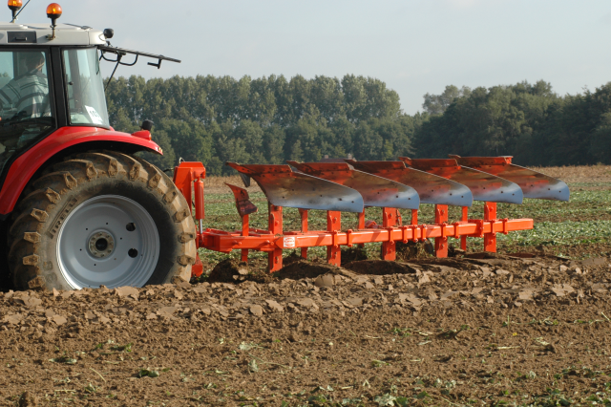
Ploughing
by turning over the top 20cm of soil every time a field is ploughed many weeds are buried deep enough for them to die and decompose.

Slide 28
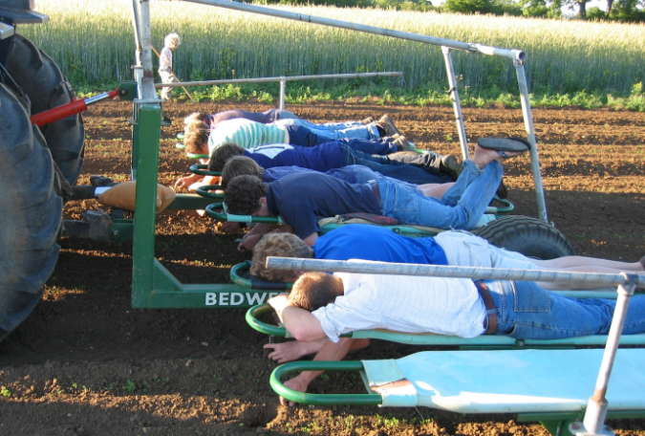
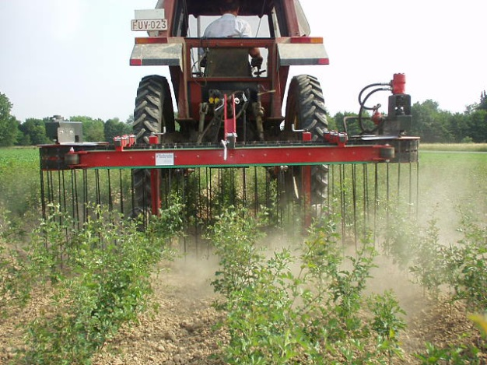
Weeding
Removal of weeds should be done early in the life of the crop to reduce competition
Weeds should also be removed from the edges of fields as they provide a breeding ground for pathogens

Slide 29
Crop Rotation
Field 1
Potatoes
Field 2
Cabbage
Field 4
Onions
Field 3
Peas (nitrogen fixing)
A series of different crops are grown one after the other on the same piece of ground – over 4 growing seasons.
Pathogens in the soil from the first crop
cannot then grow on the second crop.
Growing leguminous (nitrogen fixing)
plants can add nutrients to the soil

Slide 30
Chemical means of crop protection
Herbicides, pesticides and fungicides can be used to control pests when cultural means of control fail

Slide 31
Herbicides
These can be either:
Selective
Systemic

Slide 32
Selective herbicides
Selective herbicides mimic the action of plant growth hormones
This speeds up the metabolism of broad leafed plants to the extent that they use up their food reserves and die
Narrow leafed plants e.g. cereal crops, are not affected

Slide 33
Systemic herbicides
Systemic herbicides are absorbed by the plant and quickly transported to all areas of the plant through the vascular system
This has a lethal effect on the leaves and the roots of the plant

Slide 34
Pesticides
Are essential to protect crops. With out them about a third of crops would be lost due to invertebrate “attack”
Systemic Pesticides are absorbed by the plant and only kills invertebrates when they ingest plant material.

Slide 35
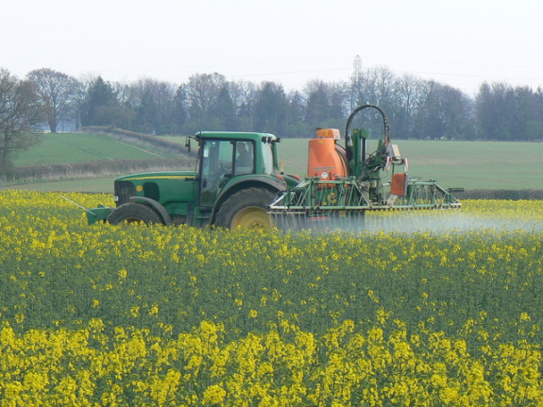
Contact pesticides
These work in two ways:
Killing the invertebrates when they come into contact with the spray
Leaving a protective residue on the plant which kills future invertebrates

Slide 36
Systemic pesticides
These are absorbed by the plant and only kills invertebrates when they ingest plant material.

Slide 37
Fungicides
Kill fungal parasites which cause diseases in crop plants.
Applications of fungicide based on disease forecasts are more effective than treating diseased crops

Slide 38
Weeds in top 20 cm of soil and buried and die.
Weeds removed early to prevent competition with crop plant.
Rotating crops to ensure pathogens cant be passed on and to ensure soil is not depleted of nutrients.
Ploughing
Weeding
Crop rotation
Cultural
Absorbed by the plant. Kills fungi only when it attacks plant. Not affected by rain.
Control of pests
Systemic
Chemical
Fungicide
Herbicide
Pesticide
Contact
Selective
Sprayed on prior to fungal attack. Kills fungi as soon as the spores germinate. Can be washed off by the rain – needs to be reapplied.
Affects broad leafed plants only.
Mimics plant growth hormones. Increases metabolic rate – growth outstrips demand and plant starves.
Contact
Systemic
Contact
Only kills leaves above ground. Roots remain.
Absorbed by the plant. Only kills the invertebrate if it eats the plant.
Kills all invertebrates when they come in contact with the pesticide.
Systemic
Quickly transported through entire plant.
Kills roots and shoots.

Slide 39
Ideal Characteristics
Ideally a plant protection chemicals (herbicide, pesticide and fungicides) should be:
Specific to the pest concerned.
Have a short life (i.e. should not persist in the environment – but be broken down into harmless by-products)
Be safe for human users and animals

Slide 40
Problems
Problems with pesticides:
  Toxicity to non target species
  Persistence in environment
  Bioaccumulation in food chains
  Producing resistant populations of pests

Slide 41
Bioaccumulation
Many plant protection chemicals have been found to persist in the environment.
Whilst they are found at low concentrations in the environment they accumulate along food chains – this is called bioaccumulation.

Slide 42
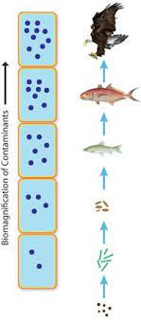
Biomaginfication
Biomaginifcation is an increase in concentration of a chemical moving between trophic levels

Slide 43
DDT- Silent Spring
https://www.youtube.com/watch?v=GLllZ-qiXJA
https://www.youtube.com/watch?v=ezVEzCmiXM4

Slide 44
DDT
DDT is a plant protection chemical which is now banned
Research and make notes on what DDT was used for and what happened to the plants and animals at each stage in the food chain

Slide 45
Research
Use your iPad to complete the pages in your booklet

Slide 46
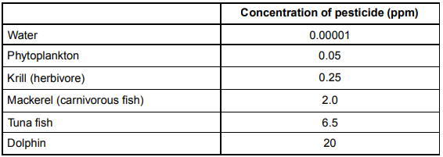
Plenary
Phytoplankton → krill → mackerel → tuna fish → dolphin
The concentration of pesticide increased by a factor of 400 times between:
a) water and tuna fish
b) krill and dolphin
c) phytoplankton and tuna fish
d) phytoplankton and dolphin

Slide 47
Starter
Write notes on human food supply under the following headings:
(i) food security and population 3
(ii) factors affecting food production 7

Slide 48
Starter
Food security is ability of human population to access sufficient supply of food.
Increasing population increases the demand for food.
Production is sustainable and does not degrade natural resources on which agriculture depends on
food production depends on photosynthesis.
factors which limit photosynthesis include light and temperature.
high-yielding cultivars increase food production.
Pests eat crops which affects food production.
The use of pesticides control pests.
Livestock produce less food per unit area than crops due to energy loss at each trophic
level
Increased fertilizers also increase food production

Slide 49
Learning Intention
By the end of this key area I will be able to:
Describe what is meant by “biological control”
Explain the possible risks associated with biological control
Explain what is meant by “integrated pest management”

Slide 50
Success Criteria
I can:
Describe Biological Control in relation to crop protection
Give examples of when Biological Control has gone wrong
Describe integrated pest management

Slide 51
Biological Control
Biological control describes the control of a pest population through the introduction of one of its natural “enemies”:
predator
parasite
pathogen

Slide 52
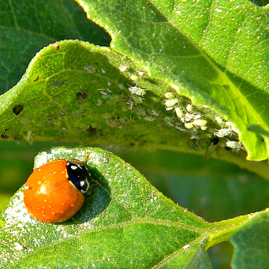
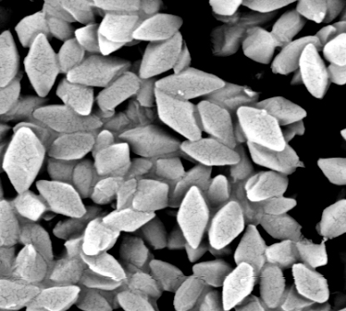
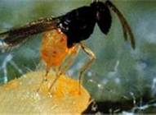
Biological Control
Predator | Parasite | Pathogen
Using ladybirds to control aphids | Using Encarsia – a parasitic wasp which lays its eggs inside whitefly and destroy it. | Using Bacillus thuringiensis – a bacterium which infects caterpillars with a toxin called Bt toxin.

Slide 53
Biological Control Risks
Biological control works best in “closed systems” such as greenhouses so that the control agent cannot “escape” into the wider environment.

Slide 54
Biological Control Risks
If escape occurs into an environment which is free from predators, parasites or disease then their numbers could increase rapidly and infect the local populations.
e.g. Cane toads in Australia

Slide 55
Biological Control
https://www.youtube.com/watch?v=oYcl0xxU5_s

Slide 56
Integrated pest management
IPM uses a combination of chemical, biological, cultural methods and plant resistance to improve yield
The main aim of IPM is to reduce chemical use and only use chemicals which do not persist and reduce pests to levels which allow biological control methods to take over

Slide 57
Plenary
Write notes on crop protection under the following headings: 8 marks
(i) weeds, pests and diseases 4
(ii) methods of control 4

Slide 58
Plenary
Weeds:
Weeds compete with crop plants and reduce productivity/growth/yield.
Annual weeds have... rapid growth/short life cycles/produce many seeds/ long term seed viability.
Perennial weeds have storage organs/vegetative reproduction
Pests:
Pests eat/damage... crops/plants/plant parts and reduce productivity/growth/yield.
Examples of pests are nematodes/insects/molluscs
Diseases:
Diseases are caused by bacteria/fungi/viruses.
Diseases are often spread by invertebrates/pests
Methods of control
Weeds/pests/diseases can be controlled by cultural means and an example is ploughing/crop rotation.
Systemic insecticide spread through the vascular system of plants and kills pests feeding on them.
Biological control is use of predator, parasite or pathogen of the pest.
The risk of a biological control include that the control organism may become an invasive species and may prey on other species.

Slide 59
Quiziz
https://quizizz.com/admin/quiz/5c8a3f556e60c8001abbe1a7/higher-biology-crop-protection?source=MainHeader&page=FeaturedPage&searchSource=&searchLocale=&fromSearch=true

