Slide 1
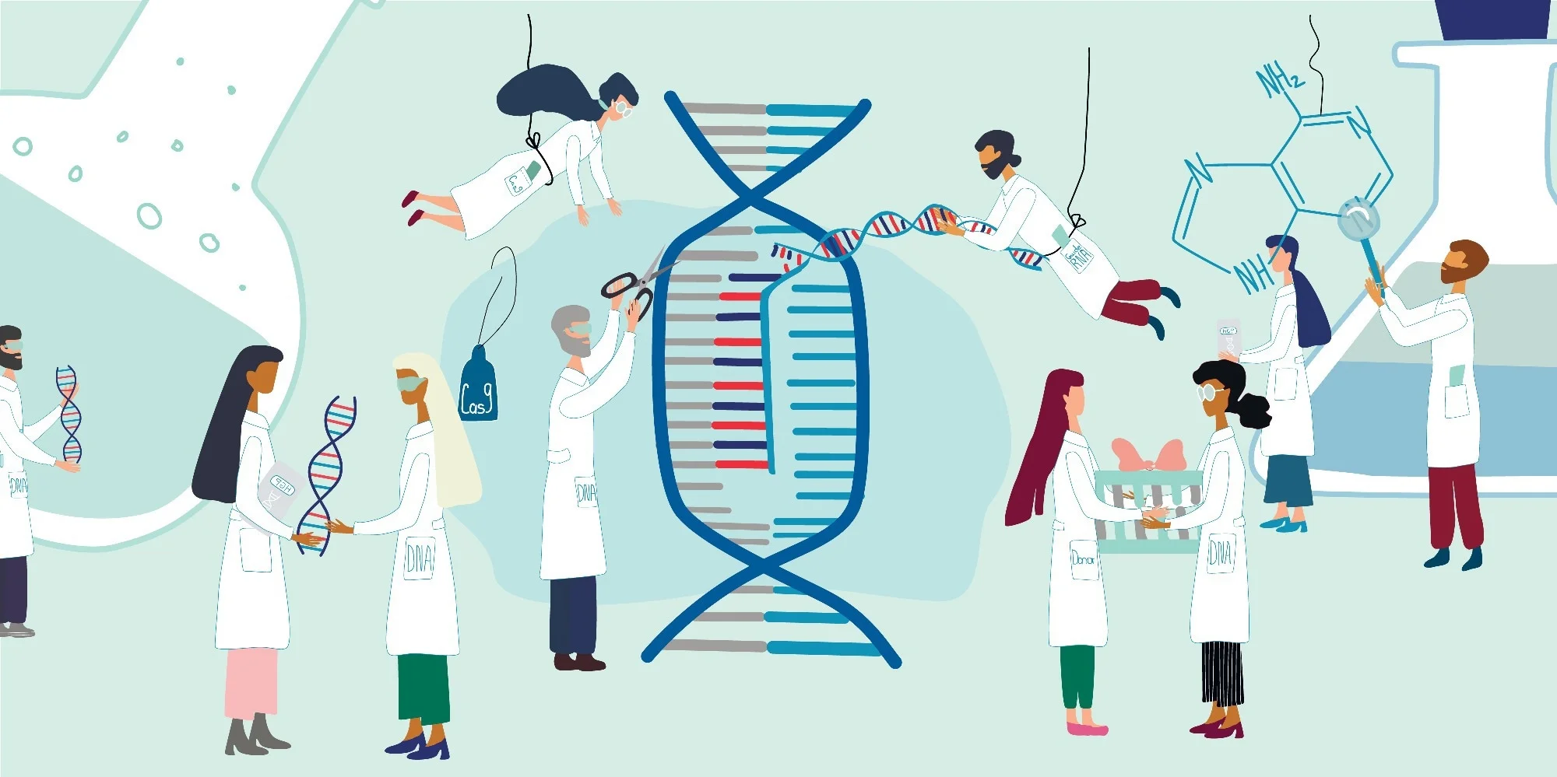
Higher Human Biology
M I S S M C B R I D E
1.5 Human Genomics

Slide 2
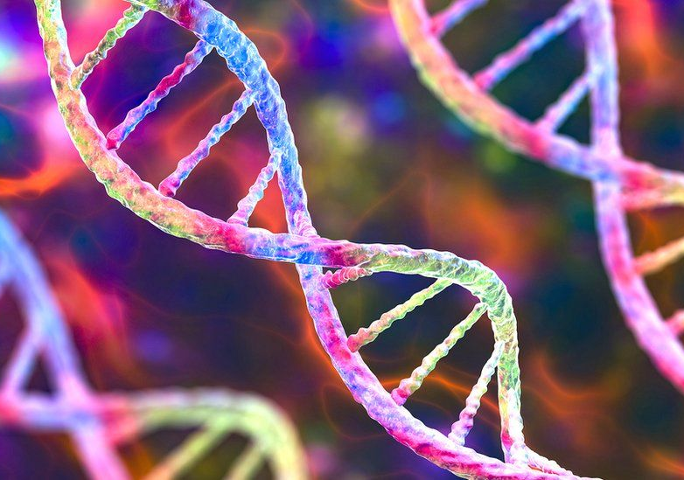
H U M A N G E N O M I C S
The genome of an organism is its entire hereditary information encoded in DNA.
A genome is made up of genes and other DNA sequences that do not code for proteins.
Comprises a total of around 3 billion base pairs contained within the nuclei of each of our cells.

Slide 3
H U M A N G E N O M I C S
In genomic sequencing, the sequence of nucleotide bases can be determined for individual genes and entire genomes.
DNA sequencing involves determining the exact order of the bases in DNA- the As, Cs, Gs and Ts that make up segments of DNA.

Slide 4
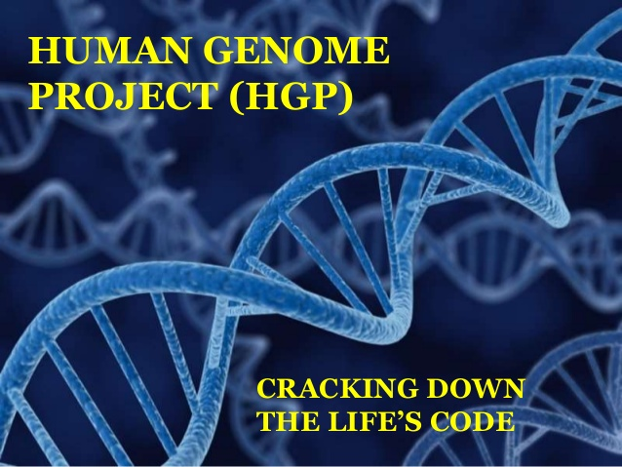
T H E H U M A N G E N O M E P R O J E C T
THE HUMAN GENOME PROJECT
This is one of the greatest scientific accomplishments in history. Launched in 1990 and completed in April 2003- a collaborative international effort to generate the first sequence of the human genome.

Slide 5

Gene sequencing reveals that we have more in common with bananas, chickens, and fruit flies than you may expect.
By sequencing the entire genome of various organisms, including yeast, rice, and frogs, researchers have found that all living things on our planet have some similarities in their instruction manuals. The overlap exists because we all evolved from a common ancestor, a single-celled organism that lived three or four billion years ago, known as the last universal common ancestor (LUCA).

Slide 6
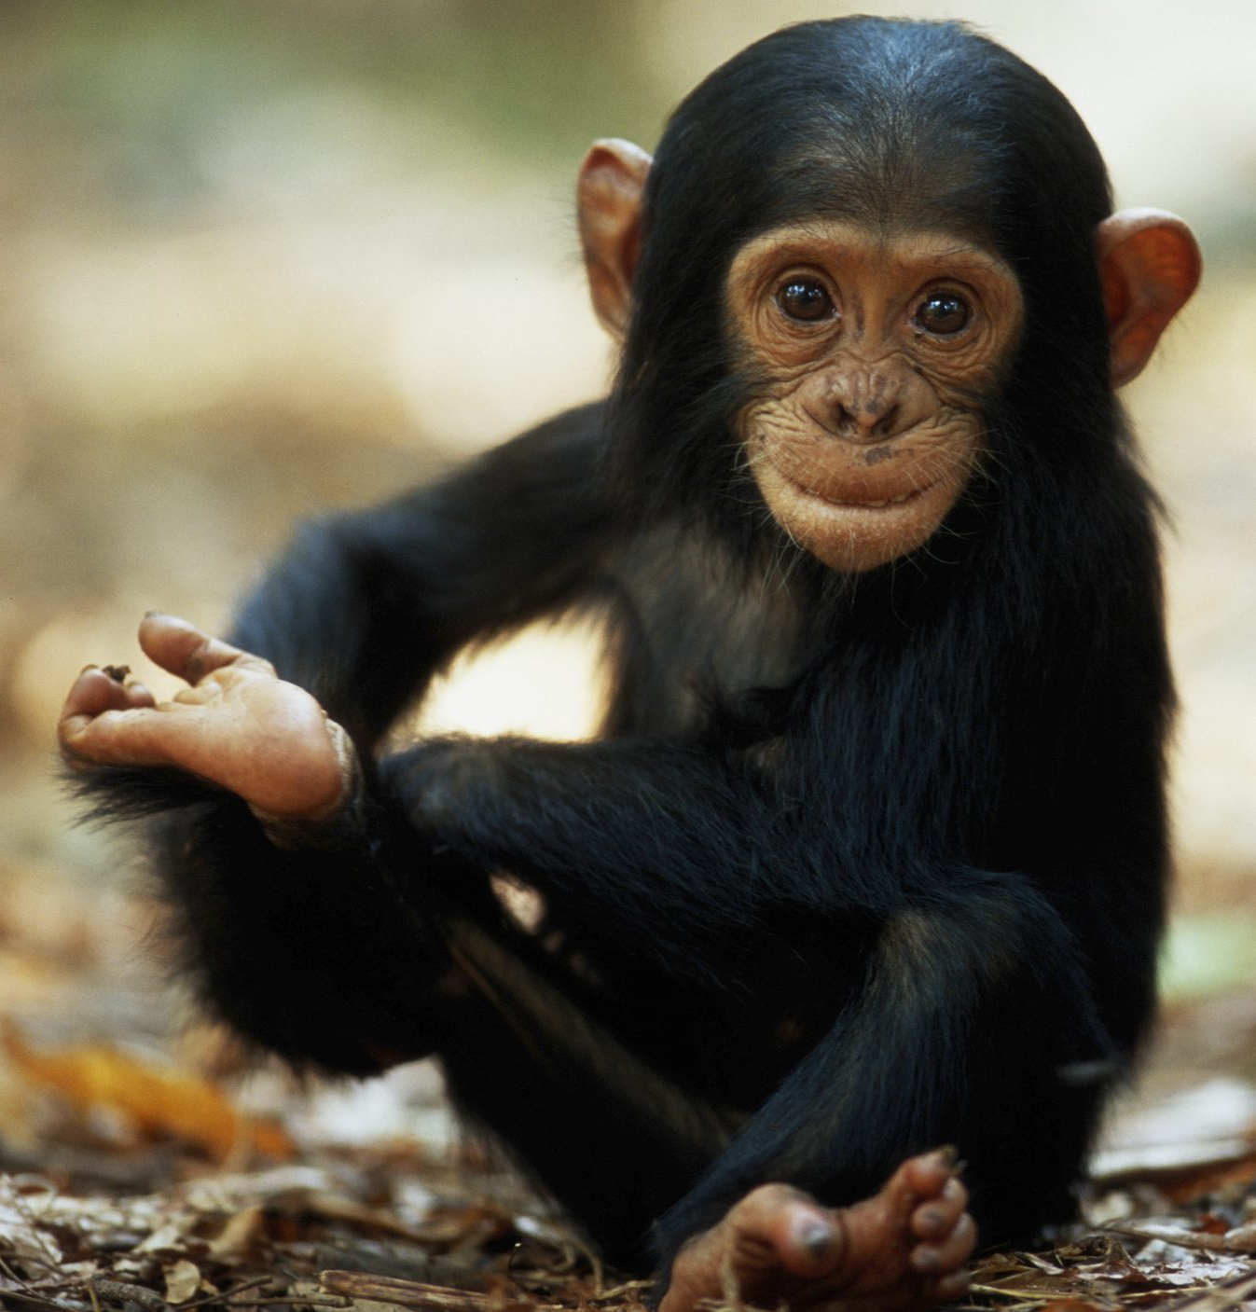

98%
We share 98% of our genome with Chimpanzees.

Slide 7
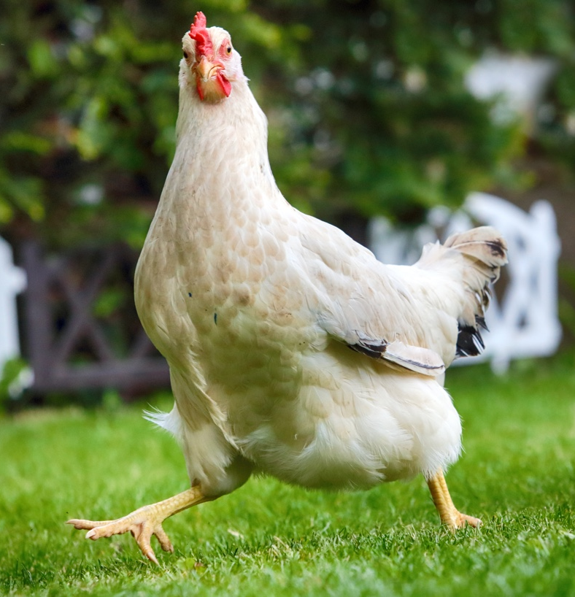
60%
We share 60% of our genome with Chickens.

Slide 8
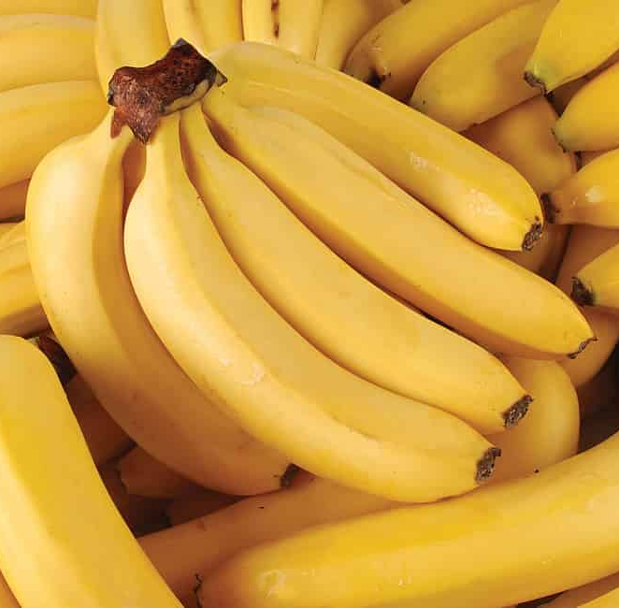
60%
We share 60% of our genome with Bananas.

Slide 9

94%
We share 94% of our genome with Dogs.

Slide 10
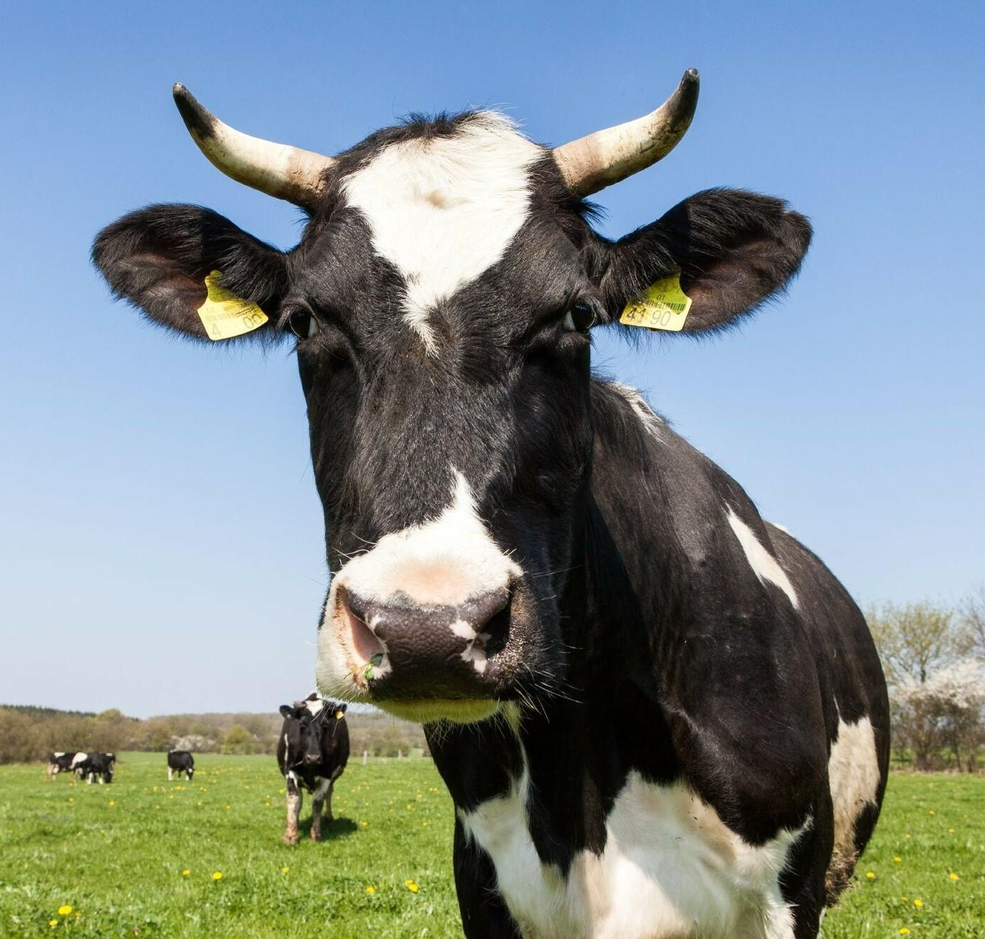
80%
We share 80% of our genome with Cows.

Slide 11
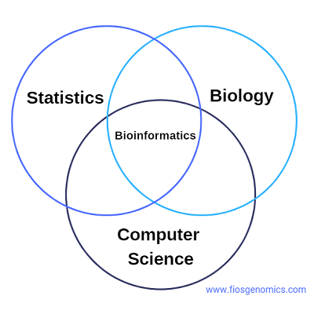
H U M A N G E N O M I C S
Computer programs can be used to identify base sequences by looking for sequences similar to known genes.
To compare sequence data, computer and statistical analyses (bioinformatics) are required.
An individual’s genome can be analysed to predict the likelihood of developing certain diseases.

Slide 12

P H A R M A C O G E N E T I C S
Pharmacogenetics is the use of genome information in the choice of drugs.
This field combines pharmacology (the science of drugs) and genomics (the study of genes and their functions) to develop effective, safe medications that can be prescribed based on a person’s genetic makeup.

Slide 13
P E R S O N A L I S E D M E D I C I N E
Many drugs that are currently available are “one size fits all,” but they don't work the same way for everyone.
It can be difficult to predict who will benefit from a medication, who will not respond at all, and who will experience negative side effects (called adverse drug reactions).
Just as our genes determine our hair and eye color, they partly affect how our bodies respond to medicine.

Slide 14
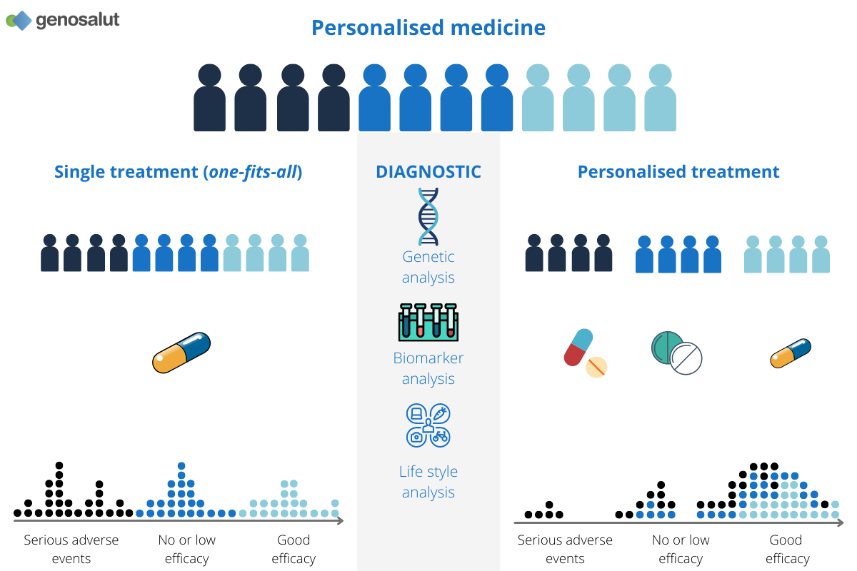
P E R S O N A L I S E D M E D I C I N E
An individual’s personal genome sequence can be used to select the most effective drugs and dosage to treat their disease (personalised medicine).

Slide 15

C O U R S E S P E C N O T E S
Human Genomics
The genome of an organism is its entire hereditary information encoded in DNA. A genome is made up of genes and other DNA sequences that do not code for proteins.
A genome is made up of genes and other DNA sequences that do not code for proteins.
In genomic sequencing the sequence of nucleotide bases can be determined for individual genes and entire genomes.
Computer programs can be used to identify base sequences by looking for sequences similar to known genes, To compare sequence data, computer and statistical analyses (bioinformatics) are required.
An individuals genome can be analysed to predict like likelihood of developing certain diseases. Pharmacogenetics is the use of genome information in the choice of drugs.
An individuals personal genome sequence can be used to select the most effective drugs and dosage to treat their disease (personalised medicine).

Slide 16

K E Y T E R M S
GENOME
GENOMIC SEQUENCING
BIOINFORMATICS
PHARMACOGENETICS
Definition page at the back of your jotter.
This will help you make flash cards at some point in the future!

Slide 17
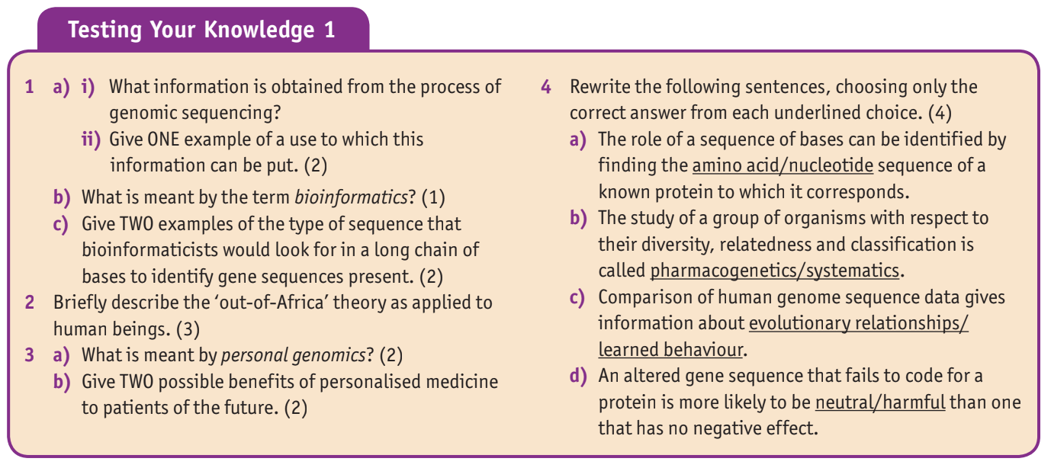

T E X T B O O K Q U E S T I O N S
Questions are on page 70 and all answers can be found on the previous pages. Answer in your jotters in full sentences.

