Slide 1
Higher Biology
Unit 1
KA8 Genomic Sequencing

Slide 2
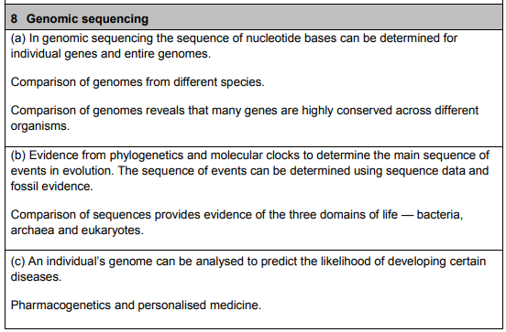
Course Specification

Slide 3
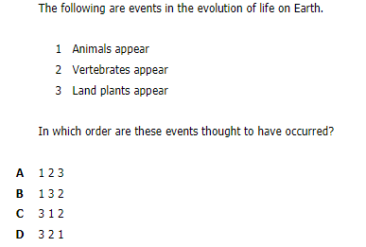
Starter
You may not know this yet but I want you to think about what you think came first!

Slide 4
Learning Intention
By the end of this topic you should be able to:
Understand and explain genomic sequencing using examples
Describe the evolution of life using phylogentics and the domains of life
Explain the uses of molecular clocks
Give reasoned arguments for and against genomic sequencing for human health

Slide 5
Success Criteria
I can:
Explain what genomic sequencing is
State how genomic sequencing can compare different organisms
Describe phylogenetics, the three domains of life and evolution of life
Explain the uses of molecular clocks
Describe the use of genomic sequencing in medicine and pharmacogenetics

Slide 6
Genomics
Genomics is the study of genomes.
In order to study genomics you must first
determine the entire DNA sequence of
the organism.

Slide 7
Genomic sequencing
There are 3164.7 million nucleotides in
the human genome spread over all the
chromosomes.

Slide 8
Genomic sequencing
In order to obtain the sequence it must
first be cut into more manageable sections
2. Determining the sequence
3. Put pieces back together.
This is done by computer analysis of the
sequences looking for sections that over-lap.

Slide 9
Genomics
As well as sequencing the human genome,
scientists have determined the genome
sequence of a range of other organisms.
Disease causing (pathogenic) bacteria or viruses
Pest species e.g. mosquitoes
Model organisms – so called because they possess genes equivalent to human genes and can be easily studied in the lab.

Slide 10
Genomics
To compare sequence data, computer and statistical analyses (bioinformatics) are required

Slide 11
Comparative genomics
When comparative genomics is carried out, this involves comparing the genomes of:
Members of different species
Members of the same species
Cancerous versus normal cells
…to identify similarities or differences in
the genomes – these could give clues to
causes of disease etc.

Slide 12
Similarities between genomes
Comparison of many genomes has revealed
that DNA sequences of important genes
are highly similar (conserved) from one
organism to the next.
e.g. genes coding for proteins involved in aerobic respiration, or for key enzymes.

Slide 13
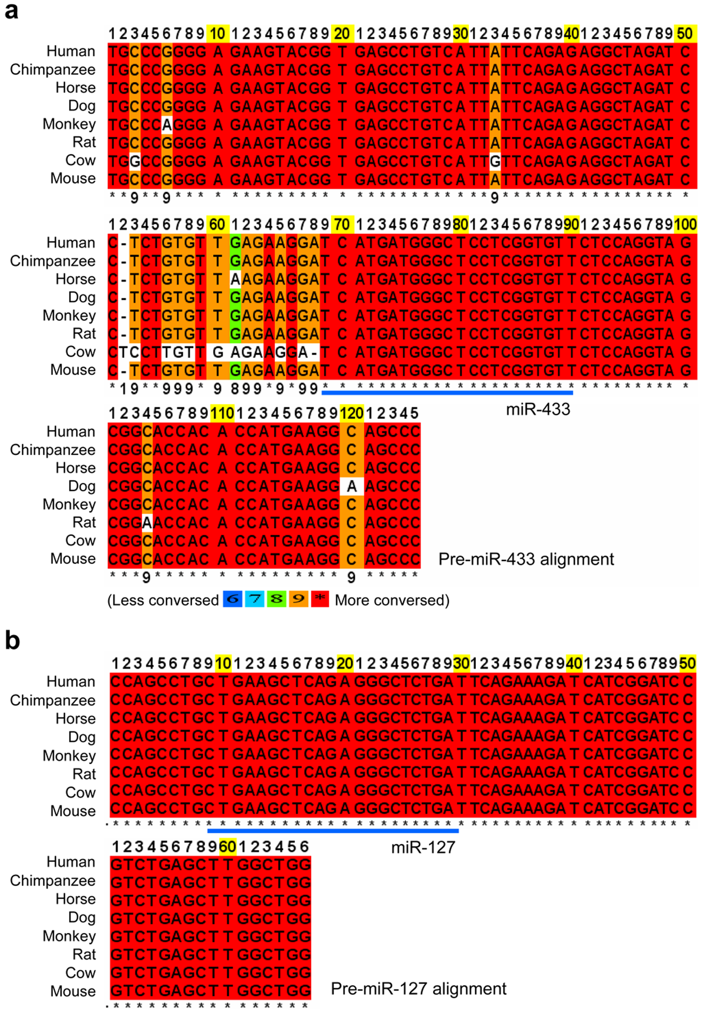

Slide 14
Phylogenetics
Comparing the genetic sequences of
organisms can demonstrate the
relatedness of groups of organisms.

Slide 15
Phylogenetic trees
Over time a group of closely related living
things will accumulate mutations e.g.
nucleotide substitutions which gradually
alter the genome.
The number of these differences per unit
length of DNA between two genomes gives a
measure of how related two genomes are
(evolutionary distance).

Slide 16
Key:
One unit of genetic change
Species A
Common Ancestor
Species B
Species C
The further apart two species are – the more distantly they are related to each other (A and D). The closer they are the more closely related they are (B and C).
Species D

Slide 17
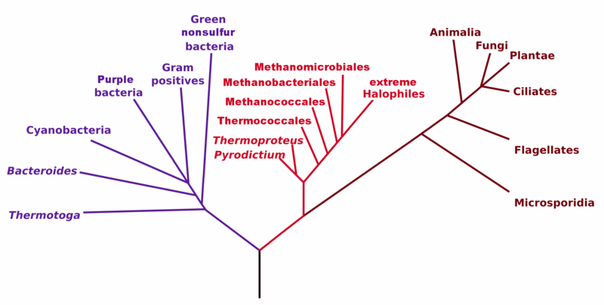
Bacteria
Archaea
Eukaryotes

Slide 18
The three domains of life
Analysis of ribosomal RNA (rRNA)
nucleotide sequences have been studied
because they are shared by all living
things.
Comparison the sequences has given clues
to the evolution of all living things and
demonstrated at all life belongs to one of
three domains.

Slide 19
Millions of years ago
4500-3500
3900-2500
3500
2700
1850
1200
580-500
485
435
Evolution of life on earth
Evolution of cells similar to prokaryotes
Evolution of last universal ancestor
Evolution of prokaryotes able to photosynthesise
Evolution of eukaryotes
Evolution of multicellular organisms
Evolution of animals
Evolution of vertebrates
Evolution of land plants
Comparison of genome sequence data and fossil data have allowed this timeline to be created.

Slide 20
Molecular clocks
Molecular clocks are used to show when species diverged during evolution.
Mutations accumulate at a steady rate
over time.
So we can use changes in DNA and amino acid sequence to see differences between species.

Slide 21
Molecular clocks
By comparing sequence data with fossil records, the molecular clock gives information about how long ago the most recent common ancestor of the species existed and the sequence in which the species evolved.

Slide 22
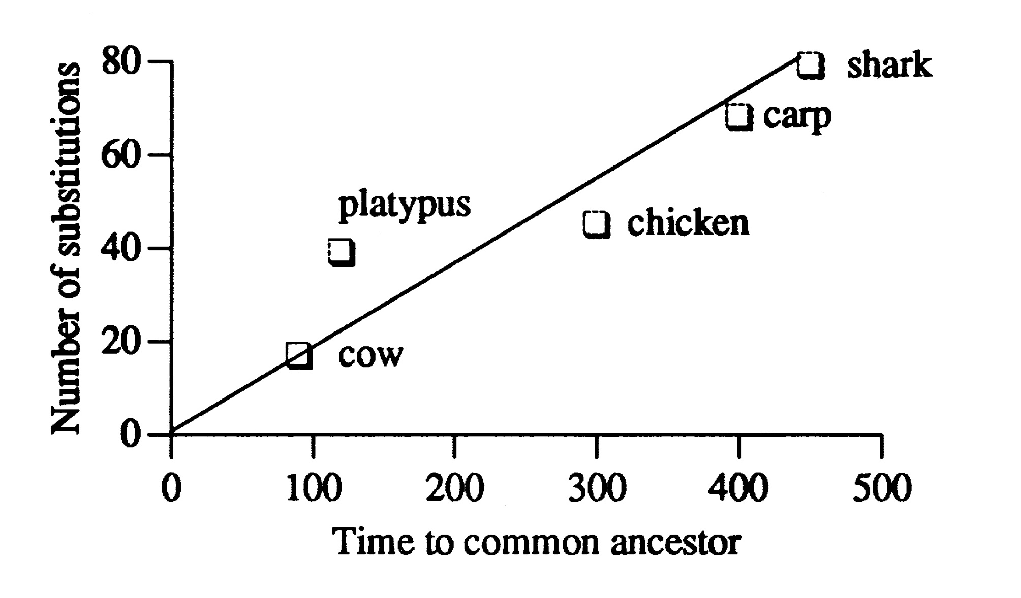
(Millions of years)

Slide 23
Molecular Clock
This molecular clock shows comparisons of
the human a-globin gene with a number of
different species. Cows can be seen to have
shared a common ancestor with humans
around 100 million years ago, whereas shark
a-globin has around 4 times more nucleotide
substitutions than cow when compared with
human a-globin and last shared a common
ancestor 450 million years ago.

Slide 24
Personal genomics
Sequencing the human genome took 13 years and cost millions of pounds – however it now possible to sequence a human genome in a couple days for about £700
This opens up many possibilities in medicine:

Slide 25
1. Predictive medicine
Once you have your DNA sequence you could look for:
Disease causing mutations
Mutations that increase your likelihood of developing a condition e.g. BRAC1 and 2 genes and breast cancer.

Slide 26
2. Pharmacogenetics
How effective a drug is in any one person is affected by your DNA.
Therefore knowing the genome sequence could be used to predict which medicines, and which dosages, will be most effective in one person compared to another.

Slide 27
Ethical issues
As a result of advances in this field, a question of ethics has also arisen.
Insurance companies, banks and others may decline services or increase premiums as a result of finding less desirable traits, e.g. Alzheimer's or other degenerative diseases. This has been termed genetic discrimination.

Slide 28
Success Criteria
I can:
Explain what genomic sequencing is
State how genomic sequencing can compare different organisms
Describe phylogenetics, the three domains of life and evolution of life
Explain the uses of molecular clocks
Describe the use of genomic sequencing in medicine and pharmacogenetics

Slide 29
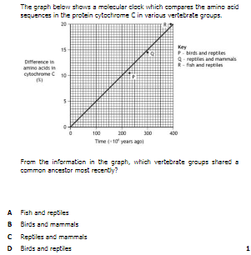
Plenary

