Slide 1
Higher Biology
Unit 1
KA1 Structure of DNA

Slide 2
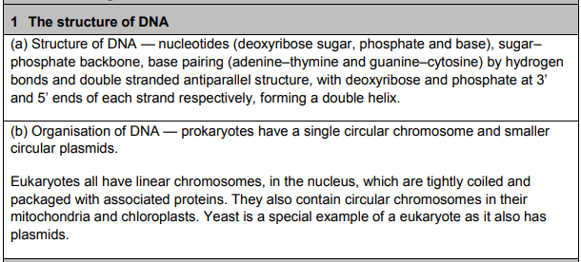
Course Specification

Slide 3
Starter
From National 5 write down what you can remember about the structure of DNA in your jotter
DNA

Slide 4
Learning Intention
I will:
Understand the structure of DNA and how it is organised in different types of cells

Slide 5
Success Criteria
I can:
Draw and label a nucleotide with a Deoxyribose sugar, phosphate and base
Describe the sugar–phosphate backbone and base pairing (adenine–thymine and guanine–cytosine) with hydrogen bonds
Describe the double stranded antiparallel structure; with Deoxyribose and phosphate at 3’ and 5’ ends of each strand respectively, forming a double helix

Slide 6
DNA
The DNA (deoxyribonucleic acid) molecule is comprised of two chains of nucleotides.
The nucleotides are comprised of a sugar, a phosphate and a base.

Slide 7
Nucleotides
5’ end
Base
5’
Phosphate
4’
1’
3’
2’
3’ end
Sugar
5’ pronounced “5 prime”

Slide 8
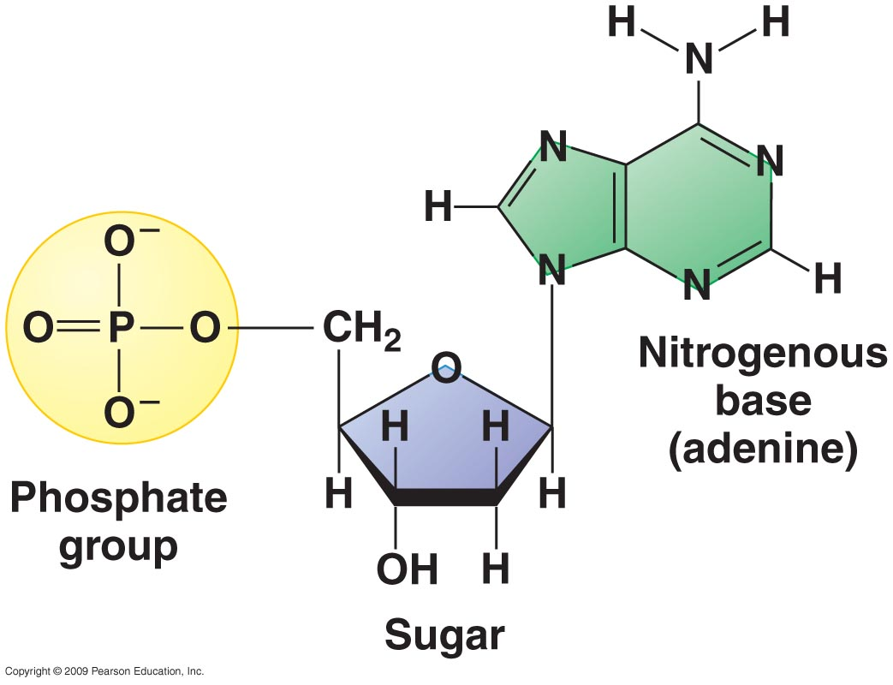
Why 5’ and 3’?
This is what a nucleotide looks like at the molecular level…
…lets zoom in to look at the sugar in more detail…

Slide 9
Carbon 5
Carbon 1
Carbon 4
Carbon 2
Carbon 3

Slide 10
Nucleotides in a chain are joined together by sugar-phosphate bond to make long chains of nucleotides – called polynucleotides.
(poly = many)

Slide 11
The bases
In DNA there are four different bases:
Adenine
Thymine
Cytosine
Guanine
or A, T, C and G

Slide 12
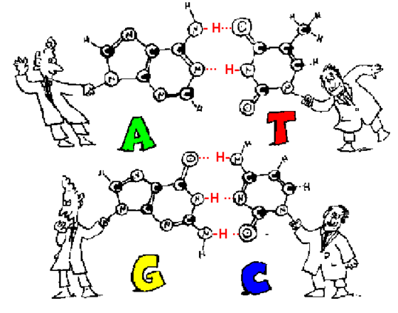
Base pairing
These bases are described as being complementary to each other.
This means their shapes match up.

Slide 13
DNA base pair rules
Adenine always joins to Thymine
Cytosine always joins with Guanine
The bases are joined by hydrogen bonds.

Slide 14
The Double Helix
The chains of polynucleotides are joined together by the bases, by hydrogen bonds, to form a double helix structure.

Slide 15

Imagine the sugars and phosphates joined together making the side of a ladder, with the pairs of bases forming the rungs.
Then the ladder gets twisted…

Slide 16
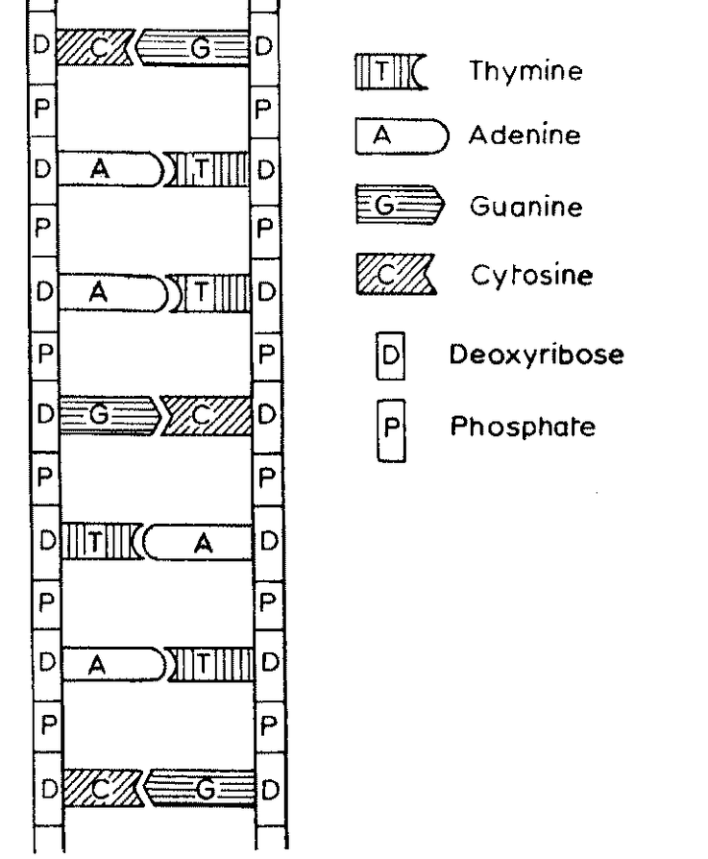

Slide 17
The Double Helix
The double helix is described as having two anti-parallel chains of nucleotides because one side goes from 5’ to 3’ and the opposite side goes from 3’ to 5’.

Slide 18
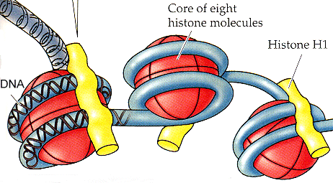
In the nucleus, the DNA double helix is tightly coiled around histone proteins forming nucleosomes (beads on a string)

Slide 19
Diagram
Now, use what you’ve learned to bring all the knowledge together and complete the diagram on page 7
Answers on the next slide.

Slide 20
PHOSPHATE
5’
DEOXYRIBOSE SUGAR
3’
NUCLEOTIDE
BASE
5’
1’
4’
3’
2’
A
T
C
G
3’
5’

Slide 21
Video
Watch the following video to recap
https://www.youtube.com/watch?v=T6_wKPAbf2k

Slide 22
How was all this discovered?
Like all major scientific discoveries, the discovery of the structure of DNA by James Watson and Francis Crick in 1953 was the result of years of work from a great number of scientists.
Not only is the story one of great scientific interest, it is also one of great human interest and controversy.

Slide 23


Task
This task is to research “Franklin, Watson and Crick” – some of the scientists whose work contributed to the discovery of DNA

Slide 24
Task
The results of your research will then be produced as a scientific poster, which you will present to the class.
who the scientists are, where they worked and when
the aims of their experiments
what the experiments were, including a diagram
what the conclusions were
other interesting information that you have gathered that lends interest to the story.

Slide 25
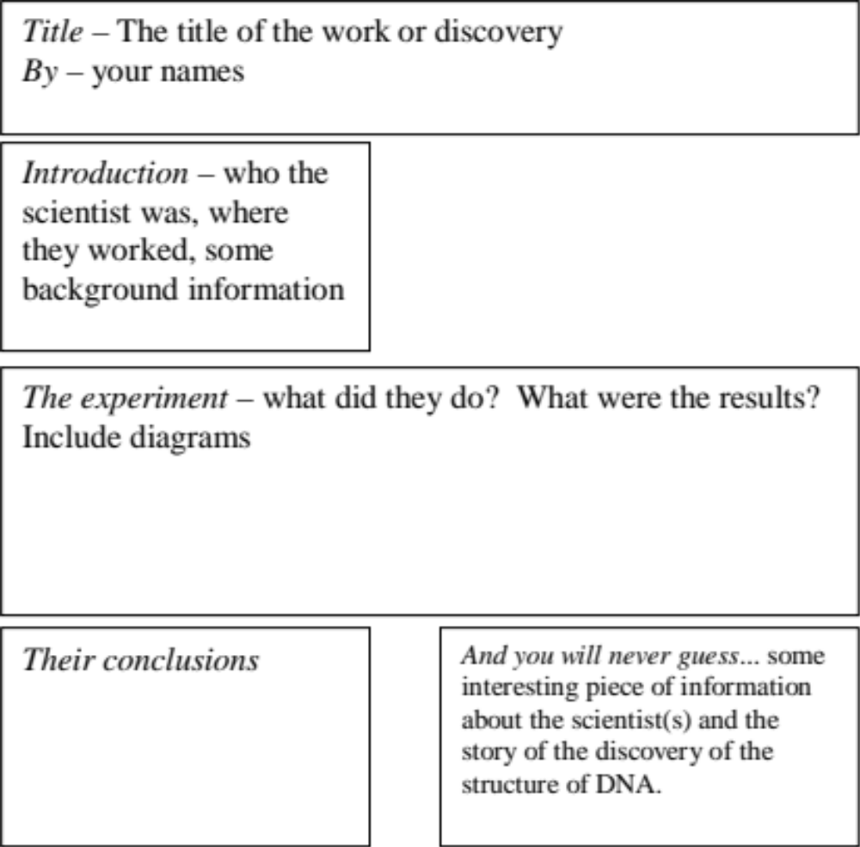

Notes:
Instruction Sheet in resources folder and on shared Higher Teams Page

Slide 26
Key concepts
DNA is composed of two polynucleotide chains.
Nucleotides consist of a sugar, phosphate and base.
Nucleotides bond to form a sugar–phosphate backbone.
The two polynucleotide chains run antiparallel, with a deoxyribose sugar at the 3′ end and a phosphate group at the 5′ end.
The nucleic acid bases are paired by hydrogen bonding in the centre to form a double helix.
Base pairing is specific, with adenine pairing with thymine and cytosine pairing with guanine.

Slide 27
Success Criteria
I can:
Draw and label a nucleotide with a Deoxyribose sugar, phosphate and base
Describe the sugar–phosphate backbone and base pairing (adenine–thymine and guanine–cytosine) with hydrogen bonds
Describe the double stranded antiparallel structure; with Deoxyribose and phosphate at 3’ and 5’ ends of each strand respectively, forming a double helix

Slide 28
Plenary
Describe the Base Pair Rule to your partner
Explain to your partner how you would identify the 3’ and 5’ end of a DNA strand

Slide 29
Starter
Give a definition and an example of a:
Eukaryote
Prokaryote
Use your iPad if you are stuck…

Slide 30
Learning Intention
I will:
Understand how DNA is organised in different types of cells

Slide 31
Success Criteria
State that Prokaryotes have a single, circular chromosome and smaller circular plasmids.
State that Eukaryotes all have linear chromosomes, in the nucleus, which are tightly coiled and packaged with associated proteins. They also contain circular chromosomes in their mitochondria and chloroplasts.
State that Yeast is a special example of a eukaryote as it also has plasmids.

Slide 32
Organisation of DNA in prokaryotes and eukaryotes
DNA is the genetic material of living things.
DNA structure.
Difference between a prokaryote and eukaryote.

Slide 33
Prokaryotes v Eukaryotes
Prokaryotes are organisms lacking a nucleus.
Think back to National 5…which organisms did not have a nucleus?
e.g. bacteria

Slide 34
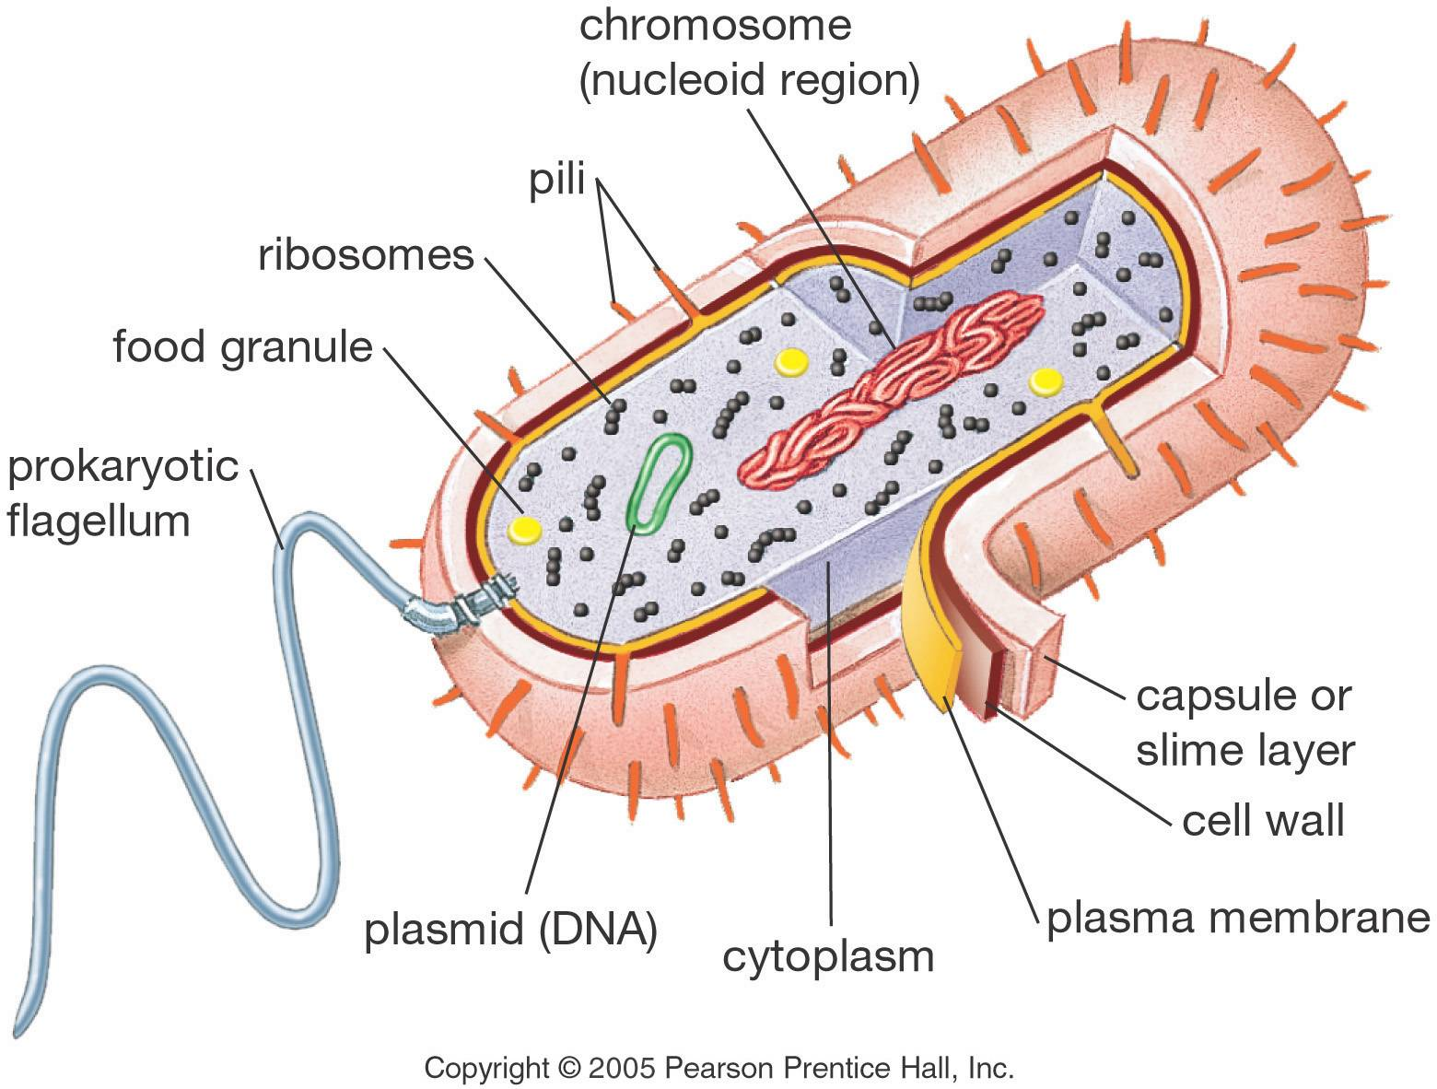

Slide 35
DNA organisation in prokaryotes
Prokaryotes usually have a single circular double stranded chromosome.
Some prokaryotes have a second chromosome which can carry extra non-essential genes – this is called a plasmid.
Bacteria are prokaryotic cells.

Slide 36
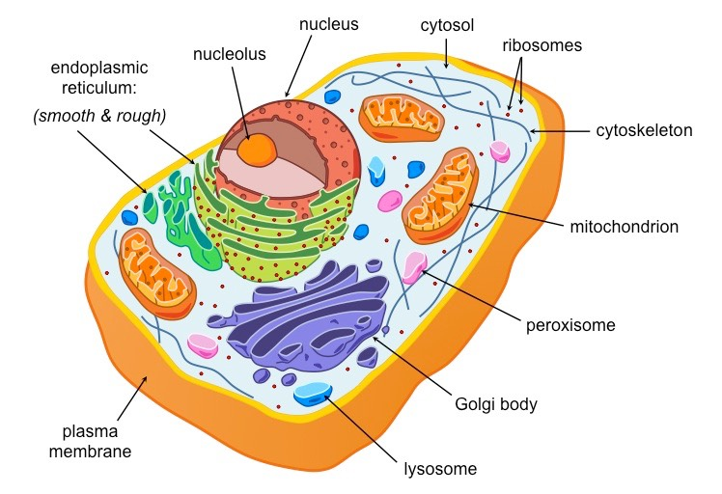

Slide 37
Eukaryotes
Eukaryotes are organisms with a nucleus containing several linear chromosomes.
Eukaryotes also have extra DNA out with the nucleus – mitochondrial and chloroplast DNA.
Examples of eukaryotes are animal and plant cells and yeast cells.
Yeast cells are a special eukaryote because they also have plasmids.

Slide 38
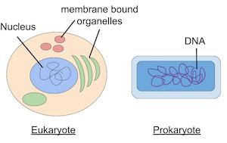
Structure of DNA in prokaryote v eukaryote
Mitochondrial and Chloroplast DNA (circular, double stranded)
Linear chromosomes in the nucleus
Circular, double stranded DNA in cytoplasm
plasmid

Slide 39
Mitochondrial and chloroplast DNA
Mitochondrial DNA is found in the mitochondria of both plants and animals.
These are inherited solely from the mother along with the other cell organelles during cell division.
Chloroplast DNA is found only in plants.

Slide 40
Mitochondrial DNA (mtDNA)
Circular, double stranded DNA.
Varies in size (15, 569 bp in humans, 80,000 bp in yeast to 2 million bp in some plants)
Codes for transfer RNA (tRNA), ribosomal RNA (rRNA) and some proteins in the mitochondria.

Slide 41
Chloroplast DNA (cpDNA)
Circular, double stranded DNA.
Between 80,000 and 600, 000 bp in size. Chloroplasts can have multiple copies.
Codes for rRNA, tRNAs, proteins required for transcription, translation and photosynthesis.

Slide 42
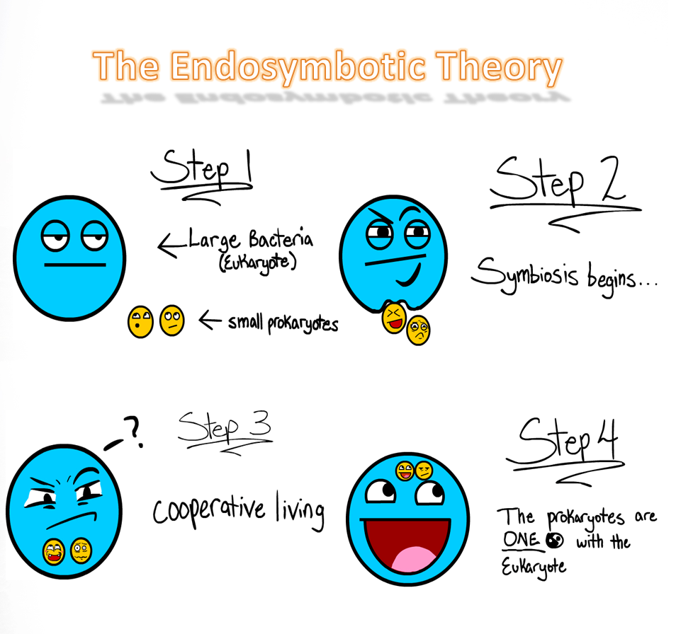
Endosymbiont theory

Slide 43
DNA packaging in eukaryotes
One human chromosome – if pulled out – is approximately 4 cm.
The cell packages this into a bundle of 1.2 – 2 μm long.
But you have 46 chromosomes – this is approximately 1.84 metres of DNA in every cell of your body.
That’s enough in your body to stretch to the moon and back!

Slide 44
Video
Watch the following video
https://www.youtube.com/watch?v=Pxujitlv8wc&pp=ygUscHJva2FyeW90aWMgYW5kIGV1a2FyeW90aWMgY2VsbHMgZGlmZmVyZW5jZXM%3D

Slide 45
Success Criteria
State that Prokaryotes have a single, circular chromosome and smaller circular plasmids.
State that Eukaryotes all have linear chromosomes, in the nucleus, which are tightly coiled and packaged with associated proteins. They also contain circular chromosomes in their mitochondria and chloroplasts.
State that Yeast is a special example of a eukaryote as it also has plasmids.

Slide 46
Plenary
A section of double stranded DNA was found to have 60 guanine bases and 30 adenine bases. What is the total number of deoxyribose sugars in this section?
30
90
180
270

Slide 47
Now Complete…
Revision Mind Map
Revision Quiziz https://quizizz.com/admin/quiz/62a8613640ae94001e68301b/higher-biology-unit-11?type=quiz,presentation&source=MainHeader&page=FeaturedPage&searchLocale=
Past Paper questions on Teams

