Slide 1
Higher Biology
Unit 2
KA 3 – Metabolic Rate

Slide 2
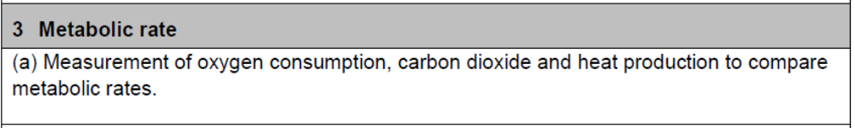
Course Specification

Slide 3
Starter – Show Me Boards
Describe the pathway of blood through the human heart, lungs and body
Draw the structure of the human heart including the right and left atria and ventricles
Explain the function of red blood cells and how they do this

Slide 4
Learning Intention
By the end of this topic you should be able to:
Understand how the rate of metabolism can be measured
Describe the mechanisms of delivery of oxygen in terms of cardiovascular system of different animals

Slide 5
Success Criteria
I can:
List the possible measurements used to compare metabolic rates
Explain why different species have different metabolic rates

Slide 6
Metabolic Rate
Metabolic rate is the quantity of energy used by the body over a given time. It is measured in kilojoules (or kilocalories).
Metabolic rate can be measured as
Oxygen consumption per unit time
CO2 production per unit time
Energy production per unit time
Glucose + Oxygen ---- > ATP + carbon dioxide + water

Slide 7
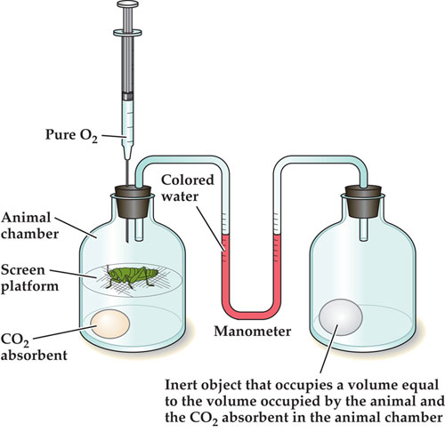
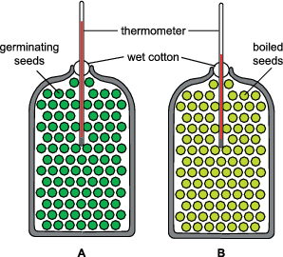
Measuring metabolic rate
There are different ways to measure metabolic rate.
Respirometers and Calorimeters are two different pieces of equipment that do this

Slide 8

Calorimeters
Calorimeters measure the heat generated by an organism and calculates the metabolic rate from the results
Water in
Warmer Water out

Slide 9
Calorimeter
This experiment shows the heat produced by germinating peas. The right flask is the control. There should be no temperature rise in the control flask.

Slide 10
Respirometers
Respirometers measure the amount of oxygen uptake by an organism.
If a man consumes 350L of oxygen on average per day this equates to 1700Kcal or 7000Kj

Slide 11
Basal metabolic rate (BMR)
At rest, meaning in periods of inactivity, the metabolic rate is known as the basal metabolic rate (BMR). At rest, the BMR is low compared to when the body is undergoing activities like exercise.
During this resting state the body only needs to use energy to keep vital organs such as the heart, lungs and brain functioning properly.

Slide 12
Metabolic Rate Video
https://www.youtube.com/watch?v=LKZZrJjI_NI

Slide 13
Compare metabolic rates
Animal | Volume of oxygen consumed (mm3 g⁻1 body mass h¯1)
Sea anemone | 13
Octopus | 80
Eel | 128
Frog | 150
Human | 200
Mouse | 1500
Hummingbird | 3500

Slide 14
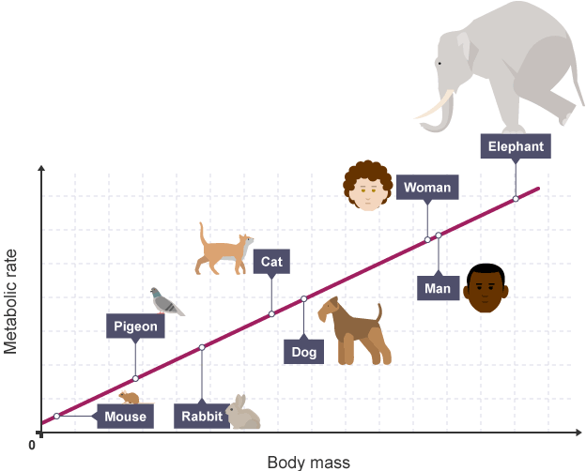
Comparative metabolic rate
As a general rule, the greater the mass of an organism the higher that organism’s metabolic rate is.
However, BMR is higher per unit of body mass in small animals compared to larger ones. This is because the higher metabolic rate of small animals needs a greater delivery of oxygen to tissues around the body.
Also, the smaller animals have a greater surface area to volume ratio, so more heat is lost

Slide 15
Oxygen delivery
High metabolic rates require efficient delivery of oxygen to cells
Multicellular organisms need oxygen delivery systems such as cardiovascular systems

Slide 16
Success Criteria
I can:
List the possible measurements used to compare metabolic rates
Explain why different species have different metabolic rates

Slide 17
Plenary
Describe the relationship between metabolic rate and body mass and explain why this is the trend

Slide 18
Starter
State the names of the 3 main types of blood vessels found in the human body
explain the functions of the 3 main types of blood vessels
State any named examples you know of

Slide 19
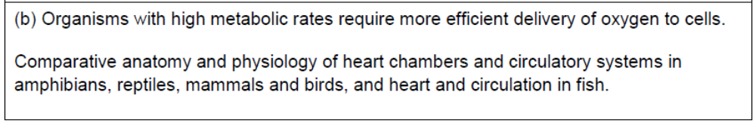
Course Specification

Slide 20
Learning Intention
By the end of this topic you should be able to:
Understand how the rate of metabolism can be measured
Describe the mechanisms of delivery of oxygen in terms of cardiovascular system of different animals

Slide 21
Success Criteria
I can:
Describe the single, incomplete double and double circulatory systems and examples of species which have one
Compare the efficiency of the types of circulatory system

Slide 22
Blood Circulation
The main blood vessels involved in the circulation of blood around the body are:
Arteries – carry blood away from the heart (under high pressure)
Capillaries – smallest blood vessels which exchange nutrients, gases, and waste products between the blood and the body tissue
Veins – carry blood back to the heart (under low pressure)

Slide 23
Circulatory Systems in vertebrates
All vertebrates have closed circulatory systems where the blood is contained in a continuous circuit of blood vessels and is kept moving by a muscular pump (a heart)
In closed systems a drop in pressure occurs when blood passes through the capillary blood because the narrow tubes offer resistance to the flow of blood

Slide 24
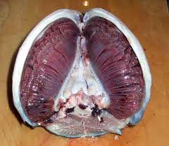
Fish Gills
Gas absorption in fish occurs in the gills. As water flows over the gill filaments oxygen diffuses down the concentration gradient in to the blood

Slide 25
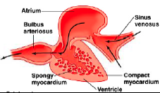
The heart of the fish
It is a 2 chambered heart with an atrium and ventricle and valve in between.

Slide 26
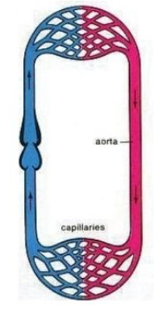
Single Circulatory System
The circulatory system of a fish is described as single because blood passes through the 2-chambered heart only once for each circuit of the body

Slide 27
Single Fish Circulatory System
In the fish the blood flows to the gills at high pressure but is delivered to the capillaries at low pressure. It is a relatively primitive and inefficient method

Slide 28
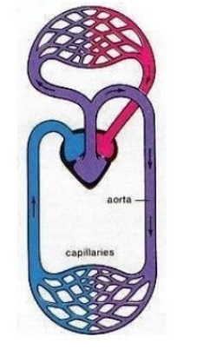
Incomplete Double Circulatory System
Reptiles and amphibians circulatory systems are described as incomplete because there is only 1 ventricle and some mixing of oxygenated blood from the lungs and deoxygenated blood from the body occurs

Slide 29

Incomplete Double Amphibian Circulatory System
In amphibians the mixing is not a major problem as the blood returning from the body has been partially oxygenated through its moist skin

Slide 30
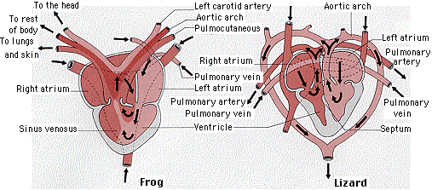
Amphibian and Reptile Heart
They are made of 3 chambers. 2 atria and 1 ventricle.
In reptiles, little mixing occurs because the single ventricle is partly divided by a septum

Slide 31
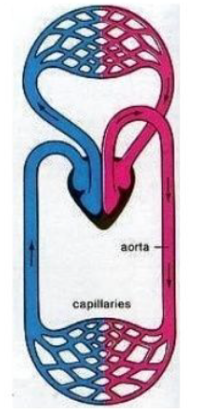
Double Complete Circulatory System
Double because blood passes through the heart twice for each complete circuit of the body
Blood is pumped to both the lungs and the body both at high pressure ensuring vigorous flow. More efficient than single systems

Slide 32
Double Complete Circulatory Systems
Birds and mammals have complete circulatory systems. They are complete because the heart has 2 ventricles completely separated by a septum.

Slide 33
How much do you know?
Rewrite the following sentences:
The heart of a fish contains two/three chambers. Blood is pumped at high/low pressure to the gills and then on to the body’s capillary beds at high/low pressure.
The heart of a mammal contains three/four chambers. Blood is pumped to the mammals lungs at high/low pressure and to the body’s capillary beds at high/low pressure.

Slide 34
How much do you know?
Rewrite the following sentences:
The heart of a fish contains two/three chambers. Blood is pumped at high/low pressure to the gills and then on to the body’s capillary beds at high/low pressure.
The heart of a mammal contains three/four chambers. Blood is pumped to the mammals lungs at high/low pressure and to the body’s capillary beds at high/low pressure.

Slide 35
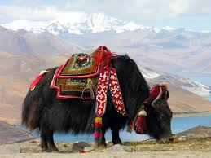
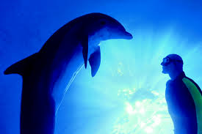
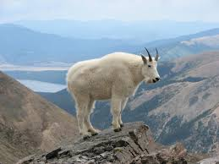
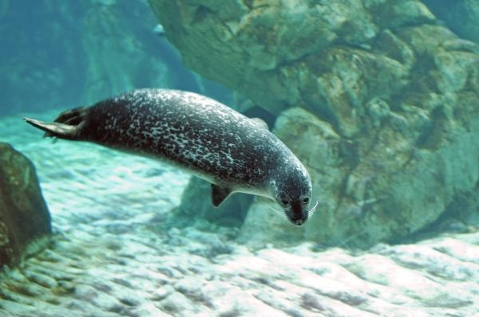
Low Oxygen Niches
There are two main low oxygen niches; at high altitudes and deep-diving marine habitats

Slide 36
Low Oxygen Niches
To be able to survive and exploit low oxygen niches, animals have to be able to adapt to the conditions
To adapt to high altitudes where there is less oxygen, humans secrete higher concentration of the hormone that stimulates red blood cells production in the bone marrow

Slide 37
DPG disphosphoglycerate
Increasing the effectiveness of oxygen uptake can be achieved by varying the levels of diphosphoglycerate or DPG (an organic phosphate in the blood)
DPG is found in red blood cells where it interacts with haemoglobin
DPG enables haemoglobin to release oxygen where it is required eg. in respiring tissues
DPG levels are lower in animals that have adapted to high altitude; this allows their blood to have a greater affinity for oxygen

Slide 38
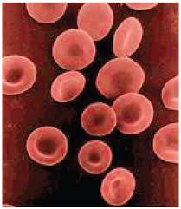
Red Blood Cells
Extra RBC also improve transport of oxygen so the person can perform activities like they would at sea level. It takes 46 days for a person living at sea level to adapt to an altitude 4km above sea level

Slide 39
Research Extension Task
Research an animal that lives either in high altitudes or is a deep diving mammal
Research how it adapts and survives in it’s low oxygen niche.

Slide 40
Success Criteria
I can:
Describe the single, incomplete double and double circulatory systems and examples of species which have one
Compare the efficiency of the types of circulatory system

Slide 41
Plenary
Swap your research with your desk partner and have a read of their findings

