Slide 1
Higher Biology
Unit 2
KA 7 – Genetic Control of Metabolism

Slide 2
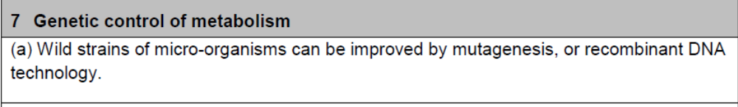
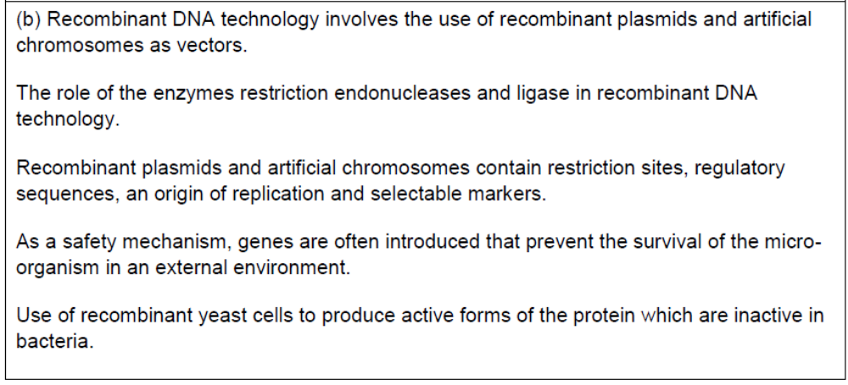
Course Specification

Slide 3
Starter
Using your Nat 5 knowledge describe the process of genetic engineering with a diagram

Slide 4
Learning Intention
By the end of the topic I will be able to:
Describe recombinant DNA technology and explain its uses

Slide 5
Success Criteria
I can:
Give two ways in which mutations can be induced in microorganisms
Describe what is meant by recombinant DNA technology
Suggest some reasons for gene manipulation
Give an example of a safety mechanism and explain how it works

Slide 6
Selection and isolation of micro-organisms
Wild strains of micro-organisms can selected to be of use in industrial processes
They are then cultured in an enriched nutrient medium, and pure strains are isolated

Slide 7
Strain Improvement
These strains may still need to be improved, for example:
  To improve genetic stability
  To improve their ability to grow on low cost nutrients
  To produce large quantities of target compound
  To allow easy harvesting of target compound after fermentation is complete
These improvements can be brought about by mutagenesis, breeding programmes or recombinant DNA technology

Slide 8
Mutagenesis
Mutagenesis is the creation of mutations.
What is a mutation?
In nature mutations are rare and spontaneous and are the cause of variation
The rate of mutagenesis can be increased by exposing organisms to mutagenic agents (UV light, radiation, mutagenic chemicals)

Slide 9
Mutagenesis
Sometimes a mutant strain produced shows improved characteristics such as increased yield

Slide 10
Recombinant DNA Technology
With this technique scientists can transfer gene sequences from one organisms to another and even from one species to another
By introducing genes to a micro-organism (bacterium or yeast) the following improvements can be made:
  Amplify specific metabolic steps in a pathway to increase yield of target compound
  Cause cell to secrete product into surrounding medium for ease of harvesting
  Prevents microbe from surviving in the external environment to reduce chances of an outbreak.

Slide 11
Vector (carrier)
A vector is a DNA molecule used to carry foreign genetic information into another cell
Recombinant plasmids and artificial chromosomes are used as vectors to carry DNA from the genome of one organism
Artificial chromosomes are preferable to plasmids as vectors when larger fragments of foreign DNA are required to be inserted

Slide 12
Restriction Endonucleases
A restriction endonuclease is an enzyme which is used:
  to cut up DNA (containing the required gene from the donor organism) into fragments
  to cut open the bacterial plasmids that are to receive it
Each restriction endonuclease recognises a specific short sequence of DNA bases called a restriction site

Slide 13
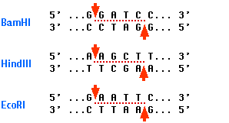
Restriction Endonucleases
The target sequence (4-8 nucleotides in length) is found on both DNA strands but running ion opposite directions
The enzyme cuts both DNA strands leaving sticky ends

Slide 14


Slide 15
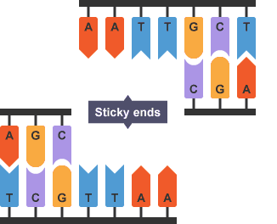
Restriction Endonucleases
Complementary sticky ends are produced when the same restriction endonuclease is used to cut open the plasmid and the gene from the chromosome

Slide 16
DNA ligase
DNA ligase is an enzyme which seals sticky ends together
It is used to seal a DNA fragment into a bacterial plasmid to form a recombinant plasmid containing recombinant DNA

Slide 17
Creating a vector
When creating a vector eg an artificial chromosome, there are several parts that have to be included.

Slide 18
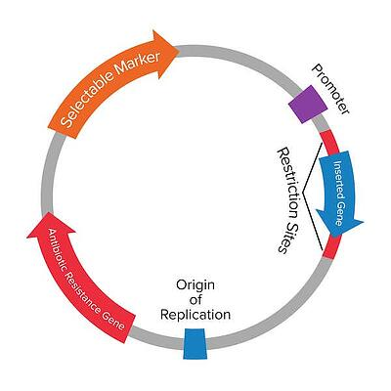
Regulatory Sequence

Slide 19
Restriction Site
Restriction sites contain target sequences of DNA where specific restriction endonucleases cut

Slide 20
Regulatory Sequences
Regulatory sequences allow control gene expression of
  existing genes
  the inserted gene.

Slide 21
Origin of Replication
This consists of genes that control self replication of the plasmid DNA
This site is essential for the generation of many copies of the plasmid (and the required gene) within the transformed bacterial host cell.

Slide 22
Selectable Marker
Selectable markers such as antibiotic resistance genes protect the microorganism from a selective agent (antibiotic) that would normally kill it or prevent it growing
They ensure only microorganisms that have taken up the vector grown in the presence of the selective agent

Slide 23
Selectable Marker
For example, a plasmid could contain the marker gene for resistance to the antibiotic ampicillin. Therefore when cultured in a medium containing ampicillin, any host cells that have failed to take up a recombinant plasmid die since they lack the resistance gene.

Slide 24
Safety Mechanisms
As a safety mechanisms, genes are often introduced that prevent the survival of the microorganism in an external environment

Slide 25
Stage | Description
1 | Transformation
2 | Cell growth and protein production
3 | Selection (and screening of cells)
4 | Microorganisms with the desired vector will grow and multiply rapidly
5 | Microorganisms without the desired vector will not grow

Slide 26
Yeast
Recombinant yeast cells may be used, as plant or animal recombinant DNA expressed in bacteria may result in polypeptides being incorrectly folded

Slide 27
Video
https://www.youtube.com/watch?v=C6DS20GktCI
Interactive
https://www.labxchange.org/library/items/lb:LabXchange:783397ff:lx_simulation:1
https://www.labxchange.org/library/items/lb:LabXchange:d92f7509:lx_simulation:1
https://www.labxchange.org/library/items/lb:LabXchange:29685159:lx_simulation:1
https://www.labxchange.org/library/items/lb:LabXchange:1fb8b9d5:lx_simulation:1
https://www.labxchange.org/library/items/lb:LabXchange:b4d9f467:lx_simulation:1?fullscreen=true

Slide 28
Success Criteria
I can:
Give two ways in which mutations can be induced in microorganisms
Describe what is meant by recombinant DNA technology
Suggest some reasons for gene manipulation
Give an example of a safety mechanism and explain how it works

Slide 29
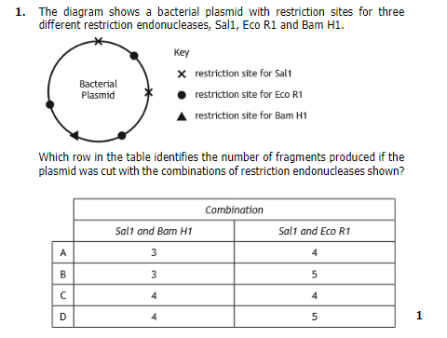
Plenary

