Slide 1
Higher Biology
Unit 2
KA 4 – Metabolism in Conformers and Regulators

Slide 2
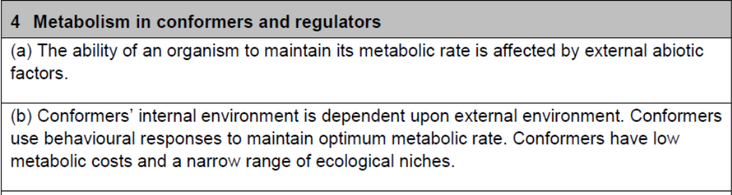
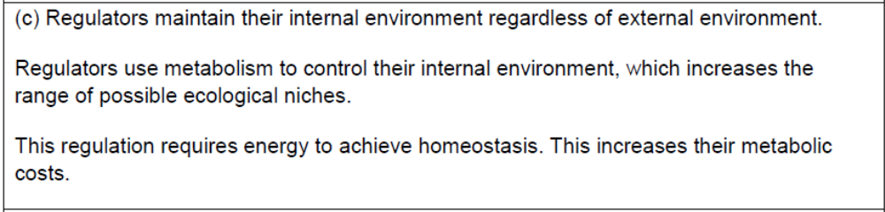
Course Specification

Slide 3
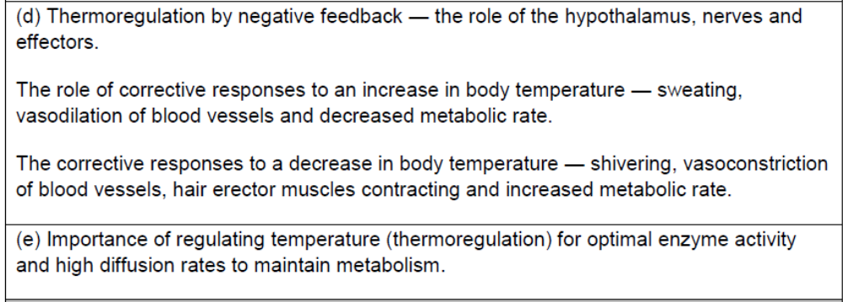
Course Specification

Slide 4
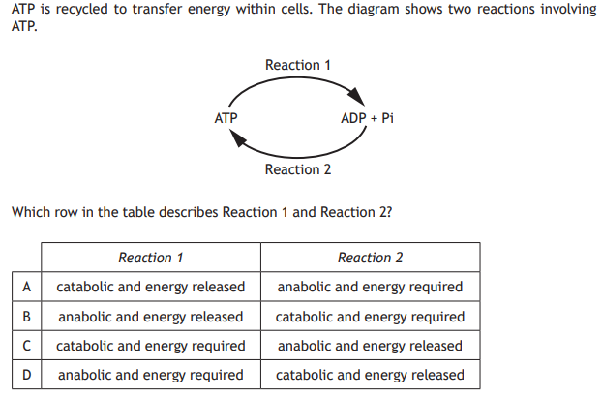
Starter

Slide 5
Learning Intention
By the end of the topic I will be able to:
Describe what is meant by a conformer and a regulator
Explain thermoregulation

Slide 6
Success Criteria
I can:
Give examples of external factors that influence metabolic rate
Define conformer and regulator and give examples of species in these categories
Describe the response of conformers and regulators to changing environmental conditions
Define homeostasis
Give reasons for regulating temperature
Describe the basic negative feedback loop
Describe thermoregulation
Explain the importance of regulating temperature in terms of cellular activity

Slide 7
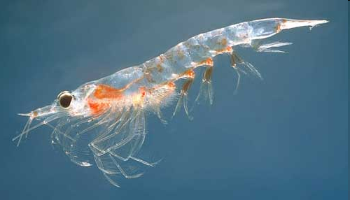
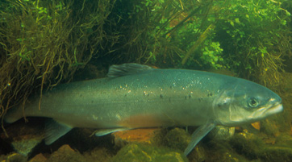
It’s All About Surviving
External abiotic factors such as temperature, salinity and pH can affect the ability of an organism to maintain its metabolic rate.

Slide 8
Measuring Metabolic Rate
Environmental conditions vary, an organism
can respond to these variations in 2 ways:
Conformation
Regulation

Slide 9
Metabolism in conformers and regulators
RIGID CONFORMER (reptile)
Increase in factor affecting animal’s internal environment
RIGID REGULATOR (mammal)
Increase in factor affecting animal’s external environment

Slide 10
Conformers
A conformers internal environment is directly dependent upon its external environment
These organisms cannot maintain their metabolic rate by physiological mechanisms.
Most conformers live in the ocean where the environment is relatively stable

Slide 11
Conformers
Advantages – low metabolic costs (physiological homeostasis uses up a lot of energy)
Disadvantages – animal is restricted to a narrow range of ecological niches, and is less adaptable to environmental change

Slide 12
Regulators
Organisms which can control their internal environment and maintain a steady state known as homeostasis

Slide 13
Regulators
Advantages: can exploit a wider range of ecological niches
Disadvantages: animal has to expend energy on homeostasis achieved by Negative Feedback Control

Slide 14
Survival of Species
How might climate change impact on survival of species?
If the climate changes and the species is not able to survive it may die out
Or another species which is better suited may outcompete the original

Slide 15
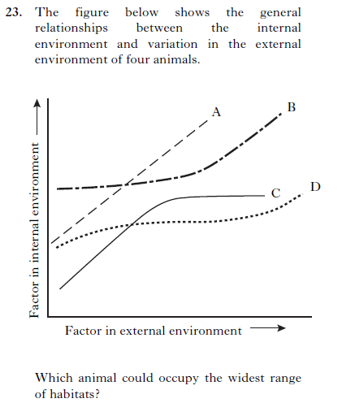
Which of these animals would be considered a complete conformer?
Which is the best regulator?
Place the animals in order of most affected to least, when there is a drop in the external factor from point z.
z

Slide 16
Physiological Homeostasis
Maintenance of the body’s internal environment within certain tolerable limits despite changes in the body’s external environment
This regulation is brought about by negative feedback control and requires energy

Slide 17

The principle of Negative Feedback control
increase
In factor
messages
Corrective mechanism
lowers factor
receptor
effector
Factor at norm or set point
Norm (no disturbance)
Factor at norm
decrease
In factor
Corrective mechanism
raises factor
receptor
effector
A factor can increase or decrease from its norm or set point. This is sensed by receptors tor that factor. Messages are sent from the receptors to the effectors which bring about a corrective response to lower or raise the actor back to its norm or set point.

Slide 18
Video
https://www.youtube.com/watch?v=vJhsyS4lTW0

Slide 19
Importance of Temperature Regulation
It is important to regulate temperature for optimal enzyme-controlled reactions and diffusion rates for maintenance of metabolism.
Diffusion of substances such as oxygen and carbon dioxide are faster at warmer temperatures.

Slide 20
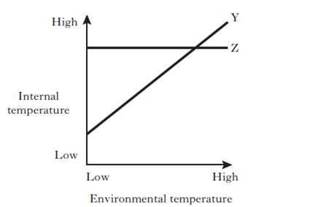
Which animal is the
ectotherm or conformer?
This animal will have a narrow
habitat range because their
metabolism is dependent on
external temperature.
Which animal is the endotherm or regulator? This animal will have a wider habitat range because their metabolism will run regardless of external temperature.
Which would have the higher energy cost, a conformer or regulator?
Regulator

Slide 21
Thermoregulation and Negative Feedback
Negative Feedback Control and Thermoregulation in mammals include the role of the hypothalamus, nerves, effectors and skin

Slide 22
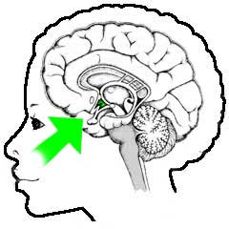
The Hypothalamus
Hypothalamus is the body’s temperature monitoring centre
Receives impulses from the heat and cold receptors of the skin.
The hypothalamus itself also contains thermoreceptors, which detect changes in blood temperature which reflect changes in the body core temperature.

Slide 23
Hypothalamus as a Thermostat
The temperature is set in the water bath
Too cool? Heater switches on and temperature goes up
Too hot? Heater stays off until bath cools down.
Constantly checking and turning on and off.

Slide 24
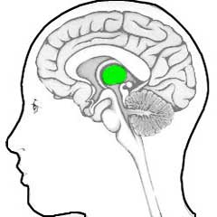
Temperature control by the hypothalamus
temperature change in blood of carotid artery
nerve impulses from skin receptors
sweat glands
hair erector muscles
skeletal muscles
skin arterioles

Slide 25
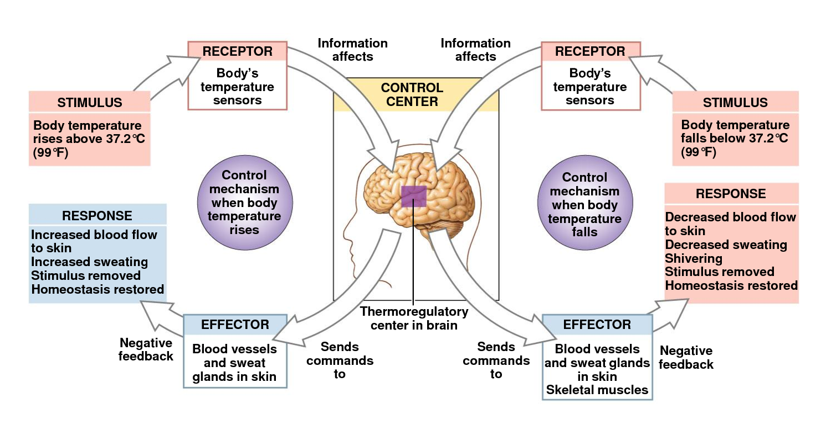

Slide 26
Role of the Skin
The skin plays a leading role in temperature regulation
In response to nerve impulses from the hypothalamus, the skin acts as an effector

Slide 27
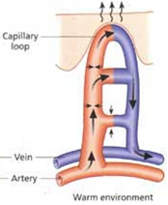
Correction of overheating
Vasodilation: when we are too hot, the capillaries to the skin surface dilate, allowing blood to the surface to lose heat BY RADIATION

Slide 28
Vasodilation
Much Heat Lost
Environment
skin

Slide 29
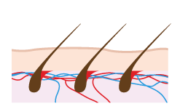
Correction of overheating
Vasodilation: enables heat to be lost from blood by radiation
Increased rate of sweating – Heat energy from the body is used to convert the water in sweat to water vapour bringing about a lowering of body temperature.
Relaxation of hair erector muscles - this prevents heat being trapped in a layer of air next to the skin and allows it to escape.
Decrease in metabolic rate

Slide 30
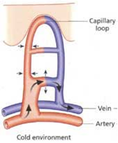
Correction of overcooling
Vasoconstriction- when we are too cold, the arterioles constrict which allows only a small volume of blood to flow to the surface capillaries. Little heat lost by radiation.

Slide 31
Vasoconstriction
Little Heat Lost
Environment
skin

Slide 32

Correction of overcooling
Vasoconstriction – reduces heat lost by radiation
Decreased rate of sweating - reduces heat lost by evaporation
Hairs raised – traps a layer of insulating air to reduce heat loss.
Increase in metabolic rate
Shivering

Slide 33
INCREASED BODY TEMPERATURE | DECREASED BODY TEMPERATURE
Dilate surface capillaries VASODILATION – more heat lost from blood by radiation | Narrow surface capillaries VASOCONSTRICTION – less heat lost from blood by radiation
Erector muscles relax – hairs lie flat –traps narrow insulating layer of air | Hair erector muscles contract – hairs become raised – traps wide insulating layer of air
Reduced rate of metabolism | Increased rate of metabolism
Sweating – heat used to evaporate water in sweat to water vapour | Reduced sweating – less heat used to evaporate water in sweat to water vapour

Slide 34
Success Criteria
I can:
Give examples of external factors that influence metabolic rate
Define conformer and regulator and give examples of species in these categories
Describe the response of conformers and regulators to changing environmental conditions
Define homeostasis
Give reasons for regulating temperature
Describe the basic negative feedback loop
Describe thermoregulation
Explain the importance of regulating temperature in terms of cellular activity

Slide 35
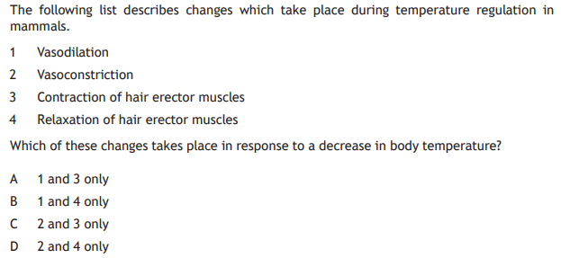
Plenary

Slide 36
Extended Responses
Give an account of the mechanisms of thermoregulation in mammals (9)
Give an account of metabolism in conformers in relation to their ecological niches (7)

