Slide 1
Higher Human Biology
Unit 2
Physiology and Health

Slide 2
2.1 Gamete Production and fertilisation
2.2 Hormonal Control of Reproduction
2.3 Biology of controlling fertility
2.4 Ante- and post natal screening
2.5 The structure and function of arteries, capillaries and veins
2.6 Structure and Function of the heart
2.7 Pathology of cardiovascular disease
2.8 Blood glucose levels and obesity

Slide 3
Structure of the Heart – What Can you Remember?
What are the chambers of the heart called?
Which side of the heart carries deoxygenated blood?
Which side of the heart carries oxygenated blood?

Slide 4
Which ventricle is the thicker of the 2 and why?
What is the function of valves?
What are the names of the valves and where are they situated?

Slide 5
1. Collect a copy of the heart diagram and stick it into your notes.
2. Add labels to show the positions of the right and left atria, right and left ventricles and valves.
3. Add arrows to your diagram to show how blood moves through the heart.
4. Colour the right atrium and ventricle blue, and the left atrium and ventricle red.
5. Add a key to explain that blue shows deoxygenated blood and red shows oxygenated blood.
6. Give the meaning of the terms oxygenated blood and deoxygenated blood.
7. Name the four major blood vessels leading into and out of the heart.
8. Explain where each blood vessel transports blood from and to.
9. How does the blood in the pulmonary artery differ from blood in other arteries?
10. How is the hepatic portal vein different from other veins in the body?
11. Look at figure 13.3 pg.160. Stick in a copy of this diagram.

Slide 6
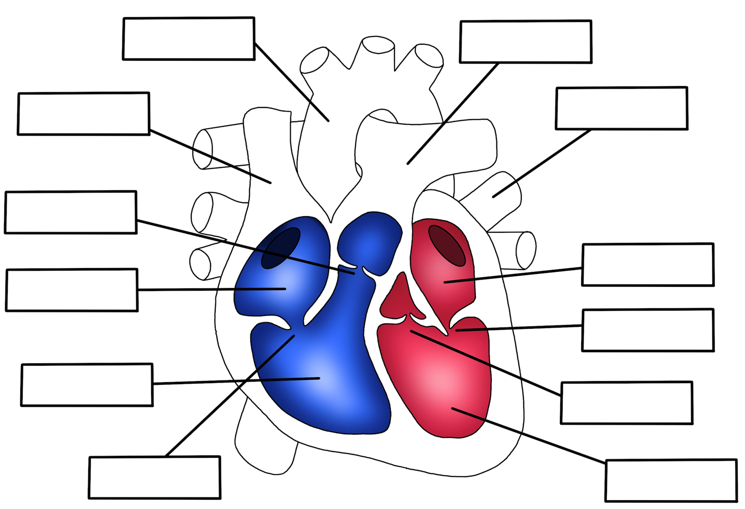

Slide 7
Heart diagram word bank:
Pulmonary Artery
Vena Cava
Aorta
Semi-lunar Valve
Semi-lunar Valve
Left Atrium
Right Atrium
Pulmonary Vein
Atrial-ventricular Valve
Atrial-ventricular valve
Left Ventricle
Right Ventricle
NEW TERMS

Slide 8
Pulmonary Artery
Aorta
Pulmonary Vein
Vena Cava
Semi-lunar valve
Left Atrium
Right Atrium
Atrial-ventricular valve
Right Ventricle
Semi-lunar valve
Atrial-ventricular valve
Left Ventricle

Slide 9
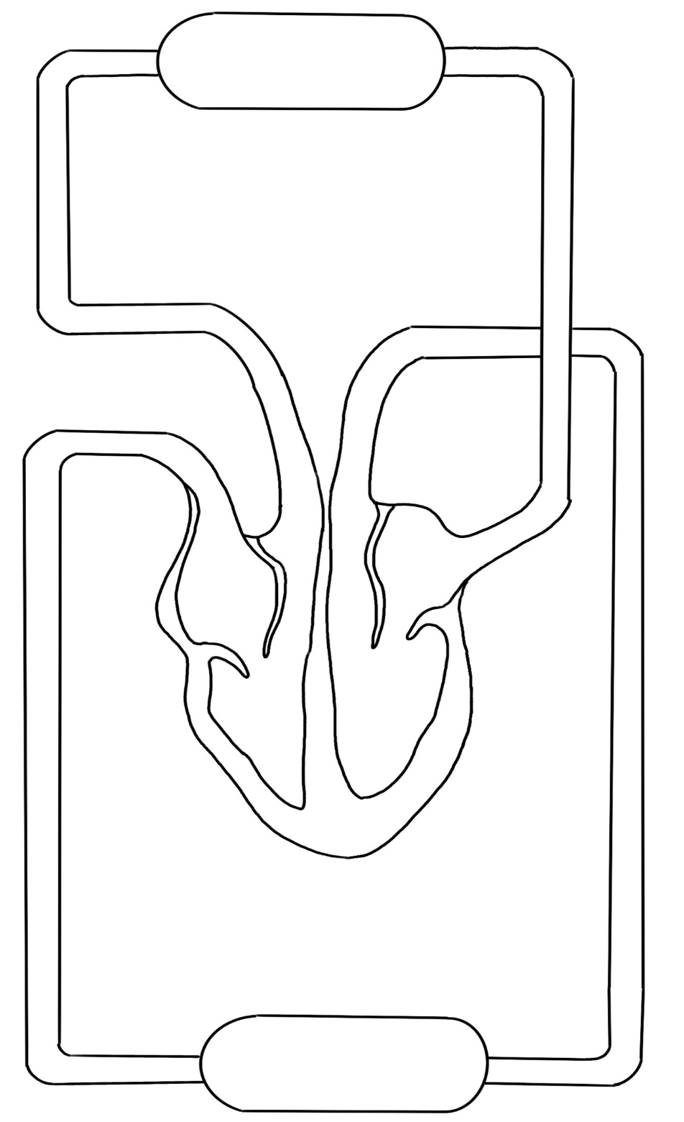
Lungs
Pulmonary Artery
Aorta
Pulmonary Vein
Vena Cava
Capillaries

Slide 10
The bicuspid and tricuspid valves are found in between the atria and ventricles – they prevent backflow of blood back to the atria.
we will call these the atrio-ventricular (AV) valves from now on.
There are valves called semi-lunar (SL) valves in the arteries leaving the heart.
Add these valve labels to your heart diagram in your diagram pack.

Slide 11
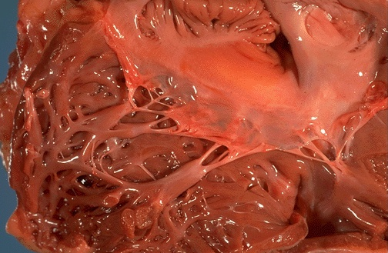
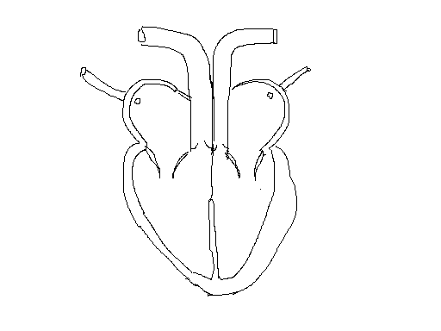
Right AV (tricuspid) valve
Left AV (bicuspid) valve
Semi-lunar valves

Slide 12
Cardiac Function
Heart rate (pulse):- the number of heartbeats in 1 minute. Can use a pulsometer to measure this.
Stroke volume:- is the volume of blood expelled by each ventricle on contraction.
Cardiac output:- the volume of blood pumped out of a ventricle per minute.
CO = HR x SV
Cardiac output increases during exercise.
*The left and right ventricles pump the same volume of blood through the aorta and pulmonary artery*

Slide 13

Cardiac Output Calculation Example
A 40 year old man has a resting heart rate of 65 bpm and a stroke volume of 59ml. What is his cardiac output?
Heart Rate = 65 bpm
Stroke volume is 59ml = 0.059 litres.
So CO = HR x SV
CO = 65 x 0.059
CO = 3.84 l/min

Slide 14
Cardiac Output Calculations
Person | Heart Rate (bpm) | Stroke Volume (ml) | Cardiac Output (l/min)
A | 60 | 60
B | 120 |  | 8.4
C |  | 80 | 14.4

Slide 15
Cardiac Output Calculations
Person | Heart Rate (bpm) | Stroke Volume (ml) | Cardiac Output (l/min)
A | 60 | 60 | 3.6
B | 120 |  | 8.4
C |  | 80 | 14.4

Slide 16
Cardiac Output Calculations
Person | Heart Rate (bpm) | Stroke Volume (ml) | Cardiac Output (l/min)
A | 60 | 60 | 3.6
B | 120 | 70 | 8.4
C |  | 80 | 14.4

Slide 17
Cardiac Output Calculations
Person | Heart Rate (bpm) | Stroke Volume (ml) | Cardiac Output (l/min)
A | 60 | 60 | 3.6
B | 120 | 70 | 8.4
C | 180 | 80 | 14.4

Slide 18
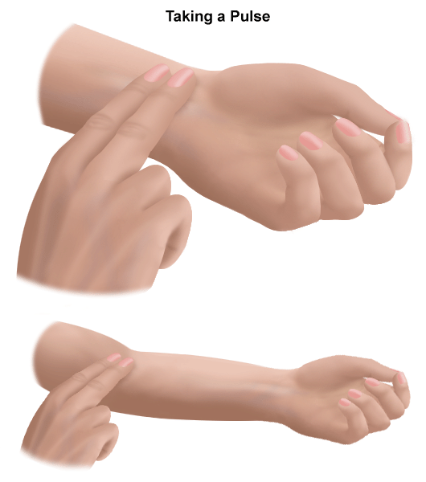
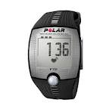
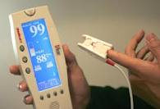
Measuring Heart Rate
Extension Exercise: If there is time
We have carried out calculations using heart rate (bpm), but how can we measure heart rate?
Easy, by measuring PULSE RATE.
Pulse rate is the same as heart rate. We can use our fingers and a stopwatch or a pulsometer to measure our pulse rate.

Slide 19
Blood pressure vs. heart rate
Some people confuse high blood pressure with a high heart rate. Blood pressure is the measurement of the force of the blood against the walls of arteries, while pulse rate is the number of times your heart beats per minute.
There is no direct correlation between the two, and high blood pressure, or hypertension, does not necessarily result in a high pulse rate, and vice versa.

Slide 20
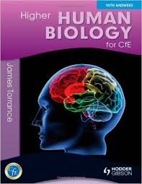

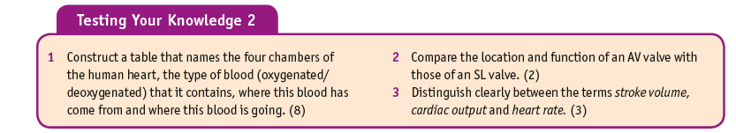
Page 169

Slide 21
Cardiac Cycle
The cardiac cycle is the pattern of contraction and relaxation shown by the heart in 1 heartbeat.
Contraction = systole
Relaxation = diastole
One full cycle takes about 0.8 seconds. (75bpm)
This can be broken down into 3 stages:
- Atrial systole
- Ventricular systole
- Diastole (of both atria and ventricles)

Slide 22
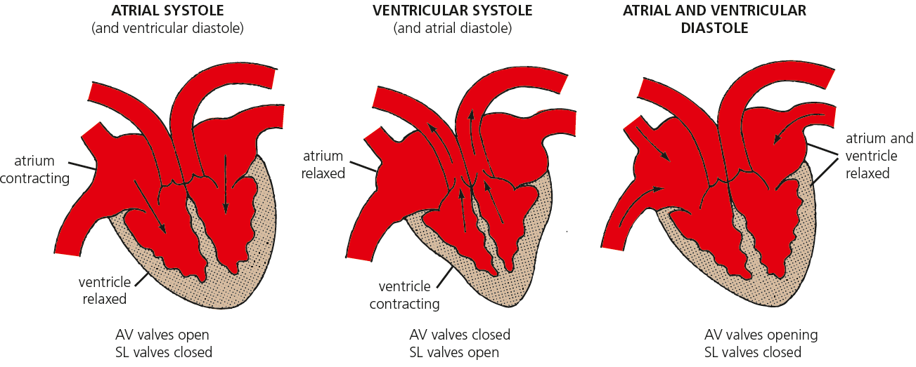
Atrial systole
The 2 atria contract at same time. This transfers the remainder of the blood through the open atrio-ventricular (AV) valves to the ventricles.
Ventricles fill with blood and semi-lunar (SL) valves stay closed.

Slide 23
Ventricular systole
Ventricles contract, the AV valves close and blood is pumped out through the SL valves to the aorta and pulmonary artery. (Ventricular pressure exceeds arterial pressure so SL valves open)

Slide 24
Diastole
The heart muscle is relaxed. Blood returning to the atria flows into the ventricles. Atrial pressure exceeds that in the ventricles. AV valves open. Higher pressure in the arteries closes the SL valves.
(The opening and closing of the AV and SL valves are responsible for the heart sounds heard with a stethoscope.)

Slide 26
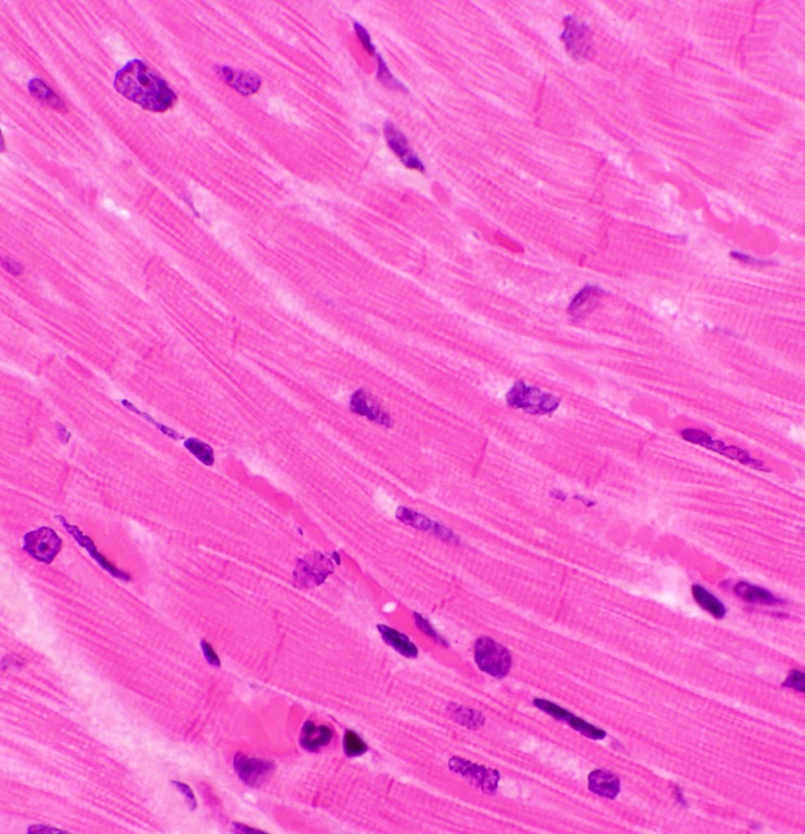
Cardiac conducting system
The heart beat originates in the heart itself but it is regulated by nervous and hormonal control.

Slide 27
Cardiac conducting system
Heart muscle cells are able to contract and produce an electrochemical signal, which is passed on to other cardiac muscle cells, causing them to contract.
The conducting system (nervous control) of the heart ensures that it beats in a co-ordinated manner.

Slide 28
Cardiac conducting system
The sino-atrial node (SAN) is found at the top of the right atrium.

Slide 29
Cardiac conducting system
The SAN is also known as the pacemaker.
It is a small area of specialised tissue (auto-rhythmic cells) that exhibits spontaneous excitation. It sets the rate at which cardiac muscle cells contract.
The electrical impulse that is generated by the contracting cells in the SAN is passed through the left and right atria (this causes the atria to contract simultaneously – systole) to the atrio-ventricular node (AVN).

Slide 30
Cardiac conducting system
The AVN is found centrally near the base of the atria (near lower wall of right atrium)
When the wave of excitation from the SAN reaches the AVN, the electrical impulse is conducted to the cells in the ventricles of the heart.
This makes the ventricles contract simultaneously during ventricular systole.
This system allows the heart to contract in a co-ordinated manner and ensures the ventricles contract after the atria.

Slide 31
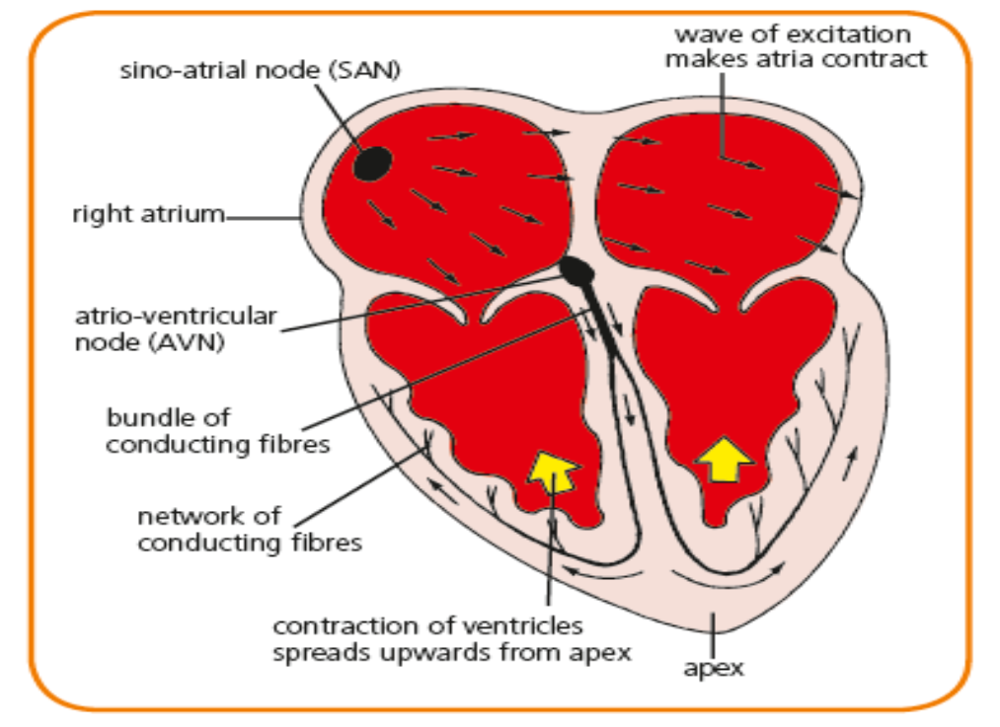

Slide 32
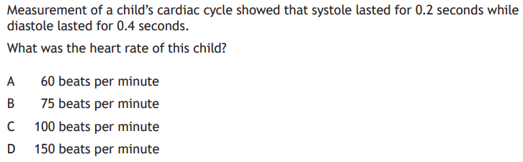
The timing of cardiac muscle cell contraction is controlled by impulses from the SAN spreading through the atria causing atrial systole. They then travel to the atrioventricular node (AVN), located in the centre of the heart. Impulses from the AVN travel down fibres in the central wall of the heart and then up through the walls of the ventricles, causing ventricular systole.

Slide 34
Starter Questions
Calculate the cardiac output if the HR is 75 bpm and the stroke volume is 68ml (include units!).
Calculate the HR if the cardiac output is 5.2L and the stroke volume is 61ml (include units!).
What happens to a muscle during a) systole b) diastole
State which valves are open and which are closed during atrial systole.
State which valves are open and which are closed during ventricular systole.
Where does the heart beat originate?
Name the area of the heart that sets the rate at which cardiac muscle cells contract.
What happens as a result of the wave of excitation from the SAN reaches the AVN?

Slide 35
Starter Questions
Calculate the cardiac output if the HR is 75 bpm and the stroke volume is 68ml (include units!).
Calculate the HR if the cardiac output is 5.2L and the stroke volume is 61ml (include units!).
What happens to a muscle during a) systole b) diastole
State which valves are open and which are closed during atrial systole.
State which valves are open and which are closed during ventricular systole.
Where does the heart beat originate?
Name the area of the heart that sets the rate at which cardiac muscle cells contract.
What happens as a result of the wave of excitation from the SAN reaches the AVN?
5100 ml or 5.1L
85bpm
Systole- contract Diastole- relax
AV valve open, SL valve closed
AV valve closed, SL valve open
Originates in the heart itself.
SAN (pacemaker)
Ventricles contact.

Slide 36
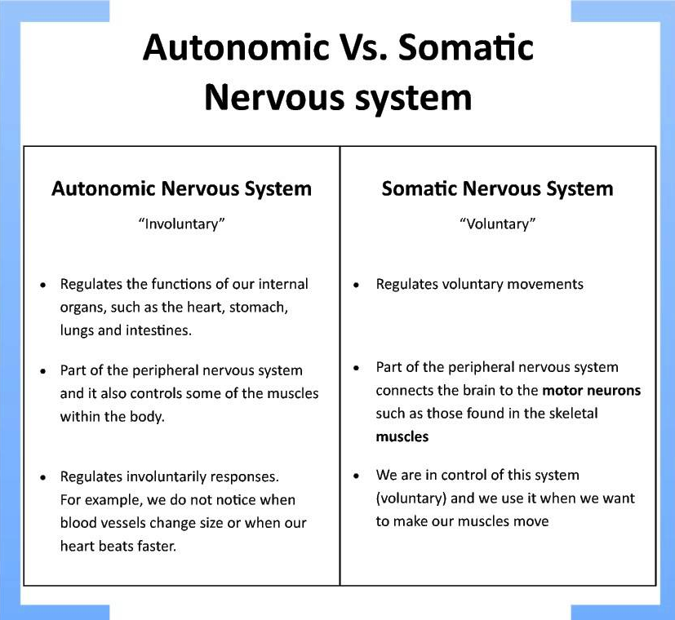

Slide 37
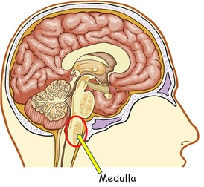
Cardiac conducting system
Heart rate is not only controlled by the SAN, it can be altered by nerve impulses and hormones.
The medulla regulates the rate of the SAN through the action of the autonomic nervous system.

Slide 38
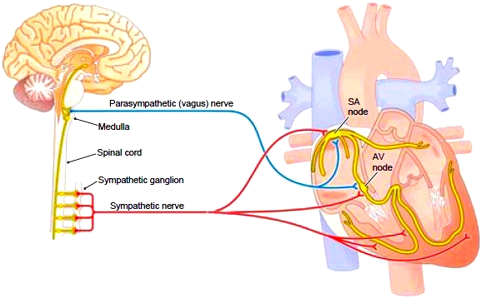
Cardiac conducting system
The autonomic nervous system is part of the peripheral nervous system and is in control of the functions of the body that are not conscious actions.
The heart is supplied by branches of the opposing parts of the autonomic nervous system:
sympathetic nerves
parasympathetic nerves

Slide 39
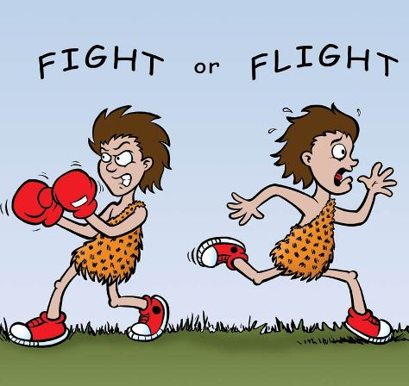
Cardiac conducting system
Sympathetic accelerator nerves release nor-adrenaline which increases the heart rate.
It can be activated due to stress or fear.
NB:-The hormone adrenaline, secreted by adrenal glands, also increases heart rate.
During times of stress or exercise the sympathetic nervous system acts on the adrenal gland making adrenaline which acts on the SAN (pacemaker).

Slide 40
Cardiac conducting system
Parasympathetic nerves release acetylcholine, which slows the heart rate.
These fibres are activated during periods of rest.

Slide 42
The medulla regulates the rate of the sinoatrial node through the antagonistic action of the autonomic nervous system (ANS). A sympathetic nerve releases noradrenaline which increases the heart rate, whereas a parasympathetic nerve releases acetylcholine which decreases the heart rate.

Slide 43
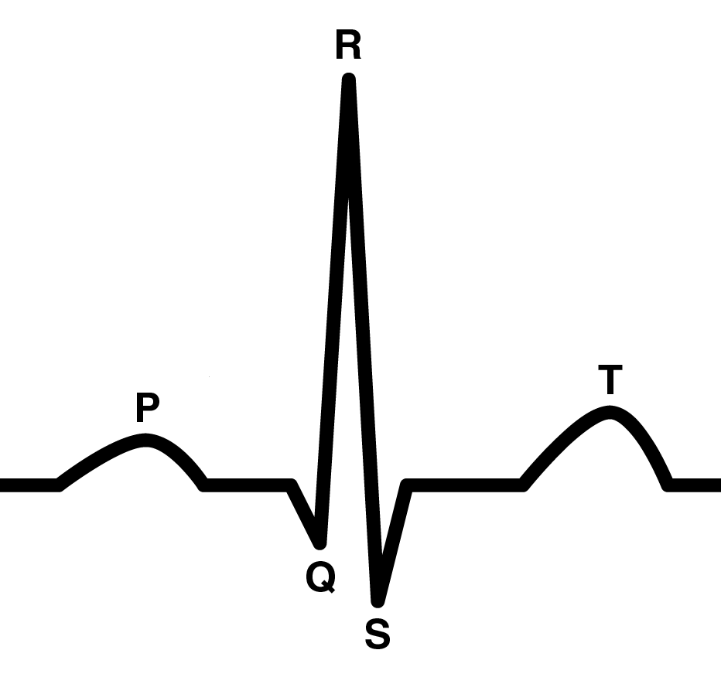
Cardiac conducting system
The electrical impulses in the heart generates currents that can be detected by an electrocardiogram (ECG).
An ECG is used to measure the electrical changes that take place in the heart.

Slide 44
Cardiac conducting system
P wave – the wave of electrical impulses spreading over the atria from the SAN.
Q-R-S complex – the electrical impulses through the ventricles.
T wave – the electrical recovery of the ventricles at the end of ventricular systole.

Slide 45
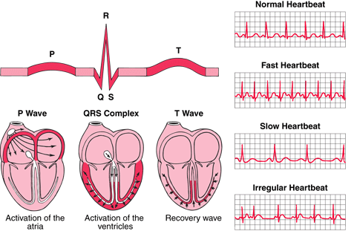

Slide 46
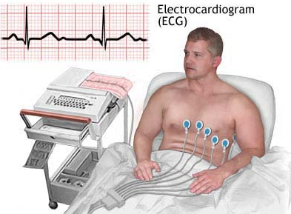

Slide 48
Look for full cardiac cycle….. In this case it is 0.5s.
Then 60/0.5 = 120 beats per minute

Slide 49
This person’s heart rate would be 75bpm based on 60s / 0.8.
= 75.

Slide 50
Impulses in the heart generate currents that can be detected by an electrocardiogram (ECG). Interpretation of electrocardiograms (ECG) should involve calculation of heart rate and linking of the waves to atrial systole, ventricular systole and diastole.

Slide 52

A = SAN B = AVN

Slide 53
Cardiac conducting system
Occasionally the heart’s conducting system fails to function properly.
Watch the video on the following website:
www.nhs.uk/conditions/pacemakerimplantation/pages/introduction.aspx

Slide 54
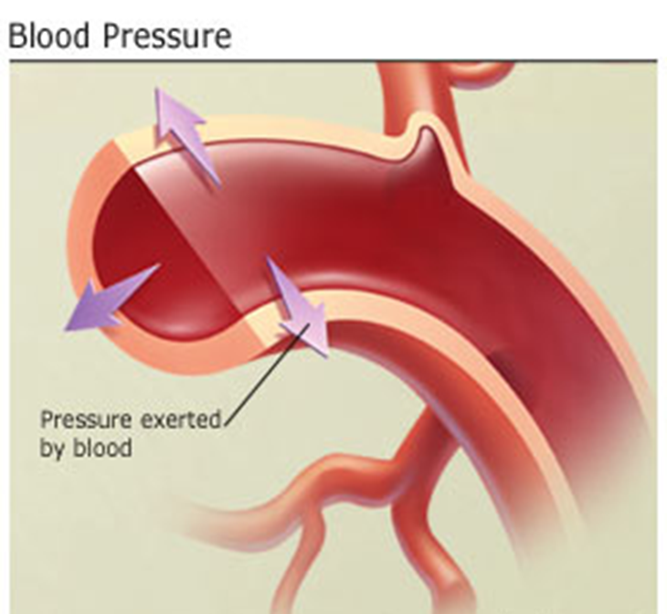
Blood Pressure
Blood pressure is the force exerted by blood against the walls of the blood vessels. It is measured in millimetres of mercury (mmHg).
It can be measured using a sphygmomanometer.

Slide 55
Blood pressure
Blood pressure is generated by the contraction of the ventricles.
Blood pressure is highest during ventricular contraction (systole) and lowest during relaxation of the ventricles (diastole).
The highest value is the systolic pressure (e.g. 120) and the lowest is the diastolic pressure (e.g. 80).

Slide 56
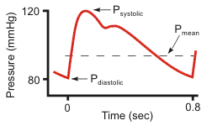
Blood pressure
The blood pressure in the aorta rises and falls during each cardiac cycle.

Slide 57
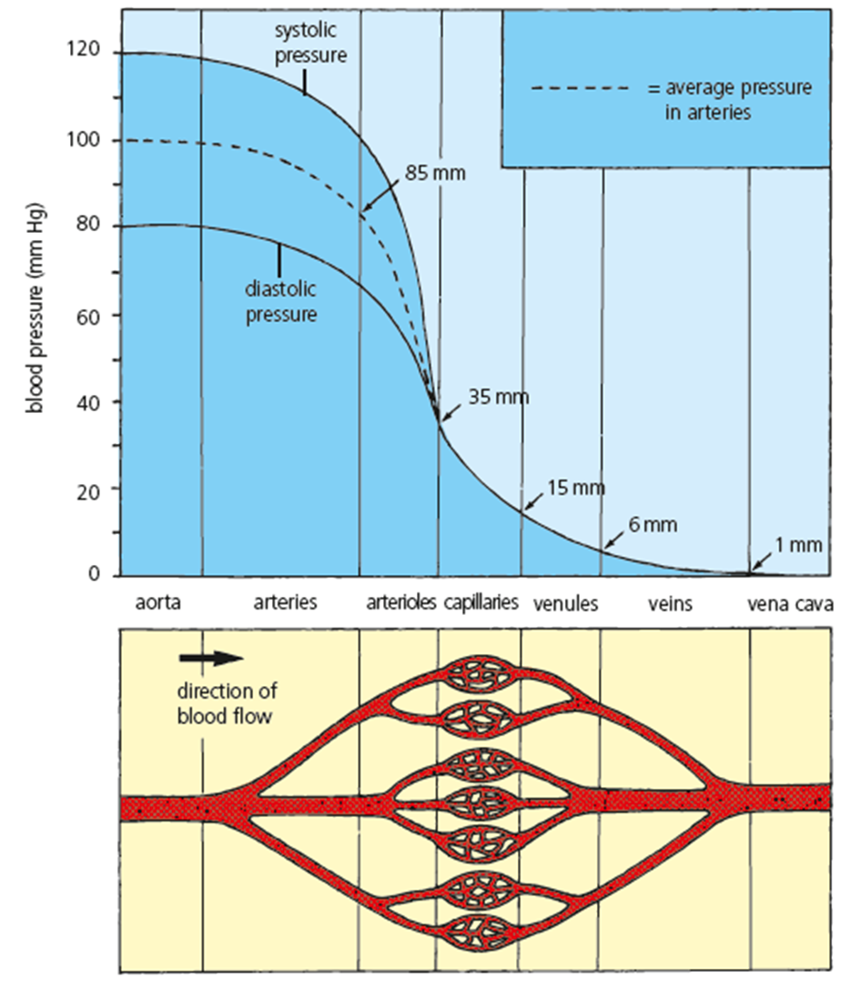
As blood travels around the circulatory system, the pressure drops to almost zero.

Slide 58
Blood pressure
Blood pressure can be a health indicator and is monitored using a sphygmomanometer.
Blood pressure values are written with the systolic pressure over the diastolic pressure.
A value of 120/80 mmHg is typical for a healthy young adult.

Slide 59
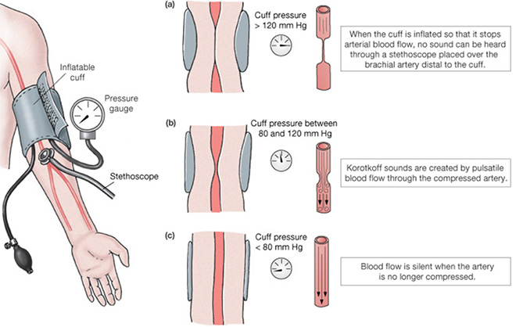

Slide 60
An inflatable cuff stops blood flow and deflates gradually.
The blood starts to flow (detected by a pulse) at systolic pressure.
The blood flows freely through the artery (and a pulse is not detected) at diastolic pressure.

Slide 61
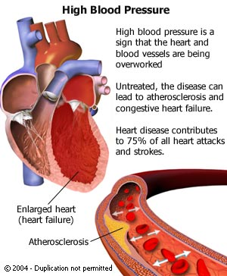
Blood pressure
Blood pressure measures how strongly blood presses against the walls of your arteries.
If this pressure is too high it is more likely that you will suffer coronary heart disease or a stroke.

Slide 62
Blood pressure
High blood pressure is known medically as hypertension.
If your blood pressure is 140/90, it means you have a systolic pressure of 140mmHg and a diastolic pressure of 90mmHg.
These values and above indicate hypertension.

Slide 63
Blood pressure
Factors that can raise your risk of developing primary high blood pressure include:
  age
  a family history of high blood pressure
  a high amount of salt in your food
  a lack of exercise
  being overweight
  smoking
  drinking large amounts of alcohol
  stress

Slide 64
Blood pressure increases during ventricular systole and decreases during diastole.
Measurement of blood pressure using a sphygmomanometer.
An inflatable cuff stops blood flow, in the artery, and deflates gradually. The blood starts to flow (detected by a pulse) at systolic pressure. The blood flows freely through the artery (and a pulse is not detected) at diastolic pressure. A typical blood pressure reading for a young adult is 120/80 mmHg.
Hypertension (high blood pressure) is a major risk factor for many diseases including coronary heart disease.

Slide 65
Starter Questions
What is the difference between the autonomic and the somatic nervous system?
What are sympathetic nerves?
What are parasympathetic nerves?
What chemical is released by sympathetic nerves? What effect does this have on heart rate?
What chemical is released by parasympathetic
nerves? What effect does this have on heart
rate?
Explain what is happening during the ‘Q-R-S’
complex in this ECG.
What is the HR of this person?
a) Explain the two numbers that make up a person’s blood pressure.
b) Wame the device used to measure BP.
c) What BP reading indicates hypertension?

Slide 66

