Slide 1
Higher Biology
Unit 2
KA 1 – Metabolic Pathways

Slide 2
Starter
Describe the function of the plasma cell membrane
Draw and label a diagram of the cell membrane

Slide 3
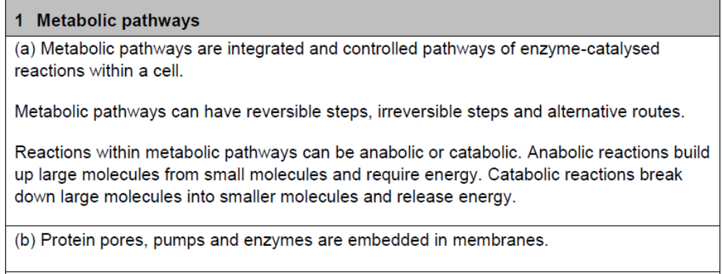
Course Specification

Slide 4
Learning Intention
By the end of this topic you should be able to:
Understand that metabolism is the sum total of all chemical reactions taking place within an organism
Describe how reactions occur in sequences, each one mediated by a specific enzyme
Describe these sequences as pathways and explain how they are linked and may be reversed
Explain the differences between anabolic and catabolic pathways
Describe the role of membranes in relation to the formation of components with cells
Explain why localisation of pathways and their components allows greater efficiency and higher reaction rates
Describe the functions of proteins embedded in the plasma membrane

Slide 5
Success Criteria
I can:
Describe how a membrane pathway are made more efficient by compartmentalisation
Define the term metabolism
Explain what is meant by a metabolic pathway
Compare anabolic and catabolic

Slide 6
1a. Metabolic Pathways

Slide 7
Cell Metabolism
Cell metabolism is the term for the thousands of biochemical reactions that occur within a living cell.
Many of these are steps ordered in to pathways and are controlled at each stage by an enzyme.

Slide 8
What do these pathways do?
Break down large molecules into smaller molecules
        Degradation
Build up large molecules from smaller molecules
        Synthesis

Slide 9
Biochemical Pathways
http://biochemical-pathways.com/#/map/1
Second option - https://upload.wikimedia.org/wikipedia/commons/6/6e/Metabolic_Metro_Map.svg

Slide 10
Catabolic Pathways
The break down of complex molecules to simpler ones (break down or degradation)
  usually releasing energy
  often providing building blocks
  Eg
Protein amino acids

Slide 11
Anabolic Pathways
The synthesis of molecules from building blocks (build up or synthesis)
  requires the input of energy.
(Anabolic = Add)
Amino acids Protein

Slide 12
Metabolic pathways
Anabolic and catabolic pathways are closely integrated and depend on each other
Respiration is a catabolic process releasing energy which is used to synthesise protein from amino acids (anabolic process)

Slide 13




Metabolic Pathways
Glucose + oxygen
Protein
Catabolic pathway
energy
Anabolic pathway
CO₂ + Water
Amino acids

Slide 14
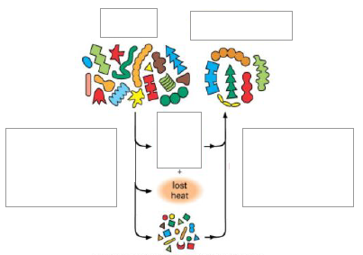
Protein
Protein
Energy (ATP)
Proteins broken down in a catabolic pathway to form amino acids
Amino Acids built up in a anabolic pathway to form protein

Slide 15
Metabolic Pathways
A metabolic pathway is the sequence of reactions that is controlled by enzymes that change one metabolite in to another
Each step is controlled by an enzyme
glucose
Enzyme A
Intermediate 1
Enzyme B
Intermediate 2

Slide 16
Reversible and irreversible pathways
Some metabolic pathways have reversible steps
Some steps are irreversible
Reversible = two way street
Irreversible = one way street
Fermentation in animal cells Fermentation in yeast
Glucose Lactic Acid Glucose ethanol + water

Slide 17
Metabolic Pathways
The conversion of glucose in to Intermediate 1 is an irreversible step. This keeps glucose at a low concentration in the cell to promote continued glucose diffusion
Pathways can have alternative routes.
glucose
Enzyme A
alternative route
Intermediate 1
Enzyme B
Intermediate 2

Slide 18
Metabolic Pathways
Problems occur in pathways if enzymes aren’t synthesised properly due to mutations you have just learnt about in unit 1.
EG. If Enzyme B doesn’t work, Intermediate 1 will build up. This could be toxic to the cell.
glucose
Enzyme A
Intermediate 1
Enzyme B
Intermediate 2

Slide 19
Membranes and metabolic pathways
The membrane system allows transport both within cells and between cells
Membranes form surfaces and compartments for metabolic pathways to allow high concentrations and reaction rates
Membranes are vitally important as they allow compartmentalisation meaning reactions can be kept separate in the cell

Slide 20
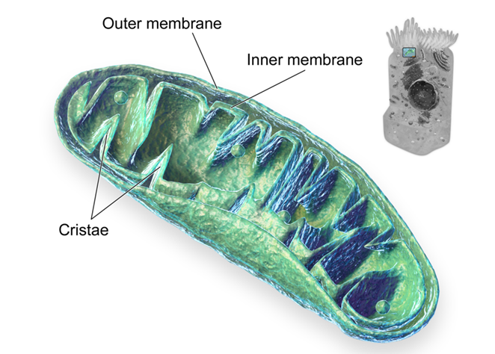
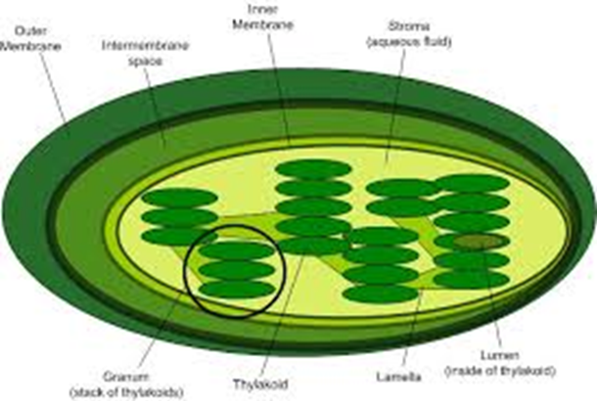
Organelles with membranes
Chloroplast Mitochondria

Slide 21
Cell Membrane Importance
Some organelles have double membranes e.g. mitochondria, where the inner membrane acts as a highly metabolic membrane surface.
Bends and folds in the inner membrane increases the surface area which allows reactions to occur faster.

Slide 22
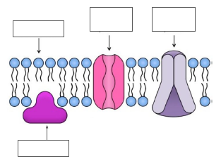
Cell Membrane Proteins
Channel Proteins
Carrier (pump) Proteins
Structural Support / surface proteins
Enzymes

Slide 23
Types of Proteins
Channel (pore) proteins – allow specific molecules and ions to pass through the membrane (by passive transport).
Carrier (pump) proteins – bind to specific molecules or ions temporarily, enabling them to cross the membrane (by active transport).
Enzymes – some proteins in the membrane catalyse a specific reaction
Structural support – some proteins help maintain the shape of the cell.

Slide 24
Venoms, Toxins and Poisons Task
Research a toxin, poison or venom that affects a metabolic pathway and make a poster about it
Include what it is, what metabolic pathway it interrupts, what effect it has and how to treat someone affected by it

Slide 25
Plenary
Describe an anabolic pathway using an example
Describe a catabolic pathway using an example
Give an example of a metabolic pathway that has both anabolic and catabolic steps

Slide 26
Success Criteria
I can:
Describe how a membrane pathway are made more efficient by compartmentalisation
Define the term metabolism
Explain what is meant by a metabolic pathway
Compare anabolic and catabolic

Slide 27
1b. Metabolic Pathways and Enzymes

Slide 28
Starter
Describe the role of enzymes in cells
List some examples of enzymes you know of and the reactions they are involved in

Slide 29
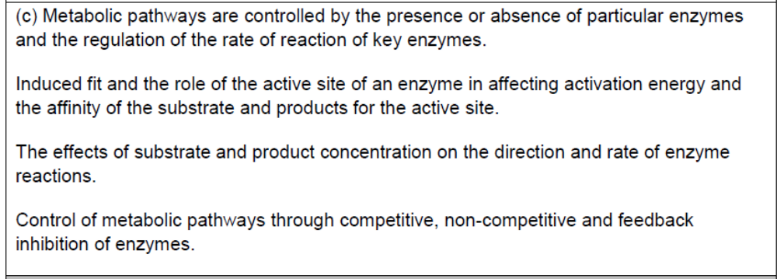
Course Specification

Slide 30
Learning Objectives
By the end of this topic you should be able to:
Understand that metabolic pathways are controlled by enzymes within the pathway
State that the rate of a pathway’s reaction is controlled by the rate of the enzymes reaction
state that the regulation of pathways can be mediated by signals from both within the cell and from outside the cell;
describe the relationship between the shape (configuration) and activity of an enzyme;
describe the 'induced fit' model of enzyme action;
explain the role and function of the active site;
explain what is meant by the term 'activation energy' and state that enzymes lower the activation energy of a reaction;
explain how the concentrations of both substrate and end product affect the rate of enzyme action;
understand that enzymes often act in groups or complexes;
explain why some genes are constantly expressed and how they are regulated;
describe inhibition of enzymes in terms of a change in configuration;
explain how metabolic pathways can be controlled through competitive and non-competitive inhibition of enzymes;
explain how metabolic pathways can be controlled by feedback inhibition of enzymes.

Slide 31
Success Criteria
I can:
Explain enzyme function in terms of the induced fit model
State the relative affinities of an enzyme for its product and substrate
Describe the activity of enzymes in terms of substrate and enzyme concentrations
Describe how substrate and product concentrations affect pathways
Explain the action of competitive and non competitive inhibition
Explain the mechanism of feedback inhibition and why it is important to cells

Slide 32
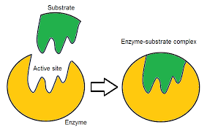
Enzyme Active Site
Enzymes have an active site where the substrate binds and the reaction is catalysed

Slide 33
Why enzymes?
Energy is required to initially break bonds for a reaction to happen
The energy required to start a chemical reaction is known as the ‘Activation energy’.

Slide 34
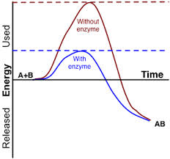
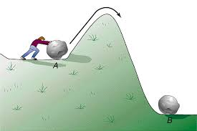
Activation Energy

Slide 35
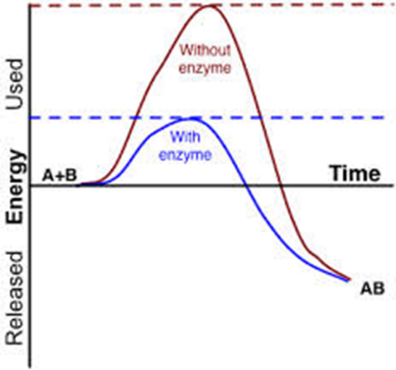
Activation Energy
Without an enzyme or catalyst the energy needed to start the reaction is large and it is slow
With an enzyme, the energy required is lowered and the reaction is quicker

Slide 36
Activation Energy Video
https://www.youtube.com/watch?v=D0ZyjpAin_Y

Slide 37
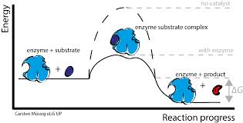
Enzymes
Enzymes therefore work by:
Bringing the substrates close together to allow a reaction to happen
Lowering the activation energy so the reaction can occur

Slide 38

In earlier biology you were taught..
That enzyme and substrate fit together like a lock and key…This is not the reality

Slide 39
Induced Fit Model
The active site is not rigid, it is a flexible structure
It alters it’s shape to fit the substrate

Slide 40

Induced Fit Model
The induced fit ensures the active site comes in close contact with the substrate increasing the chance of the reaction taking place

Slide 41
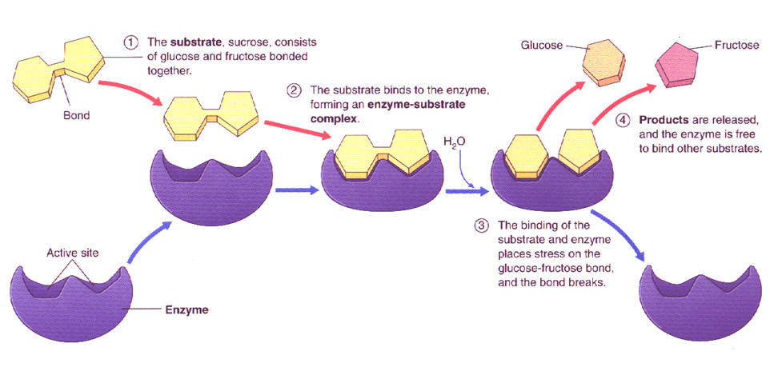
Induced Fit Model

Slide 42
Enzyme – Substrate Complex
The change in shape of the active site helps the reaction occur as it orients the substrate in the right way for the reaction to occur
Active site has high affinity for substrates (they like to be together)
When the reaction is complete, the products have a low affinity for the active site and diffuse away

Slide 43
Enzyme Co-factors
Co-factors are molecules that are often needed to make the enzyme more efficient
They can be; inorganic such as iron, zinc, magnesium. They can be organic too (are known as co-enzymes) such as FAD, NAD and many vitamins.

Slide 44
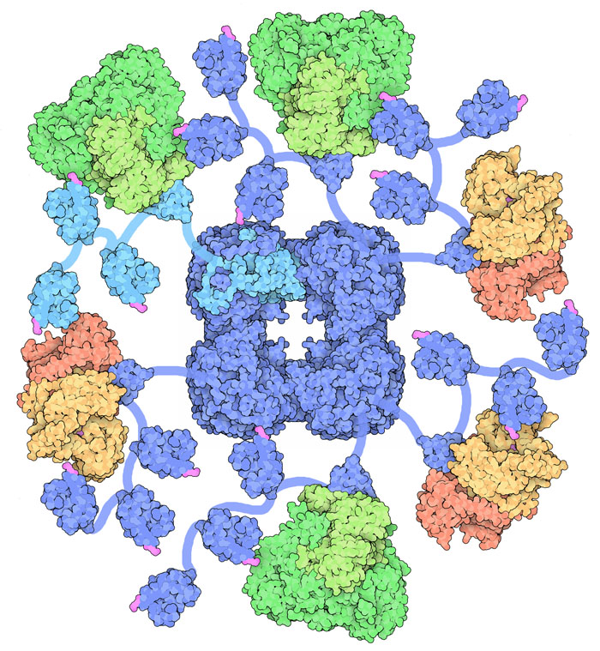
Multi-enzyme complexes
Some enzymes work in groups or in multi-enzyme complexes
eg. Pyruvate dehydrogenase complex. It is 3 enzymes that convert pyruvate in to acetyl coA

Slide 45
What affects enzyme activity
From N5 you should be able to draw a graph to show how temperature affects enzyme activity and also how pH affects Enzyme activity.

Slide 46
Effect of Substrate
Substrate molecules have a high affinity (they are very attracted to one another) for the enzyme’s active site.
The products have low affinity for the active site. This lets them leave the active site.

Slide 47
Effect of Substrate
When we increase the substrate concentration, we increase the rate of reaction.
The rate of reaction will increase until all the active sites are saturated (that is, they are all occupied).
Once all the active sites are occupied, the rate of the reaction cannot go any higher, no matter how much substrate you put into the reaction.

Slide 48
Effect of products
Some metabolic pathways have reversible steps.
The presence of a substrate can start an enzyme driven reaction
The increasing concentration of a product can cause a reaction to make use of its reversible steps.

Slide 49
Regulating Enzyme Activity
A cell has to control enzyme activity. It does this by:
Controlling number of enzyme molecules in cell
Keeping reactions (and enzymes) in compartments eg. Mitochondria or lysosome.
Changing enzyme shape (most effective)

Slide 50
Enzyme Activity
Enzymes are always present due to constant expression. This means they need to be controlled.
Enzymes can be inhibited by other things binding to them

Slide 51
Enzyme Inhibitors
Enzyme inhibitors reduce the rate of an enzyme catalysed reaction by interfering with the enzyme in some way. This effect may be permanent or temporary.

Slide 52
Competitive Inhibition
Competitive Enzyme Inhibitors work by having a similar shape to the substrate molecule.
They fit into the active site, but remain unreacted since they have a different structure to the substrate.
Therefore less substrate molecules can bind to the enzymes so the reaction rate is decreased.

Slide 53
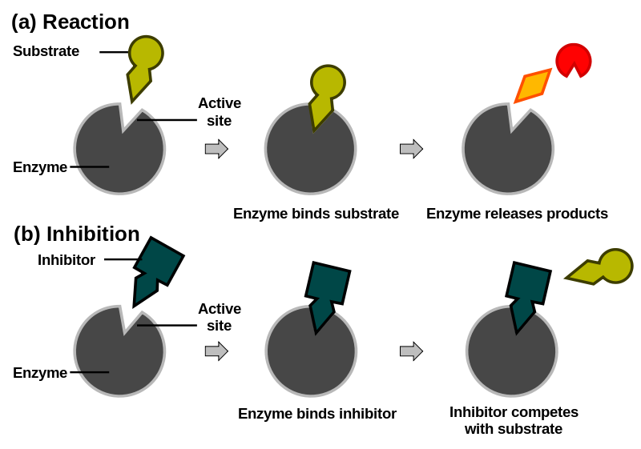
Competitive Inhibition

Slide 54
Competitive Inhibition
Competitive inhibition is usually temporary and can be reversed by increasing substrate concentration.
Adding more substrate increases the chance of the substrate molecule colliding with the enzyme and thereby overcoming competitive inhibition.

Slide 55
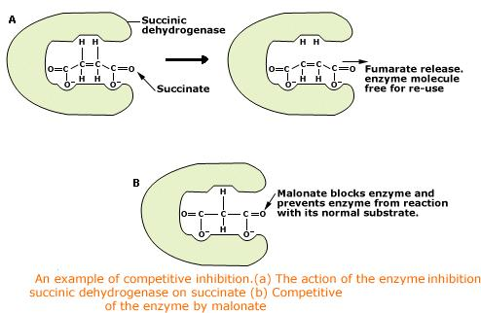
Example of competitive inhibition

Slide 56
Non-competitive inhibition
Non-competitive inhibitors bind to the enzyme but not in the active site. (sometimes called “allosteric site”)
The inhibitor binds and causes a conformation change in the enzyme – the active site is changed.

Slide 57
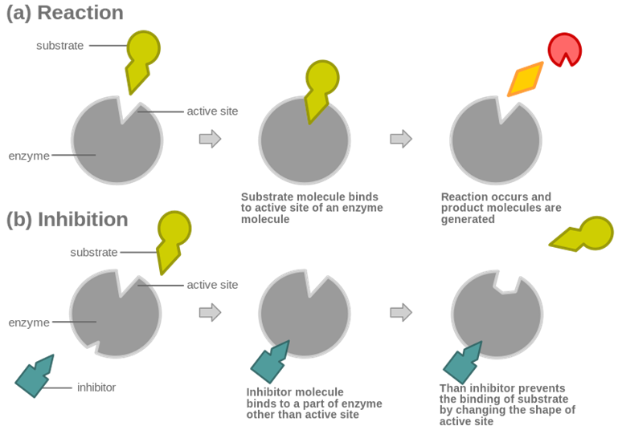
Non-competitive inhibition

Slide 58
Non-Competitive inhibition
The change in 3D Tertiary structure of the enzyme means that it can no longer catalyse a reaction.
Since they do not compete with substrate molecules, non-competitive inhibitors are not affected by substrate concentration
Non-competitive inhibition may or may not be reversible

Slide 59
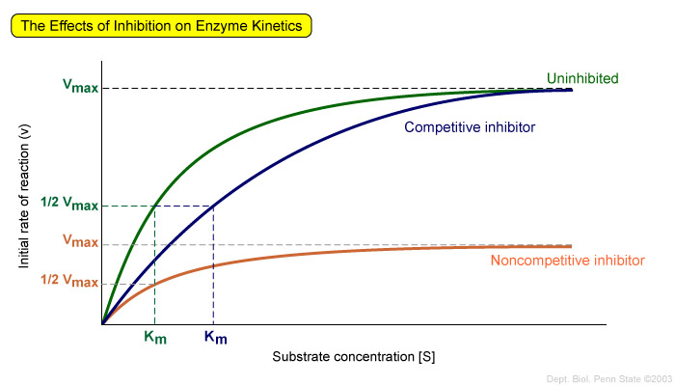
Enzyme Inhibition

Slide 60
Feed Back Inhibition
The activity of some enzymes, particularly those involved in metabolic pathways, are controlled by a self-regulating mechanism
Some specific substances, most often the product itself, acts as an inhibitor

Slide 61
Feedback Inhibition
Such an inhibitor binds to an enzyme at a specific site and modifies the active site of the enzyme. This prevents the binding of substrate molecule.
Such sites on the enzymes are called allosteric sites and such enzymes are called allosteric enzymes.

Slide 62
Feedback Inhibition
Threonine
Enz 1
The amino acid Isoleucine is made through conversion of threonine in 5 enzyme controlled steps in bacteria.
As isoleucine builds up, it binds to enzyme 1 inhibiting further production of isoleucine. By doing this the cell produces only the isoleucine that is needed.
Intermediate 1
Enz 2
Intermediate 2
Enz 3
Intermediate 3
Enz 4
Intermediate 4
Enz 5
Isoleucine

Slide 63
Feedback Inhibition Video
https://www.youtube.com/watch?v=LKiXfqaWNHI

Slide 64
Success Criteria
I can:
Explain enzyme function in terms of the induced fit model
State the relative affinities of an enzyme for its product and substrate
Describe the activity of enzymes in terms of substrate and enzyme concentrations
Describe how substrate and product concentrations affect pathways
Explain the action of competitive and non competitive inhibition
Explain the mechanism of feedback inhibition and why it is important to cells

Slide 65
Plenary
What is ‘activation energy’?
What is the induced fit method of enzyme action?
Compare competitive and non-competitive inhibition

