Slide 1
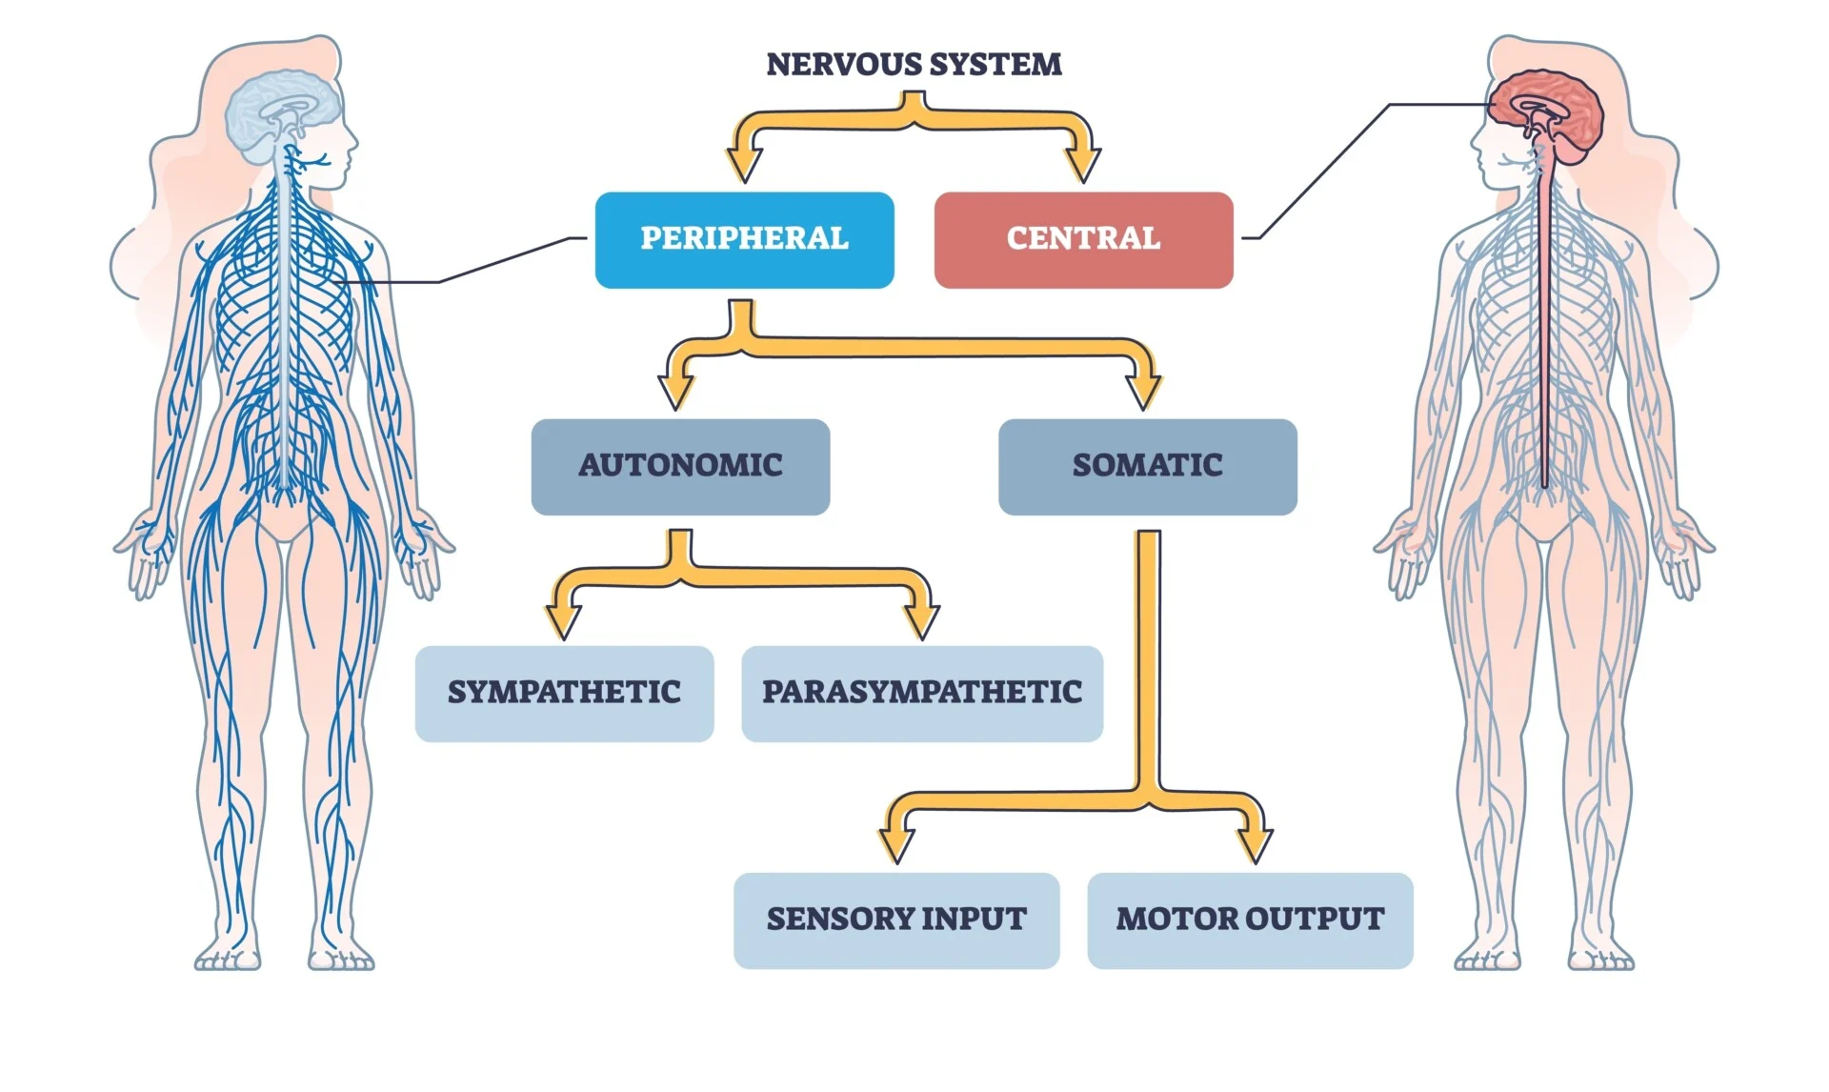
Higher Human Biology
M I S S M C B R I D E
3.1 Division of the nervous system and neural pathways

Slide 2

What should you already know from National 5 Biology?
What type cells are found near all your sense organs to pick up stimuli?
Receptors
What is an effector cell and give two examples of where they are found.
Muscle or gland
What two structures make up the central nervous system (CNS)?
Brain and Spinal cord
What is the function of the central nervous system (CNS)?
The body’s control centre by receiving, processing and responding to sensory information

Slide 3
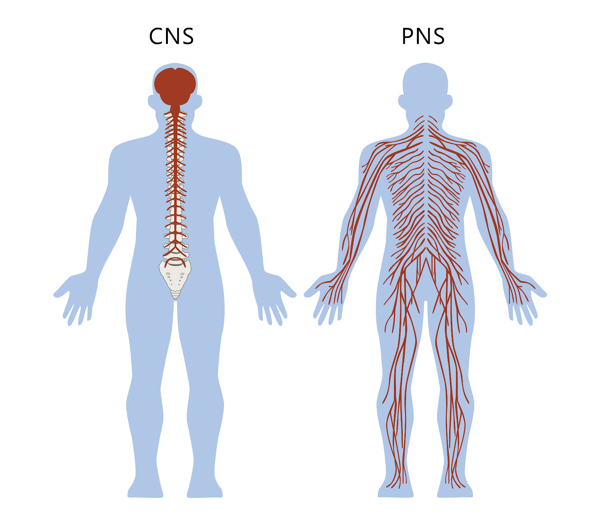
D I V I S I O N S O F T H E N E R V O U S S Y S T E M
The nervous system can be divided into two main sections:
Central nervous system (CNS) comprising the brain and spinal cord.
Peripheral nervous system (PSN) comprising the peripheral nerves.

Slide 4
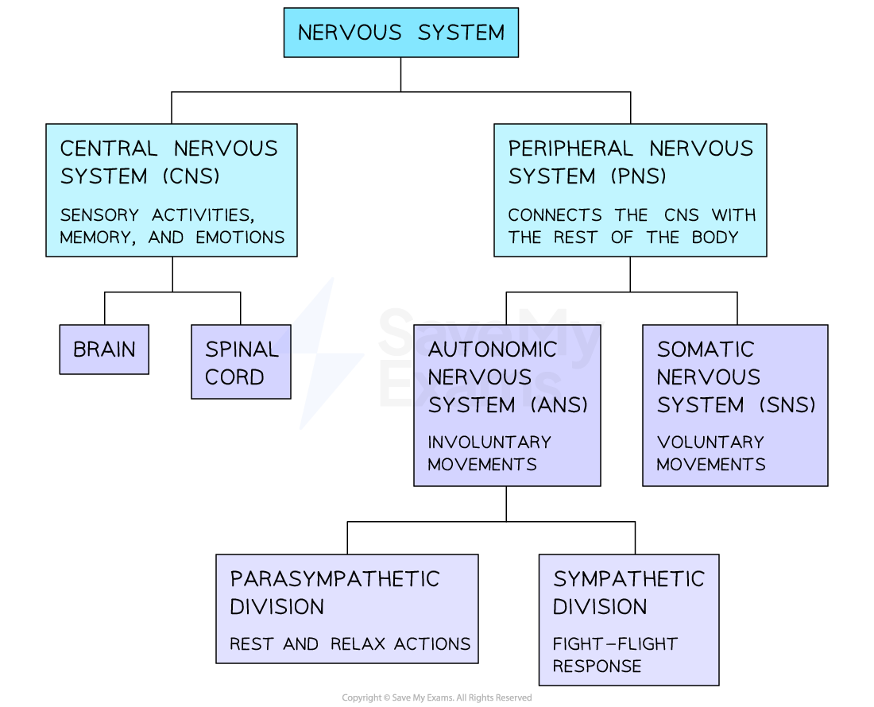
D I V I S I O N S O F T H E N E R V O U S S Y S T E M
The PNS consists of the somatic nervous system (SNS) and the autonomic nervous system (ANS).

Slide 5
Term: Somatic (Greek word Soma means ‘body’)
D I V I S I O N S O F T H E N E R V O U S S Y S T E M
Where have you heard the word somatic before?
Somatic and Germline Cells from the very first topic!
What is a somatic cell?
A somatic cell is any cell in the body other than cells involved in reproduction.
How do somatic cells divide?
Somatic stem cells divide by mitosis to form more somatic cells.

Slide 6
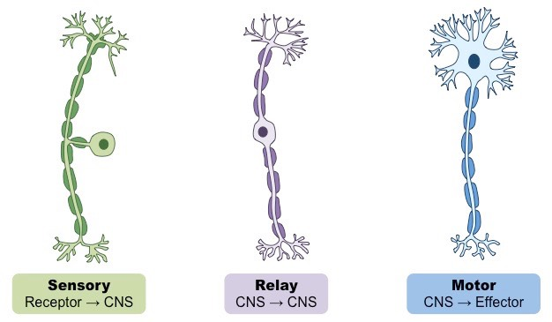
D I V I S I O N S O F T H E N E R V O U S S Y S T E M
The somatic nervous system contains sensory and motor neurons.
Sensory neurons take impulses from sense organs to the CNS. Motor neurons take impulses from the CNS to muscles and glands (effector cells).

Slide 7
D I V I S I O N S O F T H E N E R V O U S S Y S T E M
The autonomic nervous system (ANS) consists of the sympathetic and parasympathetic systems.

Slide 8
D I V I S I O N S O F T H E N E R V O U S S Y S T E M

Slide 9
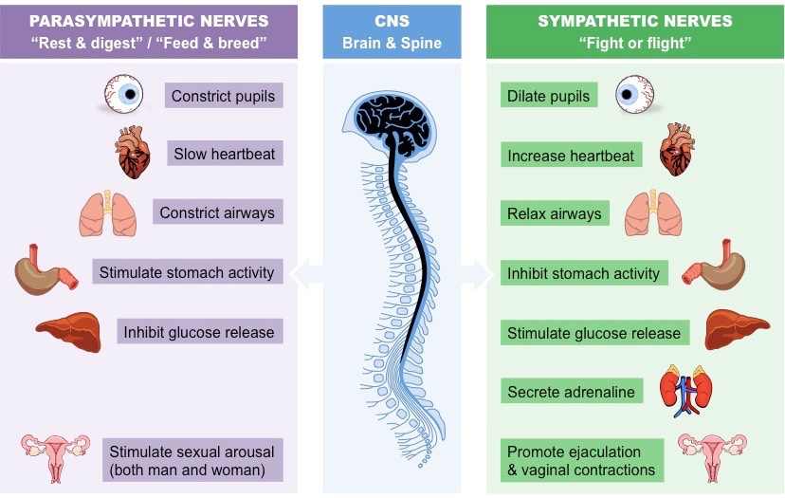
D I V I S I O N S O F T H E N E R V O U S S Y S T E M
The antagonistic actions of the sympathetic and parasympathetic systems on heart rate, breathing rate, peristalsis and intestinal secretions.
This means they have the same structures but have an opposite effect on them.

Slide 10
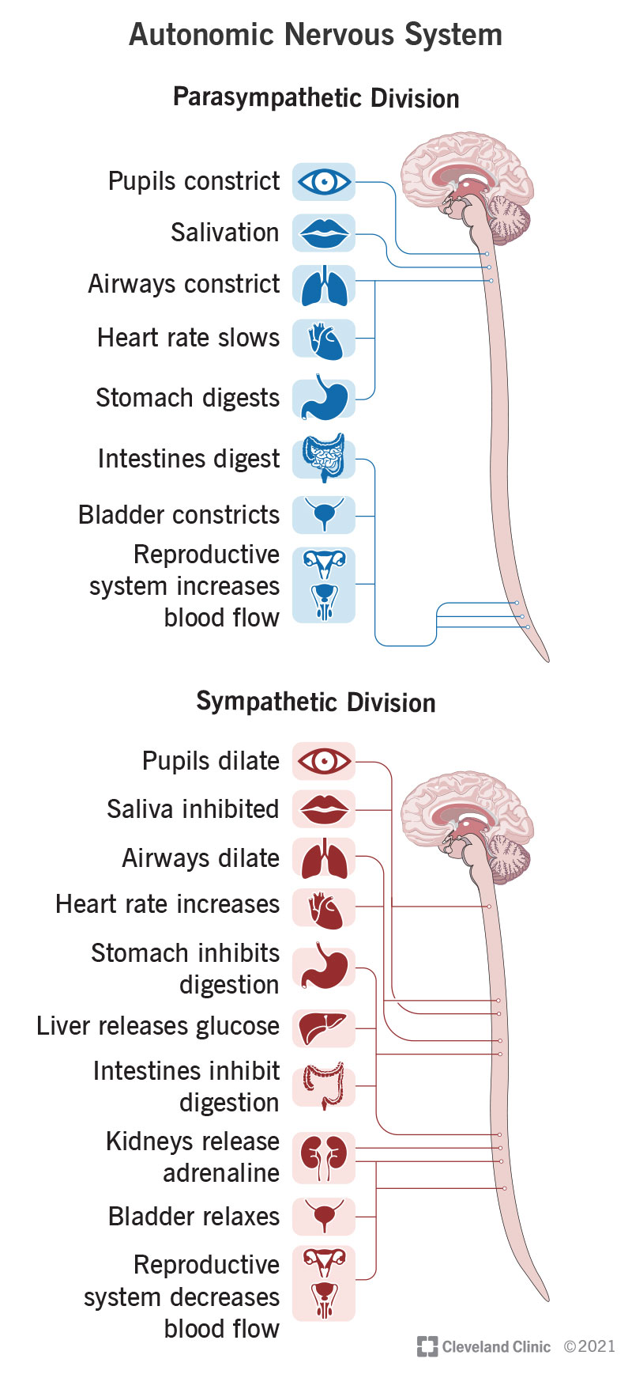
D I V I S I O N S O F T H E N E R V O U S S Y S T E M
The sympathetic system speeds up heart rate and breathing ate while slowing down peristalsis and production of intestinal secretions. The parasympathetic system changes these in the opposite way (antagonistic).

Slide 11
D I V I S I O N S O F T H E N E R V O U S S Y S T E M
Where have you heard these terms before, sympathetic and parasympathetic nerves?
2.6 Heart topic
What hormone increases heart rate?
Noradrenaline (sympathetic)
What hormone decreases heart rate?
Acetylcholine (parasympathetic)

Slide 12

C O U R S E S P E C N O T E S
3.1 Division of the nervous system and neural pathways
The nervous system can be divided into two main sections: Central nervous system (CNS) comprising the brain and spinal cord. Peripheral nervous system (PSN) comprising the peripheral nerves. The PNS consists of the somatic nervous system (SNS) and the autonomic nervous system (ANS). The somatic nervous system contains sensory and motor neurons.
Sensory neurons take impulses from sense organs to the CNS. Motor neurons take impulses from the CNS to muscles and glands (effector cells). The autonomic nervous system (ANS) consists of the sympathetic and parasympathetic systems. The antagonistic actions of the sympathetic and parasympathetic systems on heart rate, breathing rate, peristalsis and intestinal secretions.
This means they have the same structures but have an opposite effect on them. The sympathetic system speeds up heart rate and breathing ate while slowing down peristalsis and production of intestinal secretions. The parasympathetic system changes these in the opposite way (antagonistic).

Slide 13
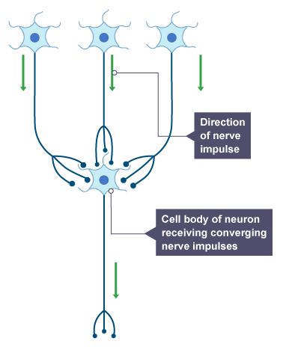
C O N V E R G I N G , D I V E R G I N G A N D R E V E R B E R A T I N G N E U R A L P A T H W A Y S
In a converging neural pathway, impulses from several neurons travel to one neuron.
This increases the sensitivity to excitatory or inhibitory signals.
Example: Visual receptors in the eye.

Slide 14
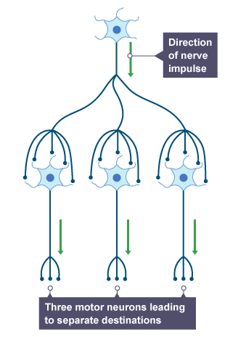
C O N V E R G I N G , D I V E R G I N G A N D R E V E R B E R A T I N G N E U R A L P A T H W A Y S
In a diverging neural pathway, impulses from one neuron travel to several neurons so affecting more than one destination at the same time.
Example: Fine motor control in fingers.

Slide 15
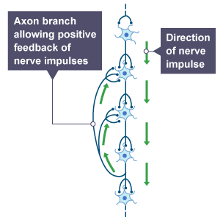
C O N V E R G I N G , D I V E R G I N G A N D R E V E R B E R A T I N G N E U R A L P A T H W A Y S
In a reverberating pathway, neurons later in the pathway link with earlier neurons, sending the impulse back through the pathway. This allows repeated stimulation of the pathway.
Example: breathing

Slide 16
C O U R S E S P E C N O T E S
3.1 Division of the nervous system and neural pathways
In a converging neural pathway, impulses from several neurons travel to one neuron.
This increases the sensitivity to excitatory or inhibitory signals.
Example: Visual receptors in the eye.
In a diverging neural pathway, impulses from one neuron travel to several neurons so affecting more than one destination at the same time.
Example: Fine motor control in fingers.
In a reverberating pathway, neurons later in the pathway link with earlier neurons, sending the impulse back through the pathway. This allows repeated stimulation of the pathway.
Example: breathing

Slide 17

K E Y T E R M S
CENTRAL NERVOUS SYSTEM
PERIPHERAL NERVOUS SYSTEM
AUTONOMIC NERVOUS SYSTEM
SOMATIC NERVOUS SYSTEM
SYMPATHETIC NERVOUS SYSTEM
PARASYMPATHETIC NERVOUS SYSTEM
ANTAGONISTIC
CONVERGING NEURAL PATHWAY
DIVERGING NEURAL PATHWAY
REVERBERATING NEURAL PATHWAY
Add these terms to the definition page at the back of your jotter.
This will help you make flash cards at some point in the future!

Slide 18
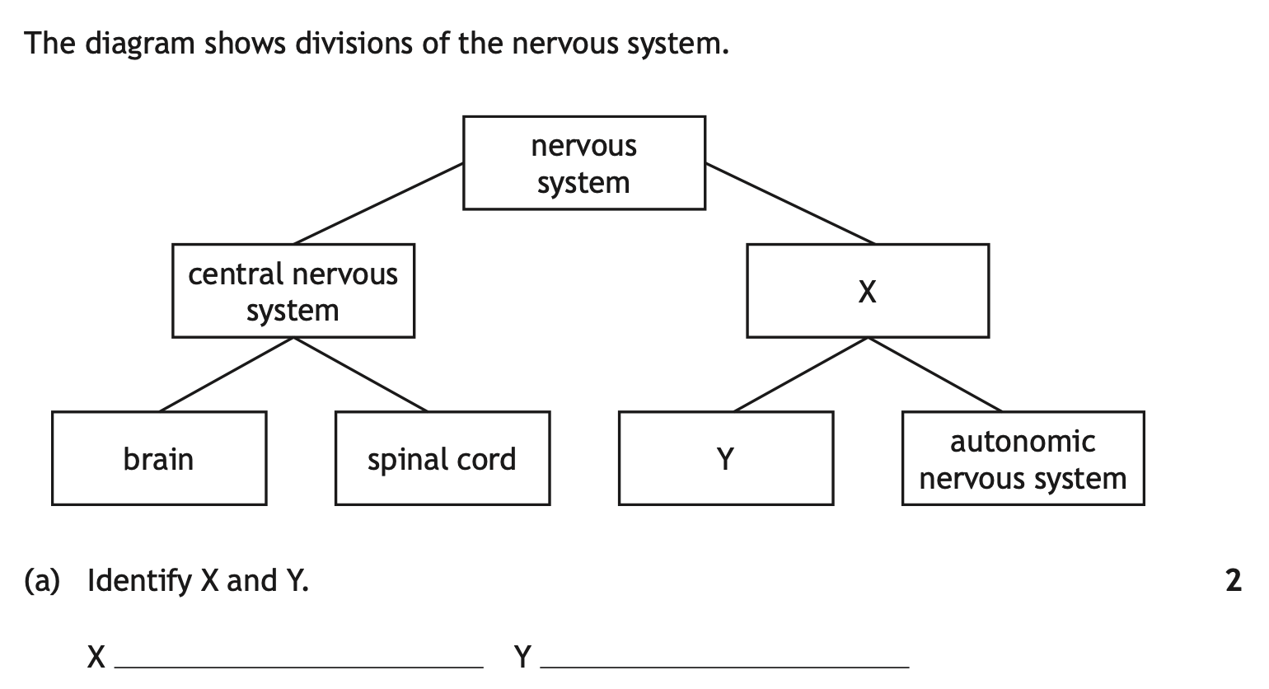

Slide 19
Peripheral nervous system
Somatic Nervous System

Slide 20
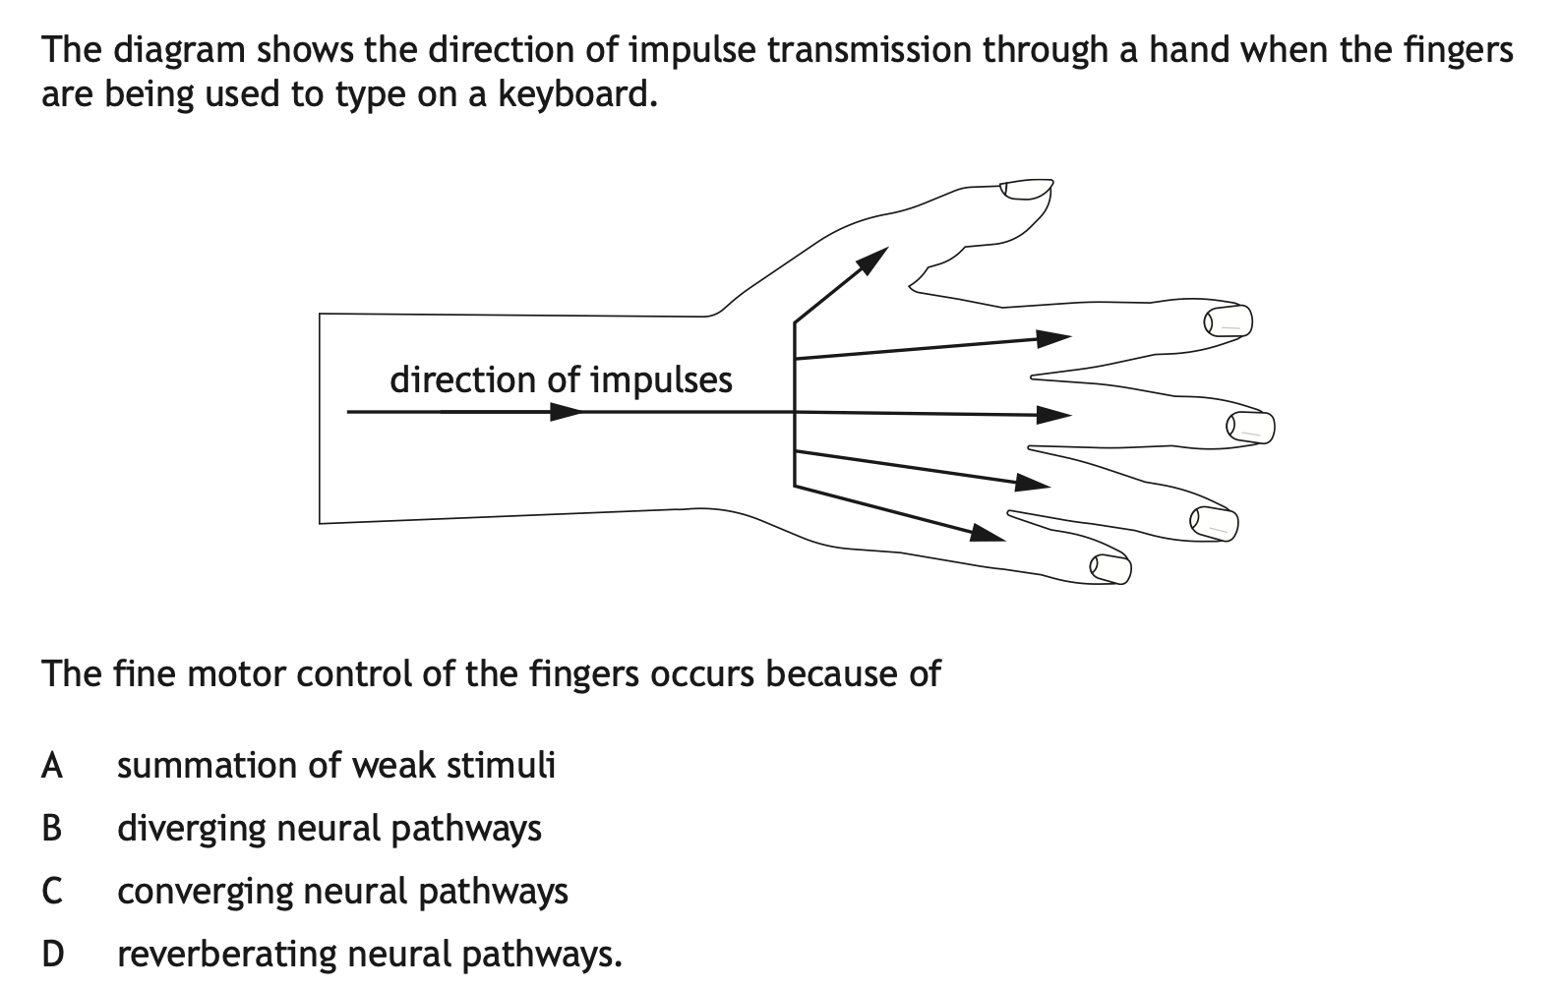

Slide 22
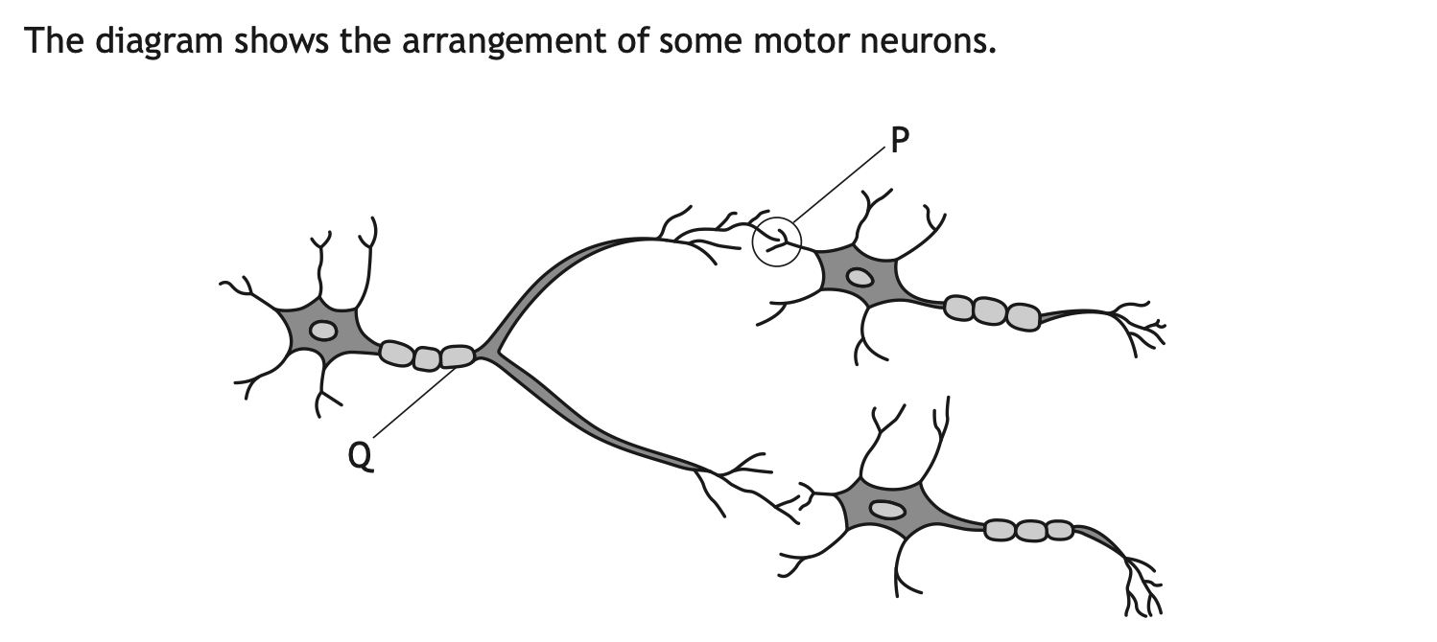
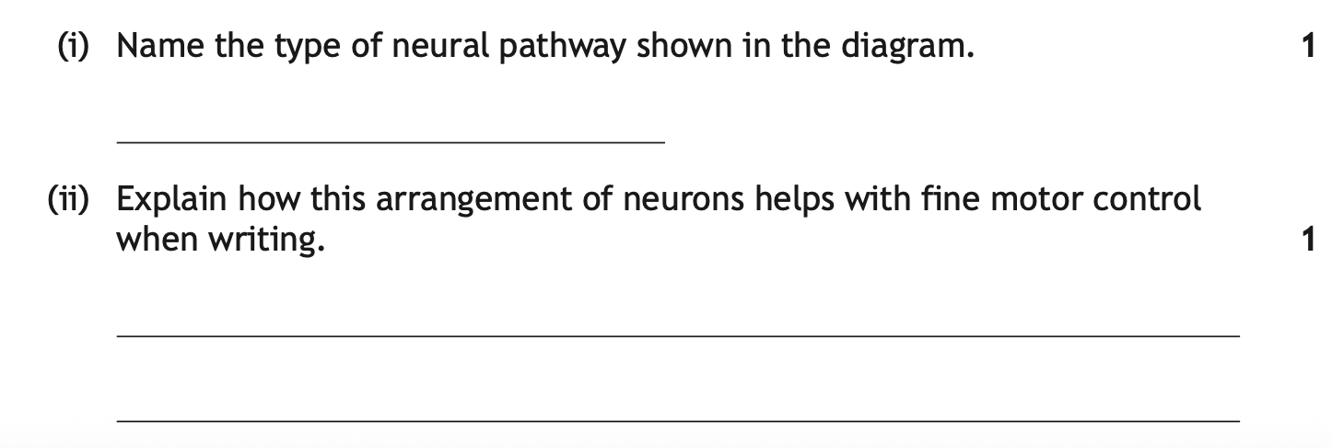

Slide 23
Diverging
More than one neuron/muscle/finger is affected/stimulated at the same time. OR
Impulse/neurotransmitter is sent to many neurons/muscles/fingers giving coordinated movement.

Slide 24
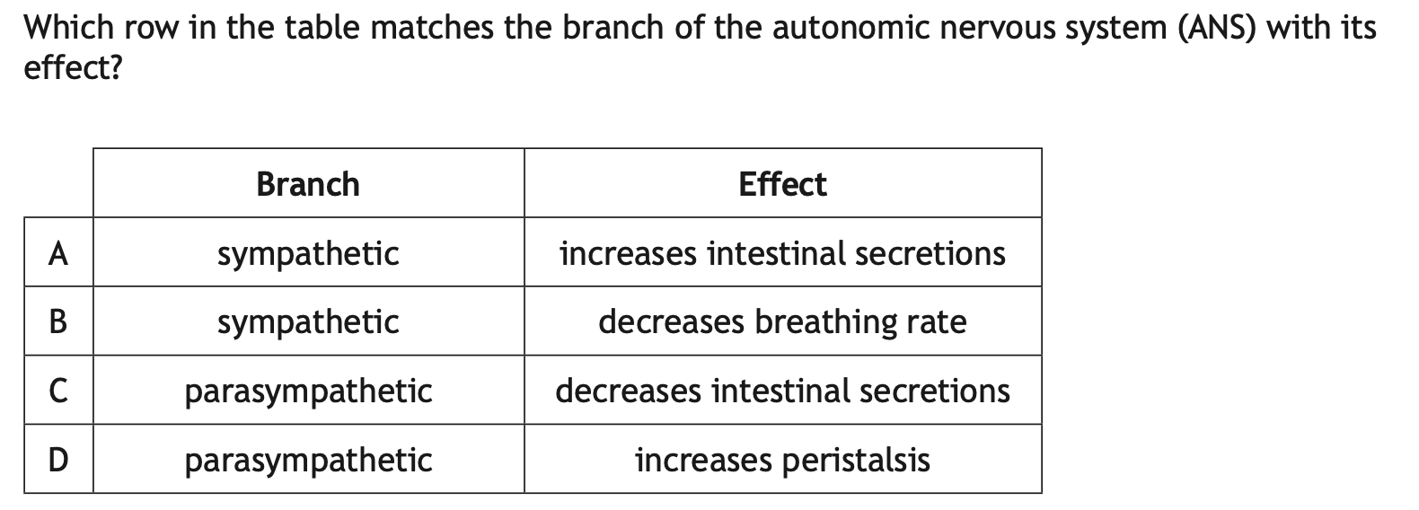

Slide 26
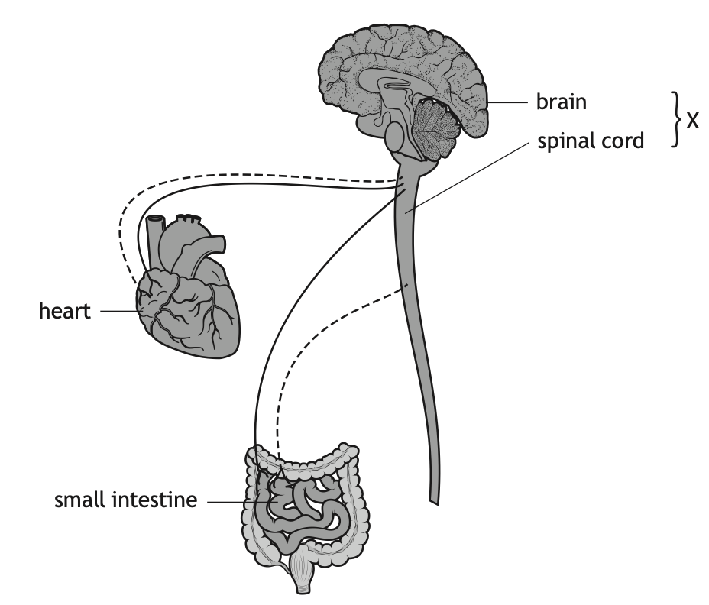
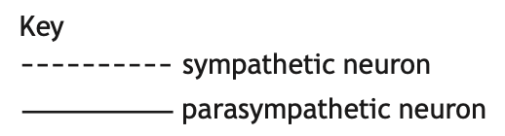
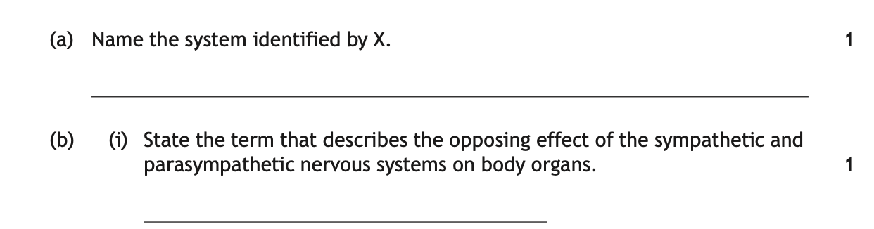

Slide 27
Central Nervous System
Antagonistic

