Slide 1
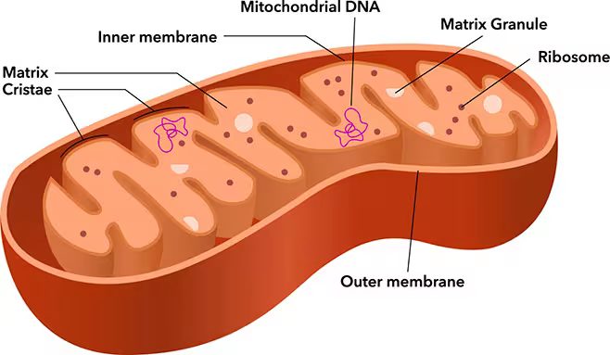
Higher Human Biology
M I S S M C B R I D E
1.6 Respiration

Slide 2
S T A R T E R
Answer the following questions…
What is the respiration equation?
What is respiration?
Where does it take place?
What happens during respiration?
What is ATP?
What is the role of ATP?

Slide 3
R E S P I R A T I O N E Q U A T I O N
We can summarise aerobic respiration using the following equation:
Carbon
Dioxide
Glucose
Oxygen
Water
ENERGY

Slide 4
Glucose
Enzyme controlled reaction
2 ATP generated
2 Pyruvate
Stage 1: Cytoplasm
Stage 2: Mitochondria
Oxygen
Enzyme controlled reaction
Total of 38 ATP generated!
Carbon Dioxide
Water
36 ATP generated

Slide 5

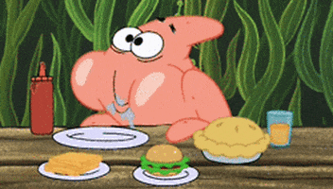

Where do we get our energy from?
What type of energy is stored in our food?
FROM OUR FOOD
CHEMICAL ENERGY

Slide 6
In Higher Human Biology respiration is split into three parts
Glycolysis
Citric Acid Cycle
Electron Transport Chain

Slide 7
G L Y C O L Y S I S
Glycolysis is the breakdown of glucose to pyruvate in the cytoplasm.
ATP is required for the phosphorylation of glucose and intermediates during the energy investment phase.
This leads to the generation of more ATP during the energy pay-off stage and results in a net gain of ATP,

Slide 8
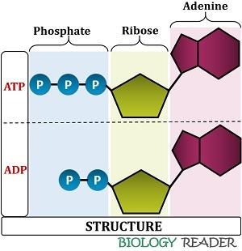
H O W D O E S A T P W O R K?

Slide 9
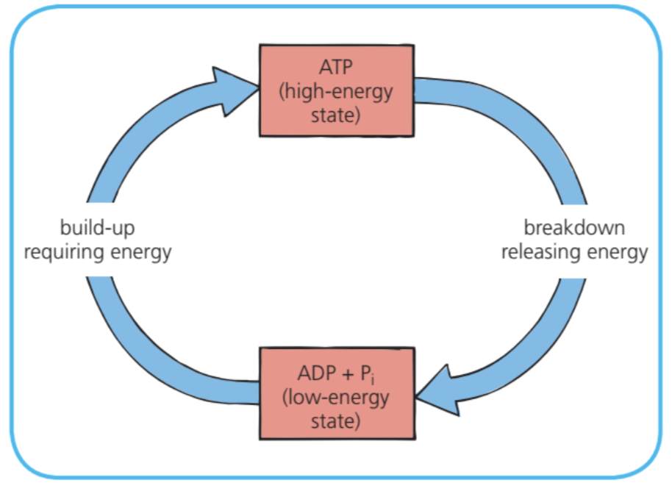
H O W D O E S A T P W O R K?

Slide 10
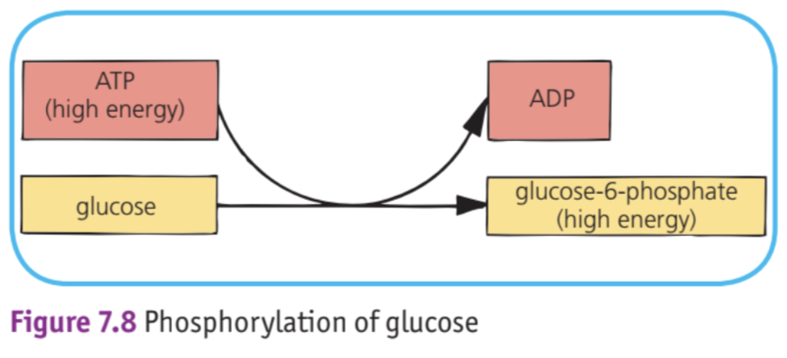
P H O S P H O R Y L A T I O N

Slide 11
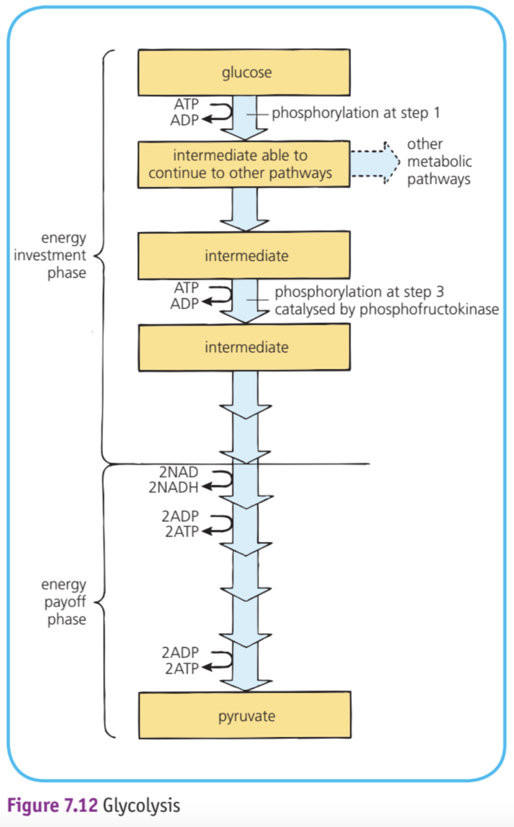
G L Y C O L Y S I S

Slide 12
ATP is required for the phosphorylation of glucose and intermediates during the energy investment phase.
Glucose
Energy Investment
2ATP
Intermediates
2 ADP + Pi
4 ADP + Pi
4ATP
NAD
Intermediates
The generation of more ATP during the energy pay-off stage results in a net gain of ATP.
NADH
Energy Payoff
Carbon Dioxide
2xPyruvate

Slide 13
Pyruvate
Two routes after pyruvate is produced depending on if oxygen is present or not.
Oxygen present
Oxygen absent
Aerobic Respiration
Fermentation

Slide 14
Oxygen present
Aerobic Respiration
Pyruvate
Acetyl group
Coenzyme A
Acetyl Coenzyme A
Enters the citric acid cycle

Slide 15

Citric Acid Cycle
This reaction occurs in the matrix of the mitochondria of living cells.

Slide 16
Citric Acid Cycle
Acetyl Coenzyme A
Oxaloacetate
Citrate
Steps
NAD
NADH
ADP + Pi
Controlled
Enzyme
ATP
Carbon Dioxide

Slide 17
Dehydrogenase enzymes remove hydrogen ions and electrons and pass them onto the coenzyme NAD to form NADH.
This occurs in both Glycolysis and Citric Acid Cycle

Slide 18
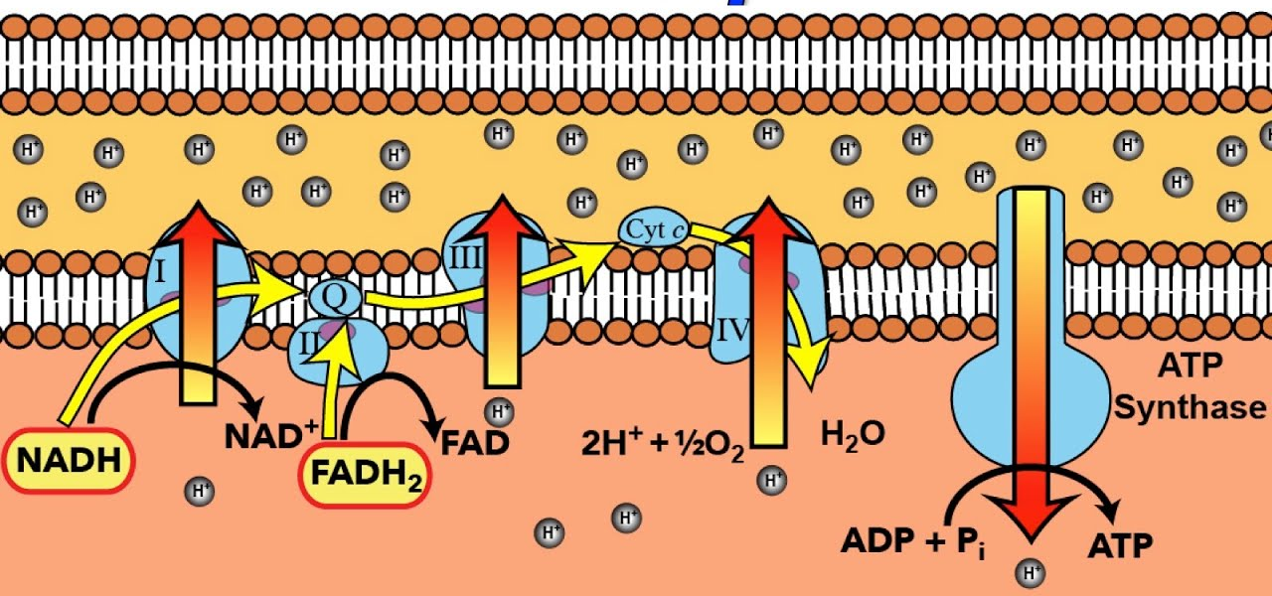
Electron Transport Chain

Slide 19
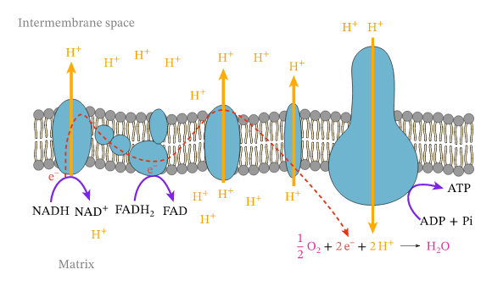
ATP Synthase

