Slide 1
Higher Biology
Unit 3
KA 8 – Threats to Biodiversity

Slide 2
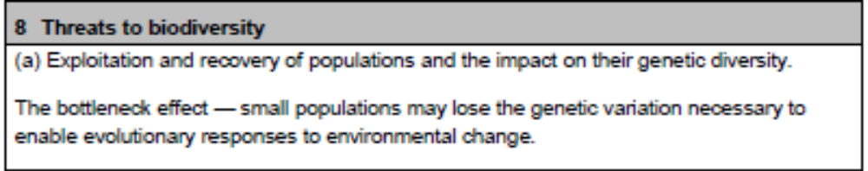
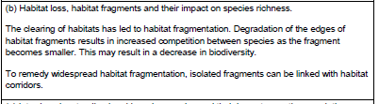
Course Specification

Slide 3
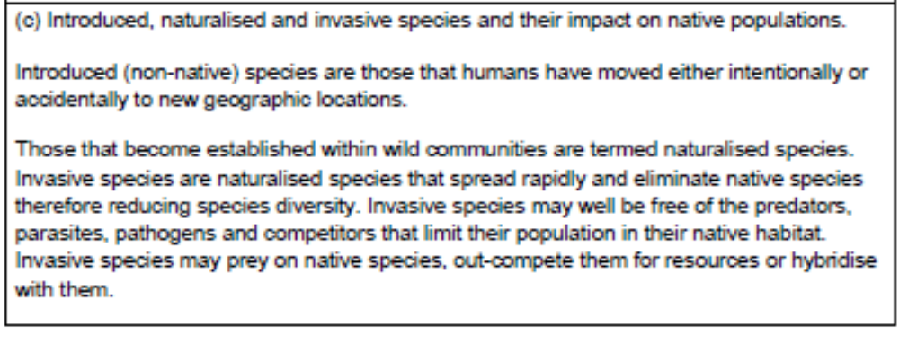
Course Specification

Slide 4
Starter
Name as many threats to biodiversity as you can, give examples where appropriate

Slide 5
Learning Intention
By the end of this topic I will be able to:
Describe threats to biodiversity
Give reasons as to why these threats occur
Explain the impact of introduced, naturalised and invasive species

Slide 6
Success Criteria
I can:
Describe what is meant by overexploitation
Explain the bottleneck effect and how it affects populations
Give reasons for habitat clearance
Describe how habitat fragmentation may reduce biodiversity
Give definitions for introduced, naturalised and invasive species
Describe how a species can become invasive
Explain how an invasive species reduces biodiversity

Slide 7
Overexploitation
Populations can become reduced to a low level but they may still recover
Some species have a naturally low genetic diversity in their population and yet remain viable

Slide 8
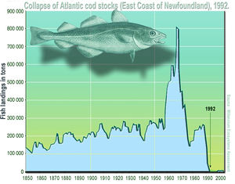
Overexploitation
Atlantic Cod stocks were severely overexploited in the 1970s and 1980s, leading to their abrupt collapse in 1992.

Slide 9
Bottleneck Effect
Reduced populations may lose genetic variation necessary to enable evolutionary responses to changing environments
The loss of genetic material can be critical for many species and inbreeding depression can result in poor reproductive rates

Slide 10
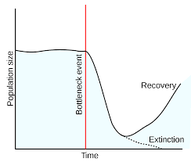
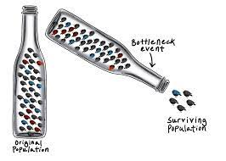
Bottleneck Effect

Slide 11
Habitat Fragmentation
The clearing of habitats has lead to habitat fragmentation
Degradation of the edges of habitat fragments results in increased competition between species as the fragment becomes smaller
This can result in decreased biodiversity

Slide 12
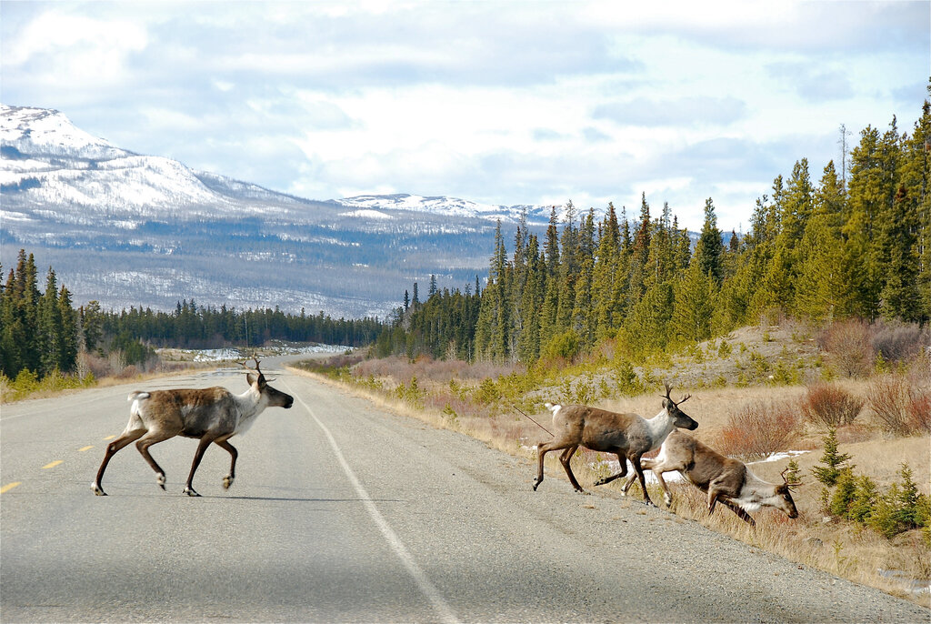
Habitat Fragmentation

Slide 13
Habitat Corridors
To remedy widespread habitat fragmentation, isolated fragments can becomes linked with habitat corridors
These allow movements of animals between fragments, increasing access to mates and food
This can lead to re-colonisation of small fragments after local extinctions

Slide 14
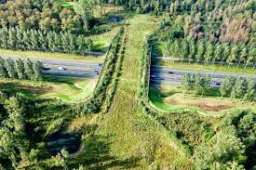
Habitat Corridors

Slide 15
Introduced Species
Introduced species are non-native species humans have introduced (on purpose or accidentally) to a new geographical location

Slide 16
Naturalised Species
If an introduced species becomes established in the wild community, it is termed a naturalised species.

Slide 17
Invasive Species
Naturalised species that spread rapidly and eliminate native species, therefore reducing biodiversity, are termed invasive species

Slide 18
Invasive Species
Invasive species may well be free of predators, parasites, pathogens and competitors that limit their rapid growth in their native habitat
Invasive species may prey on native species, out-compete them for resources or hybridise with them

Slide 19
Foreign Species living in their native environment
Species moved intentionally or accidentally by humans
Species becomes established in new wild community
Now termed a naturalised species
Naturalised species free from predators, parasites, pathogens and competition it faces in the native environment
Naturalised Species spreads rapidly and eliminates native species
Species now termed an invasive species

Slide 20
Invasive Species
https://www.youtube.com/watch?v=spTWwqVP_2s&t=16s

Slide 21
Research Task
Research an invasive species in Scotland. Describe:
When it became invasive
How it was introduced
What problems it causes native species
What is being done to help native species

Slide 22
Success Criteria
I can:
Describe what is meant by overexploitation
Explain the bottleneck effect and how it affects populations
Give reasons for habitat clearance
Describe how habitat fragmentation may reduce biodiversity
Give definitions for introduced, naturalised and invasive species
Describe how a species can become invasive
Explain how an invasive species reduces biodiversity

Slide 23
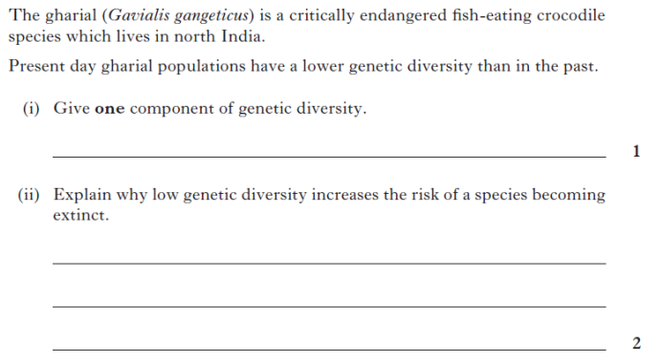
Plenary

