Slide 1
Higher Biology
Unit 1
KA7 Evolution

Slide 2
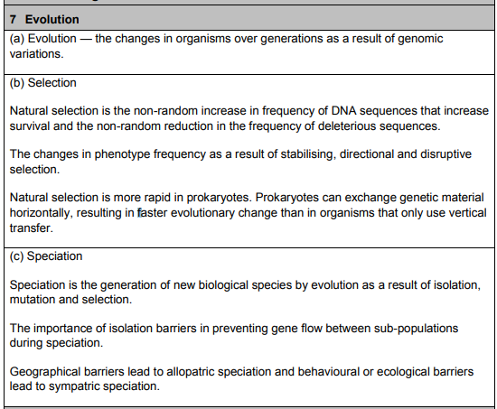
Course Specification

Slide 3
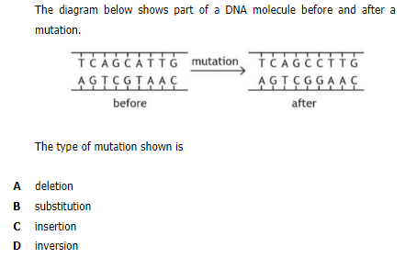
Starter

Slide 4
Learning Intention
By the end of this topic I will be able to:
Understand evolution of species over time
Describe selection processes in eukaryotes and prokaryotes
Describe the process of speciation in the formation of a new species

Slide 5
Success Criteria
I can:
Define the term “evolution”
Describe natural selection in terms of DNA Sequences
Describe the change in phenotype frequency as a result of stabilising, directional and disruptive selection

Slide 6
Evolution
Watch the following video:
https://www.youtube.com/watch?v=GhHOjC4oxh8
Notes:
8 mins

Slide 7
Evolution
Evolution is the gradual change in the
characteristics of a population of
organisms over successive generations as
a result of variation in the population’s
genomes.

Slide 8
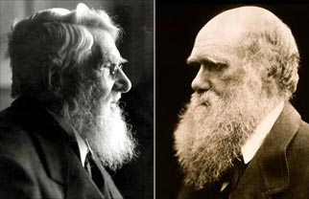
Natural selection
In 1858 Charles Darwin and Alfred
Wallace presented a theory suggesting
that the main driving force for
evolutionary change is natural selection.

Slide 9
Natural Selection
Natural selection is a non-random process
that results in the increase in frequency
among a population of individuals of those
genetic sequences that confer an
advantage on members of the population
and aid their survival.

Slide 10
Natural Selection
Watch the following video
https://www.youtube.com/watch?v=0SCjhI86grU
Notes:
10 mins

Slide 11
Organisms produce more offspring than the environment can support
All members of a species show variation from each other
A struggle for existence occurs and many offspring die before they can reproduce
Only those who are better adapted to the environment (the fittest) will survive and bred and pass those adaptations on to their offspring.
This process is repeated generation after generation causing gradual change in the characteristics of a species.

Slide 12
Selection of Quantitative Traits
Continuous variables, such as height,
mass, skin colour, hair colour etc. are
controlled by many genes and are
described as being due to polygenic
inheritance.

Slide 13
Normal Distribution
When you graph data for continuous
variable in a large population you should
get a “bell shaped curve” or normal
distribution.
Increasing number of individuals
Increasing value of inherited characteristic e.g. height (m)

Slide 14
Stabilising Selection
Mean
Mean remains unchanged
Increasing number of individuals
Increasing number of individuals
Increasing value of inherited characteristic
Increasing value of inherited characteristic
Selection pressure goes against extreme variants and favours the intermediate versions of a trait. Leads to a reduction in genetic diversity.
e.g. Human birth mass remains with in range of 3-4 kg. Babies with lower mass more susceptible to disease, higher mass have difficulties during birth.

Slide 15
Directional selection
Mean
New Mean
Increasing number of individuals
Increasing number of individuals
Increasing value of inherited characteristic
Increasing value of inherited characteristic
Common during period of environmental change. Selection favours a version which was initially less common causing a progressive shift in the mean value.
e.g. European black bears increased in mass during each ice age – as larger bodies lose relatively less heat than smaller ones.

Slide 16
Disruptive selection
Mean
Separate means emerge
Increasing number of individuals
Increasing number of individuals
Increasing value of inherited characteristic
Increasing value of inherited characteristic
Selection pressure selects extreme versions of a trait at the expense of the intermediate versions. Can result in the population being split into two distinct groups. This is the driving force behind sympatric speciation (see later in topic).

Slide 17
Success Criteria
I can:
Define the term “evolution”
Describe natural selection in terms of DNA Sequences
Describe the change sin phenotype frequency as a result of stabilising, directional and disruptive selection

Slide 18
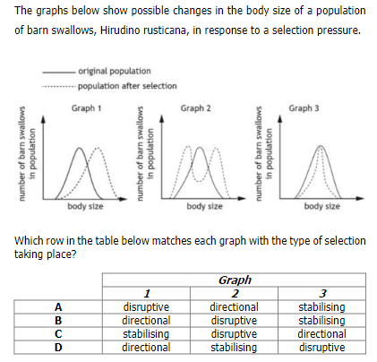
Plenary

Slide 19
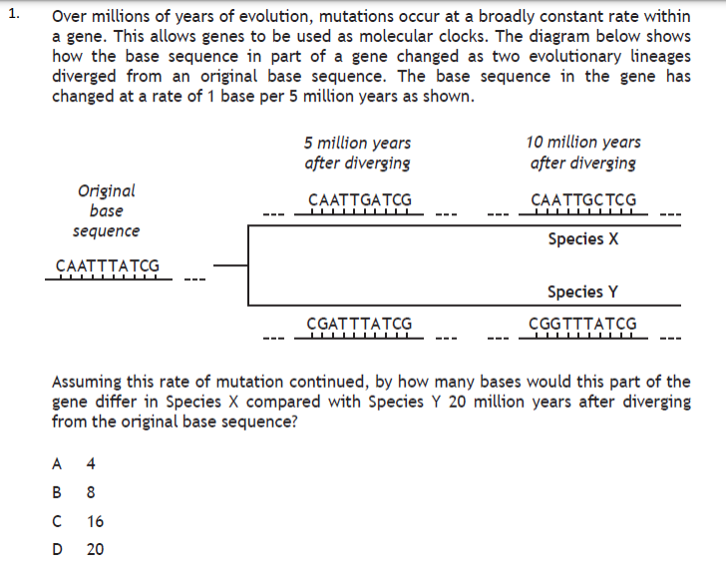
Starter

Slide 20
Learning Intention
By the end of this topic I will be able to:
Understand evolution of species over time
Describe selection processes in eukaryotes and prokaryotes
Describe the process of speciation in the formation of a new species

Slide 21
Success Criteria
I can:
Compare vertical and horizontal gene transfer
Explain why natural selection is more rapid in prokaryotes

Slide 22
Inheritance
Genetic material can be inherited by:
1. Vertical transfer
2. Horizontal transfer

Slide 23
Vertical transfer of genetic material
Genes (sequences of protein coding DNA)
are transferred from parents down to
their offspring.
This can happen by:
Sexual reproduction
Asexual reproduction

Slide 24
Sexual reproduction
This involves two parents who differ
from one another genetically.
Offspring inherit different combinations
of genes from each parent.

Slide 25
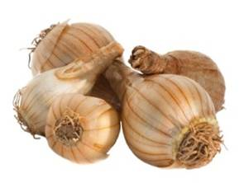
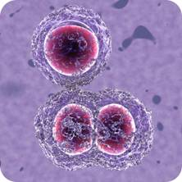
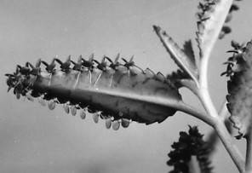
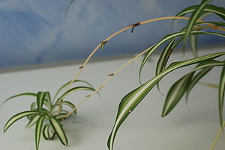
Asexual reproduction
Is reproduction from a single parent.
Produces offspring who are genetically
identical to the parent.

Slide 26
Horizontal transfer of genetic material (prokaryotes)
In prokaryotes (who reproduce using
asexual reproduction) – genetic material
can be transferred from one cell to
another through horizontal gene
transfer.

Slide 27
Horizontal vs Vertical
vertical gene transfer - when genes are transferred down generations. i.e. from parent to offspring as a result of sexual or asexual reproduction
horizontal gene transfer - when genes are transferred across from an individual to others in the same generation. This does not occur due to reproduction.

Slide 28
Rapid evolutionary change
In early evolution of prokaryotes there
was a lot of horizontal gene transfer
(HGT) because obtaining a gene from a
neighbour is much faster than waiting for
one to evolve.

Slide 29
Rapid evolutionary change
This allowed rapid evolution of
prokaryotes.
However this is a risky strategy as there
are no guarantees the transferred
genetic material will give an advantage.

Slide 30
Antibiotic Resistance
A significant amount of HGT still occurs
in modern day prokaryotes.
Resistance to antibiotics has occurred
through the transfer of plasmids carrying
antibiotic resistance genes from bacteria
to bacteria.

Slide 31
Antibiotic Resistance Video
Watch the following video:
https://www.youtube.com/watch?v=znnp-Ivj2ek

Slide 32
Horizontal transfer of genetic material (eukaryotes)
Although less common, horizontal gene
transfer can occur in eukaryotes:
From prokaryotes
Agrobacterium tumefaciens, is a bacterium, which infects plant cells with a plasmid that integrates into the genome of the plant.

Slide 33
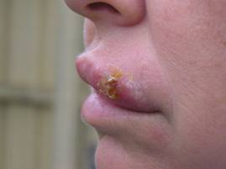
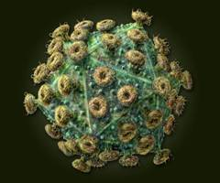
(b) From viruses
Some viruses can integrate their DNA into the host’s genome. Where they remain dormant (as a provirus) until they reproduce and destroy the cells.
e.g. Herpes virus HIV

Slide 34
Research Task
You are going to research the Antibiotic Resistance Crisis and produce an A4 poster that can be displayed in GP Surgeries in Scotland
Include:
When to take antibiotics
Risks of not finishing the course of antibiotics
The risks of antibiotic resistance
Any other relevant information

Slide 35
Success Criteria
I can:
Compare vertical and horizontal gene transfer
Explain why natural selection is more rapid in prokaryotes

Slide 36
Plenary
Check your desk partners poster- would you display it in your local GP Surgery?
Give them 2 stars and a wish!

Slide 37
Starter
Describe the differences between vertical and horizontal gene transfer.

Slide 38
Learning Intention
By the end of this topic I will be able to:
Understand evolution of species over time
Describe selection processes in eukaryotes and prokaryotes
Describe the process of speciation in the formation of a new species

Slide 39
Success Criteria
I can:
Define “species” and “speciation”
State the importance of isolation barriers in speciation
Describe the difference between allopatric and sympatric speciation and describe the process of each

Slide 40
Species and Speciation
A species is a group of organisms that can interbreed to produce fertile offspring
Speciation is the evolutionary process where one single population of organisms develops into two or more distinct species

Slide 41
Speciation
Is the formation of a new biological
species. It is brought about by
evolutionary change.
There are two types of speciation:
Allopatric speciation
Sympatric speciation

Slide 42
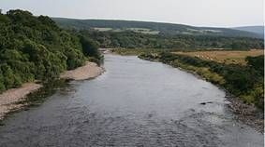
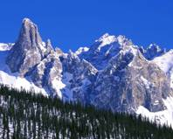
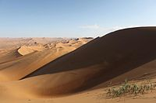

Allopatric speciation
This occurs when gene flow between two
(or more) populations is prevented by a
geographical barrier.
e.g. rivers, mountain ranges, desert, sea

Slide 43
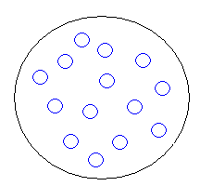
Allopatric
Large
interbreeding
population

Slide 44
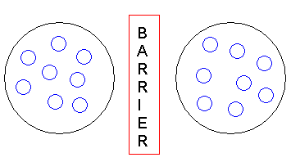
Isolation of populations
Population A
Population B

Slide 45
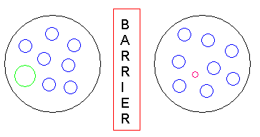
Separate populations mutate randomly –new variation
Large mutant
Small mutant

Slide 46
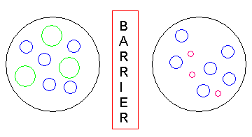
Natural selection favours mutants
e.g. Large mutant may favour dry conditions
e.g. Small mutant may favour wet conditions

Slide 47
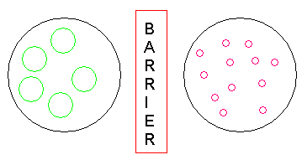
Over a long period of time natural selection increases frequency of new alleles
Species A
Species B

Slide 48
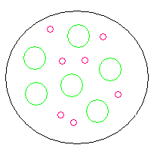
Speciation has occurred. Species A and B cannot interbreed even if barrier is removed

Slide 49
Sympatric Speciation
Two (or more) populations live in close proximity in the same environment but still become genetically isolated.
This happens due to a behavioural or ecological barrier.

Slide 50
Sympatric Speciation
Large interbreeding population sharing the same ecological niche.
(e.g. Fruit flies living on hawthorn bushes)

Slide 51
Alternative ecological niche appears.
(e.g. new species of apple tree introduced by humans)
Some members of the population start to exploit the new niche

Slide 52
The two populations now exploit different resources (e.g. food source) and no longer interbreed.
Behaviour has become an isolating barrier.

Slide 53
Mutants better adapted to exploit the new resources appear and successfully breed.
(e.g. better camouflaged on apples)

Slide 54
Natural selection favours the new mutants and eventually over a period of time two genetically distinct species are formed which can no longer interbreed.

Slide 55
Hybrid zones
A
D
B
C
Hybrid zones
An environment may contain several sub-populations of a species which cannot all interbreed.

Slide 56
Each sub-population can breed with its neighbour but may not be able to breed with more distant members of the species.
Hybrid zones exist where interbreeding is possible and as a result genes are able to flow between the sub-populations.
A
D
B
C
Hybrid zones

Slide 57
If populations B or C become extinct, gene flow is disrupted and populations A and D cannot breed together and therefore become two separate species .
A
D
B
C
Hybrid zones
A
D
C
Hybrid zones

Slide 58
Success Criteria
I can:
Define “species” and “speciation”
State the importance of isolation barriers in speciation
Describe the difference between allopatric and sympatric speciation and describe the process of each

Slide 59
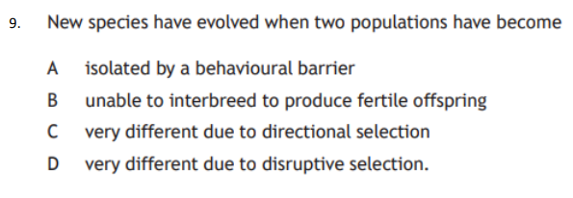
Plenary

