Slide 1
Higher Biology
Unit 3
KA 6 – Social Behaviour

Slide 2
Success Criteria
By the end of this subtopic, I will be able to:
  Name some species that live in social groups
  Describe the varied behaviours that animals demonstrate in social groups

Slide 3
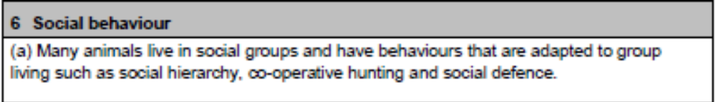
Course Specification

Slide 4
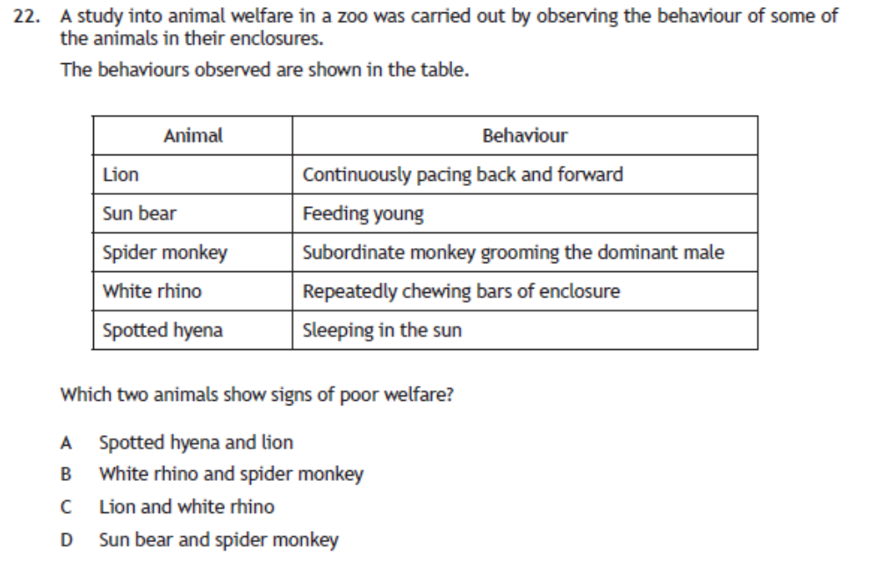
Starter

Slide 5

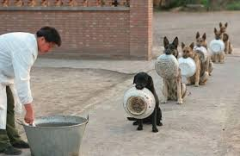
Social Behaviour
Many animals live in social groups and have behaviours that are adapted to group living
These include:
  Social hierarchy
  Co-operative hunting
  Social defence
Notes:
Potato blight photos: Irish potato famine

Slide 6
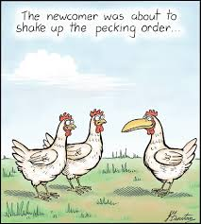
Social Hierarchy
https://www.youtube.com/watch?v=XUMBoMD5AwM – chickens
https://www.youtube.com/watch?v=mPrVMX8ACSE - monkeys
In a social hierarchy, animals order themselves by rank (rank order)
This happens in a group with dominant and subordinate members
Dominant animals carry out ritualistic (threat) displays
Subordinate animals carry out appeasement behaviour to reduce conflict
This increases the chances of the dominant animal’s favourable genes being passed on to offspring
Alliances are often formed to increase social status within the group
Notes:
https://www.youtube.com/watch?v=fKVYAqtKBVI - giraffe fighting

Slide 7
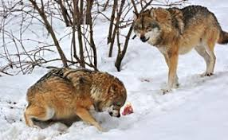
Advantages of Social Hierarchies
Aggression between individuals is mostly ritualistic
Real fighting is reduced
Serious injury is normally avoided
Energy is conserved
Experienced leadership is guaranteed
Most successful (powerful) organisms pass on their genes to the next generation
https://www.youtube.com/watch?v=MJvATG3bHbo – wolves
https://www.youtube.com/watch?v=eQgkaS0r2Lg- monkeys

Slide 8
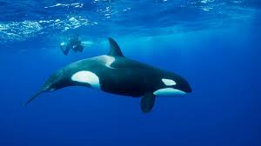
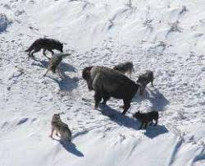
Co-operative Hunting
Some predatory animals work together to hunt
Examples are orcs in pods, wolves, and lions
Co-operative hunting allows larger prey to be hunted and caught
This improves survival chances of all the members
Dominant members get the best parts of the food
Subordinate members get more food than if they were foraging alone
All animals use less energy than hunting individually
https://www.youtube.com/watch?v=g1VEwsI4SlY

Slide 9
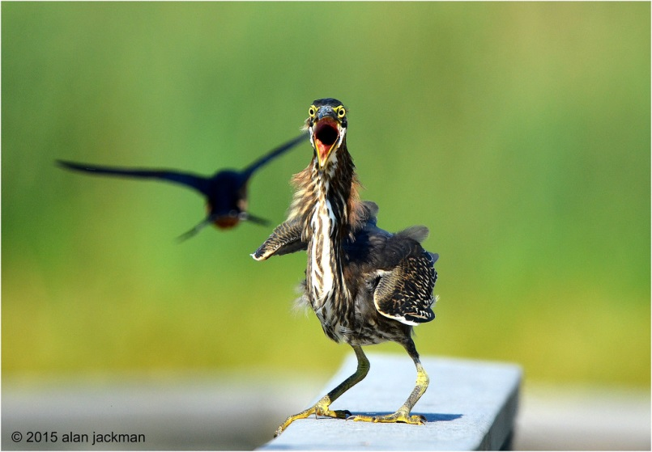
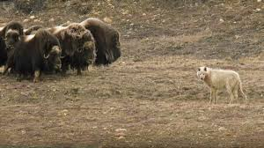
Social Defence Strategies
Groups take up specialised formations to protect their young when under attack
These strategies mean that some individuals can watch for predators while other forage for food
For example when birds are feeding, if a predator turns up an alarm call is given
The flock uses bunching and swirling tactics to confuse the predator
Musk ox form a group with young on the inside and mature males on the outside (mobbing)
https://www.youtube.com/watch?v=IvkfpgjBt5k
https://www.youtube.com/watch?v=PkWVGf2sfiw

Slide 10
Success Criteria
By the end of this subtopic, I will be able to:
  Name some species that live in social groups
  Describe the varied behaviours that animals demonstrate in social groups

Slide 11
Plenary
Give the students two post it notes.
On one they should write what they are confident about from the lesson.
On the other they should write something that they need to know more about.

Slide 12
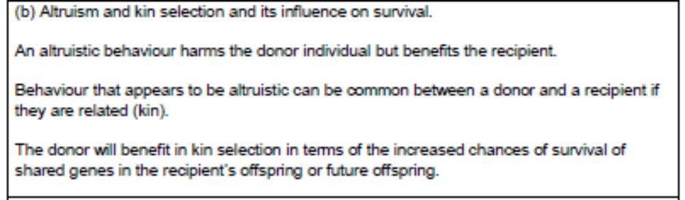
Course Specification

Slide 13
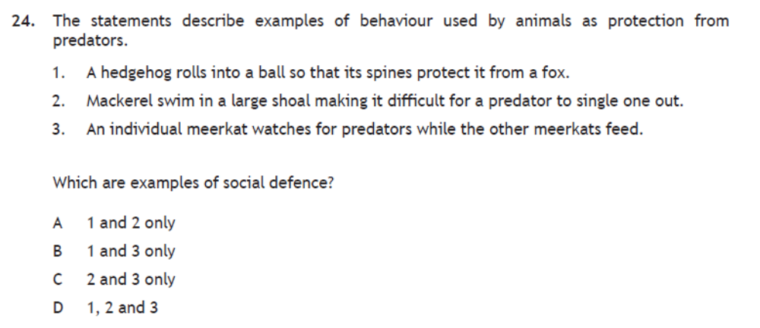
Starter

Slide 14
Starter
Is there such a thing as a selfless good deed?
https://www.youtube.com/watch?v=jgr-CpLNCYo

Slide 15
Learning Intention
To learn about altruism and kin selection

Slide 16
Success Criteria
By the end of this subtopic, I will be able to:
  Explain altruism and give examples
  Explain kin selection

Slide 17
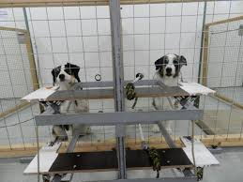
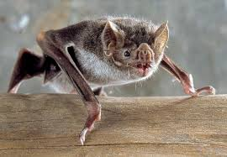
Altruism
Altruistic behaviour harms the donor but benefits the recipient
Reciprocal altruism is common in social animals, where the roles of donor and recipient reverse at a later time i.e. the favour is returned
This requires memory for favours and for cheats
The benefit to the recipient exceeds the cost to the donor
https://www.youtube.com/watch?v=icaGIeOY9gc
https://www.youtube.com/watch?v=ADWSG_JtcEw

Slide 18
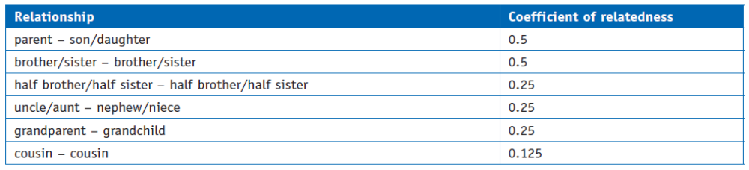
Kin Selection
Altruistic behaviour can be quite common if they are related (kin)
If they are related, kin selection can occur: increased chance of survival of shared genes in the recipient’s offspring (current or future)
Even if the donor is more likely to die as a result of their altruistic behaviour, some of their genes will survive in their kin so it is still useful
Notes:
https://www.youtube.com/watch?v=jKtOXvA14X4

Slide 19
The Prisoner’s Dilemma
Two accomplices have been arrested on suspicion of robbing a bank together. They are placed in separate cells with no communication. The prosecutor makes the following offers:
If you confess and your accomplice betrays you, you get 3 years in jail and they go free.
If they confess and you betray them, you go free and they get 3 years in jail.
You both betray each other and you both get two years in jail.
You both stay silent and you both get one year in jail.
Do you betray or stay silent?
Notes:
https://www.youtube.com/watch?v=t9Lo2fgxWHw

Slide 20
Plenary

Slide 21
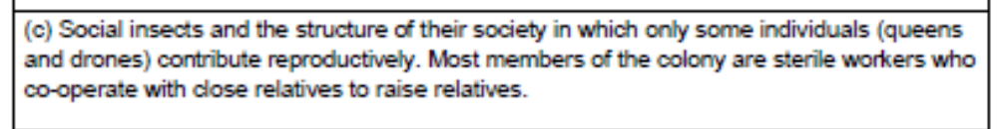
Course Specification

Slide 22
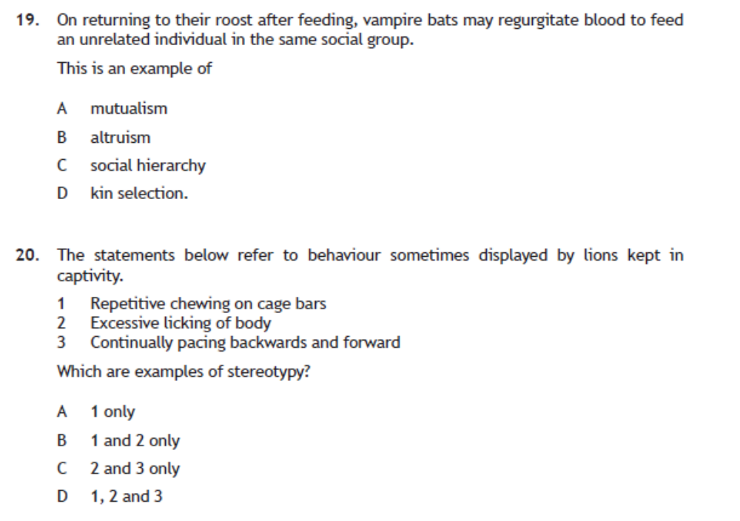
Starter

Slide 23
Learning Intention
To be able to explain social insects and how they behave

Slide 24
Success Criteria
By the end of this subtopic, I will be able to:
  Explain what a social insect is
  Name examples of social insects
  Describe the roles in colonies
  Explain the significance of the differing roles

Slide 25
Complex social organization hinges on complex signaling
In behavioural ecology a signal is a form of communication that causes a change in behaviour in another animal.
Social behaviour depends on signalling:
  sounds
  scents
  displays
  touches.

Slide 26
Signalling in bees
Honeybees perform waggle dances that communicate the direction and distance of nectar to other members of the colony.
http://video.nationalgeographic.com/video/weirdest-bees-dance
https://www.youtube.com/watch?v=12Q8FfyLLso waggle dance short 3 mins
https://www.youtube.com/watch?v=vG-QZOTc5_Q

Slide 27
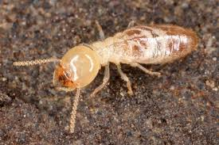
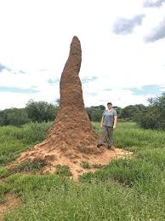
Social Insects
Social insects include bees, wasps, termites, and ants
These insects live in a colony
Only some individuals can reproduce (queens and drones)
Most members of the colony are sterile workers who co-operate with close relatives to raise other close relatives
Workers tend to
  defend the hive
  collect pollen/food
  show other workers where to find food (e.g. waggle dance by bees)
All of these activities increase the chance of survival of shared genes and is kin selection
https://www.youtube.com/watch?v=bFDGPgXtK-U
https://www.youtube.com/watch?v=-Blqi5qcGlE

Slide 28
Social insects
Ecological importance — social insects are often keystone species within their ecosystems.
Some species are of economic importance to humans providing ecosystem services such as pollination and pest control.

Slide 29
Plenary

Slide 30
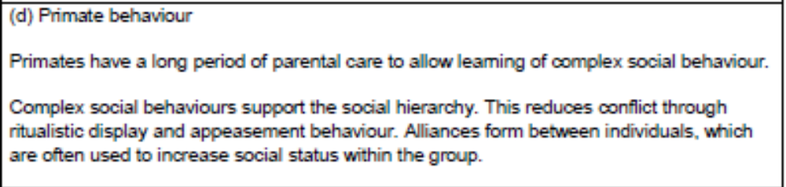
Course Specification

Slide 31
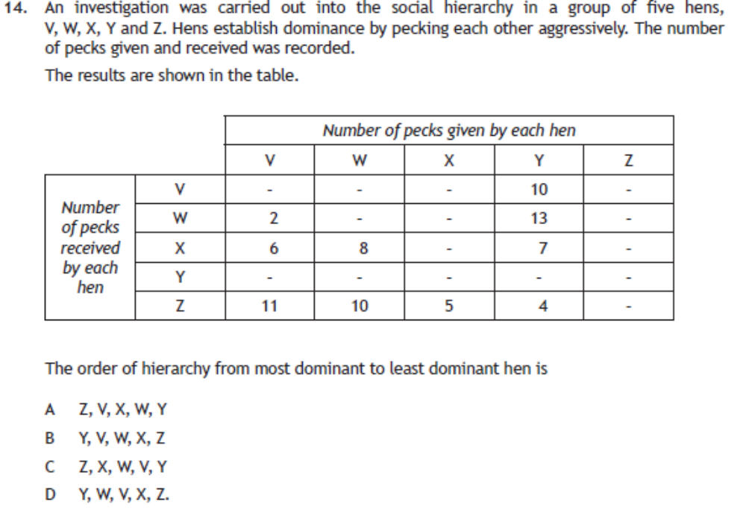
Starter

Slide 32
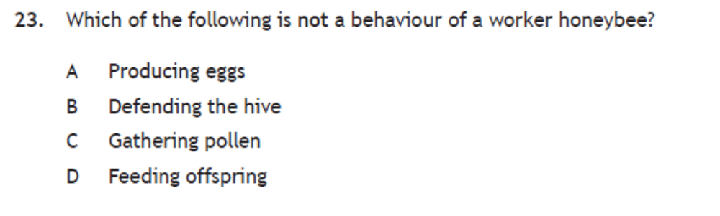
Starter

Slide 33
Learning Intention
To learn about primate behaviour

Slide 34
Success Criteria
By the end of this subtopic, I will be able to:
  Explain what is meant by parental care
  Give examples of primates that demonstrate parental care
  Explain what is meant by social hierarchy
  Give examples of learned social behaviours

Slide 35
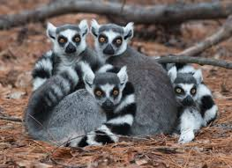
Primate Behaviour
Primates are a group of species that are placental mammals
They include lemurs, monkeys, apes, and humans
Primates have a long period of parental care to allow parents to teach offspring about complex social behaviour
For this reason, the number of offspring produced is small and they are almost helpless when born

Slide 36
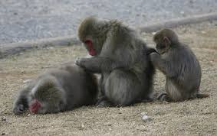
Primates learn how to:
  Groom
  Make appropriate facial expressions
  Make the correct body postures/sexual presentations
  Hunt and forage
https://www.youtube.com/watch?v=BjMhSfxL1sw

Slide 37
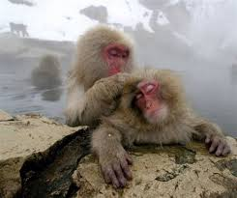
Primates and Social Hierarchy
Complex social behaviour supports the social hierarchy in the group
Conflict is reduced by using:
  ritualistic displays from dominant animals
  appeasement behaviour from subordinate animals
Alliances form between individuals which are often used to increase social status within the group
https://www.youtube.com/watch?v=os1kwb2a4wk
https://www.youtube.com/watch?v=JkzwAgTGCto

Slide 38
Primates and Social Hierarchy
Grooming reduces tension within a group and is often reciprocal
It improves hygiene by removing fleas, scabs, and plant material from the other’s body
It is used to form alliances to increase social status
After threat displays, appeasement is often done by showing submissive behaviour, closing eyes, showing vulnerable parts etc.

Slide 39
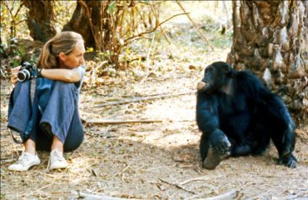
Dominance hierarchies and reconciliation behaviour in chimpanzees
Dr Jane Goodall is one of the world's best-known biologists.
She has studied the behaviour of chimpanzees in their natural habitat, in East Africa, since the early 1960s.
© The Jane Goodall Institute/Hugo Van Lawick

Slide 40
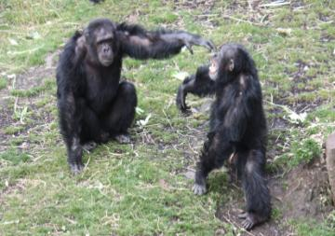
Dr Goodall’s research indicates that dominance hierarchies and reconciliation behaviours are integral parts of the lives of many primates, for example a chimpanzee that has threatened another member of its group may use a hand gesture to invite reconciliation.
© RZSS
Notes:
Video attached to picture of chimps

Slide 41
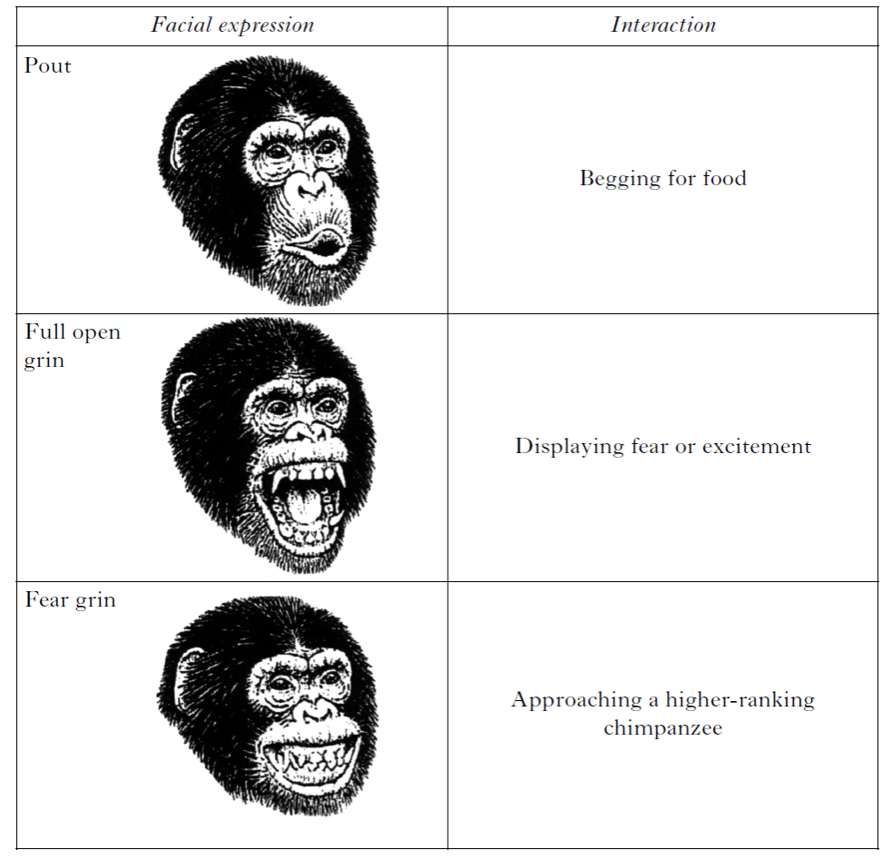
Ethogram of social behaviour
An ethogram is a list of all the different observed behaviours shown by an animal.
The ethogram shows some of the expressions or behaviours of a subordinate individual.

Slide 42
Success Criteria
By the end of this subtopic, I will be able to:
  Name some species that live in social groups
  Describe the varied behaviours that animals demonstrate in social groups
  Explain altruism and give examples
  Explain kin selection
  Explain what a social insect is
  Name examples of social insects
  Describe the roles in colonies
  Explain the significance of the differing roles
  Explain what is meant by parental care
  Give examples of primates that demonstrate parental care
  Explain what is meant by social hierarchy
  Give examples of learned social behaviours

Slide 43
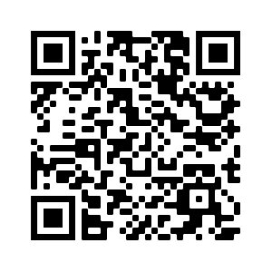
Plenary - quizziz
Notes:
https://quizizz.com/admin/quiz/62949e16eb7031001d9fb0a5/36-social-behaviour?source=MainHeader&page=FeaturedPage

Slide 44
Write notes on social behaviour under the following headings:
Altruism and kin selection (5)
Primate behaviour (5)
(10) 2023

Slide 45
PPQ
2016 – mcq19, paper 2 q14B
2017 – paper 2 q10A q14
2018 – MCQ 12, 13, 14
2019 - MCQ 23, 24 Paper 2 q15
2022 – MCQ q 23 24
2023

