Slide 1
Higher Biology
Unit 3
KA 5 - Symbiosis

Slide 2
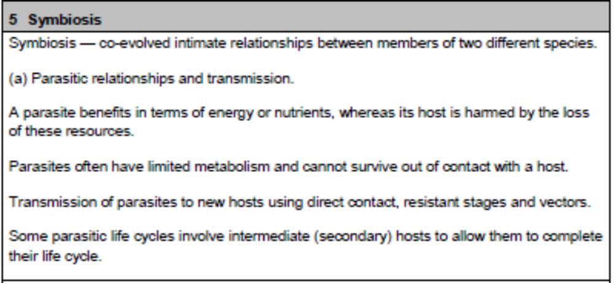
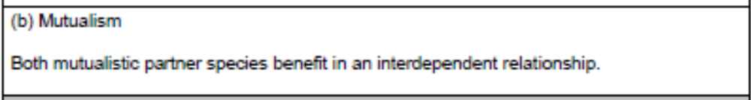
Course Specification

Slide 3
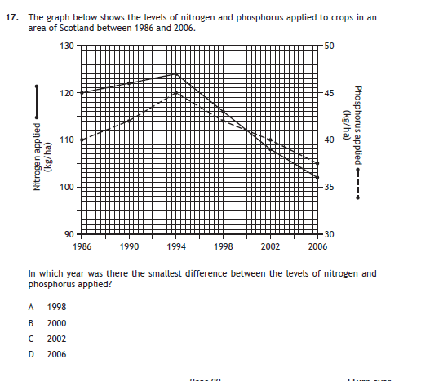
Starter

Slide 4
Learning Intention
By the end of the key are I will be able to:
Describe symbiosis, mutualism and parasitism
Explain parasite transmission
Give examples of parasite life cycles

Slide 5
Success Criteria
I Can..
Define the term symbiosis
Define the terms parasitism and mutualism
Explain the difference between parasitism and mutualism
Describe the differences between endo- and ectoparasites
List three ways in which parasites can be transmitted between hosts
Describe the difference between a direct and indirect life cycle
Give the advantages of a parasite using a secondary host

Slide 6
Symbiosis
Symbiosis is the co-evolved intimate relationship between two different species.
e.g. the relationship between nitrogen fixing bacteria and leguminous plant roots

Slide 7
Symbiosis
There are two categories of symbiosis:
Symbiosis
Parasitism
Mutualism
(Find out about commensalism)

Slide 8
Parasitism
Parasitism is a relationship between two organisms where one organism benefits and another organism is harmed.
A parasite lives on another organism called the host.
The parasite obtains nutrition and energy from the host which benefits the parasite.
The host is harmed by the loss of these resources.

Slide 9

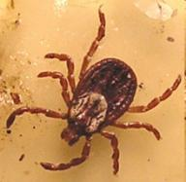
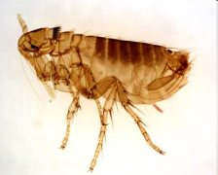
Parasitism
Some parasites are ectoparasites and live on the outer skin of the host
e.g. ticks, leeches, fleas

Slide 10
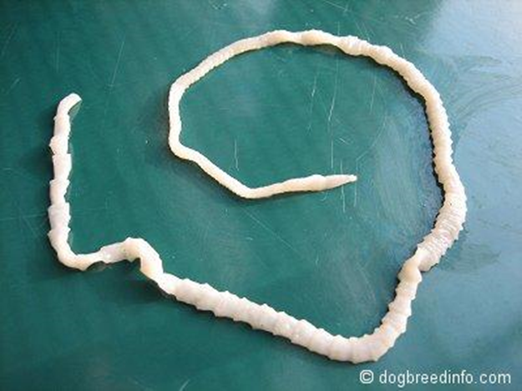
Parasitism
Some parasites are endoparasites and live inside the host.
e.g. tapeworm, malarial Plasmodium

Slide 11
Parasitism
Parasites can be transmitted to new hosts by a variety of mechanisms:
  Direct contact (passed from one host to another e.g. lice)
  Releasing resistant stages (eggs are released into environment and wait e.g. tapeworms)
  Using vectors (carried by another organisms e.g. plasmodium (malaria) in mosquitos

Slide 12
Primary and Secondary hosts
A primary host is used in a parasitic direct life cycle.
Only one species of host is used in this case.
A secondary host is a host that a parasite uses for a short time along with a primary host to ensure that the parasitic life cycle can be completed. This is an indirect life cycle.

Slide 13

Mutualism
Mutualism is an interdependent relationship between two organisms where both organisms benefit.
e.g. lichens are composed of fungus and algae in a beneficial relationship

Slide 14
Mutualism
e.g. herbivores have special cellulose digesting microorganisms in their stomachs.
As we depend on ruminants (sheep, cattle) for food and products this symbiosis is of great economic importance

Slide 15
Success Criteria
I Can..
Define the term symbiosis
Define the terms parasitism and mutualism
Explain the difference between parasitism and mutualism
Describe the differences between endo- and ectoparasites
List three ways in which parasites can be transmitted between hosts
Describe the difference between a direct and indirect life cycle
Give the advantages of a parasite using a secondary host
Give examples of mutualistic relationships

Slide 16
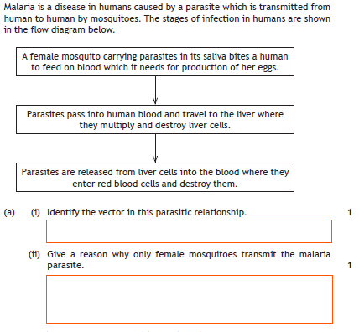
Plenary

Slide 17
Essay
Give an account of parasitism and mutualism as types of symbiosis. (8)
Notes:
2012 RH

Slide 18
Parasitism
1. symbiosis relationship/association between two different species
2. coevolution/coevolved
3. parasites gain energy/resources/nutrients
4. host is harmed by/made weaker by these losses OR one benefits and the other is harmed
5. parasites can have limited metabolism
6. often cannot survive outside host/reproduction requires host OR obligate
7. transmission/transfer method to new host or vector eg direct contact/resistant stage
8. secondary hosts as vector
9. e.g. of parasite and host
Mutualism
10. mutualism involves benefit for both species
11. interdependent relationship OR one cannot live without the other
12. example of mutualism
13. benefits to one described
14. benefits to other described

